Slide 1



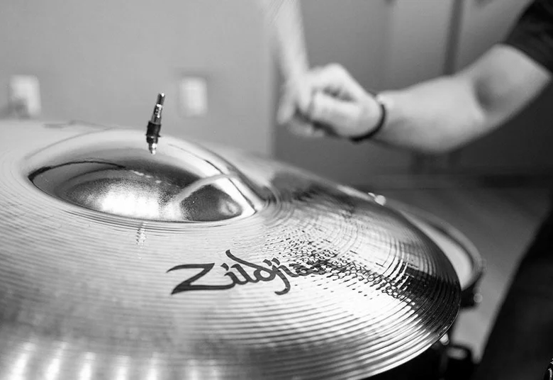
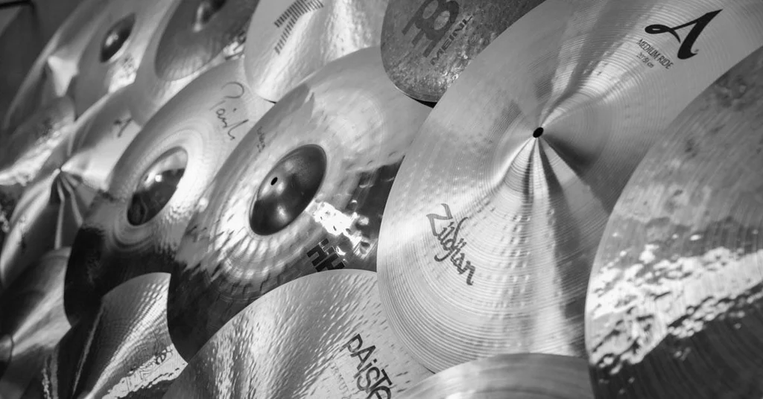
Bibliographic Study:
Nonlinear Vibrations and Chaos in Gongs and Cymbals
Author:
Antoine Chaigne
Cyril Touzé
Olivier Thomas
Nonlinear Dynamics
_______________________________________
Ali Saqib
Shahariar Ryehan
Subarna Paudel
Timothy Nathaniel Gunawan

Slide 2
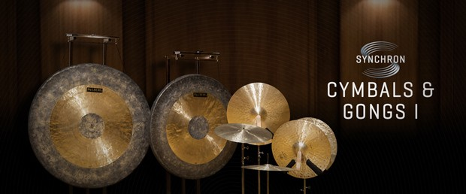
1/10 Nonlinear Vibrations and Chaos in Gongs and Cymbals
Objectives:
Summarize experiments and theoretical equations of nonlinear, chaotic vibrations in gongs and cymbals to reproduce the main dynamical features of gongs and cymbals and serve as a foundation for realistic sound production and synthesis purposes.
Gongs and cymbals are “nonlinear percussion instruments” where the vibratory displacement is comparable to thickness, leading to strong geometric nonlinearity
Observed Nonlinear Features
Amplitude-dependent harmonics
Pitch Glide
Bifurcations & Energy exchange between modes
Chaos
Introduction
Summary of Experiments
Analysis & Discussion

Slide 3
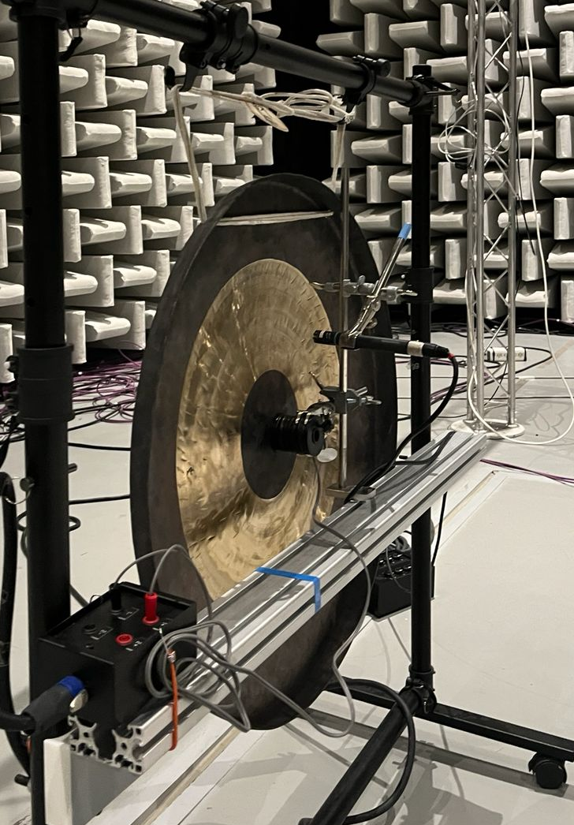
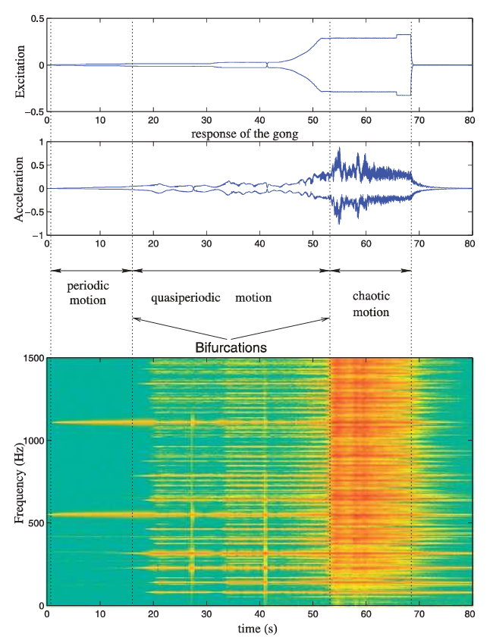


2/10 Nonlinear Vibrations and Chaos in Gongs and Cymbals
Experiment Setup
Results
1
Periodic Motion
The structure's acceleration exhibits a periodic motion with an increasing level of harmonics (2Ω, 3Ω, etc.). The vibration is largely dominated by the forced mode
2
First Bifurcation
Occurs at a given force threshold, explained by energy exchange between normal modes due to an internal resonance relationship.
3
Quasiperiodic Motion
Occurs between the first and second bifurcation, spectrum is enriched by new frequencies ($w_{i},w_{j}$).
$$pΩ=a_{i}ω_{i}+a_{j}ω_{j}$$
with $a_{i},a_{j} ε ℤ$and $\left|a_{i}\right|+|a_{j}|=2$
$$p=harmonicity order of the excitation$$
$$w_{i},w_{j}=other eigenfrequencies of the structures$$
Excitation Method:
Sinusoidal electromagnetic force with slowly increasing amplitude (instead of a mallet impact) at frequencies near eigenmodes to simplify interpretation.
4
Second Bifurcation
The motion becomes chaotic (broadband spectrum)
Introduction
Summary of Experiments
Analysis & Discussion

Slide 4
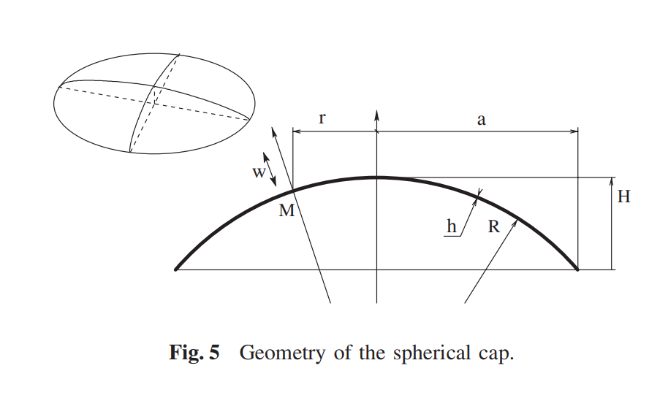
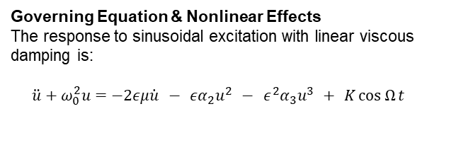

3/10 Nonlinear Vibrations and Chaos in Gongs and Cymbals
Theoretical Model & Formulation:
Governing Equation & Nonlinear Effects
The response to sinusoidal excitation with linear viscous damping is:
$$\begin{matrix} & \ddot{u}+ω_{0}^{2}u=−2εμ\dot{u} − εα_{2}u^{2} − ε^{2}α_{3}u^{3} + K\cos{Ω}t & & \end{matrix}$$
Why Quadratic (2) Dominates over Cubic (3)?
Flat Plates: Ideally, flat structures possess symmetry. This symmetry leads to Cubic nonlinearity $u^{3}$
Gongs/Cymbals: These are Shallow Spherical Shells. The curvature breaks the symmetry of the vibration.
Result: This asymmetry activates the Quadratic nonlinearity $u^{2}$
Mathematical Magnitude $ε_{q}$ vs. $ε_{c}$
The relative strength of the nonlinear terms depends on the shell’s geometry:
Quadratic parameter:
$$ε_{q}≈\frac{a^{2}}{R} \text{(}\text{Radius} \text{vs}\text{. }\text{Curvature}\text{)}$$
Quadratic Term
Cubic Term
Introduction
Summary of Experiments
Analysis & Discussion

Slide 5



4/10 Nonlinear Vibrations and Chaos in Gongs and Cymbals
Theoretical Model & Formulation:
Von Karman Equation
Physical Origin: Thin plate(h<<R)
Geometric Nonlinearity: stretching mid plane
Strain Displacement:
$$ε =∇ u +\frac{1}{2} {\left(∇ w\right)}^{2}$$
Von Karman PDE:
$$D∇^{4} w +ρ h \ddot{w} =\overset{2}{\underbrace{\frac{∂^{2}F}{∂y^{2}}\frac{∂^{2}w}{∂x^{2}}+…}}$$
Cubic Nonlinearity (Stretching$)$
Projection to ODE
Goal : Convert PDE (x,t) to ODE (t) by ansatz and Galerkin method
Result $→$ Duffing equation: $\ddot{q}+ω_{0}^{2}q +Γq^{3}=0$
Here is $Γ>0$ it’s a Hardening behaviour.
MMS Setup
Time scale $T_{0}=t(fast)$, $T_{1}=εt$ (slow)
Expansions:
$$q\left(t\right) = q_{0}\left(T_{0}, T_{1}\right)+ε q_{1}\left(T_{0}, T_{1}\right)…$$
$$\frac{d}{dt}= D_{0}+εD_{1}+…$$
Substitute & Separate:
$ε^{0}: D_{0}^{2} q_{0} +ω_{0}^{2} q_{0} =0$
$ε^{1}: D_{0}^{2} q_{1}+ω_{0}^{2} q_{1}=−2D_{0}D_{1} q_{0}− q_{0}^{3}$
Removing Scaler Term
$ε^{0}$Solution $q_{0} = A{(T}_{1})e^{i ω_{0}T_{0}} +B\left(T_{1}\right)e^{−iω_{0}T_{0}}$
Plug in to $ε^{1}$ , then $q^{3}$ create resonance.
Solvability Condition :
$$2iω_{0}A^{′}+3Γ∣A∣^{2}A=0$$
Final Amplitude–Frequency Relation:
$$ω_{\text{NL}}=ω_{0}\left(1+\frac{3Γ}{8ω_{0}^{2}}a^{2}\right)$$
Frequency increases with Amplitude $a$.
Nonlinear Normal Modes (NNM) Formulation
Concept: Extension of linear modes to the nonlinear regime.
Definition: A synchronous periodic oscillation where all material points reach equilibrium/extremum simultaneously.
Invariance Property: Motion initiated on the NNM manifold stays on it.
Energy Dependence: Unlike linear modes, NNM frequency depends on energy (E).
$$ω\left(E\right)≠\text{constant}$$
Representation: The Backbone Curve is essentially the projection of the NNM onto the Frequency–Energy plane.
Introduction
Summary of Experiments
Analysis & Discussion

Slide 6
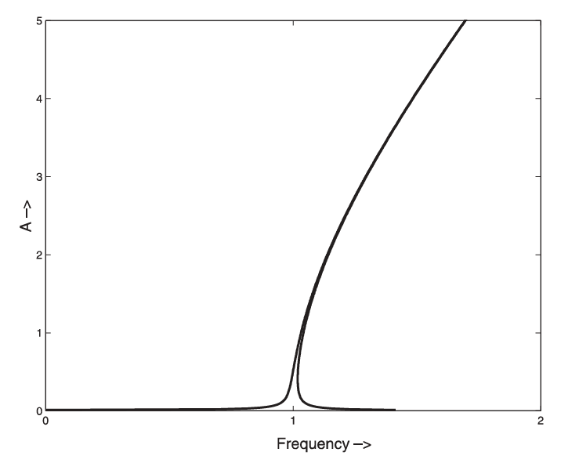
5/10 Nonlinear Vibrations and Chaos in Gongs and Cymbals
Weakly Nonlinear Regime (Pitch Glide)
1
Downward Glide
Occurs in flat surface gong
Hardening behaviour, resonance curve is bent to the right (direction of increasing frequencies)
Governed by cubic nonlinearity
2
Upward Glide
Occurs in smaller gong with a pronounced curvature
Softening behaviour, resonance curve is bent to the left
Governed by the balance between quadratic and cubic nonlinearity
Pitch Glide only occurs when the nonlinearity is kept relatively weak (ex. thick gongs), but not on thin cymbals where
the nonlinearity is more pronounced and the energy transfer and mode coupling phenomena dominates.
Introduction
Summary of Experiments
Analysis & Discussion

Slide 7
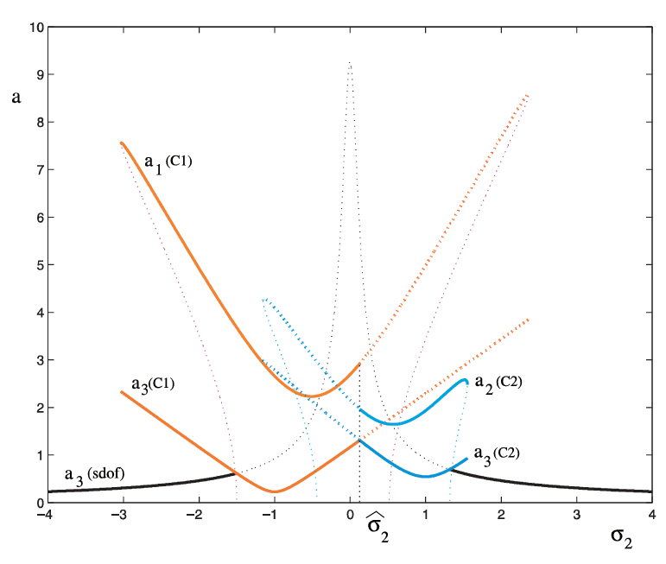
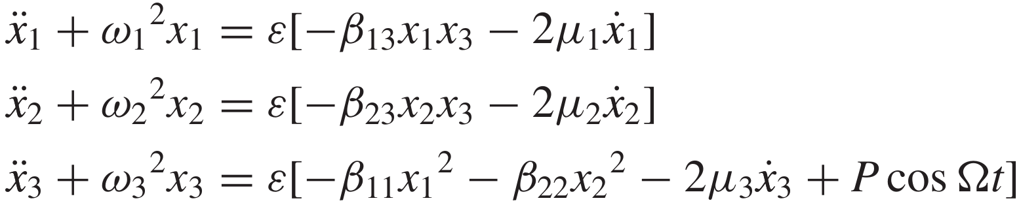
6/10 Nonlinear Vibrations and Chaos in Gongs and Cymbals
Weakly Nonlinear Regime (Nonperiodic Regime)
1
Stability Curve (amplitude vs detuning factor)
System of 3 coupled NL oscillators arose from Karman eqn
Observed on twin asymmetric modes (6,0)a and (6,0)b
Use of method of multiple scales
Where,
Amplitude of high note drop and amplitude of low subharmonic notes explodes upward
solid: stable
dashed: unstable
The rich, multitone sound of gongs and cymbals may be produced by the coexistence of stable subharmonics of order 2 with the forcing frequency.
Introduction
Summary of Experiments
Analysis & Discussion

Slide 8
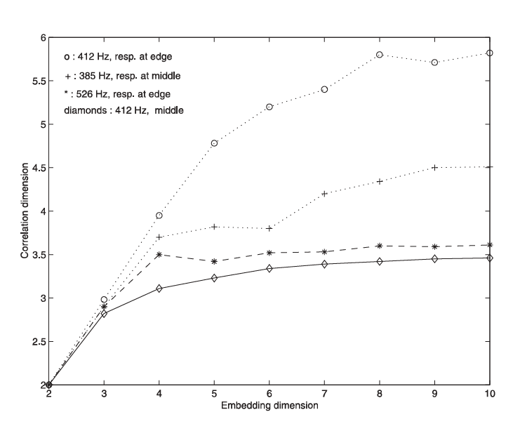
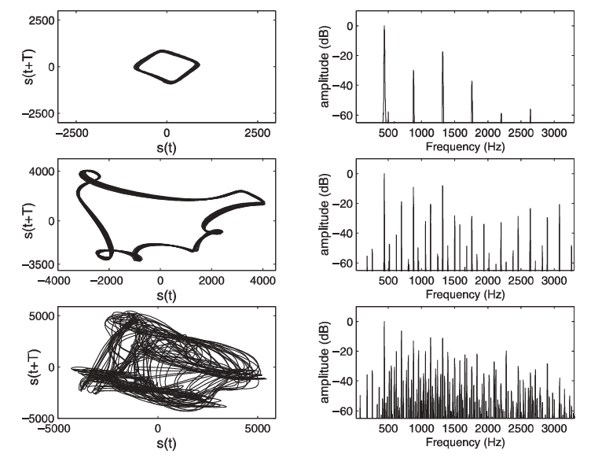
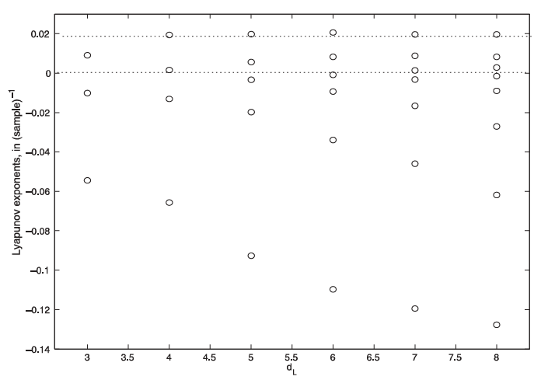
7/10 Nonlinear Vibrations and Chaos in Gongs and Cymbals
Chaos Analysis & Quantification
Phase Space
Correlation Dimension
Lyapunov Exponent
Transition to chaos when amplitude is increased:
Periodic → Quasiperiodic → Chaotic
The estimated correlation dimension quickly saturates to a finite value as the embedding dimension increases, indicating a strange (fractal) attractor of limited dimension, which is a sign of the chaos
The Lyapunov exponent quantifies chaos by measuring how rapidly nearby trajectories diverge in phase space, with a positive exponent indicating a chaotic behavior.
Introduction
Summary of Experiments
Analysis & Discussion

Slide 9
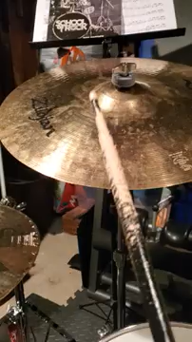
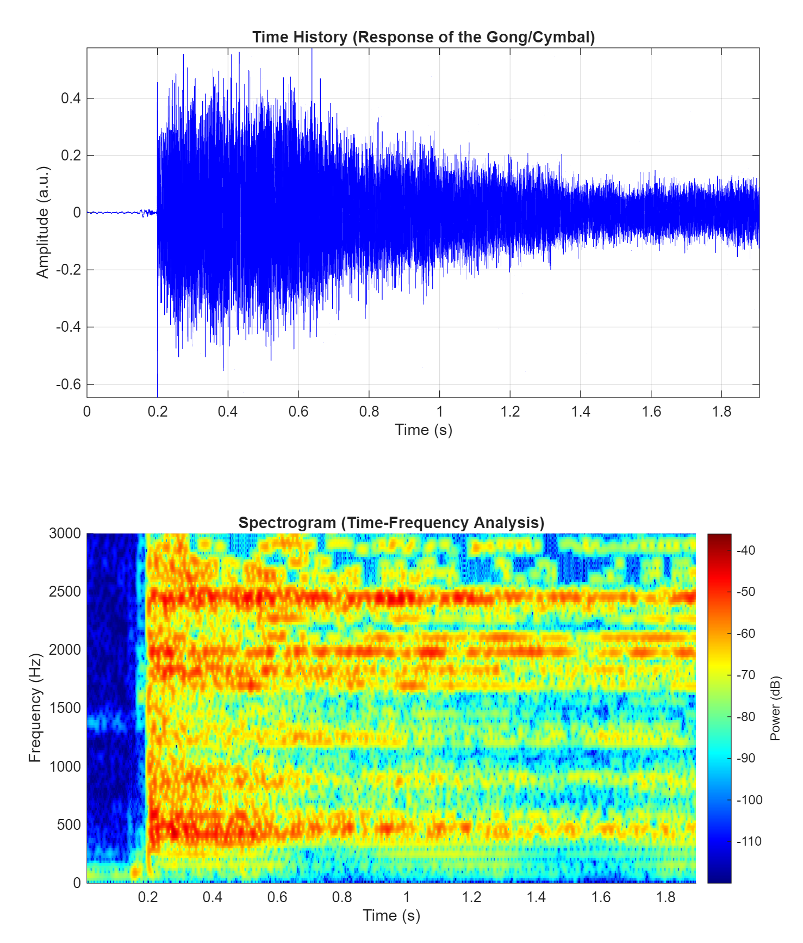
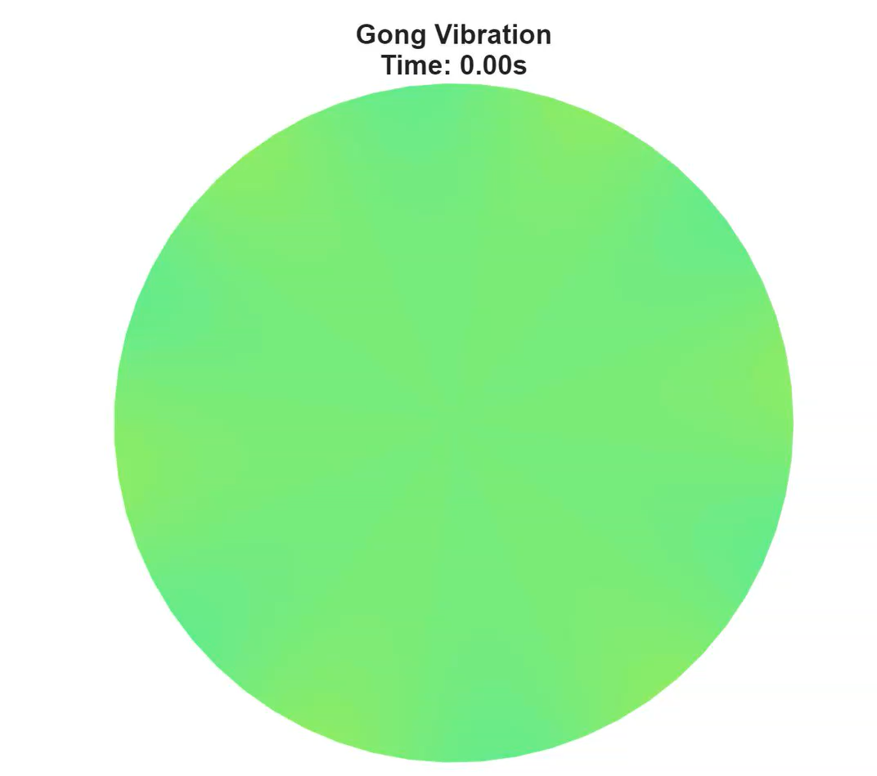
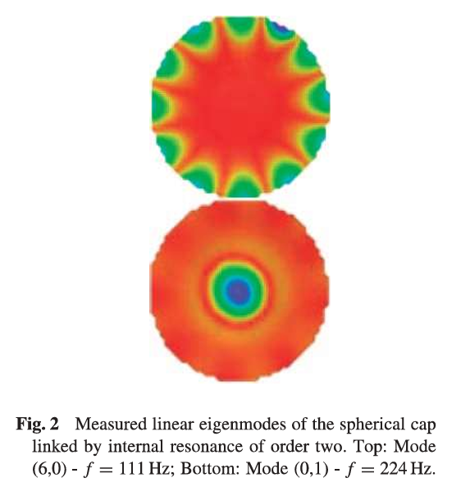
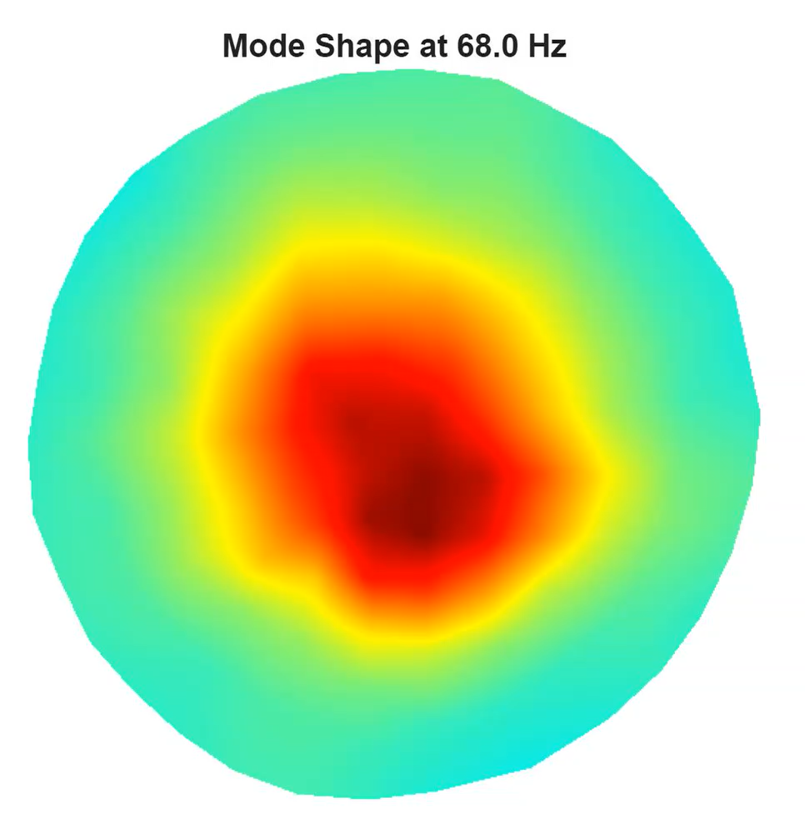
8/10 Nonlinear Vibrations and Chaos in Gongs and Cymbals
Replication of Work
Analytical (Linear Eigenmodes)
Lab Measurement (Nonlinear Eigenmodes)
Spectrogram and cymbal response from a crash cymbal audio signal
Replication of the gong vibration eigenmodes from the paper
Introduction
Summary of Experiments
Analysis & Discussion

Slide 10
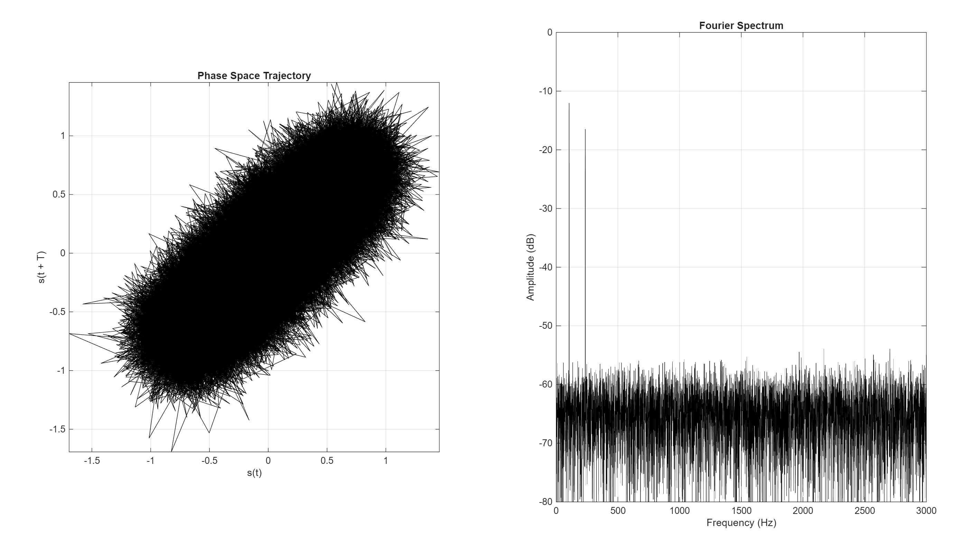
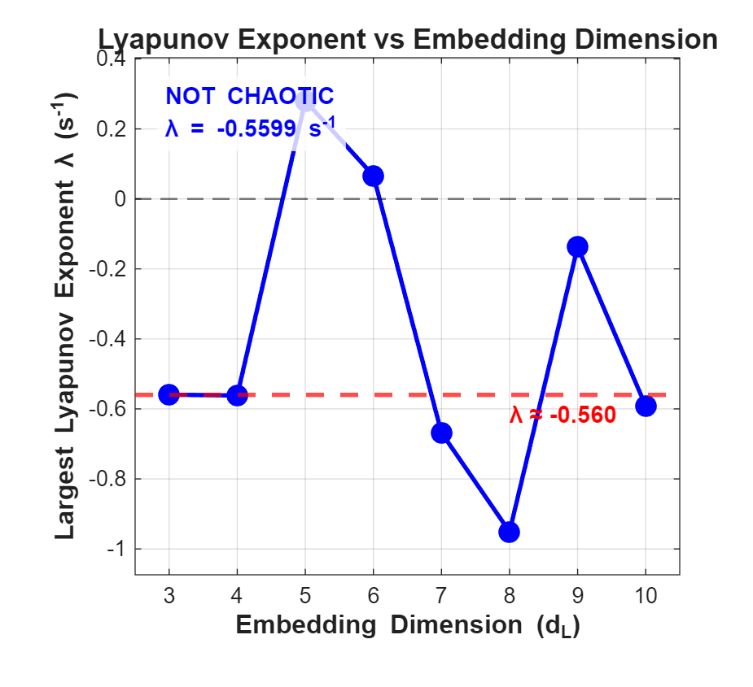
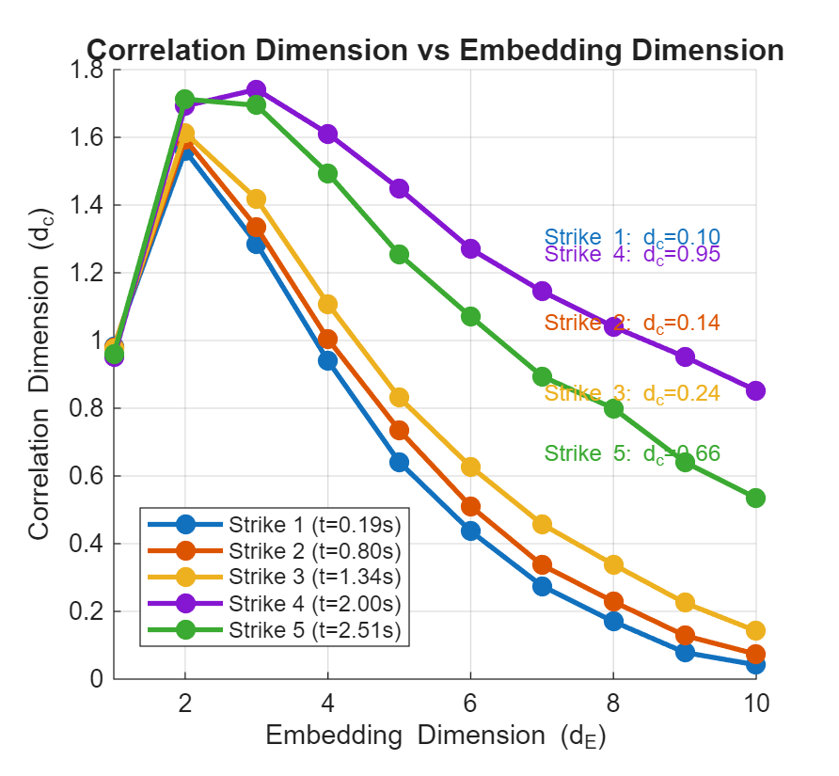
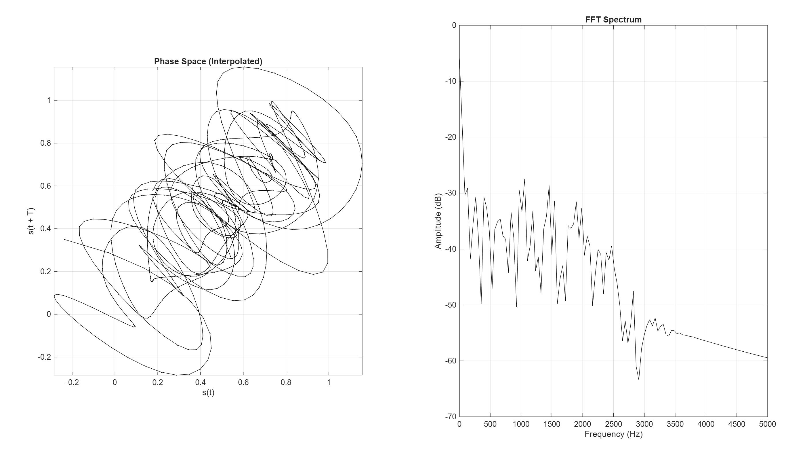

Replication of Work
Chaos analysis
Background
Methodology
Analysis & Discussion

Slide 11
9/10 Nonlinear Vibrations and Chaos in Gongs and Cymbals
Conclusion
1
The nonlinear coupling mechanisms responsible for the characteristic sounds of cymbals and gongs, using thin shallow spherical shells as an analogue and indicating that the same approach can be extended to more complex geometries, provided their coupling coefficients are computed numerically.
2
Both experimentally and theoretically, shows that energy transfer between modes is driven by quadratic nonlinearity due to shell curvature and is governed by precise frequency rules, with only a limited number of degrees of freedom needed to produce the observed instabilities.
3
Estimations of attractor dimension and Lyapunov exponents confirm that strongly excited gongs and cymbals exhibit chaotic dynamics.

Slide 12
10/10 Nonlinear Vibrations and Chaos in Gongs and Cymbals
Bibliography
1
[12] A. H. Nayfeh and D. T. Mook, Nonlinear Oscillations (Wiley, New York, 1979) (slide 4)
2
[3] C. Touze´ and A. Chaigne, ‘‘Lyapunov exponents from experimental time series: application to cymbal vibrations,’’ Acustica - Acta Acustica, 86, 557–567 (2000) (slide 8)
3
[8] O. Thomas, C. Touze´ and A. Chaigne, ‘‘Nonlinear vibrations of free-edge thin spherical shells: modal interaction rules and 1:1:2 internal resonance,’’ Int. J. Solids Struct., 42, 3339–3373 (slide 3 )

