Slide 1
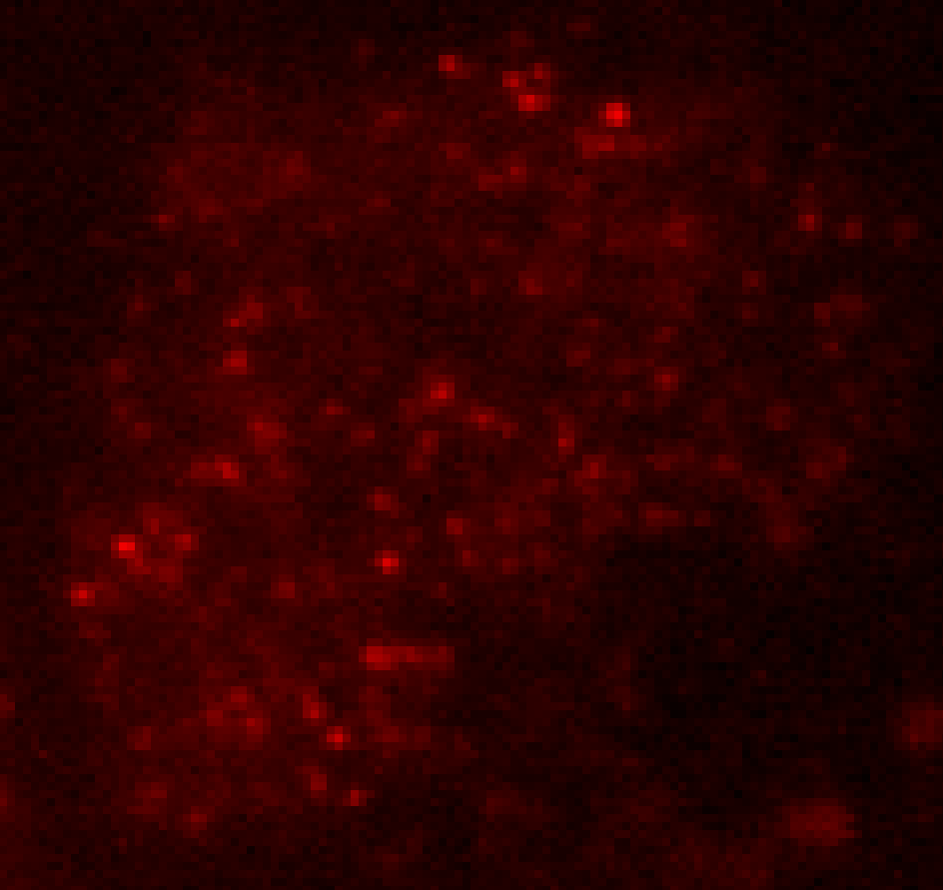
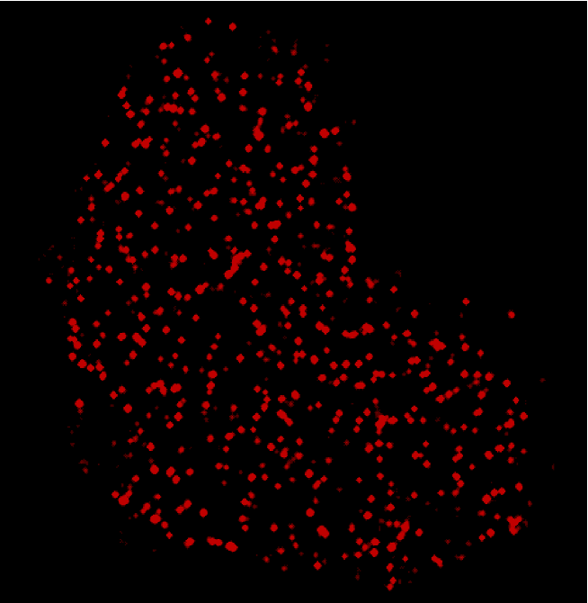
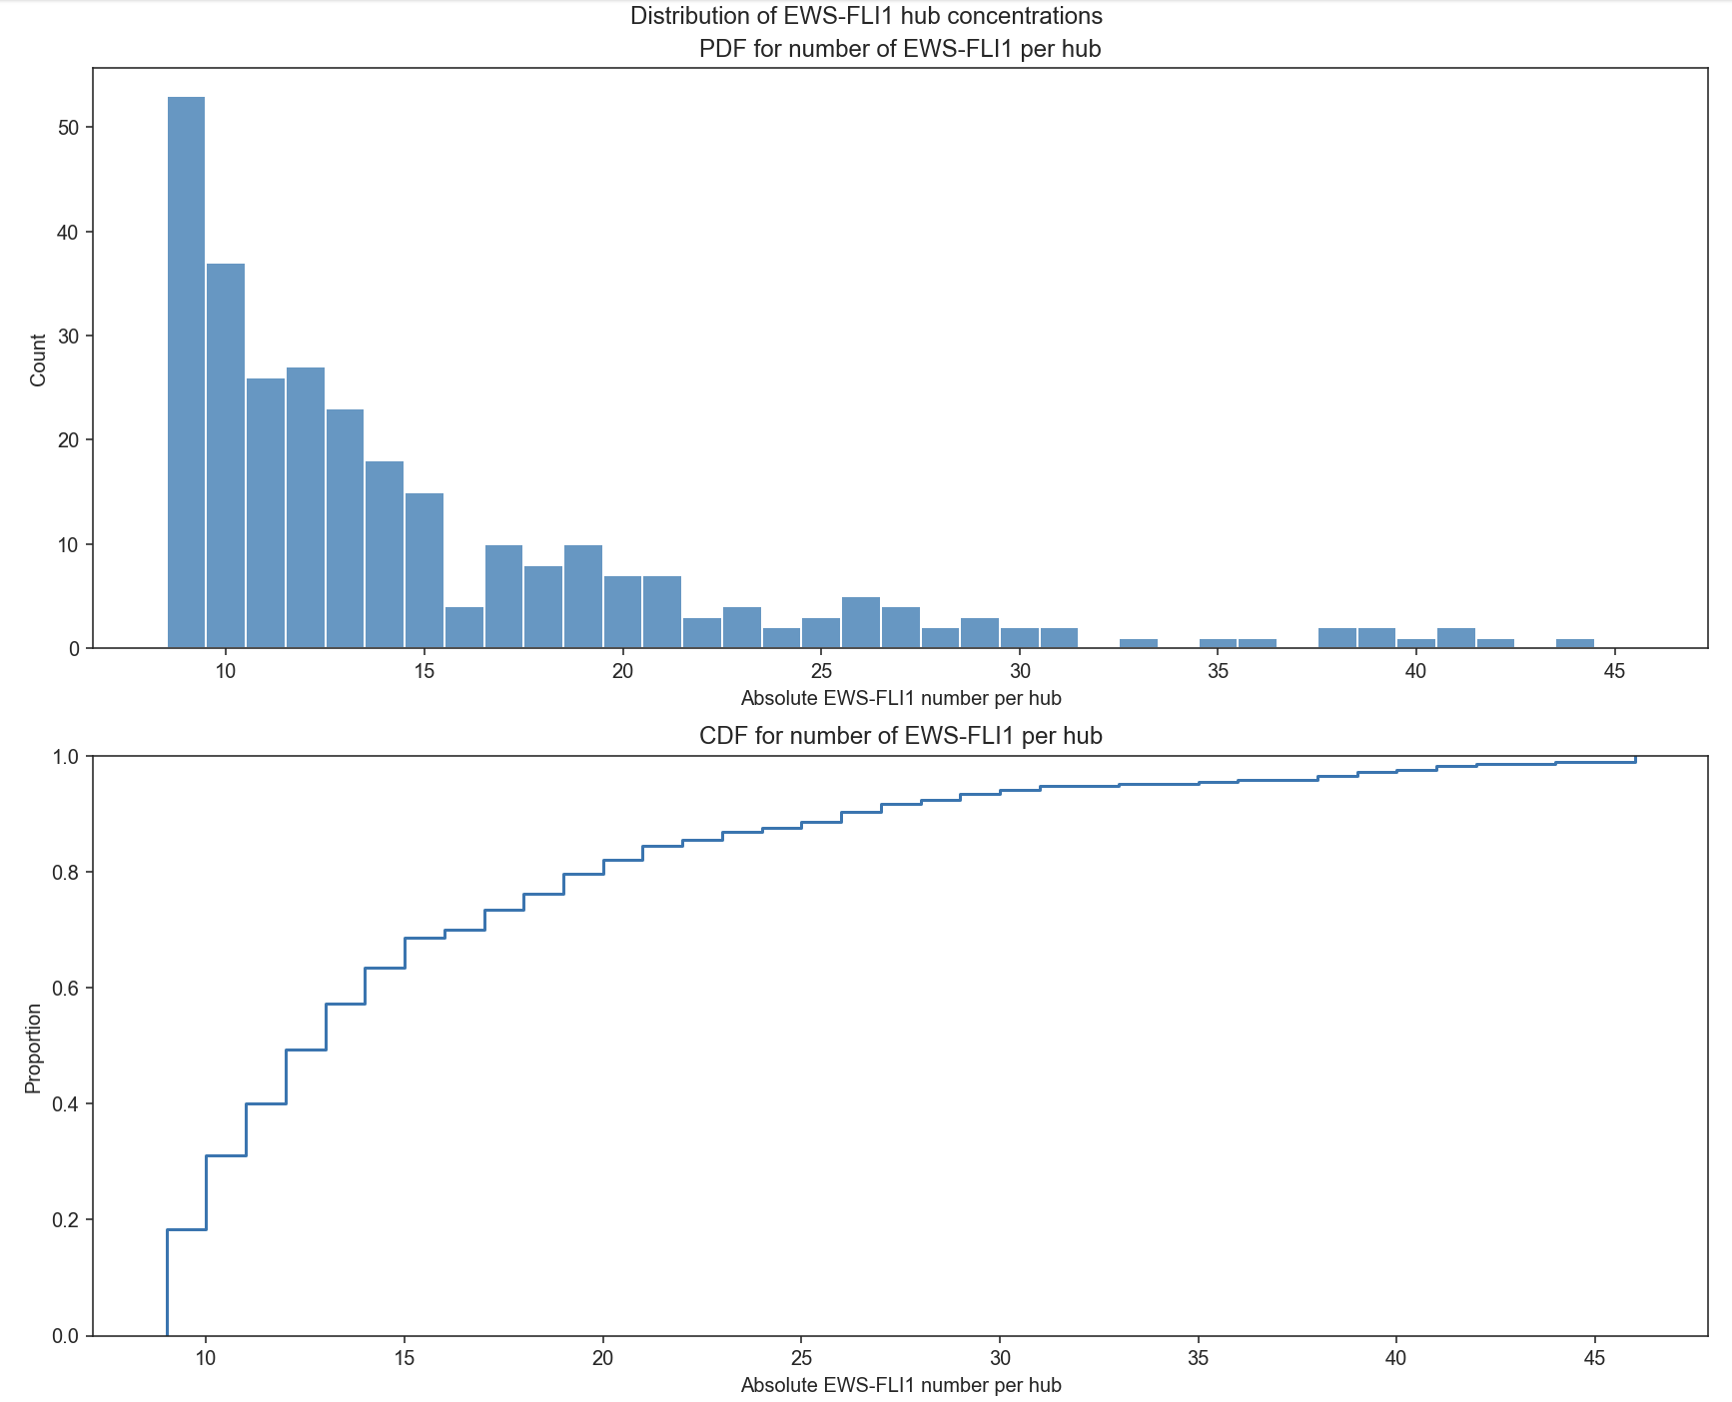
Sub-diffraction limit characterization of size and concentration of ews-fli1 lcd-mediated transcription hubs
Shawn Yoshida
Chong Lab, Caltech
December 7th, 2021

Slide 2
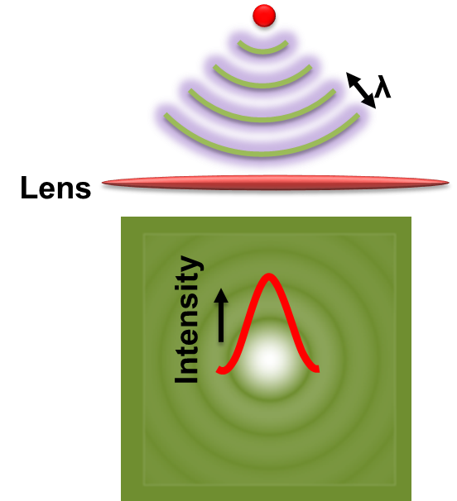
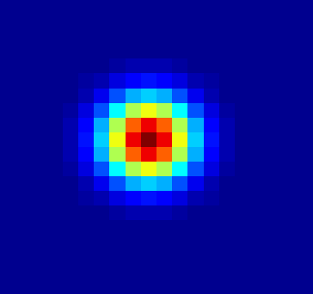
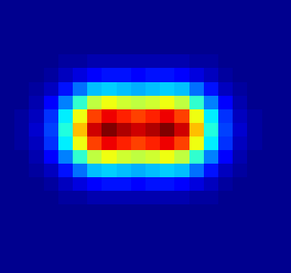
Light microscopy is diffraction limited
The diffraction limit of light is $d=\frac{λ}{2NA}\sim 250nm$
Green Light, $λ$ = 500nm
Numerical Aperture, NA = 1
Without changes, we are only able to resolve images down to ~250nm

Slide 3
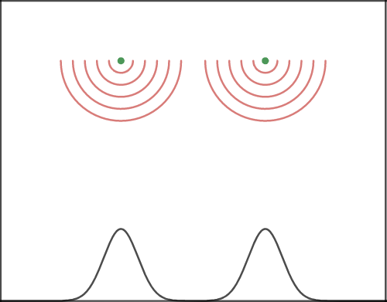
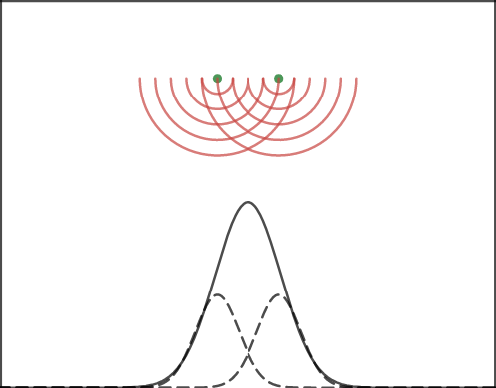
Super-localization in super-resolution microscopy
Requisites for localization-based super-resolution imaging
Sufficient sensitivity to enable single molecule imaging
Ability to localize particles with better precision than diffraction-limit
Way to limit the number of fluorescing particles at a given time
SHREC (single‐molecule high‐resolution colocalization of fluorescent probes)
Cy3 and Cy5 attached to two different calmodulin molecules that bind to the ‘legs’ of the same single molecule of myosin V
One emitter per diffraction limited region
Each can be localized independently
Two emitters in diffraction limited region
Cannot be localized
Notes:
Shrec - 10 nm resolution
Two color FIONA - image produced in the sample plane is split into two images by wavelength that are recorded separately
Cy3 and Cy5 are dyes with different emission spectra

Slide 4
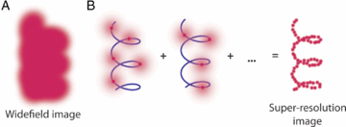
Principle behind smacm techniques
Method for imaging more complex structures with many emitters
Structure is labeled with low concentration of emitters and set in a dark state
Weak activating light is used to turn on a small subset of emitters such that the activated emitters are sufficiently far apart and can be super-localized
An image is taken, and the emitters eventually photobleach. The activating laser is turned on again, and a different subset of emitters are turned on. (B)
Another image is taken and the process is repeated until the underlying structure (blue) can be reconstructed. (C)
Can determine positions to ~20nm resolution
Notes:
Photoactivatable → PA
Storm ~ 60 repetitions to build image
Takes 2-12hrs of imaging
single-molecule active control microscopies (SMACM)

Slide 5
Super-resolution of ews/fli1 hubs
Hubs are typically on the order of hundreds of nm, i.e. diffraction limited
Super-resolution (PALM) techniques can give us order of magnitude estimates of absolute protein number
More highly resolved characterization of hub sizes can allow for quantitative drug testing analysis
Can be combined with RNA FISH to identify spatiotemporal correlation with transcriptional bursting and hub formation

Slide 6
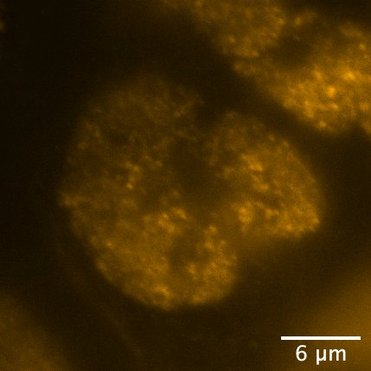
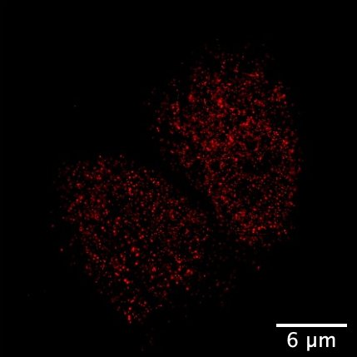
Super-resolution of ews/fli1 hubs

Slide 7
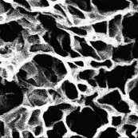
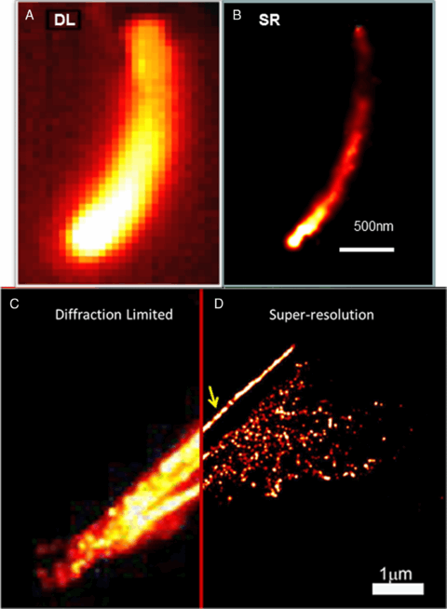
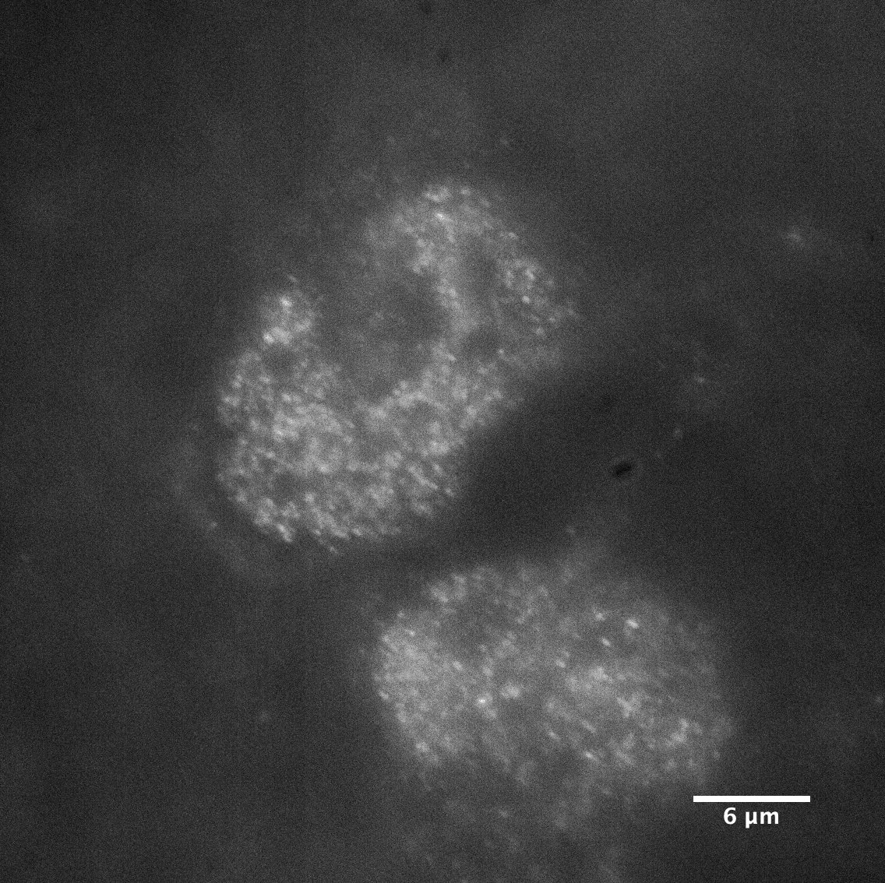
Highly-resolved diffusion dynamics, super-resolution alphabet soup, and lcd-lcd hubs
Questions?
2 µm
Shawn Yoshida
Chong Lab, Caltech
October 25th, 2021

Slide 8
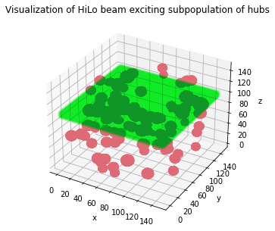
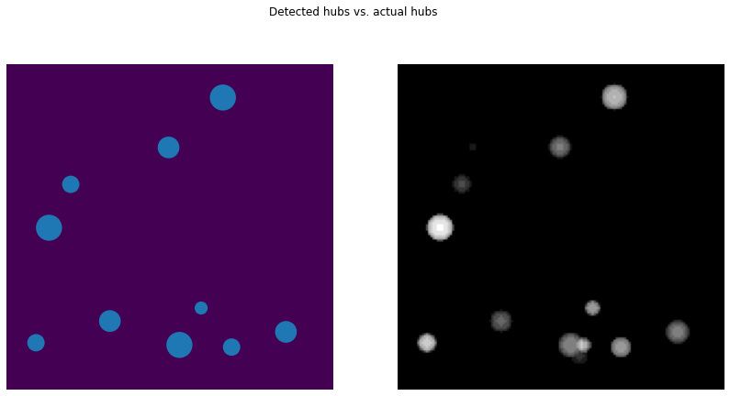
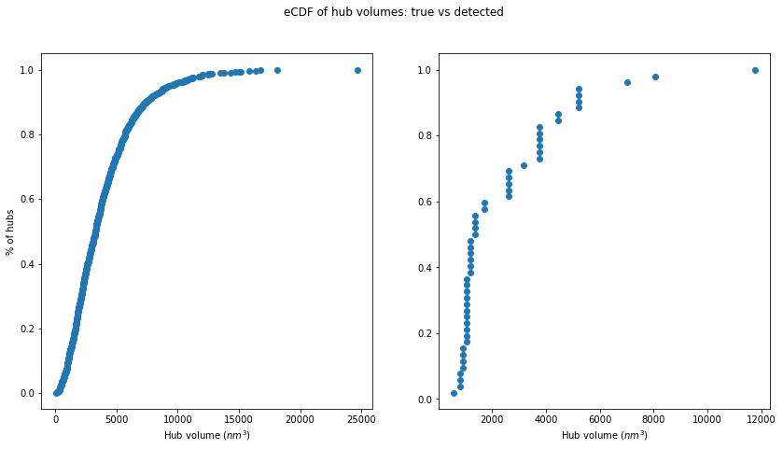
HILO simulations

Slide 9
Some considerations with smacm techniques
Require sequential imaging of sparse subsets
Sample must remain stationary during acquisition
Low end, 10-60s, High end, 2-12hrs
Reconstruction schemes and data presentation
Figures as tiny points for each super-localized emitter? Or as Gaussian spots with width as calculated uncertainty?
Investigate carefully to avoid/avoid misinterpretation of artifacts
Notes:
https://doi.org/10.1021/ja1044192

