Slide 1

Sprocket Central Pty Ltd
Data analytics approach
Srijan Chitranshi

Slide 2
Agenda
Introduction
Data Exploration
Model Development
Interpretation

Slide 3
Introduction
Identify and Recommend Top 1000 Customer to Target from Datasets
Outline of Problem
Sprocket Central is a company that specializes in high-quality bikes and cycling accessories.
Their marketing team is looking to boost business sales by analyzing provided datasets.
Using the 3 datasets provided the aim is to analyze and recommend 1000 customers that Sprocket Central should target to drive higher value for the company.
This will be done with the three phases of: Data Exploration, Model Development, and Interpretation
Contents of Data Analysis
‘New’ and “Old’ Customer Age Distributions
Bike related purchases over the last 3 years by gender
Job industry distributions
Wealth segmentation by age category
Number of cars owned and not owned by state
RFM analysis and customer classification

Slide 4
Data Exploration
Data Quality Assessment and ‘Clean Up’
Summary Table
Key Issues for Data Quality Assessment
Accuracy: Correct Values
Completeness: Data Field with Values
Consistency: Values free from Contradiction
Currency: Values up to Date
Relevancy: Data items with Value Meta-data
Validity: Data Containing Allowable Values
Uniqueness: Records that are Duplicated
An in-depth analysis has been sent via email
 | Accuracy | Completeness | Consistency | Currency | Relevancy | Validity
Customer Demographic | DOB: Inaccurate Age: Missing | Job title: blanks Customer id: incomplete | Gender: inconsistency | Deceased customers: filter out | Default column: delete
Customer Address |  | Customer id: incomplete | States: inconsistency
Transactions | Profit: missing | Customer id: Incomplete Online Order: blanks Brand: blanks |  |  | Cancelled status order: filter out | List price: format Product sold date: format

Slide 5
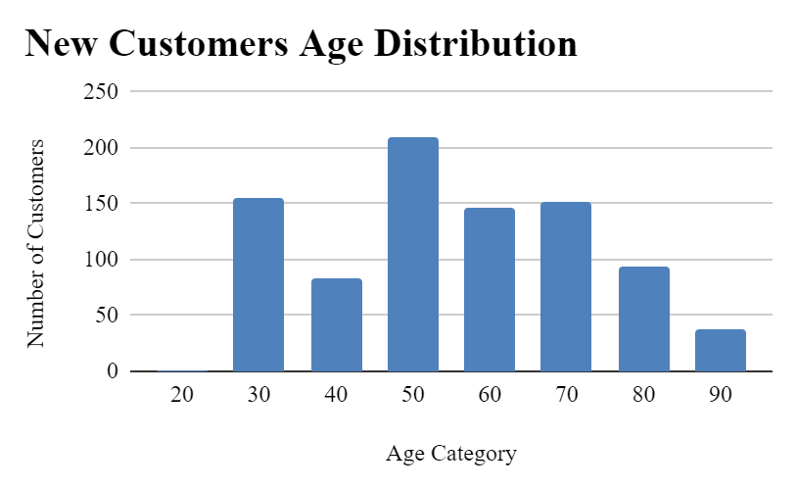
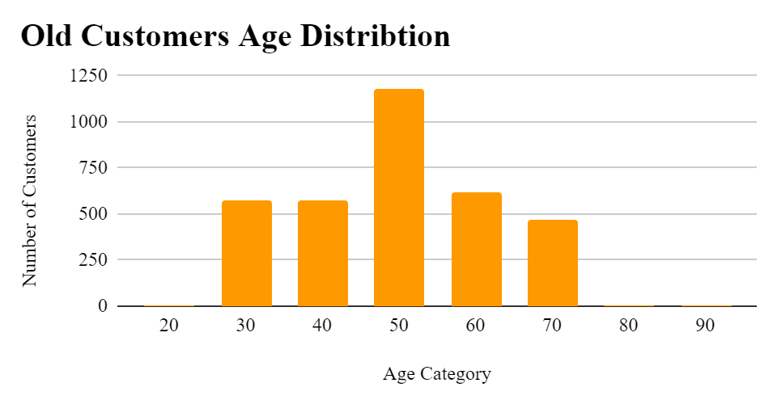
Data Exploration
‘New’ and ‘Old’ Customer Age Distributions
Most customers are aged between 40-49 in ‘New’. In ‘Old’ majority of customers are aged between 40-49 also.
The lowest age groups are under 20 and 80+ for both ‘New’ and “Old’ customers lists
The ‘New’ customer list suggests that age groups 20-29 and 40-69 are most populated.
The ‘Old’ customer list suggests 20-69
There is a steep drop of customers in the 30-39 age group in ‘New’

Slide 6
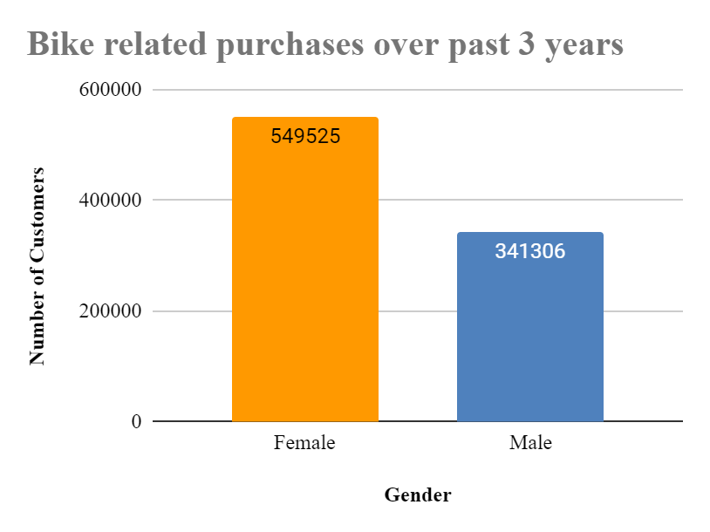
Data Exploration
Bike related purchases over last 3 years by gender
Over the last three years about 60% of bike related purchases were made by females to 40% of purchases made by males.
Numerically, females purchases almost 200,000 more than males
Females make up majority of bike related sales

Slide 7
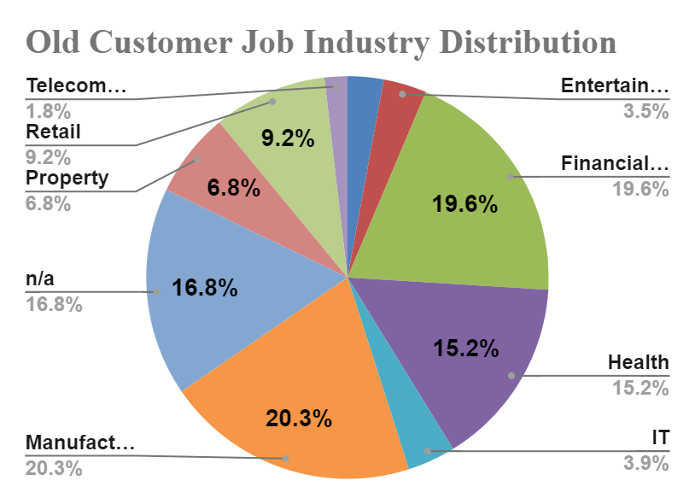
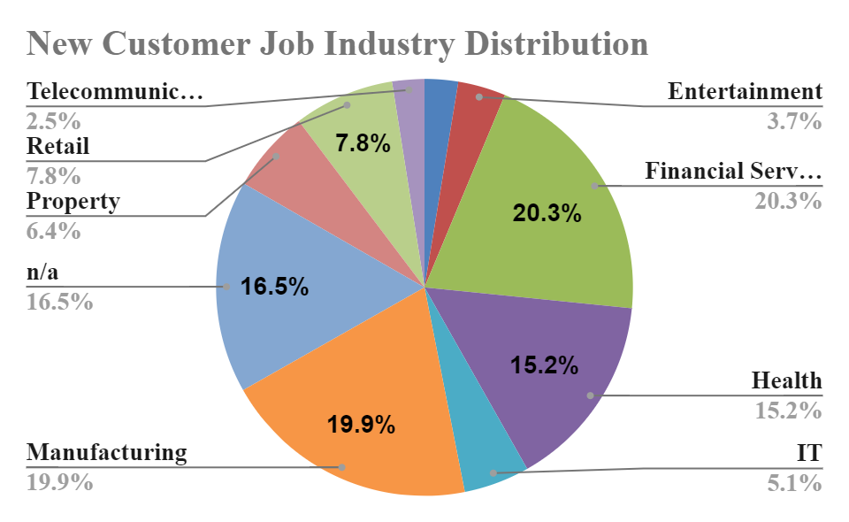
Data Exploration
Job Industry Distribution
20% of ‘New’ Customers are in Manufacturing and Financial Services
The smallest number of customers are in Agriculture and Telecommunications at 3%
Similar pattern in ‘Old’ customer list, at 20% and 19% in Manufacturing and Financial Services respectively.

Slide 8
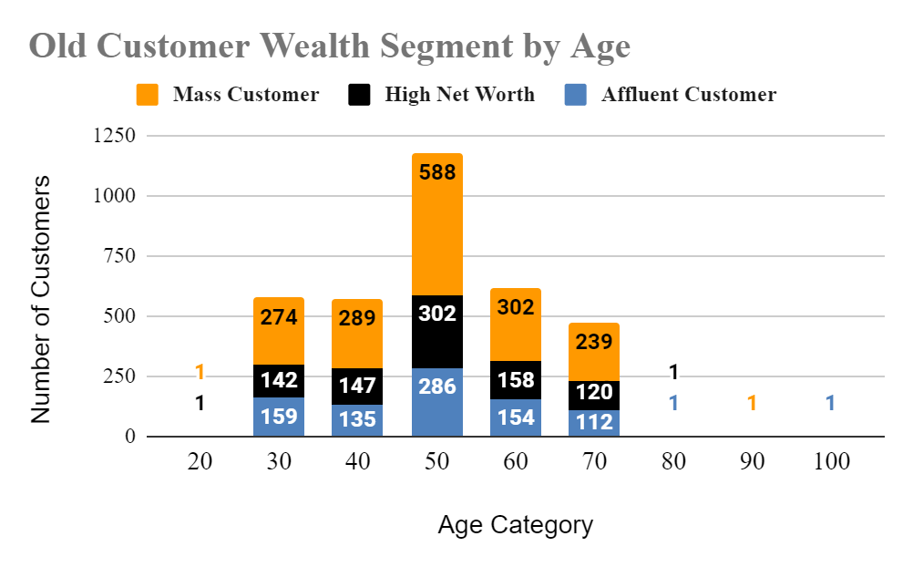
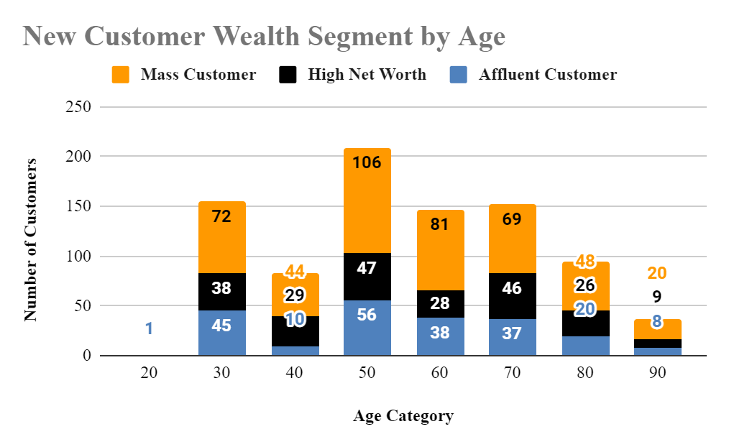
Data Exploration
Wealth Segmentation by age category
In all age categories the large number of customers are classified as ‘Mass Customer’
The next category is the ‘High Net Worth’ customers
The ‘Affluent Customer’ can outperforms the ‘High Net Worth’ customer in the age 40-49 age group.

Slide 9
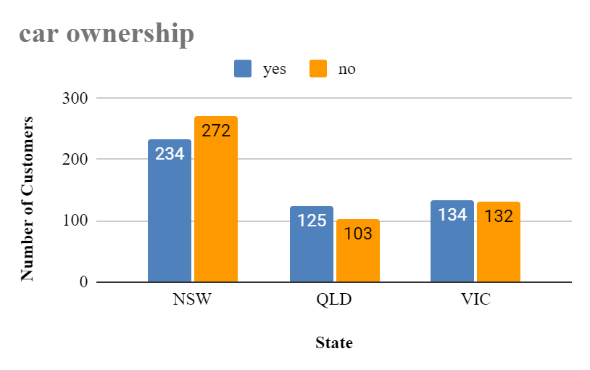
Data Exploration
Number of cars owned and not owned by state
NSW has the largest amount of people that do not own a car. NSW seems to have a higher number of people from which data is collected
Victoria is also split quite evenly. But both numbers are significantly lower than those of NSW
QLD has a relatively high number of customers that own a car

Slide 10
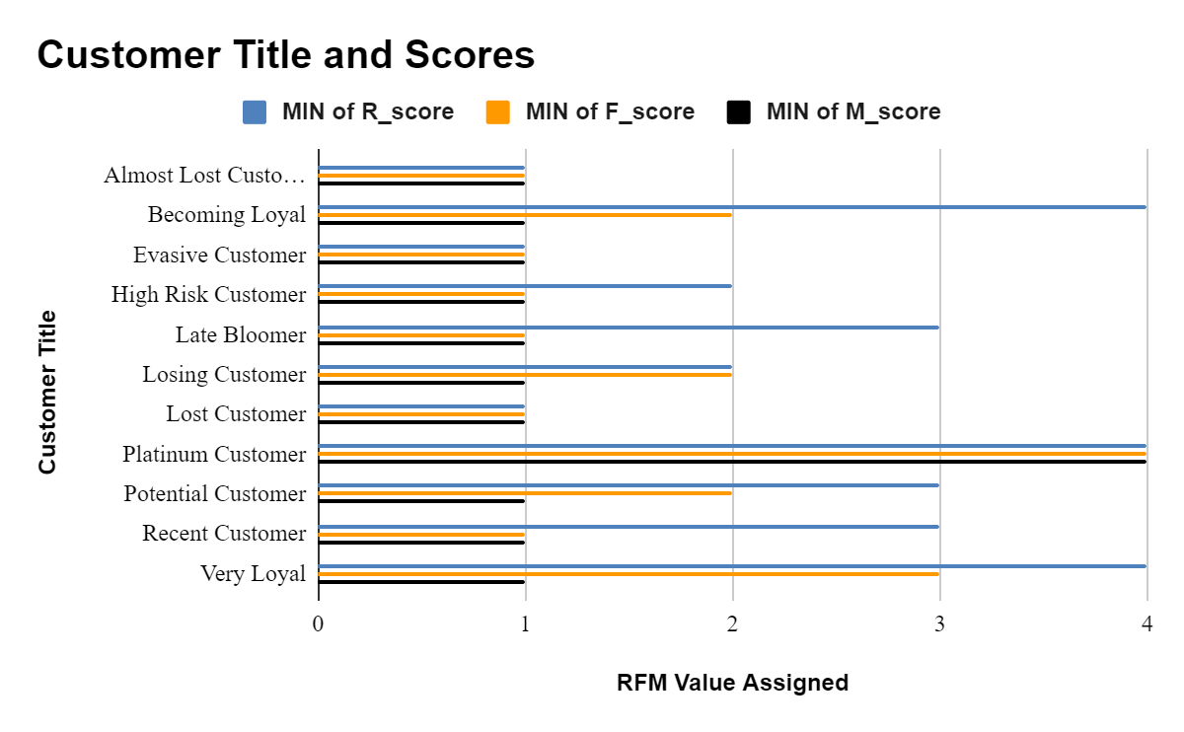
Model Development
RFM Analysis and Customer Classification
RFM analysis is used to determine which customers a business should target to increase its revenue and value.
The RFM (Recency, Frequency, and Monetary) model shows customers that have displayed high levels of engagement with the business in the three categories mentioned.

Slide 11
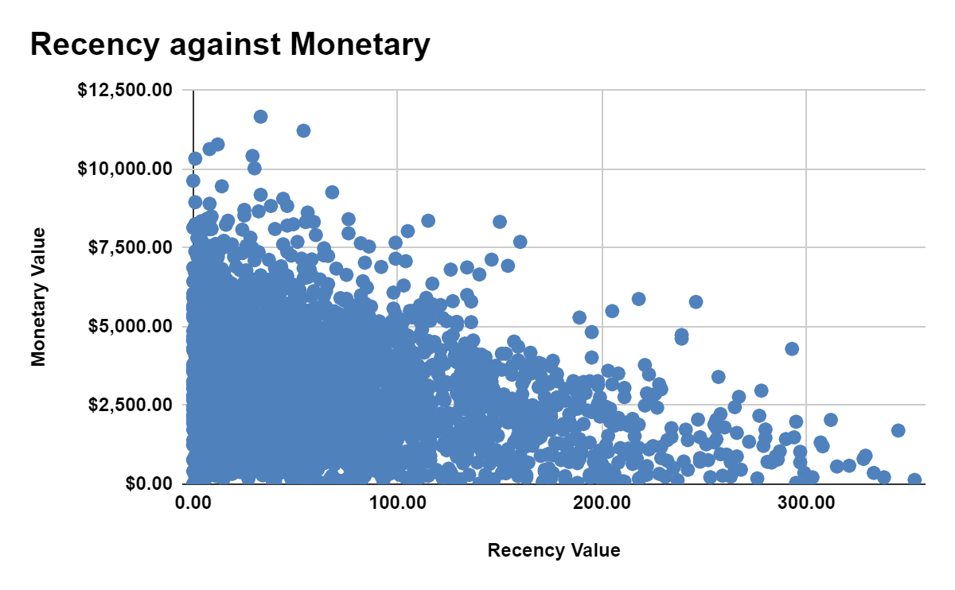
Model Development
Scatter-Plot based off RFM Analysis
The chart shows that customers who purchased more recently have generated more revenue, than customer who visited a while ago.
Customers from recent past (50-100 days) also show to generate a moderate amount of revenue
Those who visited more than 200 days ago generated low revenue.

Slide 12
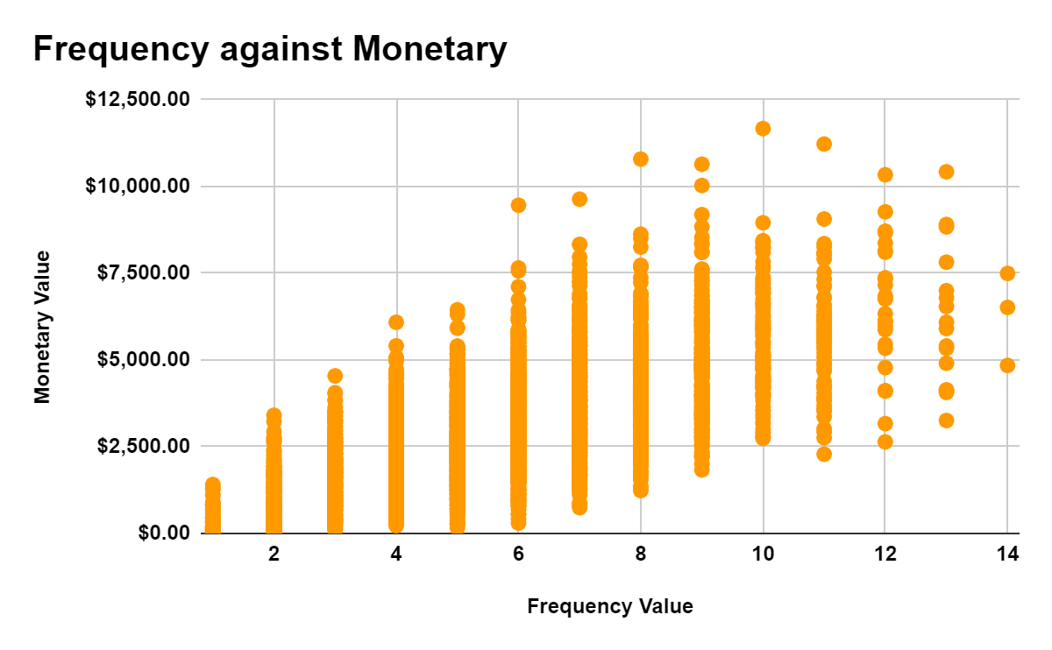
Model Development
Scatter-Plot based off RFM Analysis
Customer classified as ‘Platinum Customer’, ‘Very Loyal’, and ‘Becoming loyal’ visit frequently, which correlated with increased revenue for benefits.
Naturally there is a positive relationship between frequency and monetary gain for the business.

Slide 13
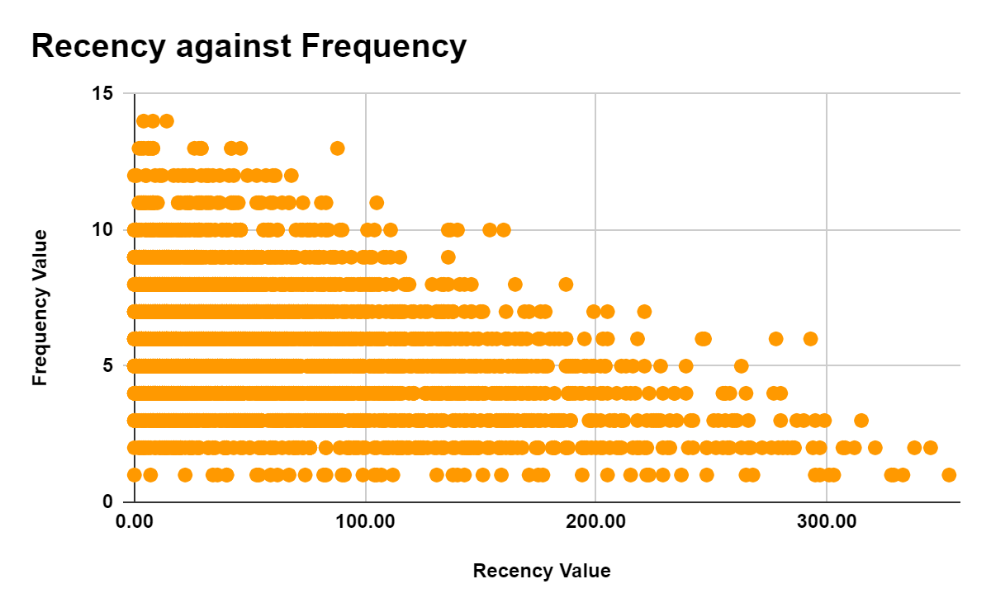
Model Development
Scatter-Plot based off RFM Analysis
Very low frequency of 0-2 correlated with high frequency values. i.e. More than 250 days ago.
Customers that have visited more recently (0-50 days) have a higher chance of visiting more frequently(6+).
Higher frequency has a negative relationship with recency values. Such that very recent customers are also frequent customers

Slide 14
Model Development
Customer Title Definition list with RFM values assigned
Rank | Customer Title | Description | RFM Value
1 | Platinum Customer | Most recent buy, buys often, most spent | 444
2 | Very Loyal | Most recent, buys often, spends large amount of money | 433
3 | Becoming Loyal | Relatively recent, bought more than once, spends large amount of money | 421
4 | Recent Customer | Bought recently, not very often, average money spent | 344
5 | Potential Customer | Bought recently, never bought before, spent small amount | 323
6 | Late bloomer | No purchases recently, but RFM values is larger than average | 311
7 | Losing Customer | Purchases was a while ago, below average RFM value | 224
8 | High Risk Customer | Purchase was long time ago, frequency is quite high, amount spent is high | 212
9 | Almost Lost Customer | Very low recency, low frequency, but high amount spent | 124
10 | Evasive Customer | very low recency, very low frequency, small amount spent | 112
11 | Lost Customer | very low RFM | 111

Slide 15
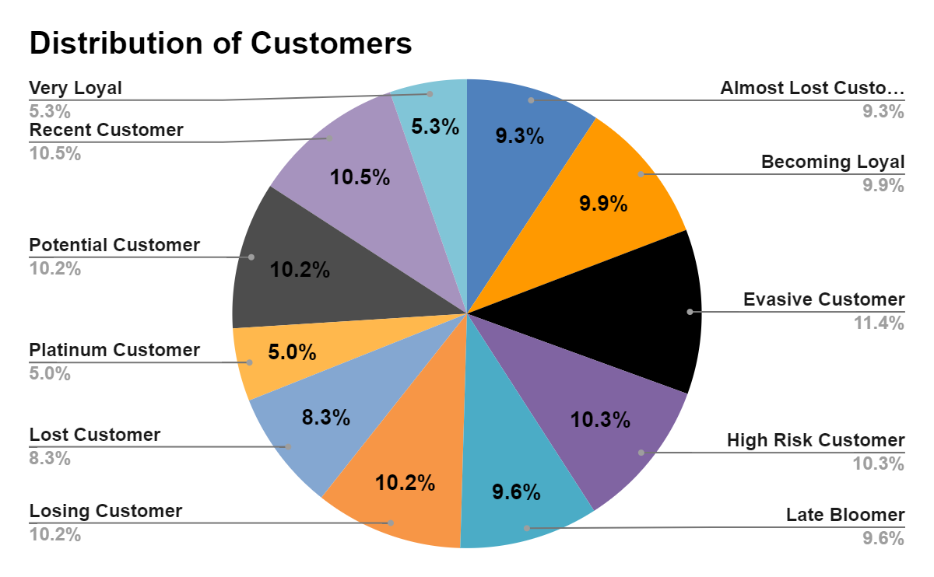
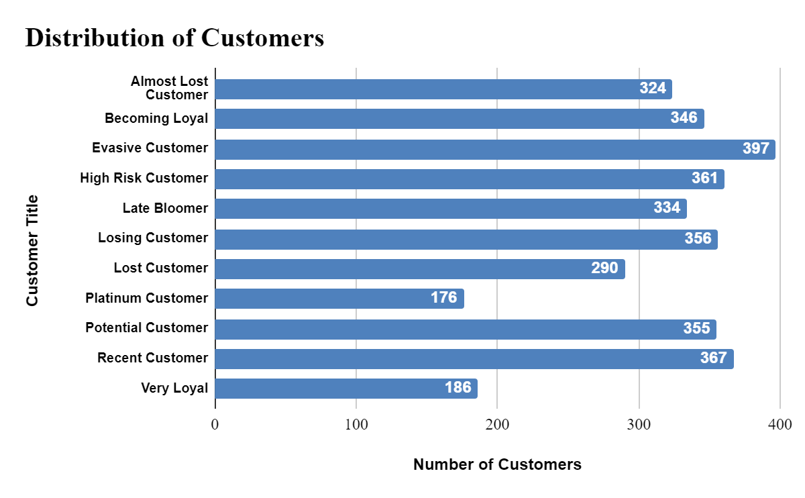
Model Development
Customer Title Distributions in Dataset

Slide 16
Interpretation
Summary Table of the Top 1000 Customers to Target
Rank | Customer Title | Description | Number of Customers | Cumulative | Customer Selection
1 | Platinum Customer | Most recent buy, buys often, most spent | 176 | 176 | 176
2 | Very Loyal | Most recent, buys often, spends large amount of money | 184 | 360 | 184
3 | Becoming Loyal | Relatively recent, bought more than once, spends large amount of money | 344 | 704 | 344
4 | Recent Customer | Bought recently, not very often, average money spent | 368 | 1072 | 296
5 | Potential Customer | Bought recently, never bought before, spent small amount | 355 | 1427 | 0
6 | Late bloomer | No purchases recently, but RFM values is larger than average | 333 | 1760 | 0
7 | Losing Customer | Purchases was a while ago, below average RFM value | 356 | 2116 | 0
8 | High Risk Customer | Purchase was long time ago, frequency is quite high, amount spent is high | 360 | 2476 | 0
9 | Almost Lost Customer | Very low recency, low frequency, but high amount spent | 326 | 2802 | 0
10 | Evasive Customer | very low recency, very low frequency, small amount spent | 401 | 3203 | 0
11 | Lost Customer | very low RFM | 290 | 3493 | 0

Slide 17
Interpretation
Customer Target and Methodology
Rank | Customer Title | Description | Number of Customers | Cumulative | Customer Selection
1 | Platinum Customer | Most recent buy, buys often, most spent | 176 | 176 | 176
2 | Very Loyal | Most recent, buys often, spends large amount of money | 184 | 360 | 184
3 | Becoming Loyal | Relatively recent, bought more than once, spends large amount of money | 344 | 704 | 344
4 | Recent Customer | Bought recently, not very often, average money spent | 368 | 1072 | 296
Filter through the top 1000 customers by assigning the conditions discussed in the table above.
The 1000 customers discovered would have bought recently, they have bought very frequently in the past and tend to spend more than other customers

Slide 18
Note: The data and information in this document is reflective of a hypothetical situation and client. This document is to be used for KPMG Virtual Internship purposes only.
Appendix

Slide 19
Note: The data and information in this document is reflective of a hypothetical situation and client. This document is to be used for KPMG Virtual Internship purposes only.
Appendix
This is an optional slide where you may place any supporting items.

