Slide 1
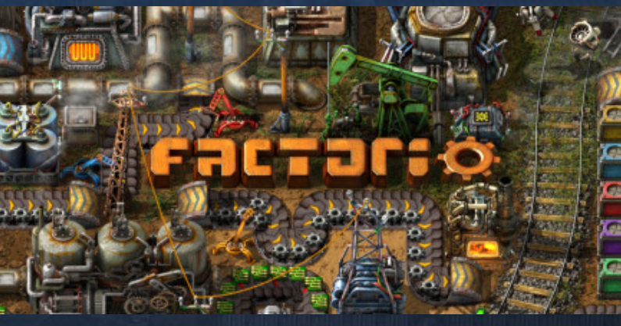
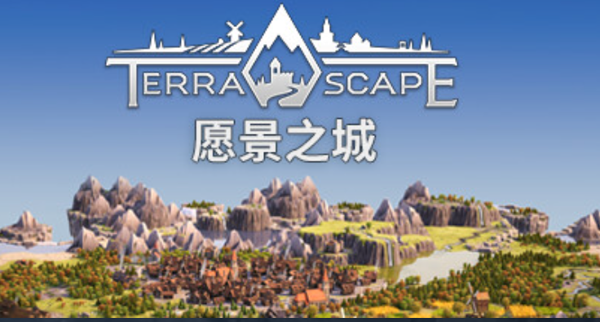
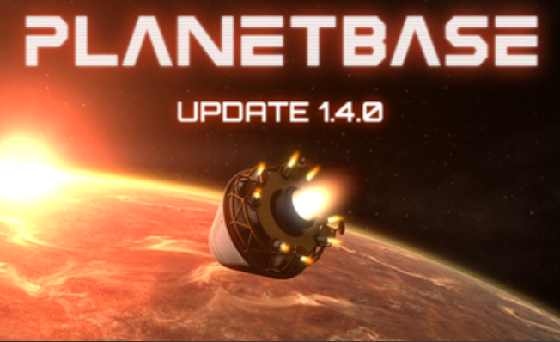
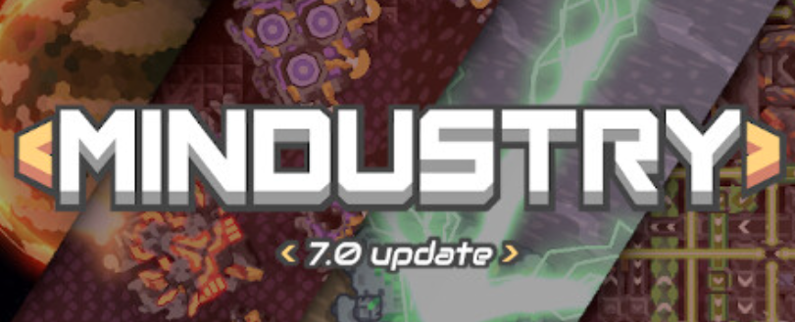


Game concept
Planet Colonization(temp)
Refer to
RTS?
Tower Defense?
-land on different planets(space shuttle)
-mining, building, automation and defense
-PvE
-produce shell for tower
-Obtain unique planetary resources and fuel. Then go to next planet(level)/return to base.

Slide 2
Organize
-Buildings
defense tower, factory ...
-Resources
iron, copper, ...
-Enemy
insects, worm, SCP? ...
-Story?

Slide 3
Difficulty
-PCG
-Enemy AI
-Simplify the rule

