Slide 1


NALAPRO PROJECT
20 NEWSGROUPS
CLASSIFICATION
By: SPARSH SOPORY

Slide 2
The Four Tasks
01
02
03
04
Simple Neural Network
BERT Fine-tuning
MLM + BERT
Llama-3
Two-layer NN with word2vec and TF-IDF inputs, plus another experiment
Fine-tune BERT-base-uncased on all 20 classes with proper train/val/testing
Continue BERT's masked-language pretraining on the newsgroup corpus, then fine-tune for classification.
Zero-shot and few-shot classification with Llama-3, compare to the supervised fine-tuned BERT.
+ BONUS
QLoRA fine-tune Llama-3
Compare to zero-shot and few-shot.

Slide 3
The Journey — From Constraints to Solutions
START
v1
v2
v3
FINAL
CPU-only laptop
6-class subset
Full 20 classes
val/test discipline
Colab T4 GPU
fp16 + batch 32
All 4 tasks + bonus
W&B tracked
Estimated 8+ h per task
Didn't match brief
Still slow on CPU
Hours → minutes
finished

Slide 4
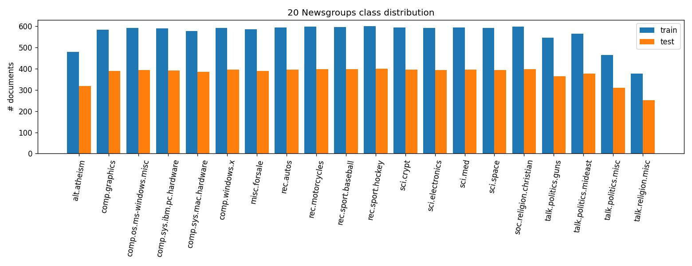
The Dataset — 20 Newsgroups
Source
sklearn.datasets.fetch_20newsgroups
Configuration
Headers / footers / quoted text removed
Stratified 10% validation split
Test set evaluated once, at the end
Why strip headers?
Email signatures and Newsgroups: headers leak the answer — the model would learn to cheat instead of read content.
11.3k
7.5k
20
Class distribution (train + test) — fairly balanced; minor underrepresentation in 4 classes.
training docs
test docs
classes

Slide 5
1
TASK 1 OF 4
Simple Neural
Network
Two linear layers with a ReLU between them — Linear(d_in → 128) → ReLU → Linear(128 → 20). The architecture stays constant across four experiments; only the input representation changes.
We compare word2vec averaged vectors (1 epoch vs 30 epochs), TF-IDF, and TF-IDF-weighted word2vec.

Slide 6
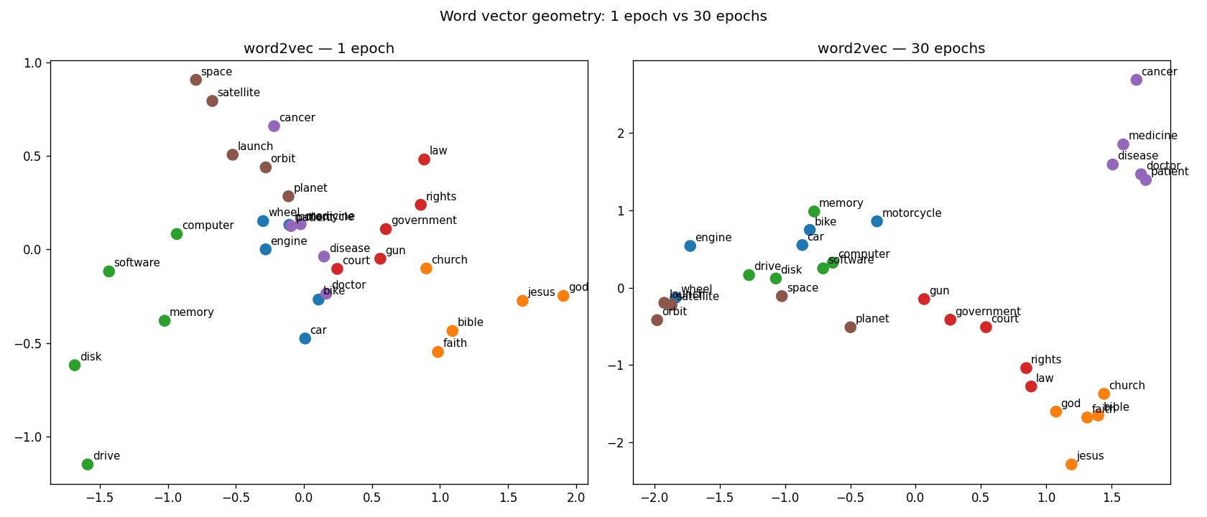
word2vec — 1 Epoch vs 30 Epochs
WHAT CHANGED
1 epoch
Words scattered randomly. Vectors are basically initialisation noise.
30 epochs
Clear semantic clusters — medical terms (doctor / patient / disease / medicine) top-right, religion (god / jesus / bible / church) bottom-right.
Tech cluster
computer / software / memory / disk / drive form their own group.

Slide 7
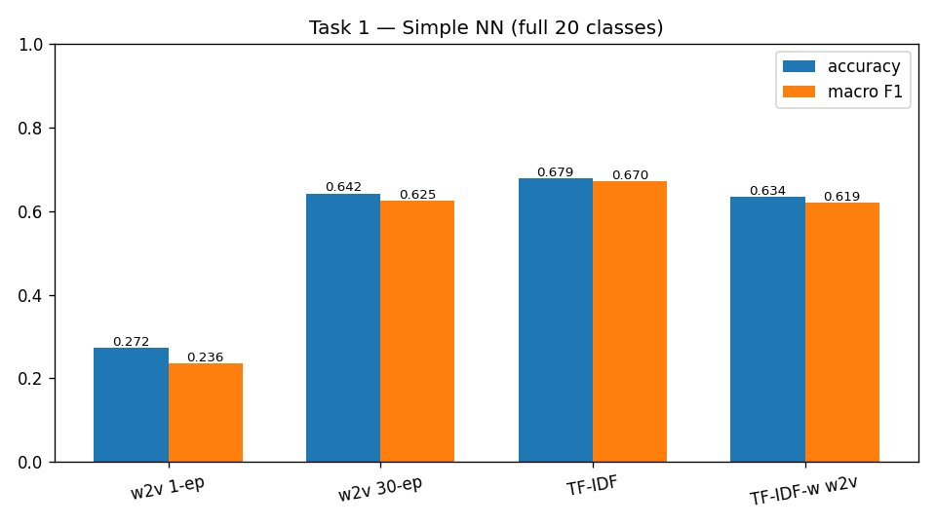
Results — Full 20-class Test Set
Final test accuracy
Input | Acc | F1
word2vec (1 epoch) | 27.2% | 0.236
word2vec (30 epochs) | 64.2% | 0.625
TF-IDF | 67.9% | 0.670
TF-IDF-weighted w2v | 63.4% | 0.619
Winner: TF-IDF.
It captures lexically distinctive words directly, while averaging word2vec dilutes them.
Test accuracy and macro F1 across the four input representations.

Slide 8
Why TF-IDF Wins on This Dataset
20 Newsgroups is lexically separable
Averaging word2vec dilutes signal
Each newsgroup has its own vocabulary (carburetor in rec.autos, encryption in sci.crypt). TF-IDF captures rare, informative words.
Taking the mean of all word vectors mixes informative content words with stopword-like noise. Class-defining terms get washed out.
More epochs help (+37 pp!)
TF-IDF-weighted w2v
1 epoch: 27%. 30 epochs: 64%. The PCA plot showed why — vectors only form meaningful clusters after many passes.
Combining strengths gave 63.4% — between plain w2v (64.2%) and TF-IDF (67.9%). Identity-preservation beats semantic averaging here.

Slide 9
2
TASK 2 OF 4
Fine-tune
BERT-base
Fine-tune bert-base-uncased on the full 20-class training set with a proper 10% stratified validation split. Max length 128 tokens, batch 32, 3 epochs, lr 2e-5, fp16 mixed precision on a T4 GPU.
The 7,532-doc test set is evaluated only once at the very end and never used for tuning.

Slide 10
Hyperparameters and Compute
Hyperparameters
8,000
957
Model | bert-base-uncased (110M)
Max sequence length | 128 tokens
Batch size | 32
Epochs | 3
Learning rate | 2e-5 (AdamW)
Weight decay | 0.01
Warmup ratio | 10% linear
Precision | fp16 mixed (T4 GPU)
training docs
training steps
~2 min
110M
per epoch on T4
trainable params
Train/val/test discipline: 10% stratified validation split for per-epoch monitoring; the 7,532-doc test set evaluated only once.

Slide 11
Training Loss vs. Validation Accuracy
68.97%
final test accuracy
0.665
final test macro F1
Training loss still falling at epoch 3 — model not fully converged.

Slide 12
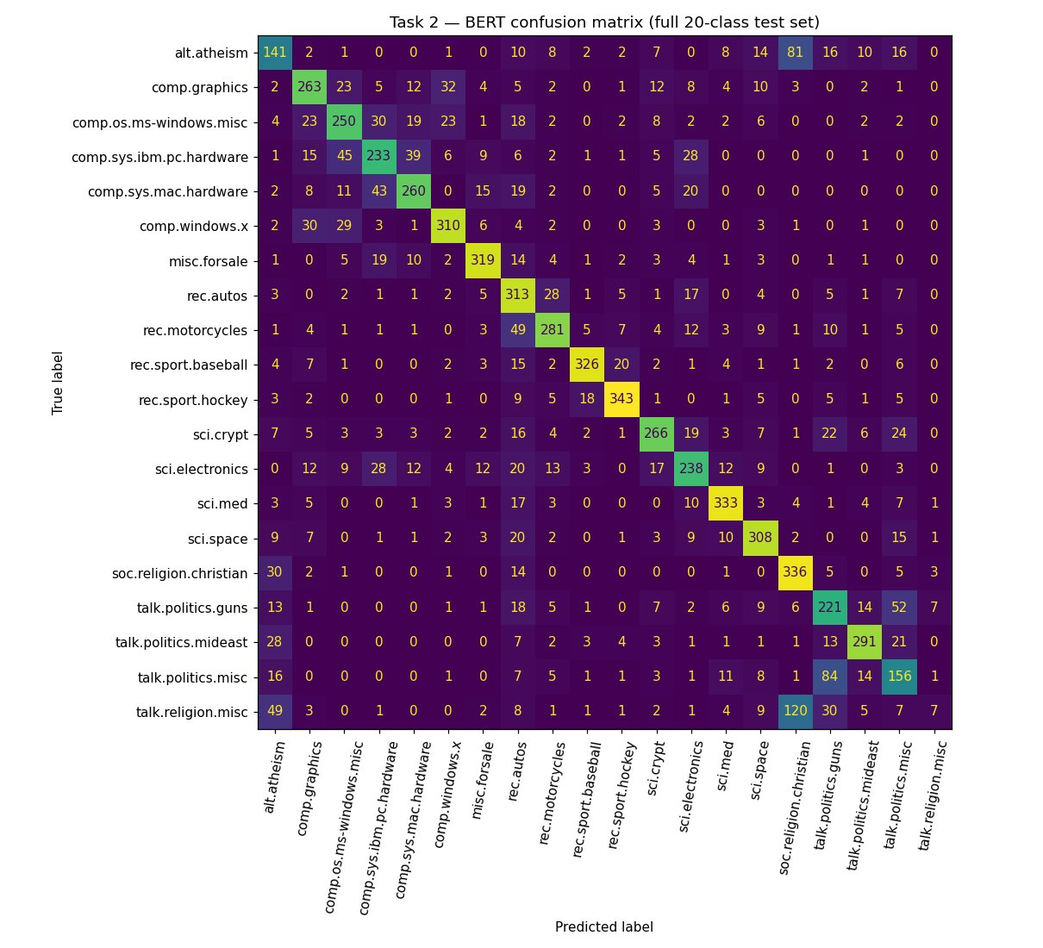
Where Does BERT Get Confused?
CONFUSABLE CLUSTERS
Religion triangle
alt.atheism ↔ soc.religion.christian ↔ talk.religion.misc — talk.religion.misc collapses (F1 = 0.04).
Computer sub-forums
PC hardware ↔ Mac hardware ↔ ms-windows.misc ↔ windows.x — same domain, different platforms.
Politics overlap
talk.politics.guns ↔ talk.politics.misc — "misc" absorbs borderline cases.

Slide 13
3
TASK 3 OF 4
MLM + BERT
Domain-adaptive pretraining. Continue BERT's masked-language pretraining on the unlabelled 11k-document newsgroups corpus, then fine-tune for classification using the same setup as Task 2.

Slide 14
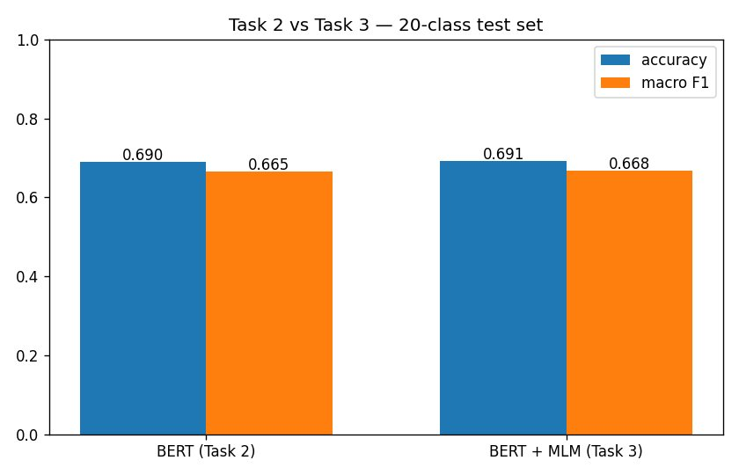
MLM Barely Moves the Needle
+0.15 pp
Test acc: 68.97% → 69.12%. Macro F1: 0.665 → 0.668. Statistically indistinguishable.
Why so small?
BERT was already pretrained on Wikipedia + BookCorpus — newsgroups text isn't far from that distribution.
MLM stage was short
Only 1 epoch of MLM (loss 2.66 → 2.46). More MLM epochs might help — but cost matters.
Task 2 vs Task 3 — same 20-class test set, same training setup.

Slide 15
4
TASK 4 OF 4
Llama-3
in-context
Run zero-shot and few-shot classification with Llama-3.1-8B-Instruct via huggingface (the official Meta repo is gated, the mirror has identical weights).
Evaluate on a balanced 100-document test sample (5 per class). The same 100 docs are also evaluated with the fine-tuned BERT from Task 2 — for a fair head-to-head comparison.

Slide 16
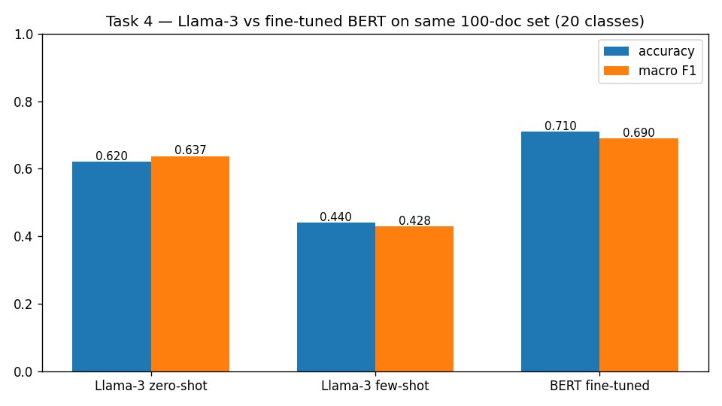
The Unexpected Finding
THE SURPRISE
Few-shot was
WORSE than
zero-shot.
Zero-shot
62.0%
Few-shot
44.0%
Llama-3 zero/few-shot vs fine-tuned BERT on the same 100-doc test set.
BERT (FT)
71.0%

Slide 17
Why Did Few-Shot Underperform Zero-Shot?
1
Context overload (~3,000 tokens)
2
Demonstration bias
20 in-context examples + 20-label system prompt push the prompt to ~3k tokens. The actual query gets buried.
One example per class. The model can latch onto surface features of those specific posts rather than learning the abstract category.
3
Format mimicry > understanding
4
Truncation of demos
Seeing "post → label" 20 times, the model matches the pattern mechanically. Harmful when reasoning is needed.
Each demo truncated to 60 words to fit context. Trimmed snippets may not be representative — biasing the model.

Slide 18
+
BONUS TASK
QLoRA
fine-tuning
The bonus question: fine-tune Llama-3 with LoRA or QLoRA on the classification data and compare to zero-shot and few-shot.
QLoRA = 4-bit quantized base model + low-rank LoRA adapters on q/k/v/o projection layers (rank 8). Only the adapters are trained: 4.6M parameters out of 3.2B (0.14%).

Slide 19
QLoRA Setup — Lightweight Fine-tuning
QLoRA configuration
Base model | Llama-3.2-3B-Instruct
Quantization | 4-bit NF4 (BitsAndBytes)
LoRA rank | r = 8
LoRA alpha | 16
LoRA dropout | 0.05
Target modules | q_proj, k_proj, v_proj, o_proj
Epochs | 1
Effective batch | 8 (2 × accum 4)
Learning rate | 2e-4 (AdamW)
Training time | ~9 minutes on T4
4.6M
0.14%
trainable params
of total params
4-bit
9 min
base model precision
total training time
Why this matters: QLoRA lets us fine-tune a 3B-parameter model on a free Colab T4 GPU. Full fine-tuning would need ~80 GB of VRAM.

Slide 20
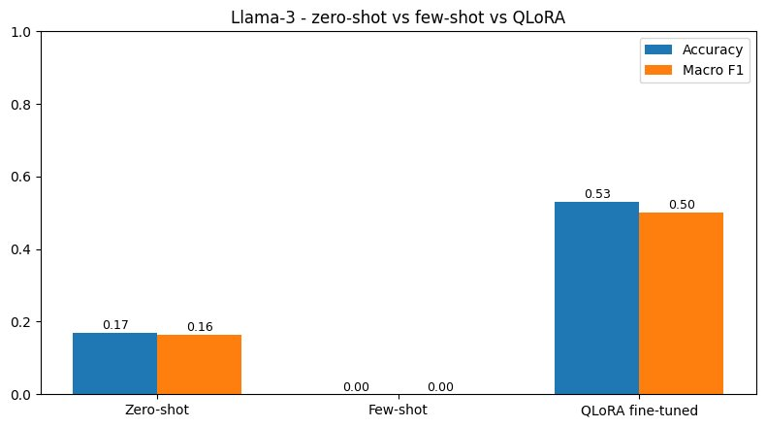
QLoRA Beats In-Context by 36 pp
HEADLINE
From 0% to 53%
with 4.6 M trained
parameters.
Zero-shot
17.0%
Few-shot
0.0%
Llama-3.2-3B — zero-shot, few-shot, QLoRA-tuned (same balanced eval set).
QLoRA fine-tuned
53.0%

Slide 21
Why QLoRA Wins — and What the 0% Means
Fine-tuning learns the task, prompting only describes it
The 0% few-shot is a parsing collapse, not pure ignorance
QLoRA updates 4.6M parameters specifically for 20-class newsgroups. Zero/few-shot rely on the base model's general world knowledge to do the same job from words alone.
With a smaller model (Llama-3.2-3B) and a strict label parser, the 20-shot prompt confused the model into outputs the parser couldn't match to any label.
Comparison caveat — different from Task 4
QLoRA still trails fine-tuned BERT
Bonus uses Llama-3.2-3B (smaller); Task 4 uses Llama-3.1-8B. Numbers within each task are comparable; across tasks they are not directly comparable.
BERT on the 20-class test set: 69%. QLoRA Llama on its bonus eval: 53%. Architecture + amount of training data matters more than model size for this task.

Slide 22
Overall Comparison
HEADLINES
BERT wins narrowly
only ~1 pp over plain TF-IDF.
MLM is neutral
+0.15 pp — within noise.
Llama few-shot regressed
Counterintuitive but plausible.
QLoRA fixed Llama
Fine-tuning beat prompting by 36 pp.
Architecture > model size
BERT (110M) still > Llama-3B with QLoRA.

Slide 23
Thank you
Questions & Discussion

