Slide 1

DHARTI-RAKSHAK
Smart Soil Monitoring & Analysis System
WorldSkills Competition Project

Slide 2

Project Overview
Precision Agriculture Revolution
DHARTI-RAKSHAK is an advanced smart soil monitoring and analysis system engineered for precision agriculture applications. This portable, battery-powered device leverages industrial-grade sensing technology with ESP32 microcontroller capabilities to deliver accurate, real-time soil data directly in the field.
The system empowers farmers with immediate insights into soil conditions, enabling data-driven decisions that optimize resource usage and maximize crop yields.

Slide 3








Problem Statement
No Real-Time Data
Resource Waste
Farmers lack immediate access to critical soil information, forcing reactive rather than proactive agricultural management decisions.
Without precise soil data, overuse of fertilizers and water is common, increasing costs and environmental impact significantly.
Expensive Testing
Soil Variability
Traditional laboratory soil analysis is slow, costly, and requires sample collection, creating delays in critical farming decisions.
Soil conditions vary dramatically across different field areas, but conventional methods fail to capture this spatial heterogeneity effectively.

Slide 4

Proposed Solution
Portable Field Testing
Battery-powered device enables soil analysis anywhere in the field, eliminating the need for laboratory visits or sample transportation.
Multi-Parameter Analysis
Simultaneous measurement of seven critical soil parameters provides comprehensive insights into soil health and fertility status in real-time.
Instant Results
Quick, accurate field data appears within seconds, allowing farmers to make immediate adjustments to irrigation and fertilization strategies.
User-Friendly Design
Intuitive interface and simple operation ensure easy adoption by farmers of all technical skill levels without extensive training requirements.

Slide 5

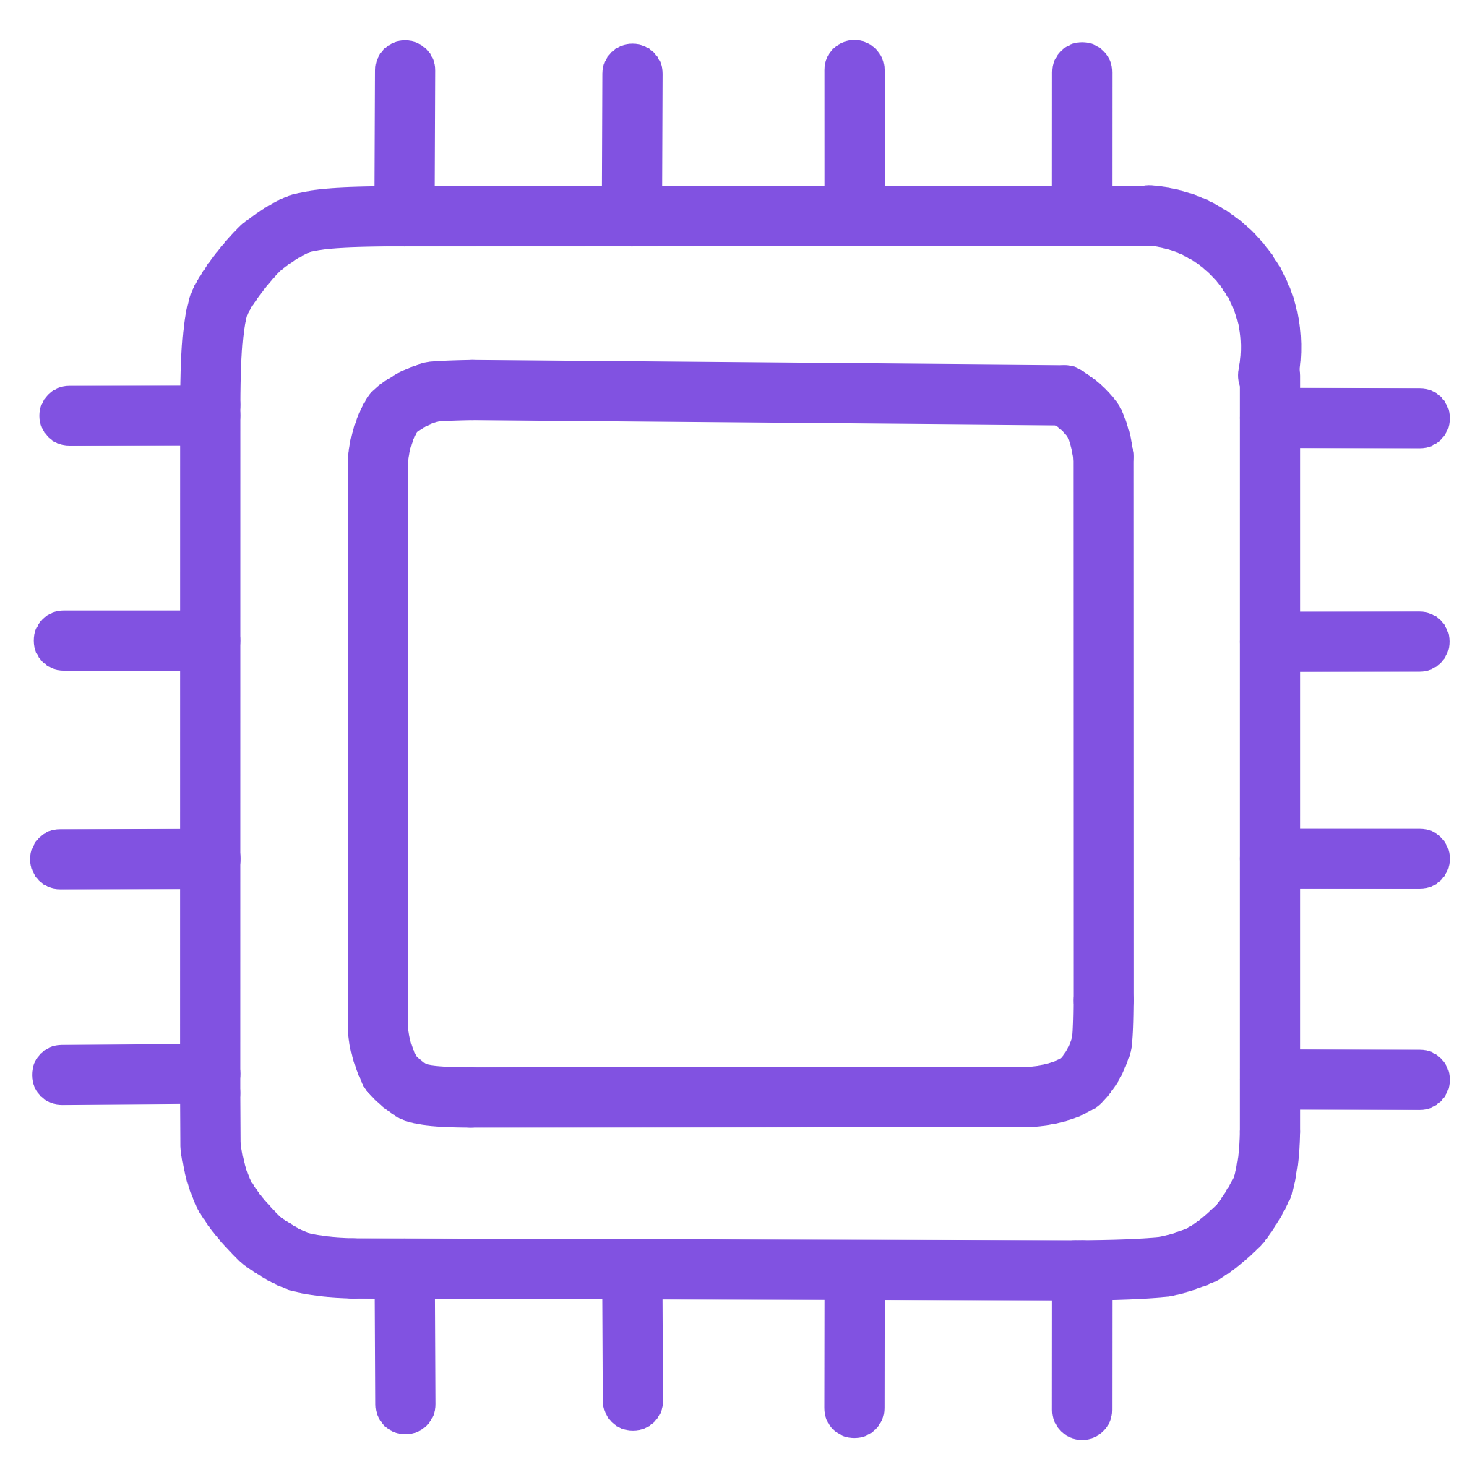



System Components
7-in-1 RS485 Soil Sensor
ESP32 Controller
MAX485 Module
Industrial-grade sensor measures moisture, pH, electrical conductivity, nitrogen, phosphorus, potassium, and temperature simultaneously with high precision.
Powerful 40-pin microcontroller handles sensor communication, data processing, and display management with efficient power consumption.
Reliable TTL to RS485 converter enables robust industrial communication between the ESP32 and soil sensor over extended distances.
OLED Display
Battery System
Compact 0.96-inch I2C display provides clear, high-contrast visualization of soil parameters even in bright sunlight conditions.
Advanced power management with 18650 lithium-ion cells and protection circuitry ensures safe, reliable operation throughout extended field use.

Slide 6
Materials Used – Sensor
Component
Specification
Purpose
7-in-1 Soil Sensor
RS485 Industrial
Measures moisture, pH, electrical conductivity, NPK levels, and temperature
The RS485 industrial sensor provides professional-grade accuracy and reliability, making it suitable for commercial agricultural applications. Its robust construction ensures durability in harsh field conditions while maintaining precision across all measurement parameters.

Slide 7



Materials Used – Electronics
ESP32 Microcontroller
MAX485 Module
OLED Display
Specification: 40-pin MCU with dual-core processor
Specification: TTL to RS485 converter chip
Specification: 0.96 inch I2C interface
Purpose: Main system controller handling sensor communication, data processing, and display output management
Purpose: Enables reliable industrial communication protocol between ESP32 and soil sensor
Purpose: Visual output displaying all measured soil parameters with high contrast clarity

Slide 8
Materials Used – Power System
Component
Specification
Purpose
18650 Li-ion Cells
3.7V, 2200mAh capacity
Primary power source providing portable energy
3S 20A BMS
Three-cell lithium protection
Ensures battery safety, prevents overcharge/discharge, and cell balancing
12.6V Charger
1A Li-ion charging
Safe and efficient battery charging between field operations
LM2596 Buck Converter
DC-DC step-down
Converts battery voltage to stable 5V for system components

Slide 9

Power System Design
Intelligent Battery Architecture
01
Series Configuration
Three 18650 cells connected in series deliver 11.1V nominal voltage (12.6V fully charged) for optimal system performance.
02
BMS Protection
Battery Management System ensures safety through overcharge protection, over-discharge prevention, and active cell balancing.
03
Voltage Regulation
LM2596 buck converter provides stable 5V output regardless of battery charge state, ensuring consistent system operation.

Slide 10





System Working – Step by Step
Sensor Insertion
Insert the 7-in-1 soil sensor probe into the ground at the desired testing location to ensure proper soil contact.
Data Transmission
Sensor automatically transmits multi-parameter measurements via RS485 industrial communication protocol.
Signal Processing
ESP32 microcontroller receives data through MAX485 module and processes all seven soil parameters simultaneously.
Data Analysis
Advanced algorithms convert raw sensor data into calibrated, accurate measurements ready for display.
Results Display
Processed results appear instantly on the OLED screen, showing all soil parameters in an easy-to-read format.

