Slide 1
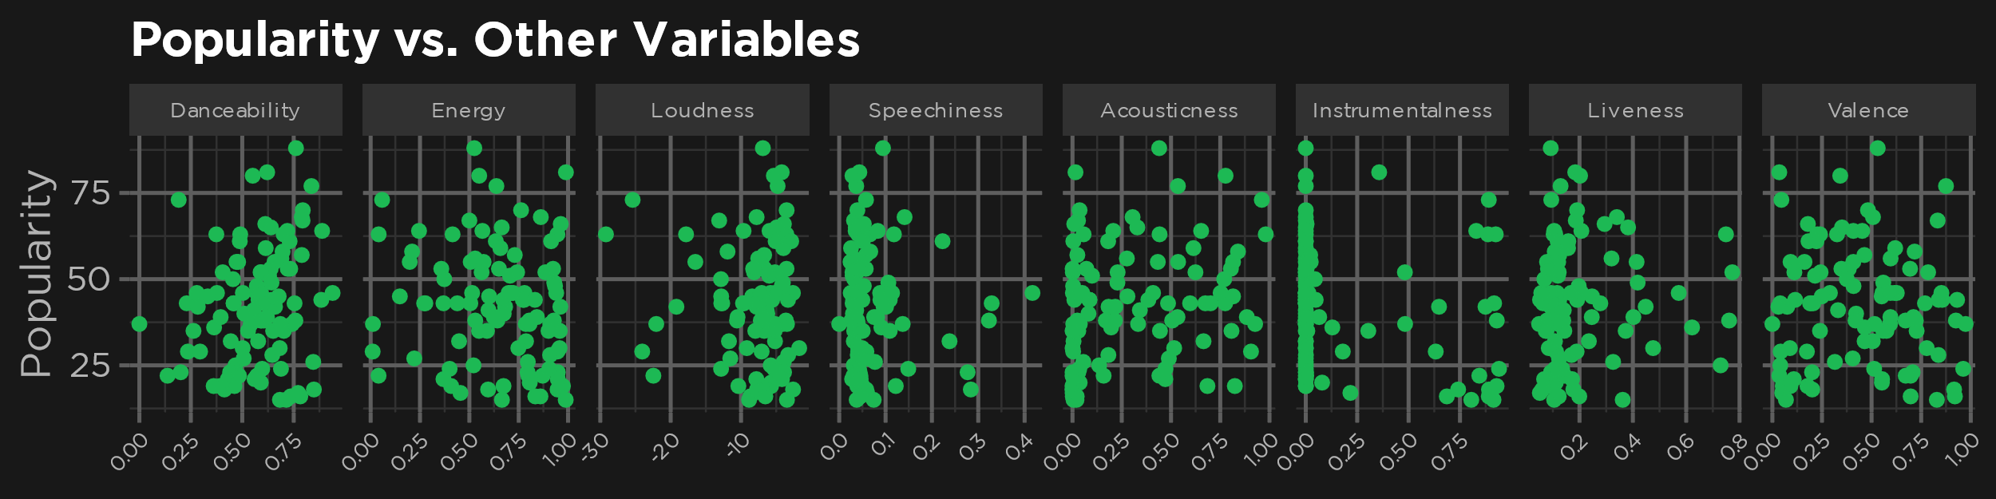
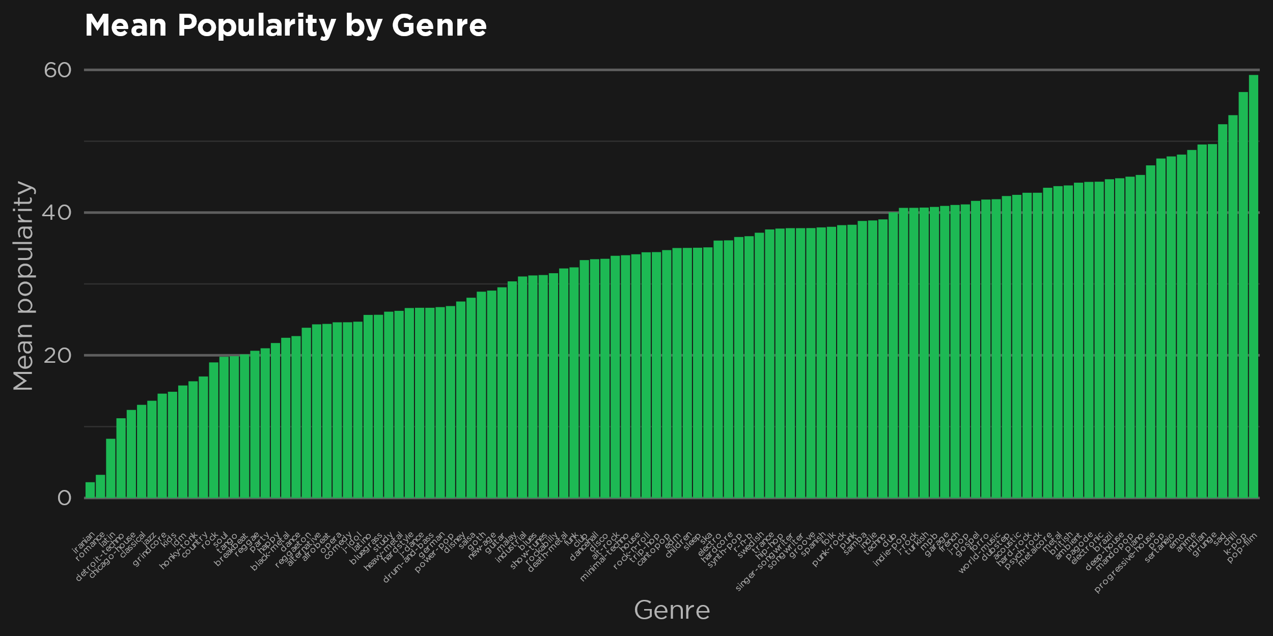
What Makes a Song Popular?
Introduction
I’m sure we’ve all wondered what makes a song popular. It seems like some songs go viral seemingly overnight, while others go unnoticed by the general population. I wanted to know what factors had the most influence on a song’s popularity, and whether it is possible to predict how popular a song will be without knowing how many people listen to it.
Background Research
I found several studies on this topic. The first study, discussed in the article “Why do songs become popular?” by Arash Emamzadeh in Psychology Today, found that songs with content that was more genre-atypical (not like content typically found in the song’s genre) tended to be ranked higher. Another study is detailed in the paper “What Makes Popular Culture Popular?: Product Features and Optimal Differentiation in Music” by Noah Askin and Michael Mauskapf. This study found the same results as the first study.
Dataset & Data Exploration
My dataset is from the user MaharshiPandya on Kaggle. The dataset includes 114,000 observations of several variables, such as genre, popularity, and danceability. There are 1,000 tracks from each of 114 genres. To explore the data, I started by creating some scatterplots comparing popularity to some of the other continuous numeric variables in the dataset. I did this to search for any obvious correlation between popularity and one of the other variables. The first group of plots below shows scatterplots of popularity versus several other variables. It does not appear as though any of these variables have a strong correlation with popularity. Next, I created a bar chart comparing the mean popularity of the tracks in each genre. I did this to see if there appeared to be a significant difference between the popularity of songs from different genres. The plot shows that there is a clear difference between different genres, with some being far more popular than others.

