Slide 1
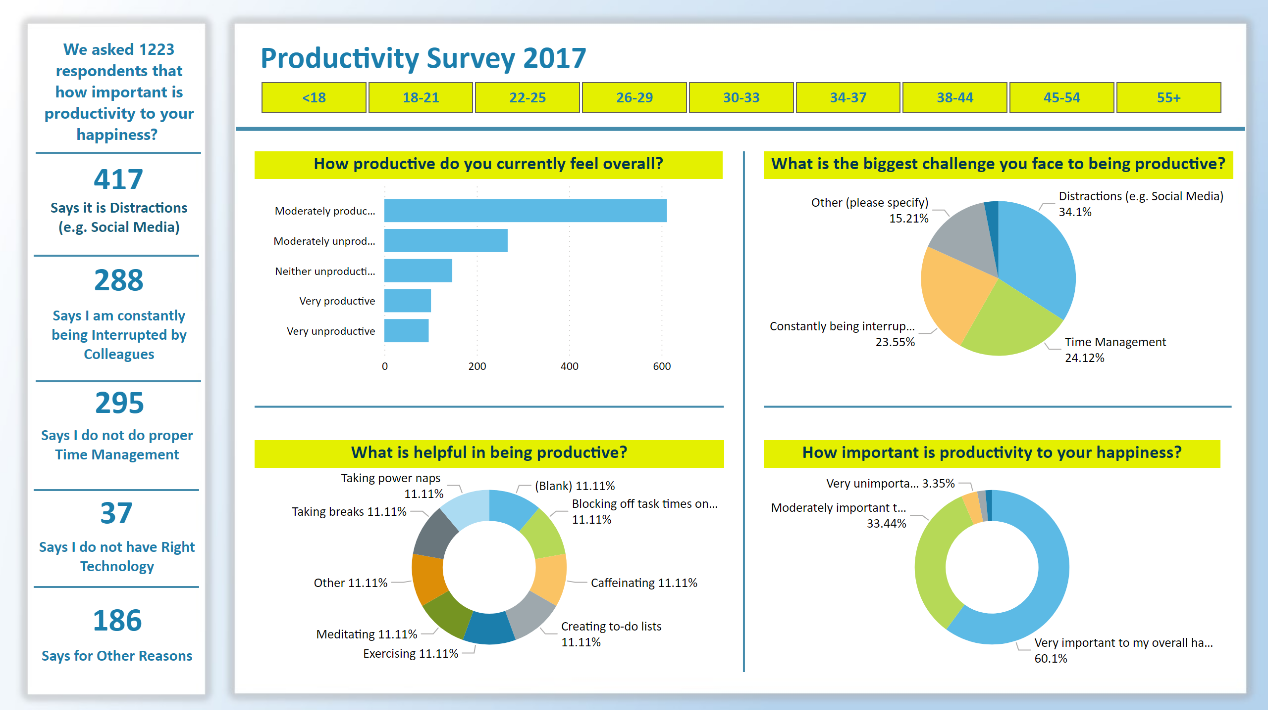
Productivity_Survey 20171
Notes:
textbox
No alt text provided
card
No alt text provided
textbox
No alt text provided
card
No alt text provided
textbox
No alt text provided
card
No alt text provided
textbox
No alt text provided
card
No alt text provided
textbox
No alt text provided
card
No alt text provided
textbox
No alt text provided
textbox
No alt text provided
slicer
No alt text provided
shape
No alt text provided
How productive do you currently feel overall?
No alt text provided
What is the biggest challenge you face to being productive?
No alt text provided
What is helpful in being productive?
No alt text provided
How important is productivity to your happiness?
No alt text provided
shape
No alt text provided
shape
No alt text provided
shape
No alt text provided
shape
No alt text provided
shape
No alt text provided
shape
No alt text provided
shape
No alt text provided
shape
No alt text provided

