Slide 1
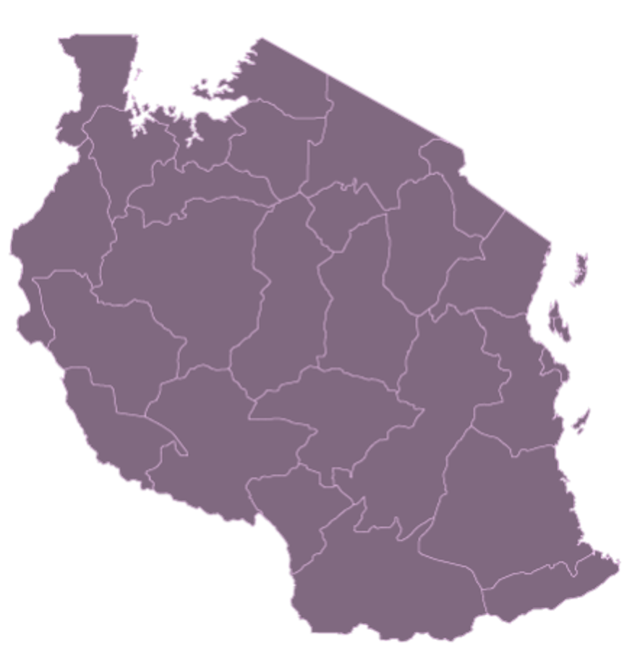


LIGHTING UP TANZANIA
AFFORDABLE ELECTRICITY FOR ALL
Principles of Urban Informatics
CUSP- New York University
Presented by :
Sonam Sonam (ss15624)
Max Magid (mmm9940)
Hanfie Vandanu (hv480)
Suraj Sunil (ss14449)
Wonchan Lee (wcl311)

Slide 2




INTRODUCTION
Over 6 out of 10 Tanzanians do not have adequate access to energy
Tanzania has high potential for hydroelectric and solar power
We want to see what is the most cost effective way to more fully electrify the country

Slide 3
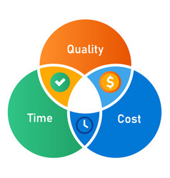

BACKGROUND
Organization and Projects:
The Millennium Challenge Corporation (MCC)
Tanzania Renewable Energy Association (TAREA)
Lighting Rural Tanzania Project
Future Goal and Plan Mentioned:
Increasing generation capacity to at least 5,000 MW by 2020 (about 1602 MW currently)
Increasing connectivity to 50% by 2025
70% by 2030

Slide 4
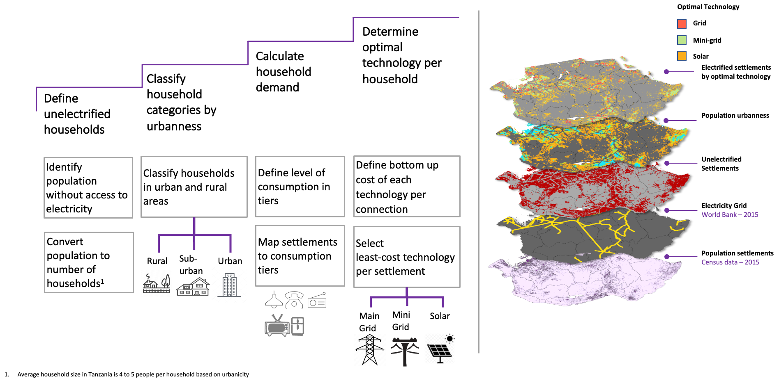
METHODOLOGY

Slide 5

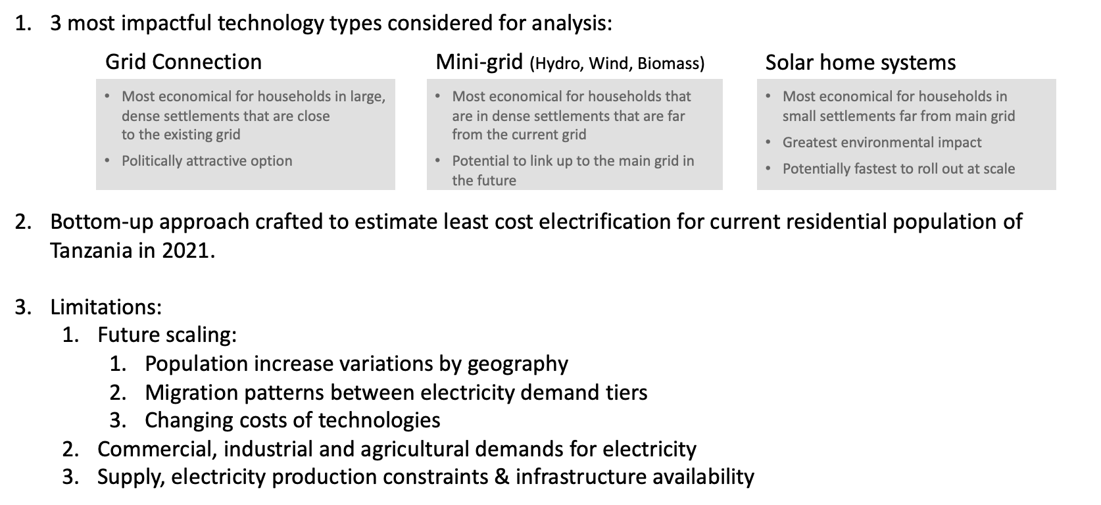
SCOPE & LIMITATIONS

Slide 6
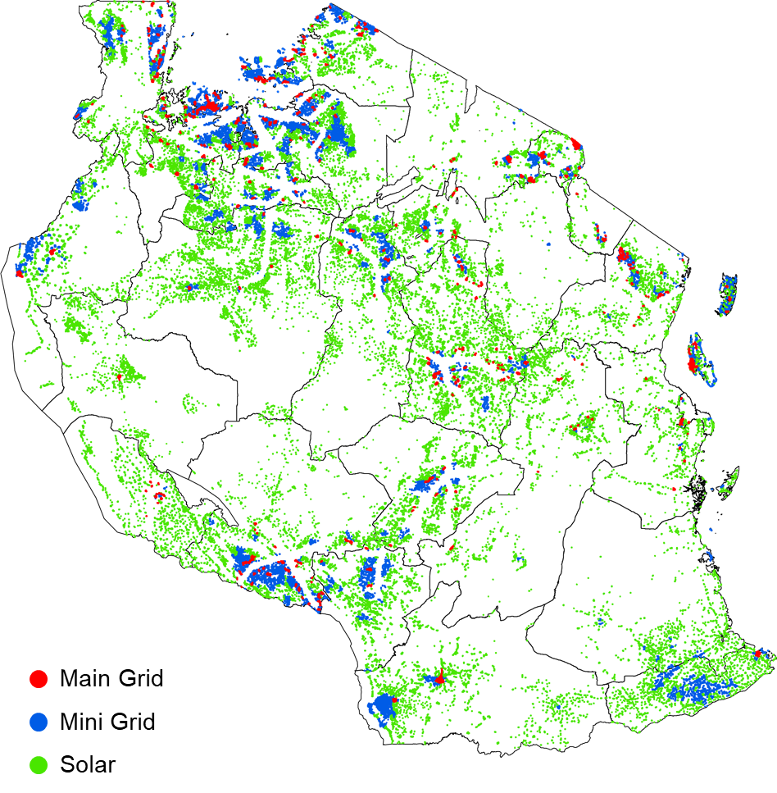
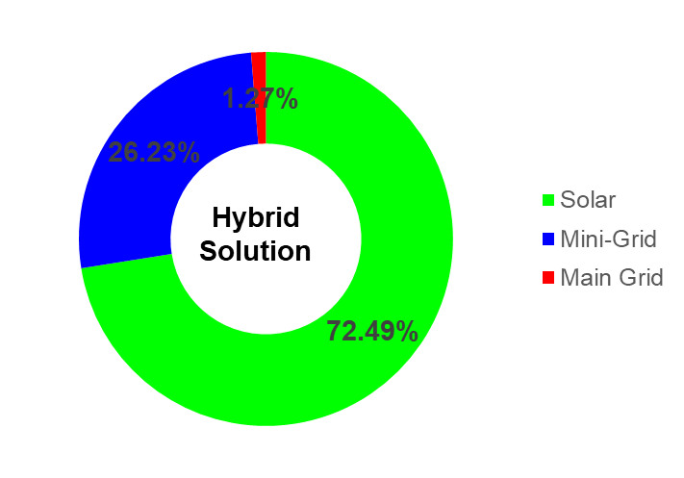
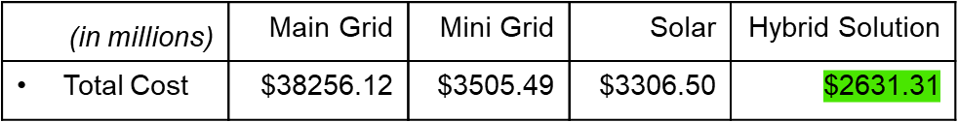
RESULTS
Reduction in electrification cost by 21.1%

Slide 7
CONCLUSION
Sub-Urban
and Rural
Solar Panel
> 98%
Tanzania
Electrification
FURTHER STUDY
Urban
Mini Grid
Hydropower
Bio-mass
Wind
95%
FURTHER STUDY
DEMAND + COST
Scaling the Cost Estimation
Population Migration + Growth
BUILDING COST
Technology Development
BUILDING COST
Demand Categorization
(Residential, Commercial, Industrial)

Slide 8
BLUEPRINT READY
THANK YOU

