Slide 1
Create a symbols and integrate multiple symbols
Organised & Supported by RuggedBOARD
Notes:
<number>

Slide 2
Agenda
Functions
Library Functions
User-defined functions
Function call by value & call by reference
Local & Global Variables
Storage Classes
Command line Arguments
Notes:
<number>

Slide 3
Functions
Def:​
A self contained block of code performing a​ specific job of some kind.​
Meaning:​
'Do something' in a program.​
Repesentation:​
Any name followed by a pair parenthesis.​
Syn:​
Functionname ( )
Two types of functions:​​
Library functionctions:​
Pre-defined functions. are called​'Library functions'.These are defined in the header files.​​
User-defined functionctions: ​
These functions are defined​ by programmer only.
Notes:
<number>

Slide 4
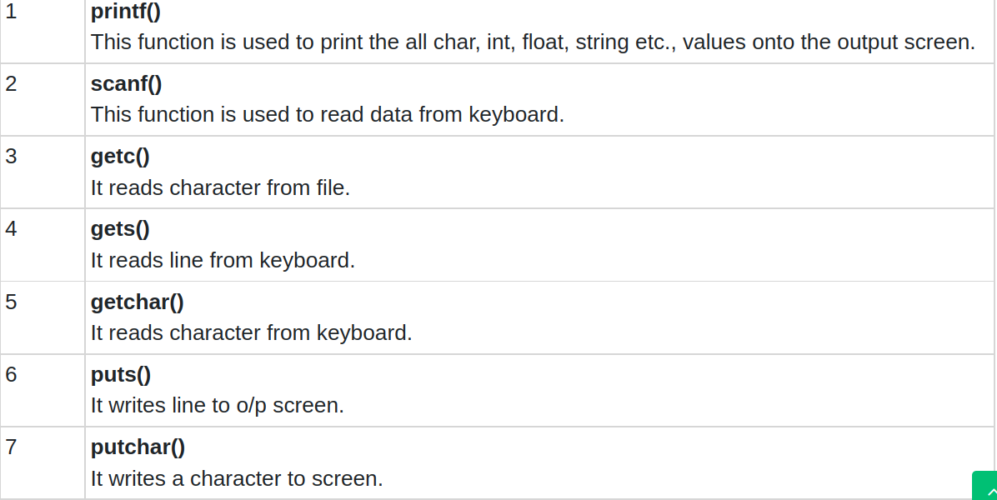
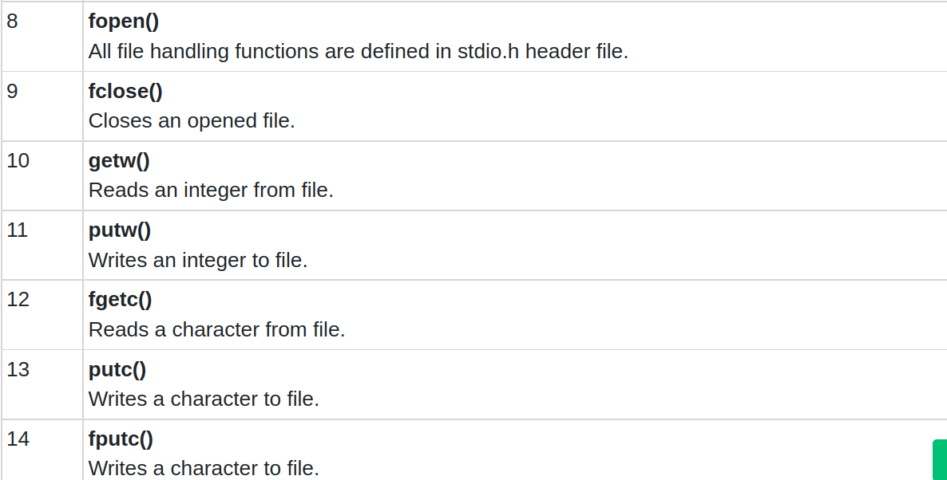
Library Functions

Slide 5
Library Functions
#include <math.h>
#include <stdio.h>
// Driver code
int main()
{
double number, squareRoot;
number = 12.5;
// Computing the square root
squareRoot = sqrt(number);
printf("Square root of %.2lf = %.2lf",number, squareRoot);
return 0;
}
Note: Compile above program with –lm option
gcc -c file.c
gcc file.o -o file -lm

Slide 6
User-defined Functions
main() is a function. ​
It has collection of function. ​
Each and every C program must start its execution from this function only.​
​
- Any number of functions can be used in a program.​
- A function can be used any number of times in a program.​
- Any function can return a value with return statement.​
​
Here, return is a key word.​
Syn: return (var / constant / exprn ) ;​
- It can be used as the last statement in every definition.​
- The void function does not return any value. ​
- The word void is also a keyword.​
- A function can be called from another one.
main() ​
{ ​
// codes start from here ​
}
Notes:
<number>

Slide 7
Arguments
Arguments Types: Actual and Formal​
Actual arguments :​
The vars., which are passing through a function called 'Actual arguments'​
​
Syn: ​
functionname (argslist) ;​
Eg. add(a, b);​
Here, the variables 'a' and 'b' are called actual args.
Formal arguments:
The variables, which are declared in a pair of parentheses at the function definition called 'Formal arguments'.​​
Syn:​​
returntype functionname(args list)​​
{​​
// body of the function.​​
}​​
​Eg:​​
void add ( int x, int y)​​
{​​
// body​​
}​​
Here, the vars. 'x' and 'y' are called formal arguments.
Notes:
<number>

Slide 8
Rules for calling a specific function
Rules for calling a specific function:​
​
1.Calling function name should be matched with function name​
in the function definition.​
​
2.No. of Actual arguments = No. of Formal arguments.​
​
3.The order, data types and returns must be matched.
Notes:
<number>

Slide 9
User-defined function
Types of User-defined functions :​
​There are 4 types of user-defined functions​
​without passing args., with no return
without passing args, with return
with passing args. , with no return​
​with passing args., with return​
#include<stdio.h>
void sum (int, int );
int main ()
{
int a,b;
printf("enter 2 numbers :");
scanf("%d%d", &a,&b);
sum (a,b);
return 0;
}
void sum ( int a, int b)
{
int c;
c= a+b;
printf ("sum=%d\n", c);
}
#include<stdio.h>
int sum ( int,int);
int main ()
{
int a,b,c;
printf("enter 2 numbers: ");
scanf("%d%d", &a,&b);
c= sum (a,b);
printf ("sum=%d\n", c);
return 0;
}
int sum ( int a, int b )
{
int c;
c= a+b;
return c;
}
#include<stdio.h>
int sum (void);
int main ()
{
int c;
c= sum ();
printf("sum = %d\n",c);
return 0;
}
int sum ()
{
int a,b,c;
printf("enter 2 numbers:");
scanf ("%d%d", &a, &b);
c = a+b;
return c;
}
#include<stdio.h>
void sum(void);
int main ()
{
sum ();
return 0;
}
void sum ()
{
int a,b,c;
printf("enter 2 numbers:\n");
scanf ("%d%d", &a, &b);
c = a+b;
printf("sum = %d\n",c);
}

Slide 10
Function call by value & call by reference
-The call by value method of passing arguments to a function copies the actual value of an argument into the formal parameter of the function.​
​
-In this case, changes made to the parameter inside the function have no effect on the argument.​
​
C programming language uses call by value method to pass arguments. In general, this means that code within a function cannot alter the arguments used to call the function.
- Call by reference method of passing arguments to a function copies the address of an argument into the formal parameter.​
​
- Inside the function, the address is used to access the actual argument used in the call.​
​
-This means that changes made to the parameter affect the passed argument.​
​
- To pass the value by reference, argument pointers are passed to the functions just like any other value.
Notes:
<number>

Slide 11
Local & Global Variables
- Variables that are declared inside a function or block are called local variables.​
- Used only by statements that are inside that function or block of code.​
- Local variables are not known to functions outside their own.​
​int d;
int main ()​
{​
/* local variable declaration */​
int a, b;​
int c; ​
} //Here all the variables a, b and c are local to main() function.
- Global variables are defined outside of a function, usually on top of the program.​
​- The global variables will hold their value throughout the lifetime of your program and they can be accessed inside any of the functions defined for the program.​
​- A global variable is available for use throughout your entire program after its declaration.
int d;
int main ()
{
/* local variable declaration */
int a, b;
int c;
} //Here variable d global to main() function.
Notes:
<number>

Slide 12
Storage Classes
Storage class refers to the permanence or longevity of a variable and its scope within the program, that is the part of the program over which the variable is recognized.​
​
C supports the following storage classes –​
automatic (local)​
extern (global)​
static​
register​
​
The general syntax for declaring a variable is ​
storage-class data-type variable_name
Notes:
<number>

Slide 13
Automatic
- Automatic variables are always declared within a function and are local to the function in which they are defined.​
​
- Any variable declared within a function is interpreted as an automatic variable unless a different storage-class specification is included within the declaration.​
​
-Automatic variables defined in different functions are independent of one another, even if they have the same name.
#include <stdio.h>
int main()
{
auto int a = 28;
int b = 8;
printf("The value of auto variable : %d\n", a);
printf("The sun of auto variable & integer variable : %d\n", (a+b));
return 0;
}
Notes:
<number>

Slide 14
Extern
The extern storage class does not create a variable, but merely informs the compiler of its existence. Their scope extends from the point of definition through the remainder of the program.
When a global extern declaration is made (outside a function), it indicates that the variable referred to is declared in another file, which will be linked with the file containing the extern declaration. ​
​
For example, the global declaration ​
extern int ram;​
​
Within this program file, ram is a global variable.​
The actual storage for ram is allocated in another program file and in that file ram is also global.
Format: ​
extern data_type variable_name;
Notes:
<number>

Slide 15
Extern
Filename : extern.c
#include <stdio.h>
#include"extern.h"
extern int x;
int b = 8;
int main()
{
auto int a = 28;
x = 32;
extern int b;
printf("The value of auto variable : %d\n", a);
printf("The value of extern variables x and b : %d,%d\n",x,b);
x = 15;
printf("The value of modified extern variable x : %d\n",x);
return 0;
}
Filename:extern.h
Int x;
Notes:
<number>

Slide 16
Static Variables
- Static variables are local to a particular function but their values are retained across function calls.​
- They remain in existence throughout the life of the program rather than coming and going each time the function is activated.​
#include <stdio.h>
void func(void);
int main()
{
func();
func();
func();
return 0;
}
void func(void)
{
int num1=1;
static int num2;
num1++;
num2++;
printf("num1 is : %d \n static num2 is : %d\n",num1,num2);
}
Notes:
<number>

Slide 17
Register
The compiler can be told to keep a variable in one of the machine's registers, instead of the memory, Since a register access is much faster than a memory access, keeping the frequently accessed variables like loop control variables in the register, will lead to faster execution of programs.
#include <stdio.h>
int main()
{
register char x = 'S';
register int a = 10;
auto int b = 8;
printf("The value of register variable b : %c\n",x);
printf("The sum of auto and register variable : %d\n",(a+b));
return 0;
}
Notes:
<number>

Slide 18
Command line arguments
It is possible to pass some values from the command line to your C programs when they are executed.
These values are called command line arguments and many times they are important for your program especially when you want to control your program from outside instead of hard coding those values inside the code.
The command line arguments are handled using main() function arguments where argc refers to the number of arguments passed, and argv[] is a pointer array which points to each argument passed to the program.
#include <stdio.h>
#include <stdlib.h>
int main(int argc, char *argv[])
{
int arg;
for(arg = 0; arg < argc; arg++) {
if(argv[arg][0] == '-')
printf("option: %s\n", argv[arg]+1);
else
printf("argument %d: %s\n", arg, argv[arg]);
}
return 0;
}
Execution:./cmd_line -i -lr 'hi there' -f file.c

Slide 19
Thank You

