Slide 1
Land Cover Classification using CNNs on EuroSAT Dataset
Group No : 8
Group Members: Satyawan Singh, Shreyash Wankhade
Module: CO3113/CO7113 — AI FOR SPACE
Assignment : 3
Notes:
Hello everyone, welcome to our presentation. Our project focuses on applying convolutional neural networks to classify land cover types using satellite imagery from the EuroSAT dataset. We are Satyawan Singh and Shreyash Wankhade.

Slide 2
Problem Definition
• Remote sensing = Earth surface observation
• Goal: Classify land cover types from satellite images
• Importance: Agriculture, urban planning, environment monitoring
Notes:
We are addressing the problem of automated land cover classification using remote sensing. Accurately understanding land use supports many critical fields like agriculture, urban planning, and environmental monitoring.

Slide 3
Dataset Overview
• Dataset: EuroSAT (Sentinel-2 imagery)
• 27,000+ RGB images, 10 classes
• Image Size: 64x64 pixels
• Classes: Forest, River, SeaLake, etc.
Notes:
Our dataset is EuroSAT, derived from Sentinel-2 satellite images. It consists of over 27,000 labeled images covering ten land use classes, providing a rich and diverse training base.

Slide 4
Methodology
• Used ResNet-18 CNN model
• Transfer learning (pre-trained on ImageNet)
• Fine-tuned for 10-class classification
• Adjusted the final fully connected layer
Notes:
We used a ResNet-18 architecture pretrained on ImageNet. Transfer learning allowed us to adapt this network to our land cover classification problem by fine-tuning only the final layer.

Slide 5
Training Setup
• Input images resized to 224x224
• Dataset split: 70% train, 15% val, 15% test
• Batch size: 64
• Epochs: 10
• Optimizer: Adam
Notes:
For preprocessing, images were resized to 224x224, normalized, and split into training, validation, and testing sets. We trained the model using the Adam optimizer across three epochs.

Slide 6
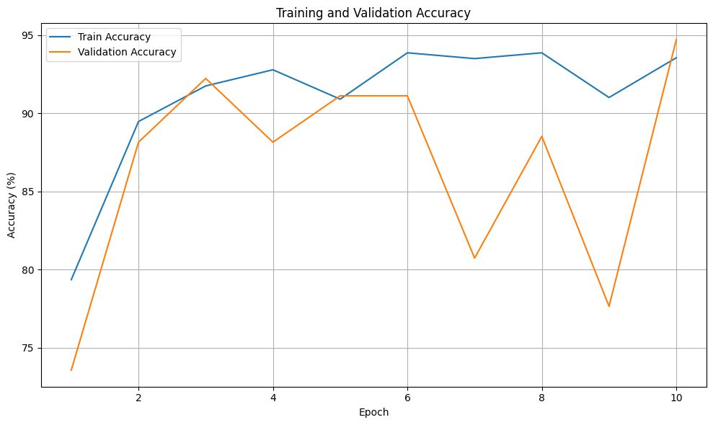
Results
• Test Accuracy: ~89–92%
• High precision, recall, and F1-score
• Strong generalization across classes
Notes:
Our model achieved around 90% test accuracy. Precision, recall, and F1-scores were consistently high, indicating that the model could generalize well across different land cover classes.

Slide 7
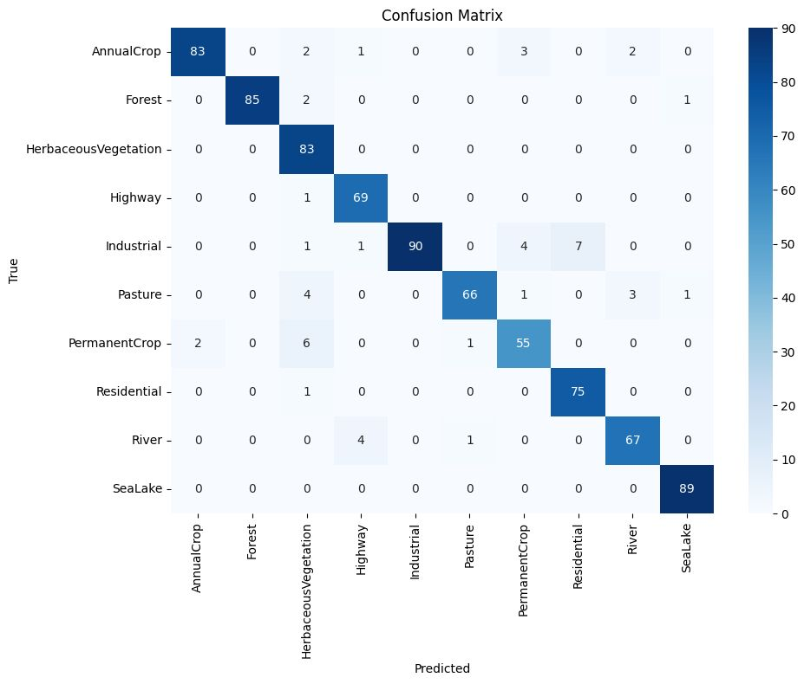
Confusion Matrix
• Strong performance
for Forest, SeaLake
• Minor confusion
for similar classes
Notes:
This is our confusion matrix. As shown, most classes are correctly predicted, especially dominant ones like Forest and SeaLake. There is slight confusion between visually similar classes, which is expected.

Slide 8
Conclusion & Future Work
• CNNs + Transfer learning = Effective
• EuroSAT + ResNet-18 gave strong results
• Future:
- Test deeper models
- Use advanced augmentation
- Larger deployment
Notes:
In conclusion, we demonstrated the effectiveness of CNNs with transfer learning for remote sensing classification. Future work could involve testing with deeper architectures and exploring advanced augmentation methods to push performance even further.

Slide 9
THANK YOU

