Slide 1

M.Tech Computer Science and Engineering
IIT Jodhpur
Group No.: 44 - MINI PROJECT
Software and Data Engineering
“ETL pipeline for Sales Data Analysis using Google cloud”
Richard David Vishwanath Singh Sachin Singh
M24CSE019 M24CSE030 M24CSE033

Slide 2
Contents
Problem Statement
Introduction
Overview
Cloud based Implementation
Non-Cloud Implementation
Comparison
Conclusion

Slide 3
Problem Statement
It is tasked with creating a data pipeline to extract sales data from various sources, mask sensitive information within the data, and load it into BigQuery. Additionally, a dashboard must be developed to visualize sales data securely.
Requirements:
Data Extraction: Extract sales data from multiple sources such as databases, CSV files, or APIs.
Data masking: Identify sensitive information within the sales data, such as phone number numbers, address, and personal information.
Data Loading into BigQuery: Design a process to securely load the extracted and masked sales data into Google BigQuery.
Dashboard Visualization: Develop a web-based dashboard using visualization tools (e.g., Google Data Studio, Tableau, or ca dashboards).

Slide 4
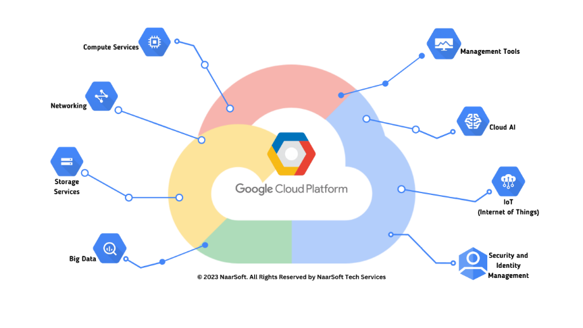
INTRODUCTION
This project focuses on building a comprehensive sales data pipeline leveraging Google Cloud Platform for automated data processing, transformation, and visualization. The pipeline ensures data privacy by incorporating techniques like data masking, while efficiently handling large-scale datasets through Cloud Composer, Cloud Data Fusion, BigQuery, and Looker Studio. Additionally, a non-cloud implementation using PySpark and Matplotlib was developed for comparison, demonstrating an alternative approach for smaller datasets or limited-resource environments. The project highlights the strengths and limitations of both cloud and non-cloud solutions, offering insights into their applicability based on different business needs.

Slide 5
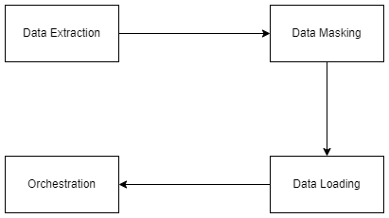
Overview
The project aims to perform the following tasks:
Data Extraction: Extract data using python.
Data Masking: Apply data masking & encoding techniques to sensitive information in Cloud Data Fusion before loading it into BigQuery.
Data Loading: Load transformed data into Google BigQuery tables.
Orchestration: Automate complete Data pipeline using Airflow (Cloud Composer )

Slide 6
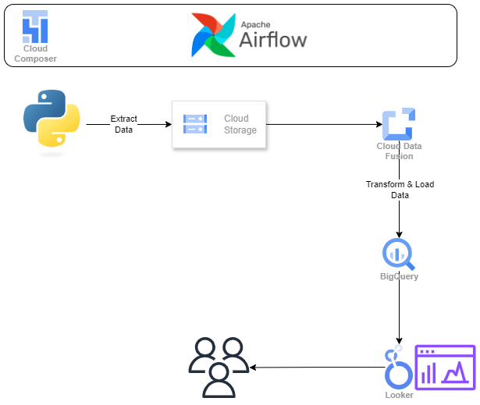
Cloud based Implementation
Apache Airflow (Cloud Composer)
Data Extraction (Python)
Cloud Storage (Cloud Bucket)
Cloud Data Fusion (Wrangler)
Data Loading (BigQuery)
Data Visualization (Looker)
6

Slide 7
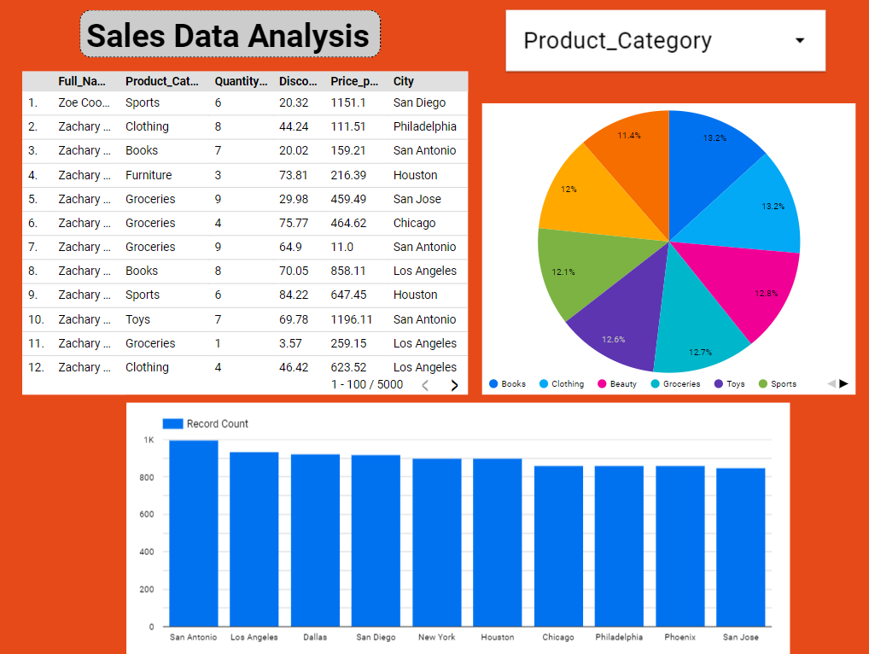
Result
7

Slide 8
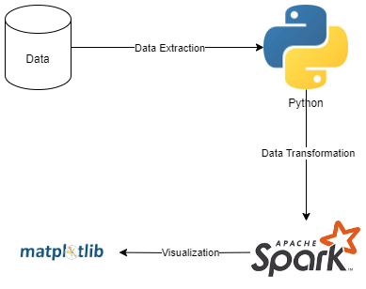
Non-Cloud Implementation
Data Extraction (Python):
PySpark
Data Visualization (Matplot):

Slide 9
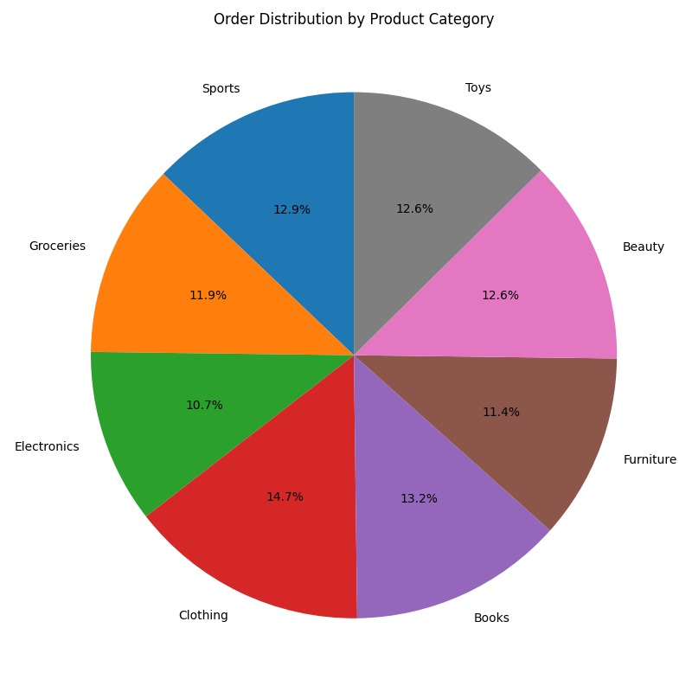
Result
9

Slide 10
Comparison
Aspect | Cloud Platform | Non-Cloud Implementation
Scalability | Highly scalable; handles large datasets with automatic resource allocation (e.g., GCS, BigQuery). | Limited by local hardware (CPU, memory, storage); performance degrades with large datasets.
Automation & Workflow | Automated with Cloud Composer (Airflow); schedules and orchestrates tasks with minimal manual intervention. | Lacks automation; requires manual script execution or complex local scheduling tools (e.g., cron jobs).
Data Security & Privacy | Built-in security (encryption, IAM, VPC); Cloud Data Fusion supports data masking and compliance with industry standards. | Depends on local infrastructure and policies; lacks built-in security features, increasing risk of data breaches.
Real-Time Data Processing | Real-time data querying and analytics with BigQuery; Looker Studio provides live, interactive dashboards. | Lacks real-time processing; data is manually processed in batches, and visualizations are static with no live updates.

Slide 11
Comparison
Aspect | Cloud Platform | Non-Cloud Implementation
Cost Efficiency | Pay-as-you-go pricing model; cost-effective as resources are scaled gradually based on need. | No direct infrastructure costs beyond local hardware, but upgrades for larger datasets can be expensive.
Data Visualization | Dynamic, real-time dashboards via Looker Studio; ideal for collaboration and live data interaction. | Static visualizations via Matplotlib (e.g., pie charts, bar graphs); limited to one-time reporting without real-time updates or interactivity.
Maintenance & Upkeep | Minimal maintenance; Google Cloud handles infrastructure updates, scaling, and security patches. | Requires significant local maintenance (hardware, software updates, performance monitoring); issues resolved manually.
Collaboration & Accessibility | Supports real-time collaboration; multiple users can access and interact with data from anywhere using BigQuery and Looker Studio. | Restricted to local environment; requires manual export for sharing, leading to version control issues and inefficient workflows.

Slide 12
Thank You

