Slide 1


Java-Based Quiz Application with MySQL Database Using Virtualized Infrastructure
Virtualization and Cloud Computing
Assignment 1
A VirtualBox-Based Implementation
By:
Sachin Singh
M24CSE033

Slide 2
Requirement
Create and configure multiple Virtual Machines (VMs) using VirtualBox, establish a network between them, and deploy a microservice-based application across the connected VMs.

Slide 3
Introduction
This project is a Java-based Quiz Application that uses MySQL as a backend database, running in a virtualized environment using VirtualBox. It is designed to allow users to take quizzes, track their scores, and manage questions via an admin panel.

Slide 4
Project Overview
The Java Quiz Application (JFrame UI) runs on VM1.
The MySQL database (MariaDB) is hosted separately on VM2.
Communication between VMs happens over an internal VirtualBox network using JDBC.
Users can register, take quizzes, and view scores, while admins can manage questions.

Slide 5

Technology Stack
Programming Language
Java (Jframe)
Database
MySQL (MariaDB)
Database Connection
JDBC
Virtualization
Virtualbox
OS
Debian Linux
Development Tool
VS Code

Slide 6
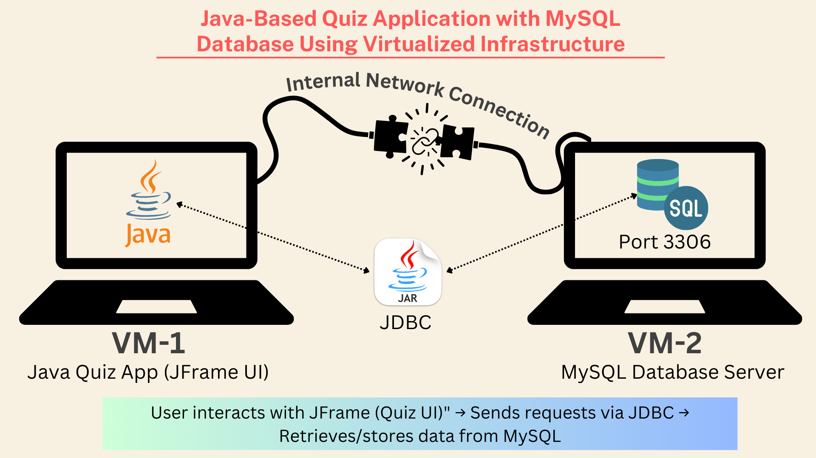
System Architecture

Slide 7
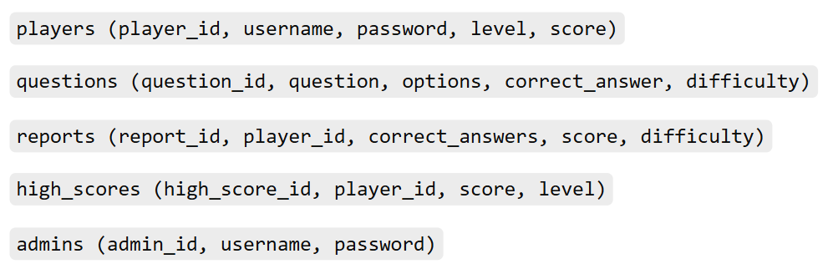
Database Schema

Slide 8
Implementation

Slide 9
Sachin Singh M24CSE033
Thank You
m24cse033@iitj.ac.in

