Slide 1
Agile Introduction
Vassilka Kirova (kirova@alcatel-lucent.com)
https://web.njit.edu/~kirova/ppt/Agile_Intro_Resources.ppt

Slide 2
Agenda
Introductory topics:
  What is Agile?
  Why is Agile important?
  How hard is it to be Agile?
Iterative development
Notes:
“What is Agile” is a difficult question. It is both a philosophy and a set of software development practices.
“Why is Agile important” is a good question for an introductory course. The simple answer: Agile is a good way to make software product more responsive to customer needs – saving effort and money as a side effect.
“How hard is it to be Agile” is a deep question. It generally very easy to use agile methods for small software products and with small development teams. For larger products and cross-location teams, it is still possible to apply many agile practices – but there will be more organizational obstacles.

Slide 3
Agile Basics

Slide 4
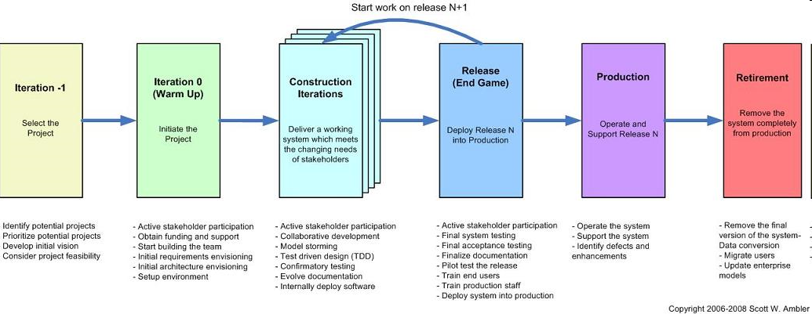
Agile Development – What does it mean?
Agile is a set of practices, values, and principles for software product development.
In software product development, we think about “methodologies,” “activities,” “interactions,” “results, work products or artifacts;” we think about “processes” that we use to organize the work:
  documents
  meetings and reviews
  diagrams and models
  coding and user documentation standards
So will Agile Development define a new set of process activities? Not necessarily.
Notes:
The main tasks of software development are still the same in Agile development – but the flow of activities will look a lot different.

Slide 5
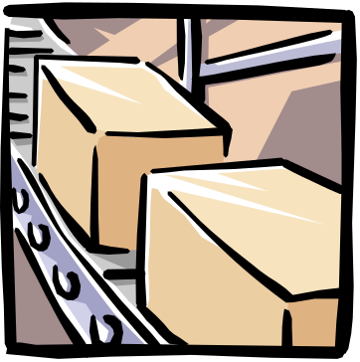

What is Agile? (Agile vs. Sequential Models or Frameworks)
Many of us are familiar with the Waterfall Model – it is a “framework” for the software development process
  Waterfall Model talks about “development activities through time”
  Waterfall Model talks about “teams of people”
Development activities | Teams
Divide the work into stages | A separate team of specialists for each stage
At each stage, the work is passed from one team to another | Some coordination is required for the handoff from team to team – using “documents”
At the end of all of the stages, you have a software product ready to ship | As each team finishes, they are assigned to a new product
Notes:
The main ideas of Waterfall:
Each of the development activities is a separate “stage” – with a “gate” that they must pass at the end of the stage
We can think of team of specialists as working at its own station on a factory assembly line
Waterfall can be thought of as an “efficient” process because the work is structured in a way that allows each team to be reassigned to other projects when their part of the project is complete.
Unfortunately, this doesn’t always work so well. The communication between teams is usually imperfect and inefficient. It is a lot of work to create “complete” documentation at each stage of the process, and if the requirements or architecture teams have moved on to other projects, the design/development and test teams might not be able to get their questions answered promptly.
If there are late requirements and architecture changes, the waterfall process has even more overhead costs – documents need to be updated, re-reviewed, and approved in order to conform to the overall process.

Slide 6

What is Agile? (continued)
The core ideas in Agile Development:
  Adaptive
  Iterative/incremental
  People-oriented
Adaptive means that the teams and the process should be flexible in the presence of “rapid-fire change”.
Iterative and incremental means that Agile Development produces working products in stages – a growing set of “completed and working software”.
People-oriented means the team organization and processes will support good people, who are the most important ingredient to project success.
Notes:
The list of “core ideas” is from this paper -- Noura Abbas, Andrew M. Gravell, and Gary B. Wills, “Historical Roots of Agile Methods: Where Did “Agile Thinking” Come From?” Proceedings of XP 2008, pp. 94-103.
In theory, the Waterfall Model could be used in an Adaptive and People-oriented way. In practice, however, Waterfall projects are pretty rigid and bureaucratic.
(It is interesting that most manufacturing work has been moving away from the old-fashioned rigid assembly line techniques of the early twentieth century – because management has found that they can get better quality and productivity with cross-trained cross-functional teams. So why are “knowledge workers” (software professionals) are often managed in a more assembly-line style than factory workers?)

Slide 7
Iterative development
One way to organize agile development is using short iterations:
Each iteration
might be 4 weeks
iteration
planning
iteration
1
iteration
2
iteration
3
iteration
4
iteration
5
iteration
6
Today
Ship date
Internal prototype (demo 1)
Customer-viewable prototype (demo 2)
Customer-viewable prototype (demo 3)
Each iteration step:
  has some analysis, some design, some coding, some integration and testing
  executed by a cross-functional team
  delivers some kind of internally or externally usable functionality – intermediate demos or deliveries are possible!
Question:
  Could we do a “demo” every iteration?
  Absolutely yes! The team gets practice at doing system integration
Notes:
Why iteration? It gives the development team a chance to change course several times during the course of development.
In this example, with six iterations of 4 weeks each, the team can take a breath and say “we are done with part of the system” six times during a 24-week period – and they should be able to demonstrate that they have implemented some real customer-visible functionality. Then the team can ask some most important questions:
“Are we building the right things?”
“Will the performance be adequate for the customer?”
“Can we find some tools, components, architecture changes, or development process changes that can improve the rest of the development work?”

Slide 8

Main characteristics of Agile Development
Agile Development as a “software development framework” says:
  keep things small
  deliver partially-completed software frequently
  talk to the customer often
  write more code than documentation
  everyone on the team learns together
Every 4 weeks, produce a new shippable product
Work for the
current
iteration
Work for future
iterations
Notes:
Planning in Agile development:
The most detailed plans are for the current iteration
The work for future iterations can be adjusted after talking with the customers
No “big design document” – because the future work might change, depending on the customers’ priorities
In a good Agile project, the team “gets into a rhythm” – delivering a set of new features every cycle

Slide 9




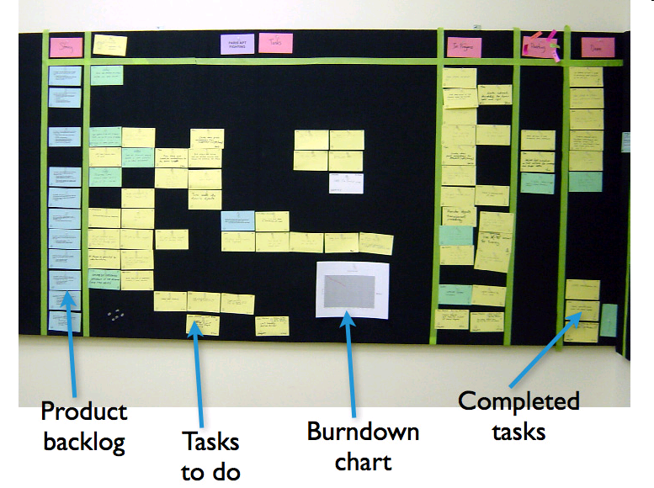
Agile Practices
There are many Agile practices:
  short timeboxed iterations
  continuous integration
  daily unit testing
  regular retrospectives
  direct communication between developers and the customer or a customer surrogate
  a single list of features and tasks
  short-term estimation of development tasks
  information radiators
  refactoring
Will you use every Agile practice? Maybe not…. they are not all required.
What is required? Agile values…
Check in changes
update build status
Continuous
Integration
Server
Product
Source code repository
(Subversion)
Developer workstations
Product Backlog Items for current Sprint
Notes:
This is a list of common Agile practices. Most of these practices have been used in a range of projects – from small web-based applications to embedded real-time systems to complex communications systems.
You don’t need to use every Agile practice to be an agile project. It is more important to understand the set of agile values and principles – and to use the values and principles to select a reasonable set of practices.

Slide 10

The Agile Manifesto: An Eloquent Statement of Agile Values or Goals
We are uncovering better ways of developing software by doing it and helping others do it. Through this work we have come to value:
  Individuals and interactions over processes and tools
  Working software over comprehensive documentation
  Customer collaboration over contract negotiation
  Responding to change over following a plan
That is, while there is value in the items on the right, we value the items on the left more.
Agile Alliance: http://www.agilealliance.org
Kent Beck
Mike Beedle
Arie van Bennekun
Alistair Cockburn
Ward Cunningham
Martin Fowler
James Grenning
Jim Highsmith
Andrew Hunt
Ron Jeffries
Jon Kern
Brian Marick
Robert Cecil Martin
Steve Mellor
Ken Schwaber
Jeff Sutherland
Dave Thomas
© 2001, the above authors
this declaration may be freely copied in any form,
but only in its entirety through this notice.
Notes:
Most of you have seen the Agile Manifesto. It is a brilliant document, and we let it speak for itself here. Let me ask you a couple of things about the Manifesto:
What does it say about iteration?
What does it say about customer satisfaction with the product?
What new things does it tell you to do that you are not already doing?
What are the consequences of using processes, tools, documentation, contracts, and plans?
You get the idea. The Manifesto is a framework for thinking about what you value; it is not a framework that you can fill in according to your needs.
It is nonetheless a firm starting point for Scrum—which itself is a framework that guides you and you can fill in. However, don’t leave your brains behind: you will need your wits just as much as a Scrum practitioner as an Agile fan.

Slide 11
Individuals and Interactions over Processes and Tools
People are the most important ingredient of success.
A good process will not save a project from failure if the team doesn't have strong players, but a bad process can make even the strongest of players ineffective.
A strong player is not necessarily an ace programmer. A strong player may be an average
programmer but someone who works well with others.
A team of average programmers who communicate well are more likely to succeed than is a group of superstars who fail to interact as a team.
The right tools can be very important to success. Compilers, interactive development environments (IDEs), source code control systems, and so on, are all vital to the proper functioning of a team of developers. However, tools can be overemphasized. An overabundance of big, unwieldy tools is just as bad as a lack of tools.
<number> | RDC presentation |June 2009

Slide 12
Working Software over Comprehensive Documentation
Software without documentation is a disaster. Code is not the ideal medium for communicating the rationale and structure of a system. Rather, the team needs to produce human-readable documents that describe the system and the rationale for design decisions.
It is always a good idea for the team to write and maintain a short rationale and structure document. But that document needs to be short and salient.
The two documents that are the best at transferring information to new team members are the code and the team.
Many teams have gotten hung up in pursuit of documentation instead of software. This is often a fatal flaw. There is a simple rule that prevents it:
Martin's First Law of Documentation
Produce no document unless its need is immediate and significant.
<number> | RDC presentation |June 2009

Slide 13
Customer Collaboration over Contract Negotiation
Software cannot be ordered like a commodity. You cannot write a description of the software you want and then have someone develop it on a fixed schedule for a fixed price.
Time and time again, attempts to treat software projects in this manner have failed.
Successful projects involve customer feedback on a regular and frequent basis.
Rather than depending on a contract, or a statement of work, the customer of the software works closely with the development team, providing frequent feedback on its efforts.
The best contracts are those that govern the way the development team and the customer will work together.
<number> | RDC presentation |June 2009

Slide 14
Responding to Change over Following a Plan
The ability to respond to change often determines the success or failure of a software project.
When we build plans, we need to make sure that they are flexible and ready to adapt to changes in the business and technology.
The course of a software project cannot be planned very far into the future.
  First, the business environment is likely to change, causing the requirements to shift.
  Second, once they see the system start to function, customers are likely to alter the requirements.
  Finally, even if we know what the requirements are and are sure that they won't change, we are not very good at estimating how long it will take to develop them.
It is tempting for novice managers to create and tape to the wall a nice PERT or Gantt chart of the whole project.
A better planning strategy is to make detailed plans for the next week, rough plans for the next 3 months, and extremely crude plans beyond that.
<number> | RDC presentation |June 2009

Slide 15
Agile principles
1. Our highest priority is to satisfy the customer through early and continuous delivery of valuable software.
5. Build projects around motivated individuals. Give them the environment and support they need, and trust them to get the job done.
9. Continuous attention to technical excellence and good design enhances agility.
2. Welcome changing requirements, even late in development. Agile processes harness change for the customer's competitive advantage.
6. The most efficient and effective method of conveying information to and within a development team is face-to-face conversation.
10. Simplicity--the art of maximizing the amount of work not done--is essential.
3. Deliver working software frequently, from a couple of weeks to a couple of months, with a preference to the shorter timescale.
7. Working software is the primary measure of progress.
11. The best architectures, requirements, and designs emerge from self-organizing teams.
4. Business people and developers must work together daily throughout the project.
8. Agile processes promote sustainable development. The sponsors, developers, and users should be able to maintain a constant pace indefinitely.
12. At regular intervals, the team reflects on how to become more effective, then tunes and adjusts its behavior accordingly.
Notes:
http://www.agilemanifesto.org/principles.html

Slide 16
Requirements process
There is no “standard way” to do requirements in Agile development
  Could be a normal “Software Requirements Document”
  But it is better to be more lightweight
One way to do requirements:
Start with a much slimmer “initial requirements document” at the beginning of the iterations…
  Initial list of overall “systems capabilities” – written in the form of User Stories
  Plus a section containing “global non-functional requirements” (security, reliability, performance, usability, etc.)
The list of system capabilities and global non functional requirements will be the first draft of the SRD.
In each iteration, elaborate a small set of the functional requirements (the high-priority behavior)
  This avoids creating a big requirements document too soon
  A good strategy is to delay writing most of the “fine details” in the requirements until the iteration when they will be implemented
  Why? Because you will have learned more about the problem…
For some key requirements, create some acceptance tests at the same time as you write the requirements
<number> | Agile Intro | June 2010
Notes:
User stories, scenarios, and use cases are popular methods of writing lightweight requirements – you write stories of how the system will be used from the viewpoint of one of the users. It is a “scenario-based” requirements technique, and it always uses vocabulary that makes sense to the customer.
A good requirement / use case / user story is never really “complete” – it is just an outline of what should happen, and it can’t possibly cover all possible errors and branches. But – scenarios are a good thing to focus on during discussions with the customer. A good agile team member will get the customer to talk about some of the alternatives that weren’t listed in the original requirement.

Slide 17
Agile – questions and challenges?
  Documentation – it is still important in an Agile project.
    If it is the only kind of communication in your project, it isn’t good
    Real working code is more valuable than documents – less ambiguous
    Documents – easy to leave something out, easy to misinterpret
  Development plans – also important in an Agile project
    the format of an Agile development schedule is a bit different from a conventional project plan.
    Development plan includes “iterations”
    Each iteration gives the team has a chance to incorporate what they learn, rather than just following a non-adaptive plan
  Contracts – we expect to have contracts, but we need to talk with the customers as well.
    Customer collaboration is one way to reduce development costs
    Do you want to deliver “everything” the customer asked for in the original contract? No – if the customer no longer needs it, the extra code will increase maintenance costs
    Always ask: Who needs this feature and how does it contribute to the value of the product?
Notes:
Documentation is not necessarily contrary to Agile values. You should think about keeping the process lightweight -- eliminating documentation that isn’t providing value. Scott Ambler has some interesting thoughts about what kinds of documentation make sense in an agile environment:
http://www.agilemodeling.com/essays/agileDocumentation.htm
Iterative development changes the way that development planning is done. In Agile methodologies such as Scrum, there is an organized way of doing adaptive planning, and there is a special vocabulary for describing both long-term and short-term plans
http://www.mountaingoatsoftware.com/product-backlog
http://www.mountaingoatsoftware.com/sprint-backlog
Alistair Cockburn has some good ideas about how to use Agile development techniques for situations such as fixed-price, fixed-scope contracts:
http://alistair.cockburn.us/Agile+contracts

Slide 18
Why is Agile Development important?
The world is a lot different today. A large feature set might only increase costs for the customer.
  There is a constant introduction of new technology
  New players enter the market,
  New requirements are added
  “Small is Beautiful”
  If we are listening to the customer, we will reduce our chances of being “blindsided” by a smaller, more flexible competitor
  Anything that helps reduce maintenance costs will contribute to the bottom line
Notes:
What is more important – delivering hundreds of features in a product, or delivering just the right set of features to meet your customer’s greatest needs? The answer is not obvious. But here is one consideration:
A product with a lot of features can be costly to deploy and costly to maintain. In today’s market, our customers are often looking to reduce their internal training and deployment costs – so it might be better to forget about delivering 92 features in a release… just think about the 16 features that are needed to implement the top 5 use cases.
If you develop a product with a small but well-coordinated feature set, you might be able to get it on the market faster – beat the competition.
Here are a few good articles on the benefits of keeping your code small:
“Keep It Small” by Jack Ganssle - http://www.ganssle.com/articles/keepsmall.htm
“Less Software” (from the online book Getting Real ) - http://gettingreal.37signals.com/ch10_Less_Software.php
“Small is Beautiful” by John Mashey (slides from an ACM talk in the late 1970s) -- http://www.usenix.org/events/bsdcon/mashey_small/

Slide 19
How hard is it to be Agile?
“Don’t do Agile, be Agile”
  Just doing “development in iterations” isn’t enough
Agile Development is about:
  Keeping the process lightweight
  Making real progress in each iteration
  Communicating – face-to-face when possible
  Actively gathering customer input – early and often
  Being willing to make minor changes to your process
Notes:
What does it mean to “Be Agile”?
“Agile is not a practice. It is a quality of the organization and its people to be adaptive, responsive, continually learning and evolving – to be agile, with the goal of competitive business success and rapid delivery of economically valuable products and knowledge.” (Craig Larman and Bas Vodde, Scaling Lean & Agile Development, Chapter 6.)
There are a number of Agile practices – you can “do iteration”, “do continuous integration”, “do automated testing”, “do regular customer demos”, and “do regular retrospectives”. These practices will help you be more adaptive and responsive.

Slide 20
Thank You…..
<number> | RDC presentation |June 2009

