Slide 1
Short-Term Load Forecasting
Using ML & Statistical Methods

Slide 2
Load Forecasting:
Forecasting is a technique which uses historical data as input to make informed estimates that are predictive in determining the direction of future trends.
Time series forecasting model is used to make predictions of future load consumptions based on past observations, consumer behaviour and to meet demand-supply equilibrium.
Short-Term Load Forecasting – ( on an hourly basis to one week in advance for daily operation and cost minimization)
a) General algorithms :( Naïve approach, Moving average, Holt’s models, and Simple Exponential Smoothing)
b) Non-traditional algorithms: ( ARIMA, SARIMA, FFNN and LSTM )

Slide 3
Role of Short-Term Load Forecasting:
short-term load forecasting helps in various decision making :
Supply Planning
Generation Reserve
System Security
Dispatching and Scheduling
Demand-side Management
Financial Planning

Slide 4
Factors affecting Short-Term Load Forecasting:
Time Factors such as:
1) Time hours ( day/night)
2) Days of the week (weekdays/weekend)
3) Time of the year (season)
Weather Factors such as :
1) Temperature
2) Humidity
Other factors such as:
1) Customers Behaviours
2) Resident Schedules
3) Special Events
4) Electricity Rate

Slide 5
Data set:
Past Data points collected from following site and converted into suitable structure:
https://www.ema.gov.sg/statistic.aspx?sta_sid=20140826Y84sgBebjwKV
The above link pasted here provides past electricity load (energy demand) values in MW unit within interval of 30 minutes.
Features used:
1) Date of the Week
2) Time of the Day
3) Electricity Load Value ( Actual Demand)

Slide 6
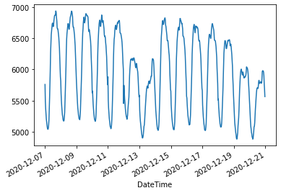
Data set For Interval (7-12-2020 to 20-12-2020):
Below figure describes time series data for the time interval of 30 minutes:

Slide 7
Forecasting Methods:
These are traditional and non-traditional algorithms we implemented on our data set and got the results.
Naïve Approach
Moving Average
Simple Exponential Smoothing
Holt’s Linear Trend
Holt’s Winter Model
ARIMA
Feed Forward Neural Network
Long Short Term Memory

Slide 8
Forecasting Methods:
Naïve Approach : In this method we assume next expected value is equal to last observed value.
Moving Average : In this method we take average of last few data points. We used python’s rolling window method, in which we keep window size of 3 data points.
Simple Exponential Smoothing : In this forecasting technique, we assign weights to past observations.
f_{t} = α * (Y_{t}) + (1 − α)*f_{t-1}
Where Y_{t} is recent observation and f_{t-1} is last forecast.
Y_{t+1} = α*Y_{t} + α * α-1 * Y_{t-1} + …..
These methods are useful for data containing no trend, no seasonality.

Slide 9
Forecasting Methods:
Holt’s Linear Trend Model :
In this method we forecast the values by capturing the trend. Equations are as follows:
u_{t} = α*y_{t} + (1 − α)*(u_{t-1} + v_{t-1})
v_{t} = β*(u_{t} − u_{t−1}) + (1 − β)*v_{t−1}
y_{t+h|t} = u_{t} + h*v_{t}
Where α and β are smoothing constants, lies between 0 ≤ α,β < 1.
u_{t} is level updating equation.
v_{t} is trend capturing equation.
Last equation is forecast equation for the time interval h.
If time series data contain only trend then this method is useful.

Slide 10
Holt’s Winter Model:
In this method of forecasting we forecasted future values by capturing trend and seasonality.
Equations are follows:
l_{t} = α*(y_{t} − s_{t}−m) + (1 − α)*(l_{t−1} + b_{t−1})
b_{t} = β(l_{t} − l_{t−1}) + (1 − β)(b_{t−1})
s_{t} = γ*(y_{t} − l_{t−1} − b_{t−1}) + (1 − γ)*s_{t−m}
y_{t+h|t} = l_{t} + hb_{t} + s_{t+h−m(k+1)}
where α ,β, γ are smoothing constants.
l_{t} represents level updating equation.
b_{t} represents trend capturing equation.
s_{t} represents seasonality capturing equation.
h is time interval, m is seasonal periods and k is integral part of (h-1/m).

Slide 11
Auto-Regressive Integrated Moving Average (ARIMA):
Auto-Regression(AR): In this model we forecast the variable of interest using its past values i.e. regression against itself.
y_{t} = c + φ₁y_{t−1} + φ₂y_{t−2} + ... + φ_{p}y_{t−p} + ε_{t}
Integrated(I): To make time series data stationary we use differencing technique, order of differencing is denoted by d.
Moving Average(MA): In this method we forecast values by using linear function of past errors.
y_{t} = c + ε_{t} + θ₁ε_{t−1} + θ₂ε_{t−2} + ... + θ_{q}ε_{t−q}
Our data contains seasonality, with the help of “autoarima” library we get the best model fit and implemented SARIMA model of appropriate order.

Slide 12
Feed Forward Neural Network(FFNN):
Artificial Neural Network, which is a multi-layer perceptron, consists of an input layer, one or more hidden layers and an output layers.
Here we feed sequential data to our model architecture which consists of two dense layers with ‘relu’ as activation function, and one output layer without any activation function.
Optimization algorithm used to reduce loss is “ADAM” (adaptive moments).
We converted our data into sequential format and then feed it to our model architecture, trained it for 25 epochs and make predictions on required time interval.
Evaluation metric used for model performance is RMSE, and it’s value is within good range.

Slide 13
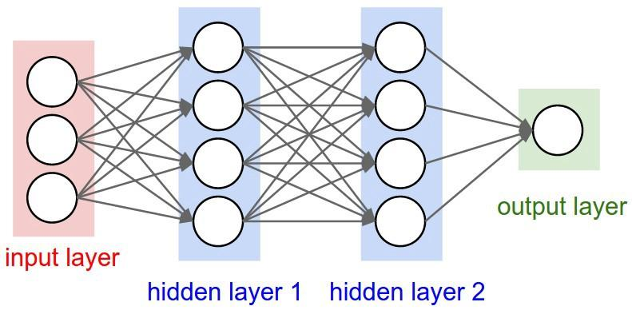
Model Architecture of FFNN:

Slide 14
Long Short Term Memory (LSTM):
Our time series data contain trend and seasonality, we can say that it has to be remembered.
To remember previous information, an efficient neural network is available to us which is basically a generalization of FFNN.
LSTM is a recurrent neural network, which solves following problems which occurs in ordinary RNN quite efficiently:
1) Exploding Gradient Problem
2) Vanishing Gradient Problem
Exploding gradient problem is easier to handle, as we are interested only in direction of gradient, we can normalize the gradient or we can clip the gradient

Slide 15
Long Short Term Memory (LSTM):
Vanishing gradient problem is overcome with the help of concept of gates.
LSTM remembers information over a long period of time with the help of its memory, called gated cell.
This gated cell decides which information has to be retained, has to be add newly and has to be forget.
This is done by assigning weights to the information, which are learned by learning algorithm.

Slide 16
Long Short Term Memory (LSTM):
LSTM cell consists of three gates:
1) Input Gate
2) Forget Gate
3) Output Gate
Input gate decides which information has to retain and which new information has to add on.
Forget gate decides which information is not important and delete it.
Output gate decides which information allows to make impact on the output.
We implemented LSTM networks in python using “Keras” library.
We evaluated model’s performance using metric root mean squared error (RMSE). We got RMSE value within good range.

Slide 17
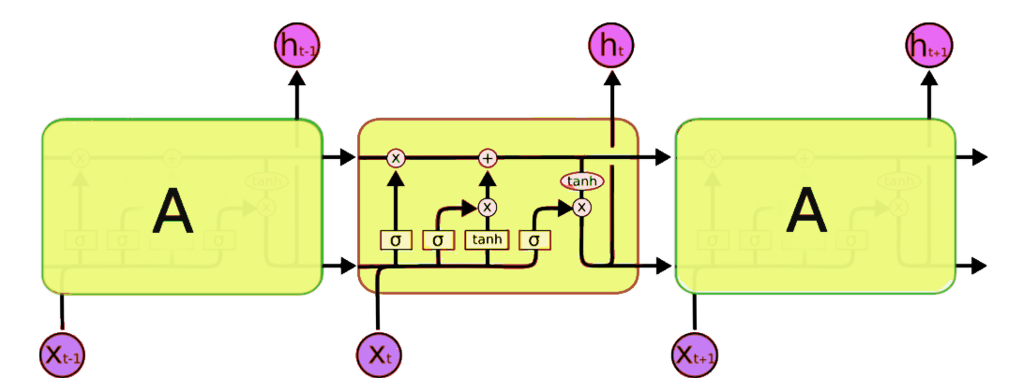
Model Architecture of LSTM:

Slide 18
Methodology:
We collected data from Energy market authority of Singapore. Data restructured such that we can use it properly for our algorithms.
For traditional algorithms (Naïve approach, Moving average, Simple Exponential Smoothing and Holt’s linear trend and Holt’s winter model), we split our dataset into three parts train set, validation set and test set.
We trained our models on train set and see results on validation set if model’s performance was good on validation set then we forecast vales on test dataset.
For Non-traditional algorithms (ARIMA, FFNN and LSTM), we spit our data set into train and test data set.
We trained our models on train data set and forecasted values on test data set.
We evaluated performance of each model using metric root mean squared error (RMSE) value.

Slide 19
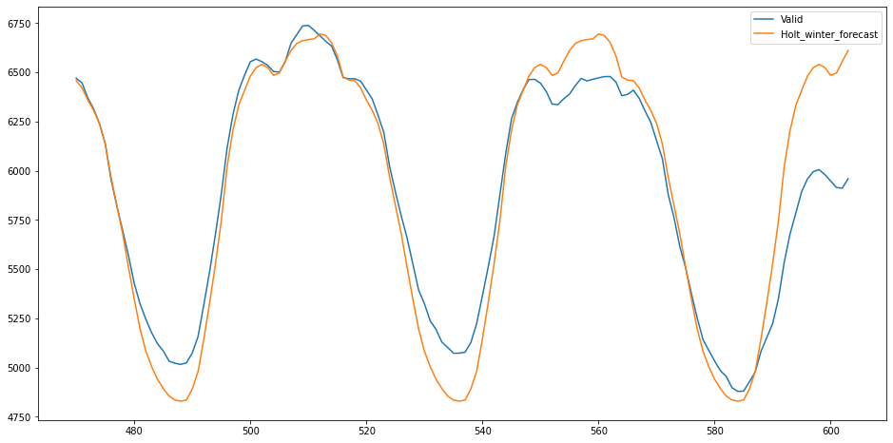
Results:
Holt’s winter model performance is shown in following figure with RMSE value is 209.2447.

Slide 20
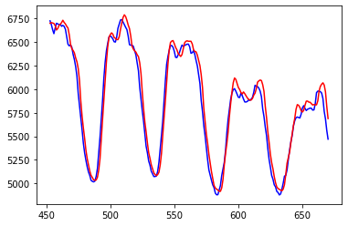
Feed Forward Neural Network’s Performance:
FFNN model performed well on our dataset and RMSE value is 52.54.

Slide 21
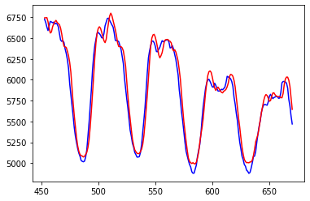
Long Short Term Memory (LSTM) Performance:
LSTM performed well on our data set and RMSE value is 65.61.

Slide 22
Conclusion:
We implemented different algorithms on our data set and obtained results. Among them Holt’s Winter Model, Feed Forward Neural Network Model and Long Short Term Memory Model performed well on our data set.
Evaluation of Model’s Performance was done using metric root mean squared error (RMSE) value.
RMSE value for Holt’s winter model is quite high, and for FFNN model and LSTM model is within good range.
Further we can increase model’s performance by incorporating weather parameters and increasing size of data set.

Slide 23
References:
[1] S. N. Fallah, M. Ganjkhani, S. Shamshirband, K.-w. Chau, Computational intelligence on short-term load forecasting: A methodological overview, Energies 12 (3) (2019) 393.
J. Moon, S. Park, S. Rho, E. Hwang, A comparative analysis of artificial neural network architectures for building energy consumption forecasting, International Journal of Distributed Sensor Networks 15 (9) (2019) 1550147719877616.
[3] T. Yang, Electric load forecasting using long short-term memory algorithm. @MastersThesisyang2019electric, author = Yang, Tianshu, title = Electric Load Forecasting Using Long Short-term Memory Algorithm, year = 2019

