Slide 1
Introduction to Rails

Slide 2
Objectives
Quick Intro to Ruby
Learn what Rails is about
MVC
Walk through Rails directories and structures
Create a simple Rails app
Learn about Gems
Learn about ActiveRecord
Build a more complicated app

Slide 3
Ruby
Ruby is a dynamic object oriented language
It was created around 1995 by Matsumoto (Matz)
Was mostly an obscure language until the release of Rails
Ruby’s syntax is similar to python

Slide 4
Intro to Rails
Rails is framework built using the Ruby programming language
Rails is currently in version 4, although version 5 is coming out soon
Rails has been around for almost 9 years now and has a very mature ecosystem and a large community of developers around it
Rails stress “Convention over Configuration” philosophy
Rails is based on the MVC paradigm

Slide 5
MVC
MVC stands for Model – View – Controller
It is a software engineering pattern that has been around a while but gained popularity with Rails
MVC allows us to separate our pieces of code into areas of responsibilities
MVC pattern is very common now among many other frameworks
We will discuss each component of MVC in detail in the following slides.

Slide 6
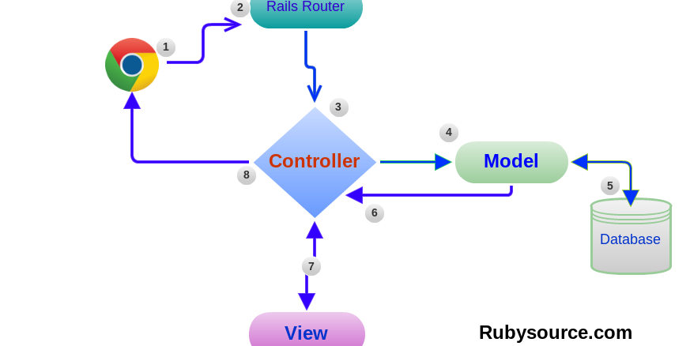
MVC - Diagram

Slide 7
MVC - Model
Model is the data layer
A model is a representation of your tables
It’s only job is to represent the data, and nothing else.
Example: User model in your application represents the users table
In Rails, by convention, models are singular

Slide 8
MVC - View
This is the layer that your user sees
View interacts with your controller
It can interact with your model but generally should not
In rails, the view file names are correlated with the action names in the corresponding controller

Slide 9
MVC - Controller
Controller ties the view and models together
Controller is the “brain” behind the application
Generally a model has a controller attached to it
Each controller also has a set of views attached to it
In rails, the controller is plural. Ex: users_controller
The action/method in the controller corresponds to the filename of the view

Slide 10
Gems
Gems are libraries for ruby
Huge community of developers build and release gems for public use
Thousands of gems such as authentication, database adapters, forms, styling, mailers, etc
Gems are listed in the Gemfile
You need to run bundle install to install any new gems
Some popular gems include: devise, simple_form, pry

Slide 11
ActiveRecord
ActiveRecord is an Object Relational Mapping (ORM) for Rails
It wraps around SQL (and non SQL calls)
There are adapters for many major databases
AR can be used for creating, reading, updating, and deleting (CRUD) records
AR also provides validation methods that checks and validates records before writing to the database
Callbacks are built into the lifecycle of the models

Slide 12
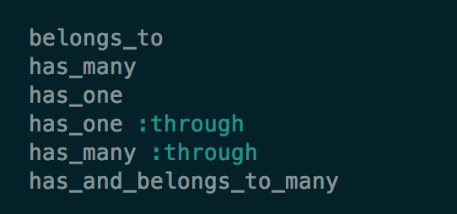
Assocations
Rails makes it easy to create associations between different models
These associations are:

Slide 13
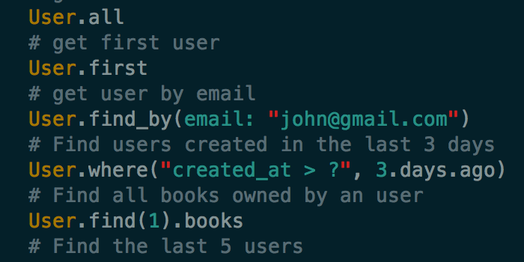
Sample AR Queries

Slide 14
Next Week
More rails, especially learning about complicated database queries
Building a simple dashboard using rails and javascript

