Slide 1
Rails Part 2

Slide 2
Agenda
Review last session
Learn about charting and grouping data
Learn about what scoping is
Create a simple dashboard
Access control for dashboard

Slide 3
Review
Create a new rails app
Create a page that is only viewable by an user
On the home page display every user’s name and email and total # of users

Slide 4
Dashboard App
Clone the repo
Install it and get it running
Navigate to the root URL
We will make it so only an admin can view the page

Slide 5
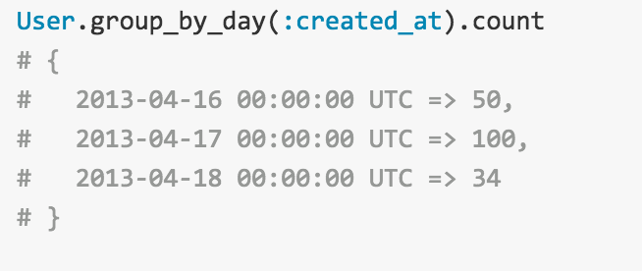
Groupdate
A gem that allows you to group records by date much easier
You can group by second, minute, hour, day, week, month, and year
To install just add gem ‘groupdate’ to your Gemfile
For sqlite3 groupdate won’t work so you need to use dateslices gem

Slide 6
Chartkick
It’s a charting gem that uses other charting libraries to create charts with one line of code
Has line charts, pie charts, country charts, bar, area and other charts
Works very well with groupdate gem
To install just add

Slide 7
Scope
Scope allows you to create simple method calls for commonly used queries
For example, you commonly query users with role of a tester created last 30 days. Regular query would be: User.where(“created_at > ?”, 30.days.ago).where(role: “tester”)
You can create a scope called new_testers and just call User.new_testers
You would create the scope in the user model

Slide 8
Conclusion
By now you have learned basics of how to build a simple app using rails
Rails is very powerful and we have only began to scratch the surface
You can build powerful dashboards using javascript libraries and rails

