Slide 1
EDGE-FIRST SECURITY ARCHITECTURE // TECHNICAL OVERVIEW
PySURVEILLANCE
Intelligent Edge Surveillance, Perimeter Defense & Threat Deterrence Console
⚡ Decoupled Edge Runtime
Autonomous Linux runtime (x86_64 / ARM64) with zero cloud reliance or monthly fees.
🧠 YOLOv8n ONNX Engine
Event-triggered 1.5 FPS neural classification via OpenCV DNN C++ runtime.
📹 Motion-Triggered Video
Instant frame-1 recording with 15s inactivity reset and 60s segment rotation.
🔒 Zero-Trust Cryptography
Salted PBKDF2-HMAC-SHA256 authentication, brute-force lockout, and RFC 1918 firewall.
PySURVEILLANCE Edge Platform | Hardware-Independent Intelligent Security | github.com/ss3325713/survelance
1 / 18

Slide 2
00 // EXECUTIVE SUMMARY
Traditional Surveillance vs. PySURVEILLANCE
Eliminating cloud subscription lock-in, latency bottlenecks, and invasive facial profiling.
❌ Legacy CCTV & Cloud Cameras
• High Bandwidth Drain: Uploads continuous uncompressed video to cloud data centers 24/7.
• Expensive Recurring Fees: Requires ongoing subscriptions for storage, playback, and AI detections.
• Critical Latency Delays: Cloud roundtrips delay intrusion alerts by 5 to 30 seconds.
• Invasive Facial Profiling: Feeds raw facial biometric data into proprietary training models.
• Single Point of Failure: An internet outage disables alerts, recording, and camera monitoring.
✅ PySURVEILLANCE Edge Platform
• Zero Cloud Dependence: 100% of processing, inference, and storage executes locally on host.
• Open Standards Architecture: Supports standard RTSP, HTTP/MJPEG, and Linear PCM WAV streams.
• Sub-50ms Edge Response: Immediate local threat classification and instant laptop speaker sirens.
• Strict Ethical Architecture: Zero biometric facial recognition; automatic privacy face blurring.
• Air-Gapped Resiliency: Fully functional without internet connection; isolated inside private LAN.
PySURVEILLANCE Edge Platform | Hardware-Independent Intelligent Security | github.com/ss3325713/survelance
2 / 18

Slide 3
SYSTEM ARCHITECTURE
Decoupled Multithreaded Pipeline Architecture
Zero dropped frames: Stream ingestion, neural inference, and video encoding operate in isolated queues.
1. Decoupled Ingestion & Hardware Telemetry
RTSP / H.264 / H.265:
Network CCTV feeds via OpenCV VideoCapture.
HTTP / MJPEG Feed:
High-framerate video stream (/video).
HTTP Linear PCM Audio:
Dedicated audio stream (/audio.wav).
Device Sensors Telemetry:
Battery, temperature, and AC status (/sensors.json).
2. Real-Time Core Engines (FastAPI Runtime)
CameraWorker:
Bounded frame queue preventing memory buildup.
OpenCV MOG2 Subtractor:
Instant pixel-level background motion evaluation.
FlashlightController:
Illumination automation in low-light environments.
AudioDetector:
Adaptive noise floor and RMS energy spike analysis.
3. Asynchronous Storage & Forensics Queue
VideoRecorder:
60s segment rotation with 15s inactivity reset.
SQLite video_jobs Queue:
Crash-resilient persistent background queue.
Laplacian Variance Filter:
Discards blurred frames to extract sharp keyframes.
YOLOv8n ONNX Engine:
CPU-optimized neural classification via OpenCV DNN.
PySURVEILLANCE Edge Platform | Hardware-Independent Intelligent Security | github.com/ss3325713/survelance
3 / 18

Slide 4
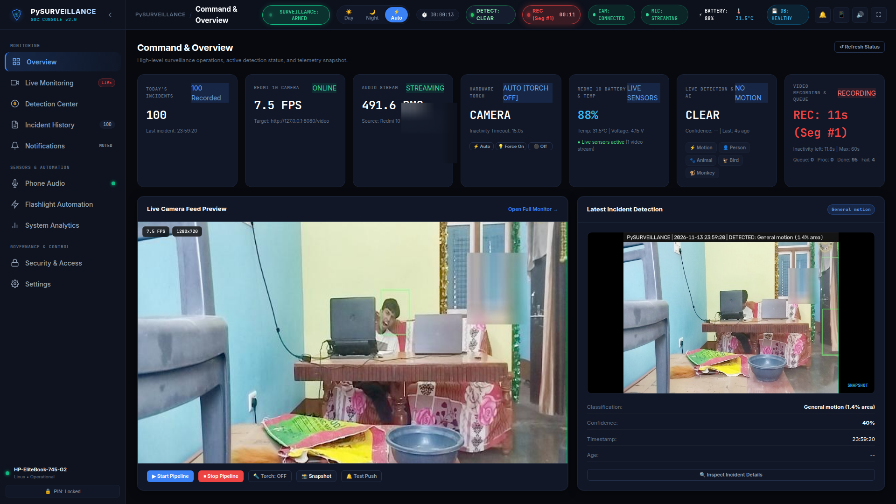
01 // COMMAND CONSOLE
Real-Time Security Operations Center (SOC) Command Console
Centralized situational awareness: live stream preview, hardware health, and daily incident metrics.
⚡ Sub-50ms MJPEG Streaming
Ultra-low-latency video preview with continuous resolution and acquisition FPS telemetry.
🔋 Device Hardware Telemetry
Real-time battery percentage, thermal monitoring, and AC/PoE power status.
📊 Real-Time Threat Metrics
Dynamic perimeter event counters, severity summaries, and multi-frame alert cards.
PySURVEILLANCE Edge Platform | Hardware-Independent Intelligent Security | github.com/ss3325713/survelance
4 / 18

Slide 5
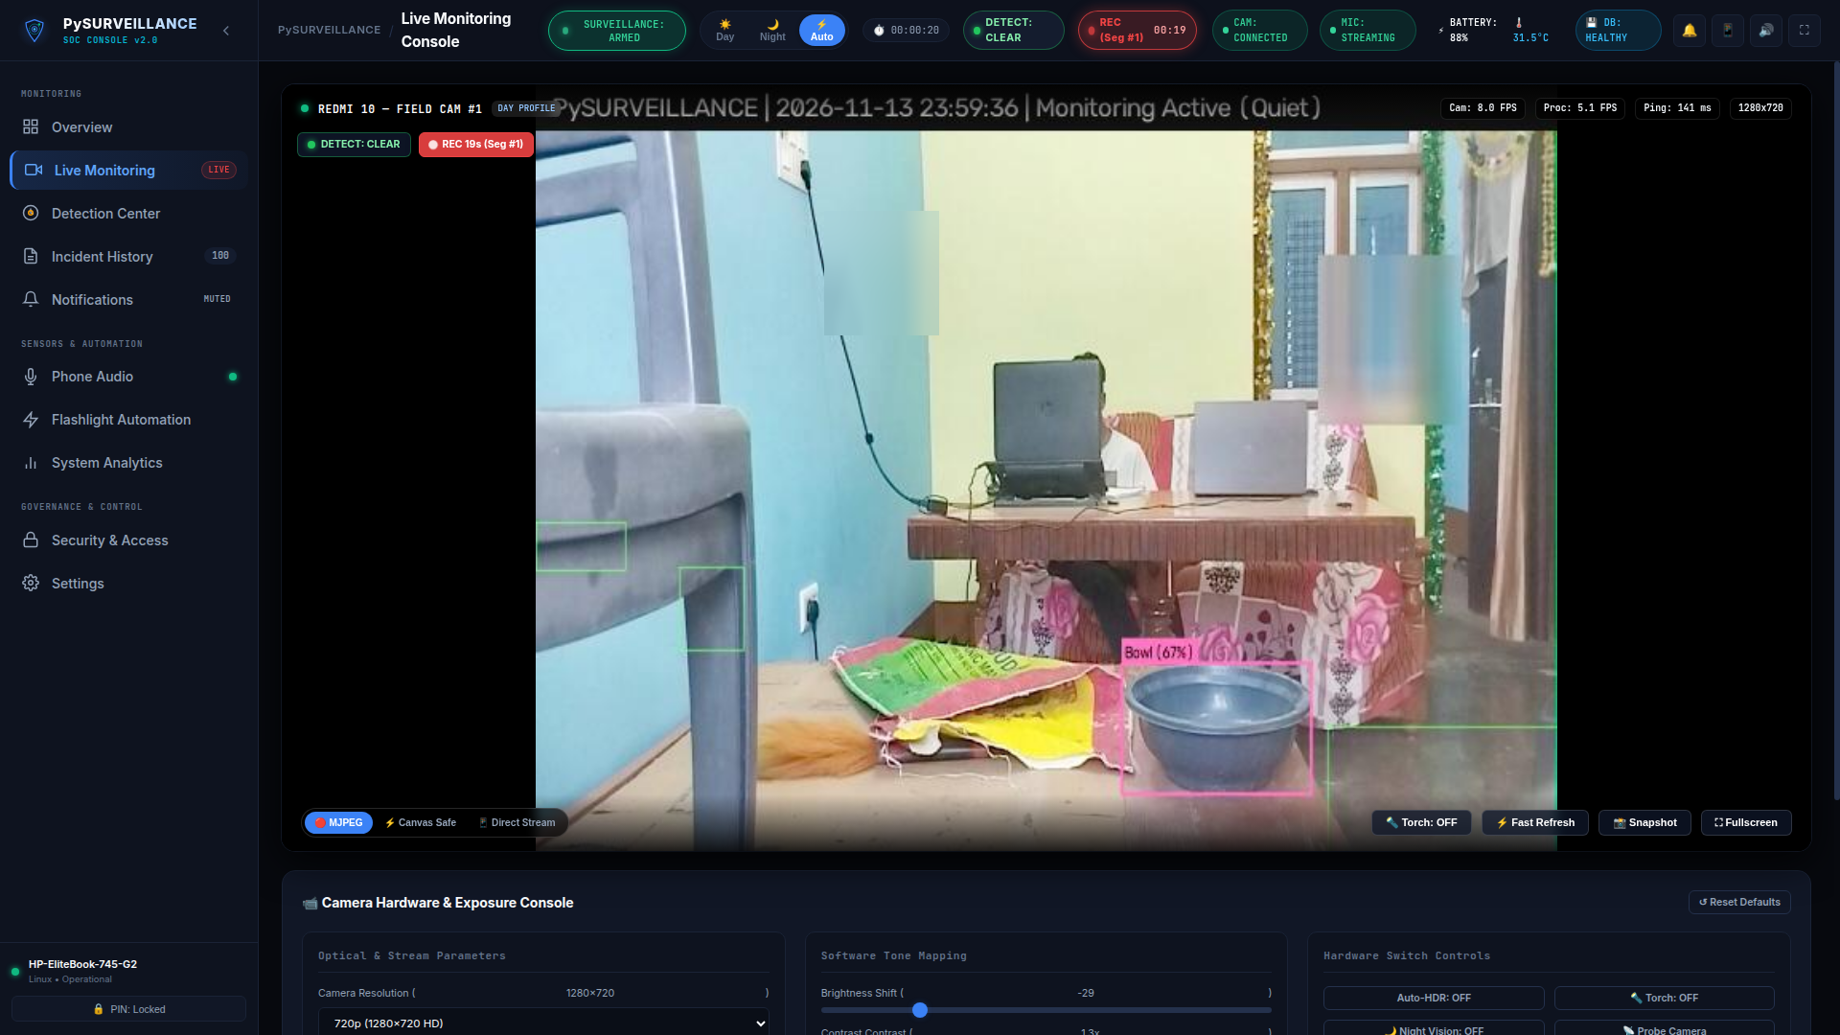
02 // CINEMA WORKSPACE
Full-Framerate Cinema Workspace & Floating HUD
Dedicated perimeter observation with non-intrusive target alert overlays and software tone mapping.
🚨 Floating Target Alerts
Instant visual notifications (🚨 PERSON 83% DETECTED) overlaid without obstructing controls.
📹 Recording Status HUD
Live recording indicator badge tracking active elapsed duration and segment index.
🎛️ Software Tone Mapping
Real-time gamma (0.5–2.0), brightness, contrast, and backlight HDR compensation.
PySURVEILLANCE Edge Platform | Hardware-Independent Intelligent Security | github.com/ss3325713/survelance
5 / 18

Slide 6
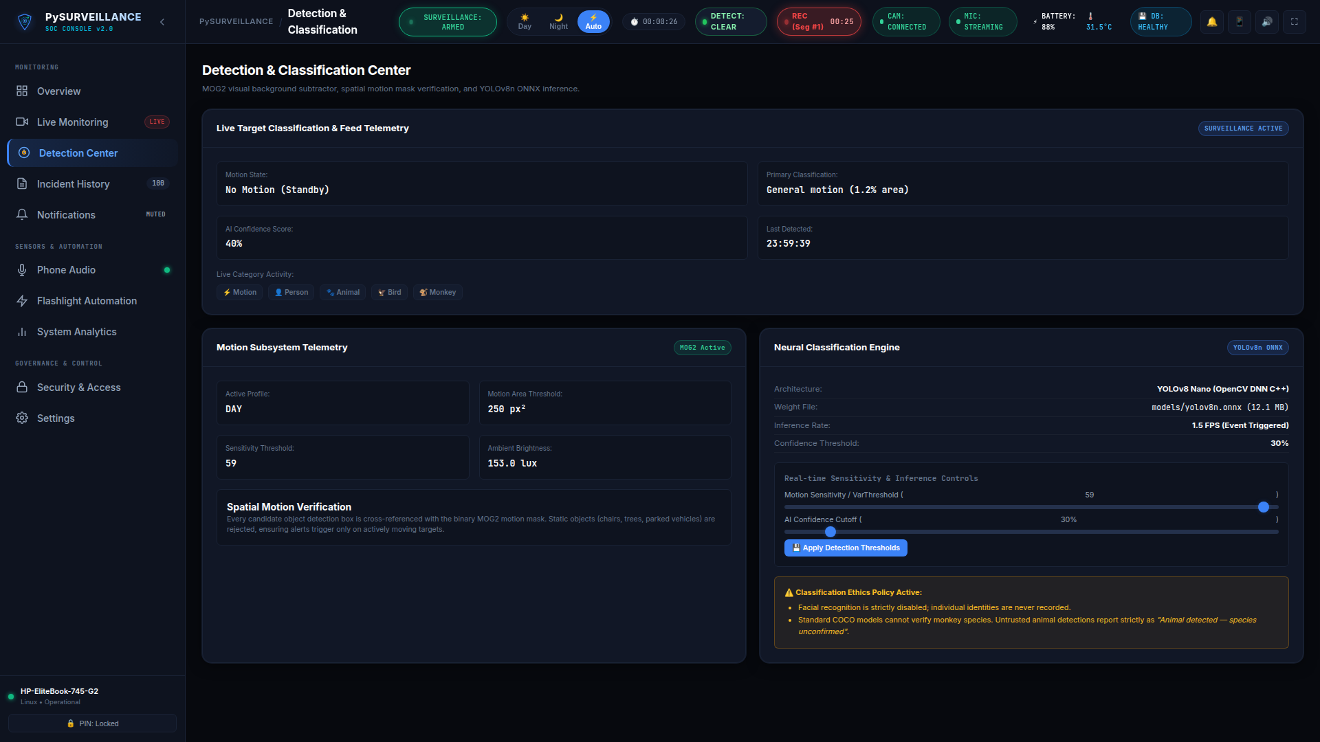
03 // NEURAL CLASSIFIER
YOLOv8n ONNX Deep Learning & OpenCV MOG2 Subtraction
Dual-engine architecture combining rapid background subtraction with deep convolutional neural inference.
🎯 Spatial Overlap Verification
Neural detections strictly correlated with active visual motion bounding boxes to suppress false positives.
🎚️ Runtime Sensitivity Sliders
Instant adjustment of MOG2 VarThreshold and neural confidence cutoff with zero service restarts.
⚡ CPU-Optimized Inference
OpenCV DNN C++ backend executing 1.5 FPS event-driven inference on standard CPUs.
PySURVEILLANCE Edge Platform | Hardware-Independent Intelligent Security | github.com/ss3325713/survelance
6 / 18

Slide 7
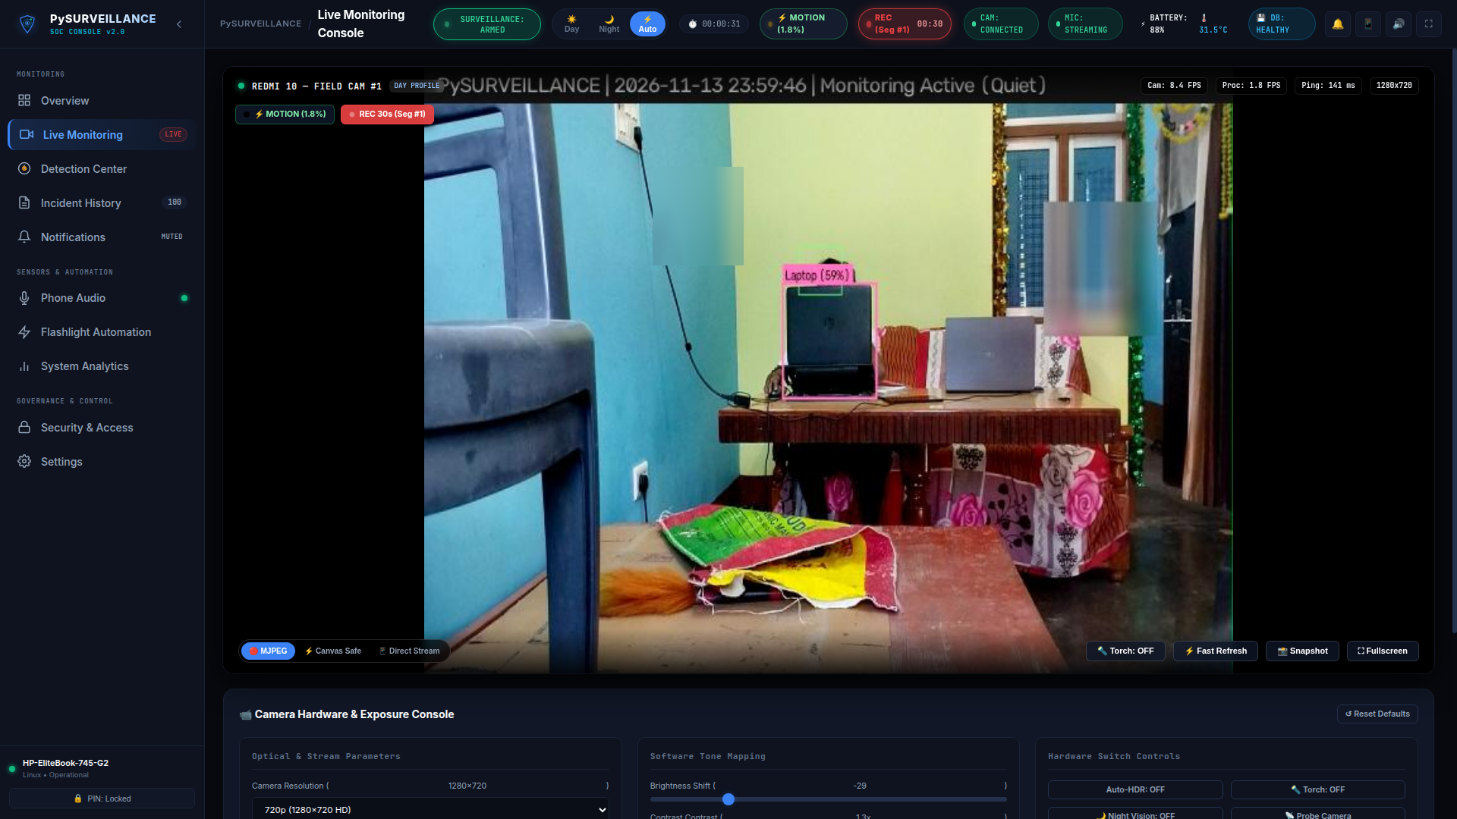
04 // VIDEO RECORDING
Motion-Triggered Video Recording & Segment Rollover
Continuous incident capture without unbounded file growth or memory leaks.
⏱️ Immediate Motion Trigger
Video recording initiates on frame 1 of qualifying visual motion without waiting for neural inference.
🔄 15-Second Inactivity Timer
Countdown resets on every recurring motion event. Continues same recording if subject moves again.
📦 60-Second Segment Rotation
Continuous events automatically split into clean 60-second video segments under the same incident session.
PySURVEILLANCE Edge Platform | Hardware-Independent Intelligent Security | github.com/ss3325713/survelance
7 / 18

Slide 8
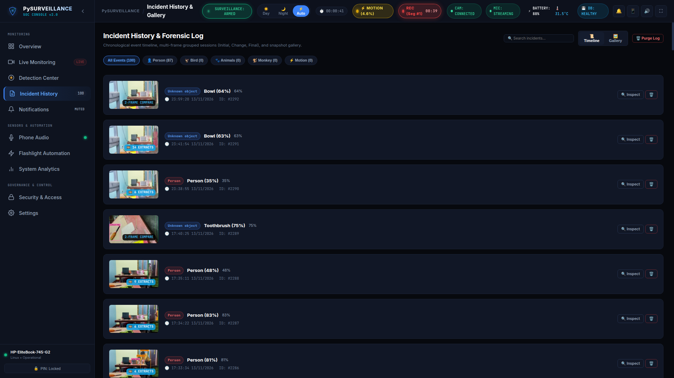
05 // INCIDENT AUDIT
Chronological Incident History & Multi-Frame Progression
Audited record of perimeter events with automated three-stage keyframe capture.
📸 Three-Stage Keyframe Capture
Automatically preserves Initial Trigger, Peak Motion Change, and Final Concluding frames for every incident.
🔍 Dynamic Category Filtering
Fast filtering across Person, Animal, Bird, and Unknown Object classes with severity classification.
📈 Acoustic & Lux Correlation
Logs synchronized microphone RMS energy and ambient lux levels at the exact moment of breach.
PySURVEILLANCE Edge Platform | Hardware-Independent Intelligent Security | github.com/ss3325713/survelance
8 / 18

Slide 9
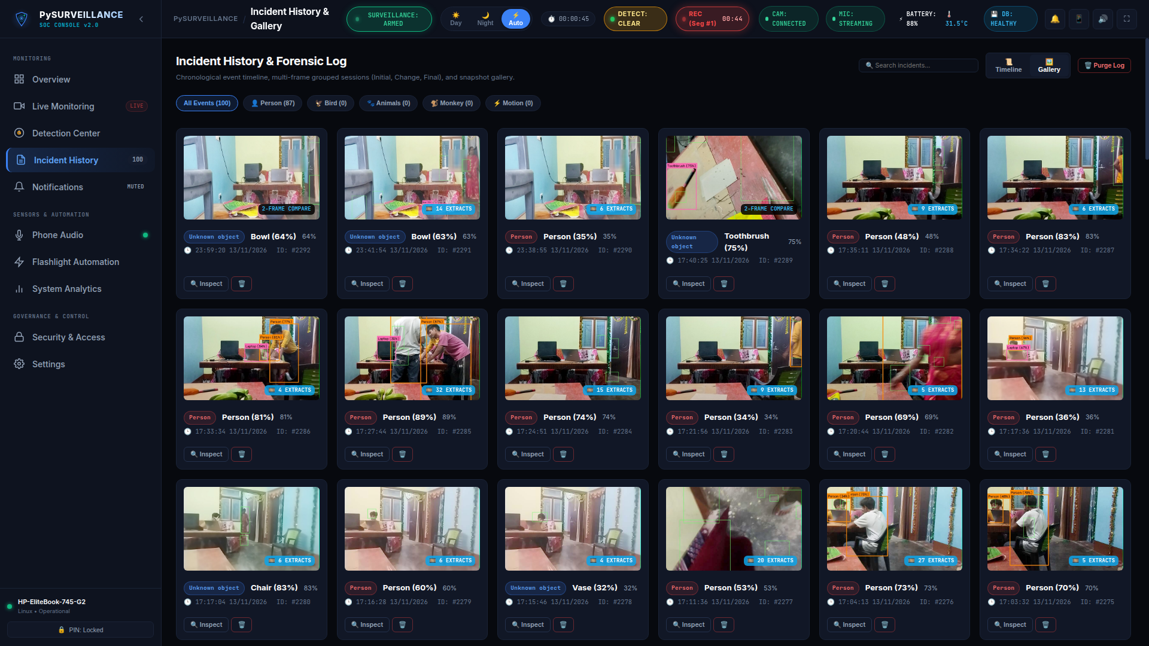
06 // INCIDENT GALLERY
Visual Card Grid for Rapid Threat Screening
High-density card grid optimized for swift threat pattern recognition and evidence export.
🖼️ High-Density Card Grid
Thumbnail cards with category badges, confidence ratings, and ISO-8601 timestamps.
💾 One-Click Cryptographic Export
Direct download of full-resolution forensic JPEGs with embedded metadata.
🔎 One-Click Forensic Inspection
Instant modal launch for multi-frame inspection and sharpness comparison.
PySURVEILLANCE Edge Platform | Hardware-Independent Intelligent Security | github.com/ss3325713/survelance
9 / 18

Slide 10
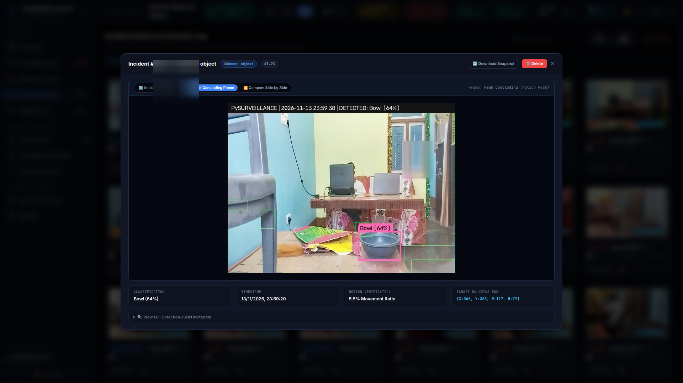
07 // FORENSIC EXTRACTION
Laplacian Variance Sharpness Scoring & Deep Forensics
Background worker extracts the sharpest forensic keyframes from recorded video segments.
📐 Laplacian Variance Formula
Evaluates frame focus score to systematically discard motion-blurred frames.
🗄️ Persistent SQLite Job Queue
Closed video segments queued in video_jobs table, surviving reboots without job loss.
🔬 Side-by-Side Comparison
Modal displays trigger snapshot, peak frame, concluding frame, and extracted video keyframe.
PySURVEILLANCE Edge Platform | Hardware-Independent Intelligent Security | github.com/ss3325713/survelance
10 / 18

Slide 11
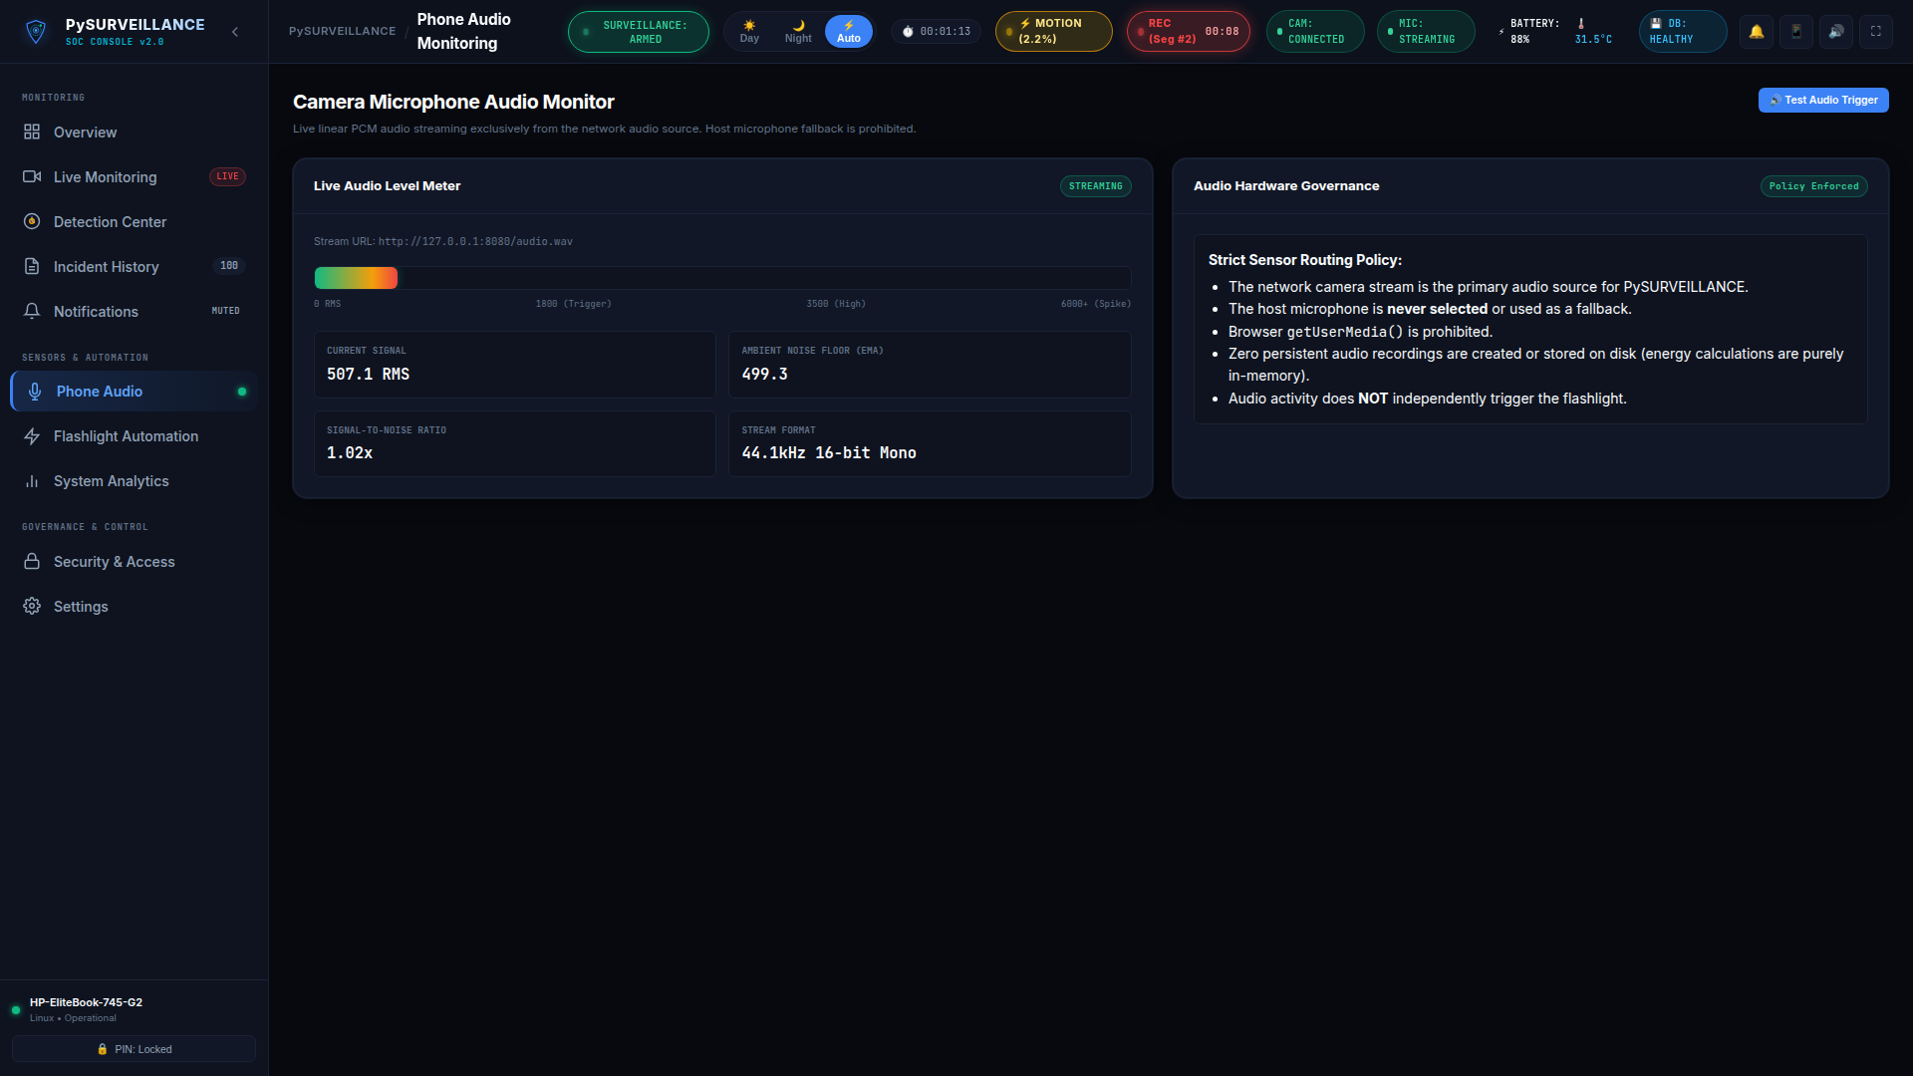
08 // ACOUSTIC INTELLIGENCE
Phone Microphone RMS Energy & Noise Floor Monitoring
Network audio stream analysis with dynamic ambient noise floor tracking.
📈 Dynamic Rolling Noise Floor
Adaptive alpha filter continuously learns ambient acoustics to suppress false sound triggers.
📶 Signal-to-Noise Ratio (SNR)
Sound alerts trigger only when audio energy spikes exceed the ambient noise floor.
🔒 Network Stream Isolation
Ingests audio via HTTP linear PCM (/audio.wav), bypassing local laptop microphones.
PySURVEILLANCE Edge Platform | Hardware-Independent Intelligent Security | github.com/ss3325713/survelance
11 / 18

Slide 12
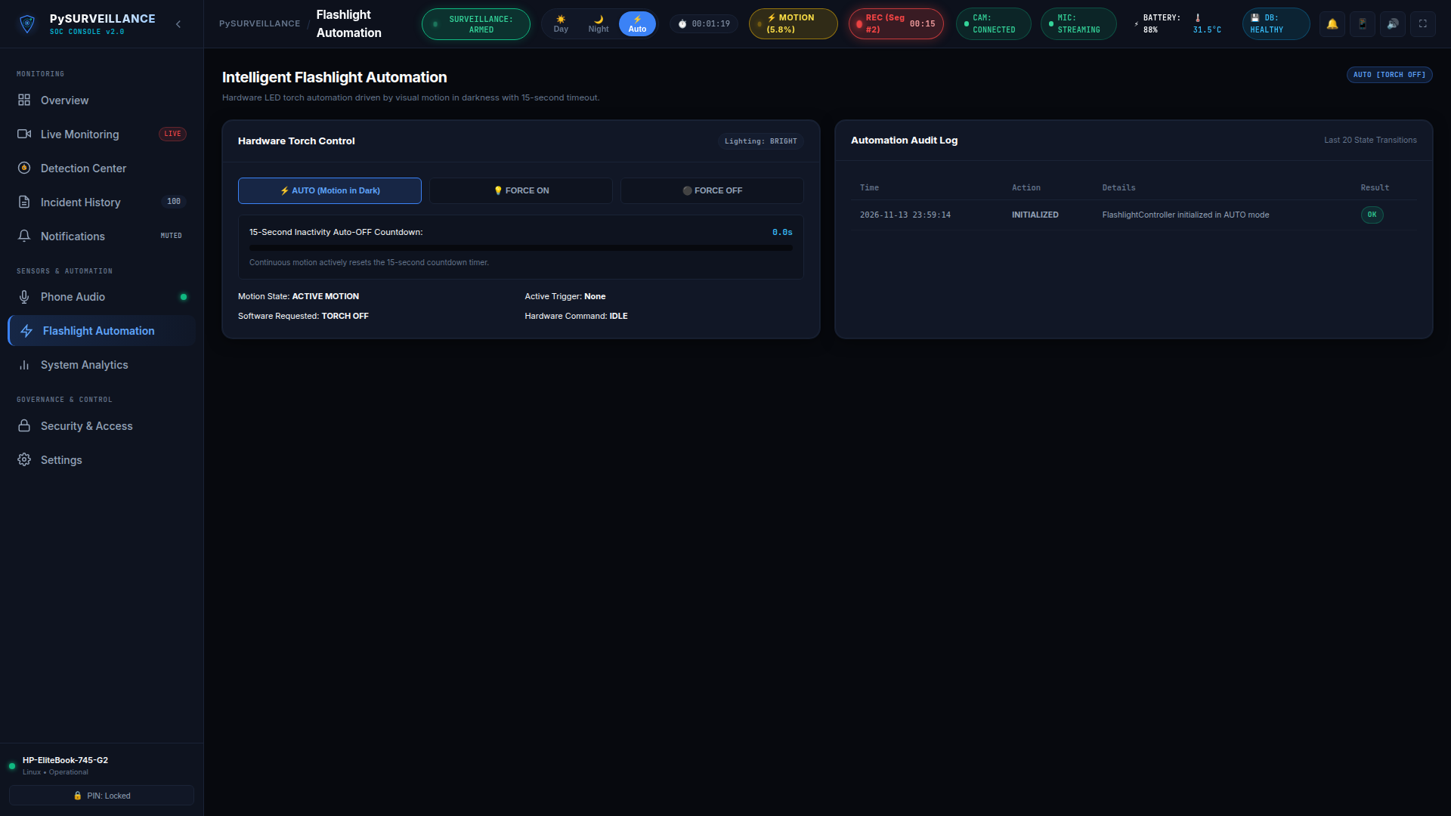
09 // HARDWARE AUTOMATION
Ambient Darkness Detection & Motion-Triggered Flashlight
Smart illumination automation activates lighting only when motion occurs in the dark.
🌙 Lux-Aware Illumination
Scene brightness evaluated in real-time (lux_threshold: 45.0); daytime motion never triggers lighting.
⏳ 15-Second Inactivity Countdown
Light remains active while motion continues and cleanly turns off 15 seconds after motion ceases.
💡 Force Overrides & Torch API
Manual FORCE ON, FORCE OFF, and AUTO modes with seamless IP Webcam torch integration.
PySURVEILLANCE Edge Platform | Hardware-Independent Intelligent Security | github.com/ss3325713/survelance
12 / 18

Slide 13
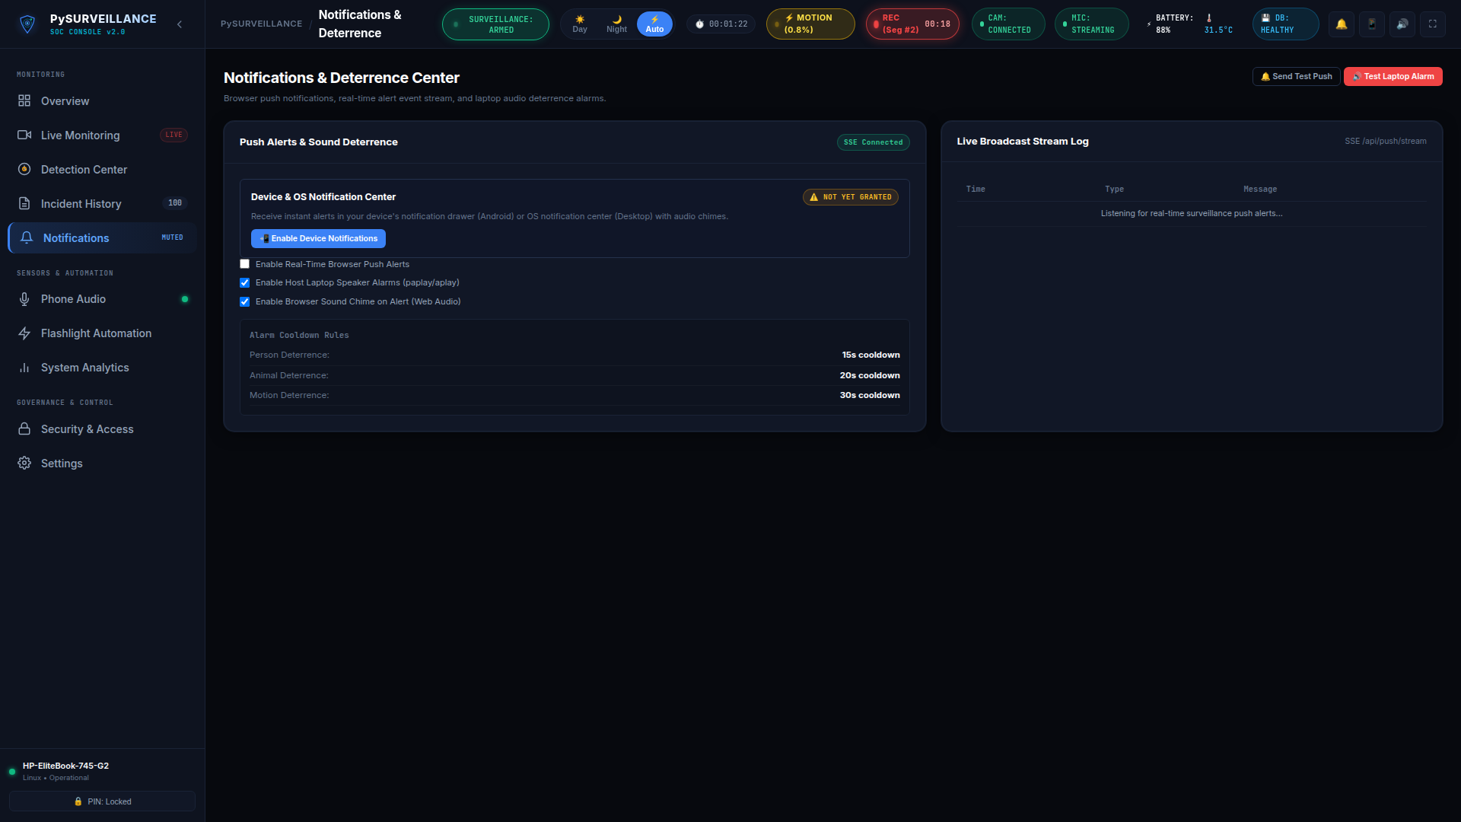
10 // NOTIFICATIONS & DETERRENCE
Native Device Push Notifications & Host Speaker Sirens
Dual-channel notification: immediate desktop/mobile alerts and audible deterrence.
📲 Browser & Device Push Alerts
Service Worker push alerts deliver threat notifications with snapshot thumbnails directly to operator devices.
🔊 Local Speaker Deterrent Siren
Synthesizes deterrent tones via host paplay / aplay upon verified Person or Animal intrusions.
⏱️ Per-Class Alarm Cooldowns
Configurable cooldown timers (30s Person, 20s Animal) prevent alarm fatigue.
PySURVEILLANCE Edge Platform | Hardware-Independent Intelligent Security | github.com/ss3325713/survelance
13 / 18

Slide 14
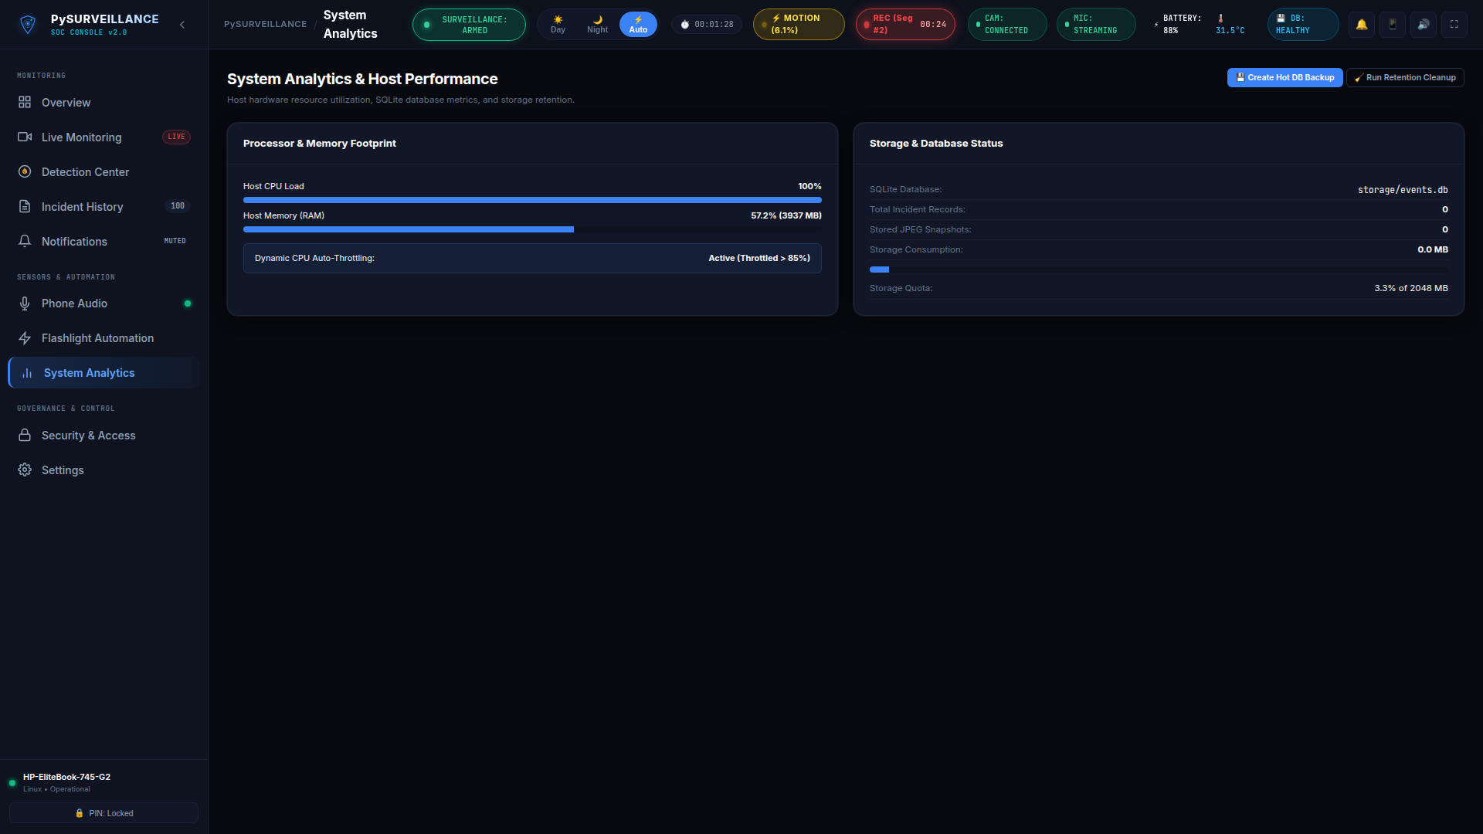
11 // SYSTEM TELEMETRY
Resource-Conscious Performance & System Telemetry
Engineered for continuous 24/7 reliability on standard laptops, mini-PCs, and edge nodes.
⚡ Dual-Rate FPS Monitoring
Tracks camera ingestion (10-15 FPS) vs. neural inference rate (1.5 FPS) for smooth operation.
💻 CPU & RAM Monitoring
Real-time system graphs with automatic CPU throttling safeguards when host CPU exceeds 85%.
🧹 Rolling Storage Retention
Background storage manager cleans oldest recordings when disk usage reaches quota (2048 MB).
PySURVEILLANCE Edge Platform | Hardware-Independent Intelligent Security | github.com/ss3325713/survelance
14 / 18

Slide 15
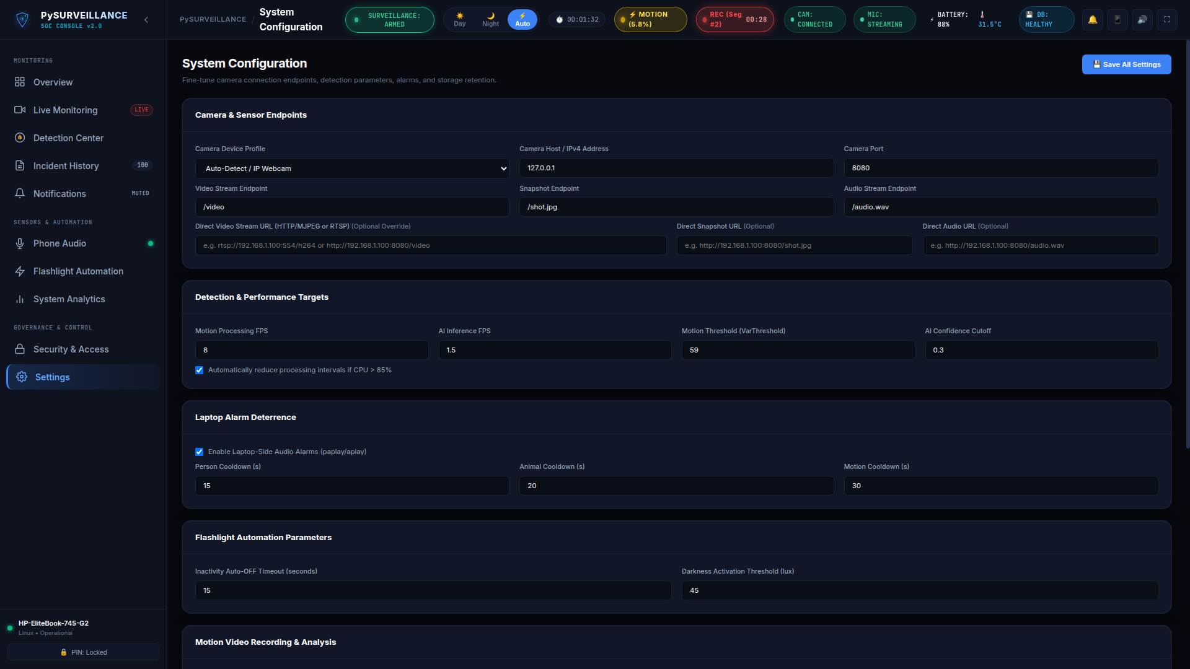
12 // STREAM CONFIGURATION
Decoupled Protocols & Hardware Independence
Universal compatibility with RTSP IP cameras, smartphone cameras, and HTTP streams.
📹 Standard Video Protocols
Direct ingestion of RTSP (H.264 / H.265) feeds or multipart HTTP/MJPEG streams via OpenCV VideoCapture.
🎙️ Independent Audio Channel
Audio streams independently over uncompressed Linear PCM WAV (/audio.wav) over HTTP.
⚙️ Hardware Profile Adapters
Adaptable profiles (auto, ip_webcam, generic) ensure smooth operation across smartphones and commercial IP cameras.
PySURVEILLANCE Edge Platform | Hardware-Independent Intelligent Security | github.com/ss3325713/survelance
15 / 18

Slide 16
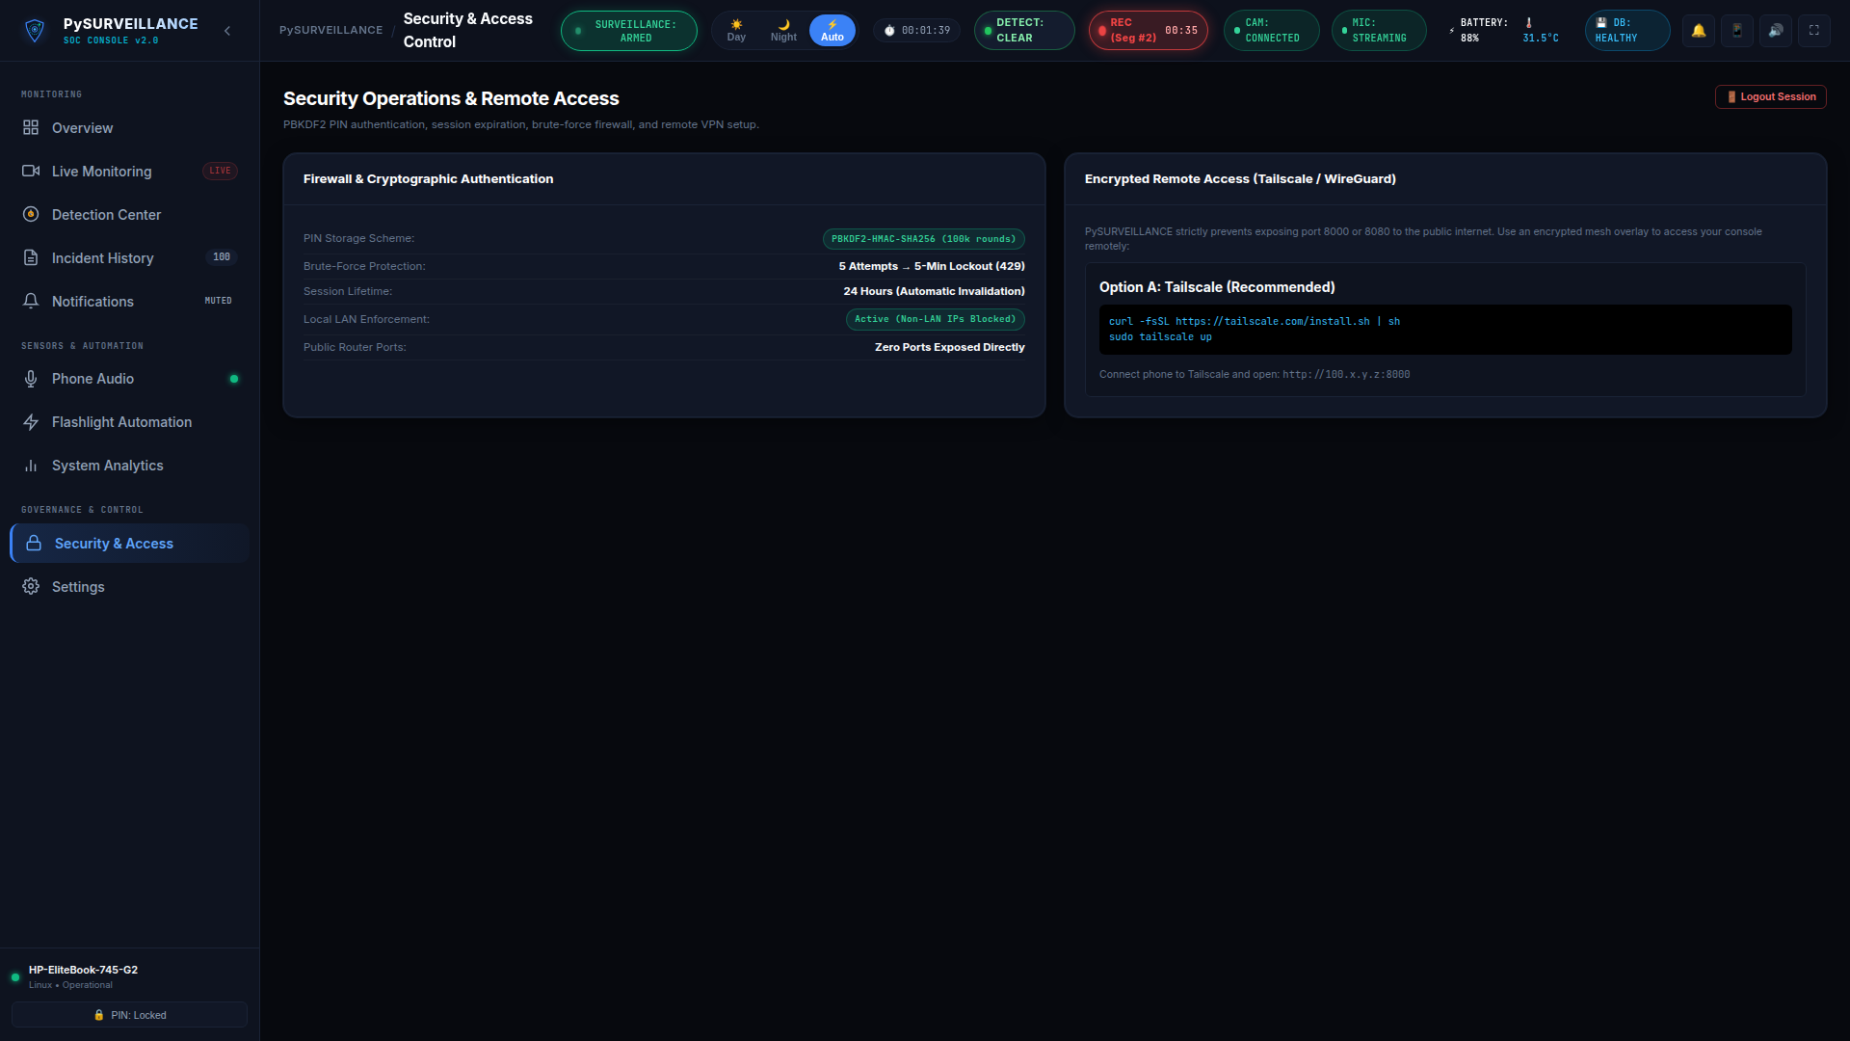
13 // ZERO-TRUST SECURITY
Cryptographic Security & RFC 1918 Private Firewall
Zero default backdoors, salted PBKDF2 authentication, and strict private LAN isolation.
🔑 Salted PBKDF2-HMAC-SHA256
Master PIN is hashed with 100,000 iterations and 16-byte cryptographic salt; plaintext credentials never touch disk.
🛑 Brute-Force Rate Limiting
5 consecutive failed authentication attempts trigger an automatic 300-second IP lockout (HTTP 429).
🛡️ RFC 1918 Private Firewall
Rejects all public internet requests by default (HTTP 403), restricting access strictly to private subnets and localhost.
PySURVEILLANCE Edge Platform | Hardware-Independent Intelligent Security | github.com/ss3325713/survelance
16 / 18

Slide 17
ETHICAL SURVEILLANCE & CIVIL LIBERTIES
Ethical Surveillance & Human Rights Architecture
Uncompromising perimeter security while strictly upholding privacy, civil liberties, and human dignity.
🚫 Zero Facial Recognition
Biometric face profiling, facial embeddings, and identity databases are strictly excluded from the codebase. Detections report strictly as generic 'Person' entities.
🎭 Privacy Face Blurring
All human faces featured in public documentation, marketing screenshots, and presentation slide decks are systematically obscured with Gaussian blur (ksize=51x51).
🐾 Species Verification Caution
Standard COCO models cannot verify specialized wildlife or primates. Detections outside benchmark certainty report strictly as 'Animal detected — species unconfirmed'.
🔇 In-Memory Audio Analysis
Network audio is processed strictly in volatile memory for acoustic RMS energy spikes and SNR alarms. Continuous ambient voice audio is never stored or written to disk.
PySURVEILLANCE Edge Platform | Hardware-Independent Intelligent Security | github.com/ss3325713/survelance
17 / 18

Slide 18
PRODUCTION READINESS
Platform Summary & Technical Specifications
A battle-tested, autonomous edge surveillance system ready for production deployment.
⚡ High Performance
• Sub-50ms live stream rendering with hardware acceleration
• 1.5 FPS CPU-friendly YOLOv8n ONNX inference
• Non-blocking background video processing queue
📦 Storage & Forensics
• 15s inactivity reset with 60s max segment rotation
• Laplacian variance sharpness scoring for clean keyframes
• Automated rolling disk quota management
🔌 Universal Compatibility
• Native RTSP (H.264 / H.265) and HTTP/MJPEG video
• Independent HTTP Linear PCM audio streaming
• Support for smartphones, ONVIF, and IP cameras
🛡️ Zero-Trust Security
• Salted PBKDF2-HMAC-SHA256 (100,000 rounds)
• 5-strike brute-force rate limiter (300s lockout)
• RFC 1918 private LAN isolation firewall
🚀 GitHub Repository & Technical Documentation
Repository: https://github.com/ss3325713/survelance | Branch: main | Commit: db1efb2 | Environment: Linux Mint / Ubuntu
PySURVEILLANCE Edge Platform | Hardware-Independent Intelligent Security | github.com/ss3325713/survelance
18 / 18

