Slide 1





Evaluating the impacts of fixing or estimating growth parameters, across life histories and data availability
Juan L. Valero, Kelli F. Johnson, Christine C. Stawitz, Roberto Licandeo, Sean C. Anderson, Allan Hicks, Felipe Hurtado-Ferro, Peter Kuriyama, Cole C. Monnahan, Kotaro Ono, Ian Taylor, Merrill Rudd

Slide 2
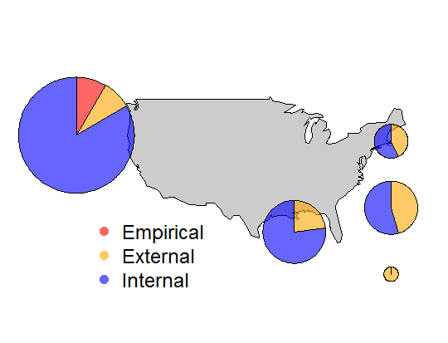
Treatment of growth in assessments*
* Not exhaustive, n = 58

Slide 3
Main questions
What data types are informative for estimating growth inside an integrated model?
Data quantity needed to estimate growth inside an integrated model?
Tradeoffs between using external estimates of growth versus estimating growth inside an integrated model?
Growth estimation across methods, data type/quantity, and life history?

Slide 4





ss3sim Developers
Sean Anderson – Simon Fraser University, PhD student; Lead developer and technical guru (sean_anderson@sfu.ca)
Kelli Johnson – UW, Punt PhD student
(kfjohns@uw.edu)
Cole Monnahan – UW, Trevor Branch PhD student
(monnahc@uw.edu)
Kotaro Ono – UW-NOAA, Postdoc
(kotarono@uw.edu)
Juan Valero – CAPAM, Research Scientist
(jvalero@iattc.org)
WCSAM Participants contributed conceptually and technically: Curry Cunningham, Felipe Hurtado-Ferro, Roberto Licandeo, Carey McGilliard, Melissa Muradian, Cody Szuwalski, Katyana Vert-pre, Athol Whitten

Slide 5
ss3sim: Big picture
Reproducible, flexible, and rapid end-to-end simulation framework: OM -> Data -> EM -> analysis
all within R, using SS3 for both models
Designed to programmatically induce structural differences to SS3 models (control, data, starter files)
Useful for testing: model performance, model misspecification, value of data, etc.

Slide 6
ss3sim work
Publications
Anderson, S., C. Monnahan, K. Johnson, K. Ono, J. Valero. 2014. ss3sim: An R package for fisheries stock assessment simulation with Stock Synthesis. PLoS One.
Ono, K., R. Licandeo, M. Muradian, C. Cunningham, S. Anderson, F. Hurtado-Ferro, K. Johnson, C. McGilliard, C. Monnahan, C. Szuwalski, J. Valero, K. Vert-pre, A. Whitten, A. Punt. 2014. The importance of length and age composition data in statistical age-structured models for marine species. ICES JMS.
Johnson, K., C. Monnahan, C. McGilliard, K. Vert-pre, S. Anderson, C. Cunningham, F. Hurtado-Ferro, R. Licandeo, M. Muradian, K. Ono, C. Szuwalski, J. Valero, A. Whitten, A. Punt. 2014 Time-varying natural mortality in fisheries stock assessment models: Identifying a default approach. ICES JMS.
Hurtado-Ferro, F., C. Szuwalski, J. Valero, S. Anderson, C. Cunningham, K. Johnson, R. Licandeo, C. McGilliard, C. Monnahan, M. Muradian, K. Ono, K. Vert-pre, A. Whitten. In Press. Looking in the rear-view mirror: reflections on bias and retrospective patterns from a fisheries stock assessment simulation study. ICES JMS.
Upcoming presentations
Valero, J., K. Johnson, C. Stawitz, R. Licandeo, S. Anderson, A. Hicks, F. Hurtado-Ferro, P. Kuriyama, C. Monnahan, K. Ono, I. Taylor, M. Rudd. Evaluating the impacts of fixing or estimating growth parameters, across life histories and data availability.
Monnahan, C., S. Anderson, F. Hurtado-Ferro, K. Ono, M. Rudd, J. Valero, K. Johnson, R. Licandeo, C. Stawitz, A. Hicks, I. Taylor. An evaluation of alternative binning approaches for composition data in integrated stock assessments.
Kuriyama, P., A. Hicks, K. Johnson, I. Taylor, S. Anderson, F. Hurtado-Ferro, R. Licandeo, C. Monnahan, K. Ono, M. Rudd, C. Stawitz, J. Valero. An investigation of using empirical weight-at-age instead of modeling parametric growth in statistical age-structured population models

Slide 7
ss3sim: Package details
Software
Open source, cross platform (Windows, OS X, Linux).
Requires: SS3.24O, R >= 3.0.0, r4ss
Availability
CRAN (http://cran.r-project.org/package=ss3sim)
Development version (www.github.com/ss3sim/ss3sim)
Contents
SS3 models, modified for simulation with ss3sim
R functions for modifying models, running simulations, and extracting/plotting results

Slide 8
Data scenarios
0. Length composition and age compositions
1. Only length composition
2. Length composition and conditional age at length
3. Length composition, age composition and conditional age at length

Slide 9
Sampling Design
Length comps and age comps sampled as multinomial (although overdispersion is an option)
Mean length at age
Fishery
Fraction of samples by age based on observed age composition
Used in external estimation of growth

Slide 10
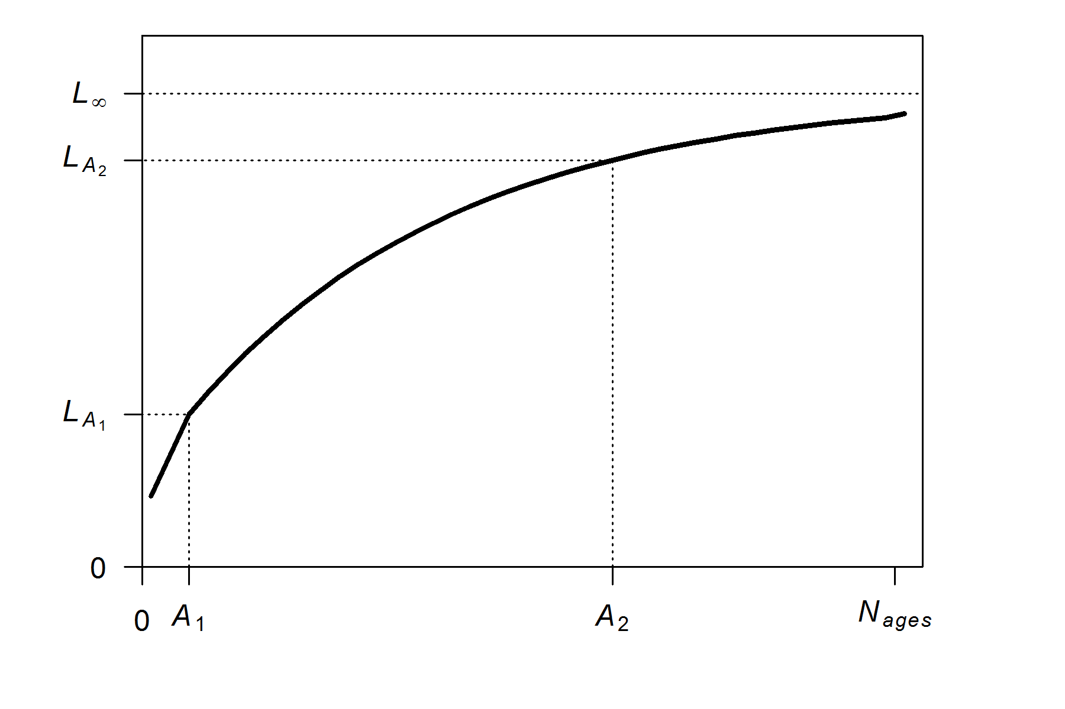
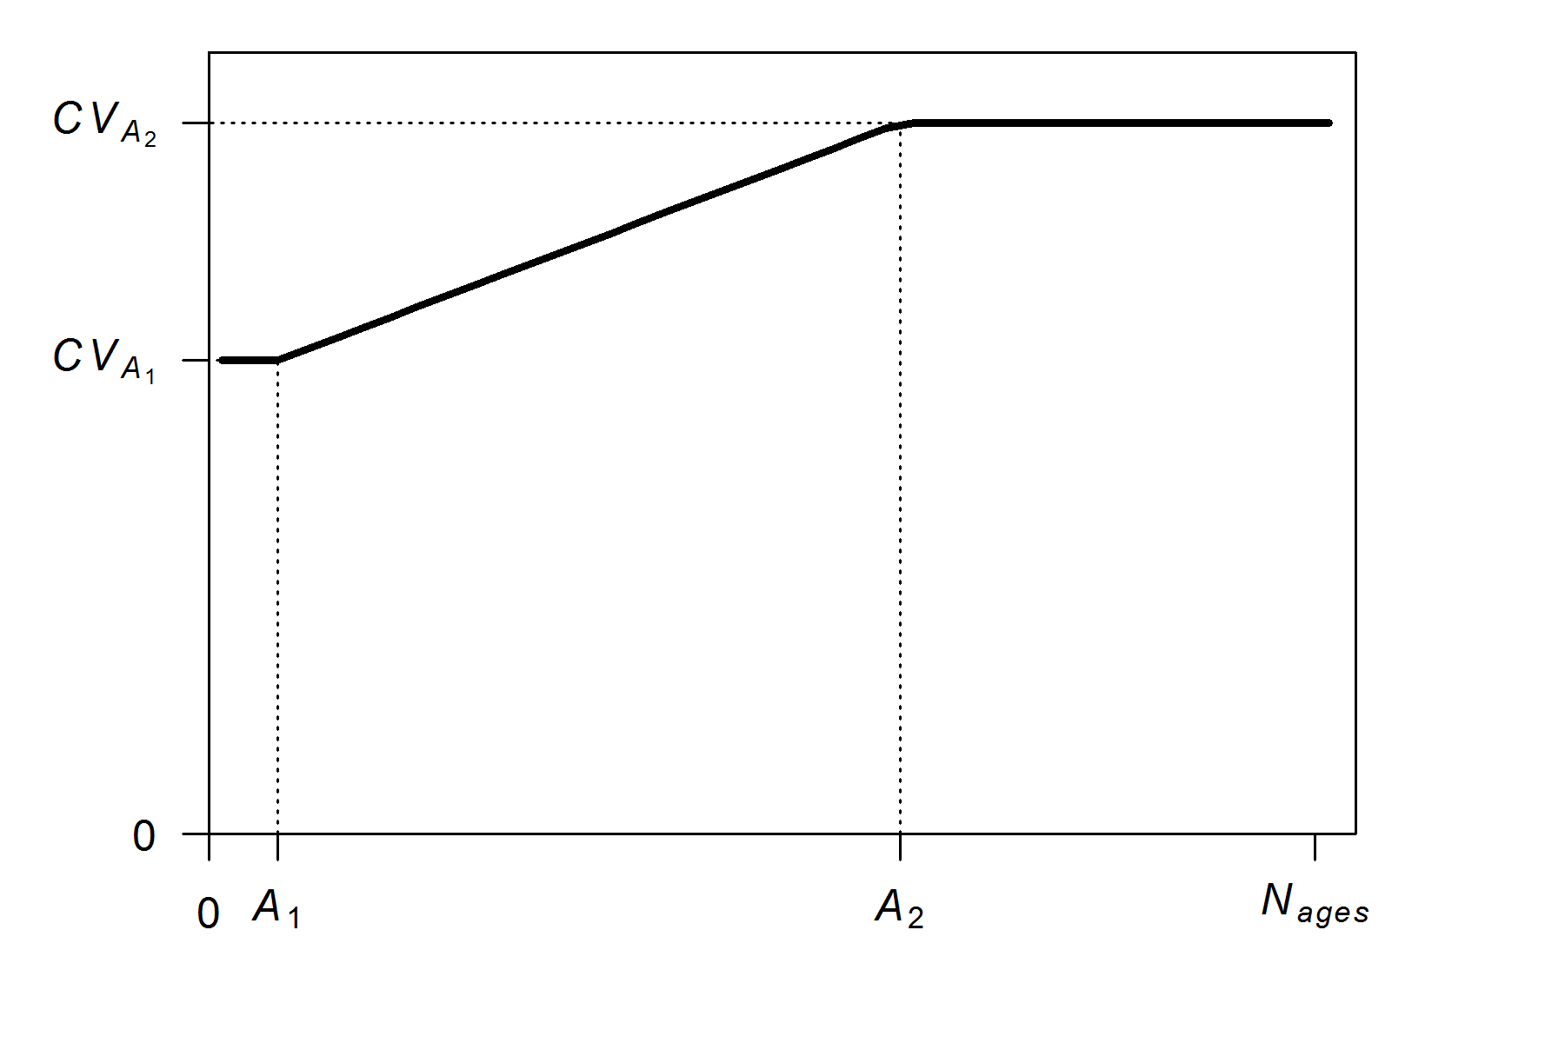
Experimental Design
Biological assumptions
Life history: cod-like (North Sea cod).
Natural mortality fixed at truth
BH SR function w/ h fixed at truth, R₀ estimated.
Weight/length and maturity fixed at truth
VBK growth in OM and EM

Slide 11
Experimental Design
Fishery and survey assumptions
1 fishery starting in year 25, with two fishing patterns (constant and two-way trip); 1 survey after year 75
Catchability coefficients constant + estimated
No ageing error (for now)
Process error through recruitment
OM Selectivities
Size, Time-invariant Asymptotic (Survey, Fishery)
Size, Time-invariant Asymptotic (Survey) and Dome (Fishery)
EM Selectivities
Size, Time-invariant Asymptotic (Survey, Fishery)

Slide 12
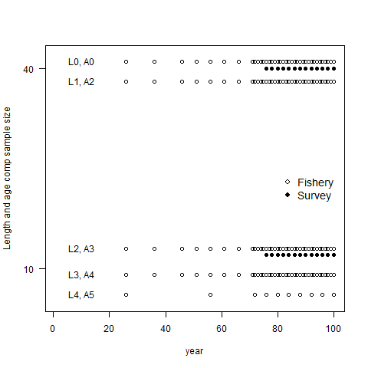
Sample intensity and sizes for Age, Lengths
high-fish-surv
high-fish
Age and length sample size
low-fish
Year

Slide 13
Growth estimation scenarios
5-parameter VBGF with K, Lyoung, Lold and CV for young and old
estimated or fixed based on 4 scenarios:
Internal: Lyoung, Lold, K and CVs estimated internally
External: Lyoung, Lold, K and CVs fixed at external estimates
Ext_CV: Lyoung, Lold and K estimated internally and
CVs fixed at external estimates
Ext_LK: Lyoung, Lold and K fixed at external estimates and
CVs estimated internally

Slide 14
Some Preliminary Results

Slide 15
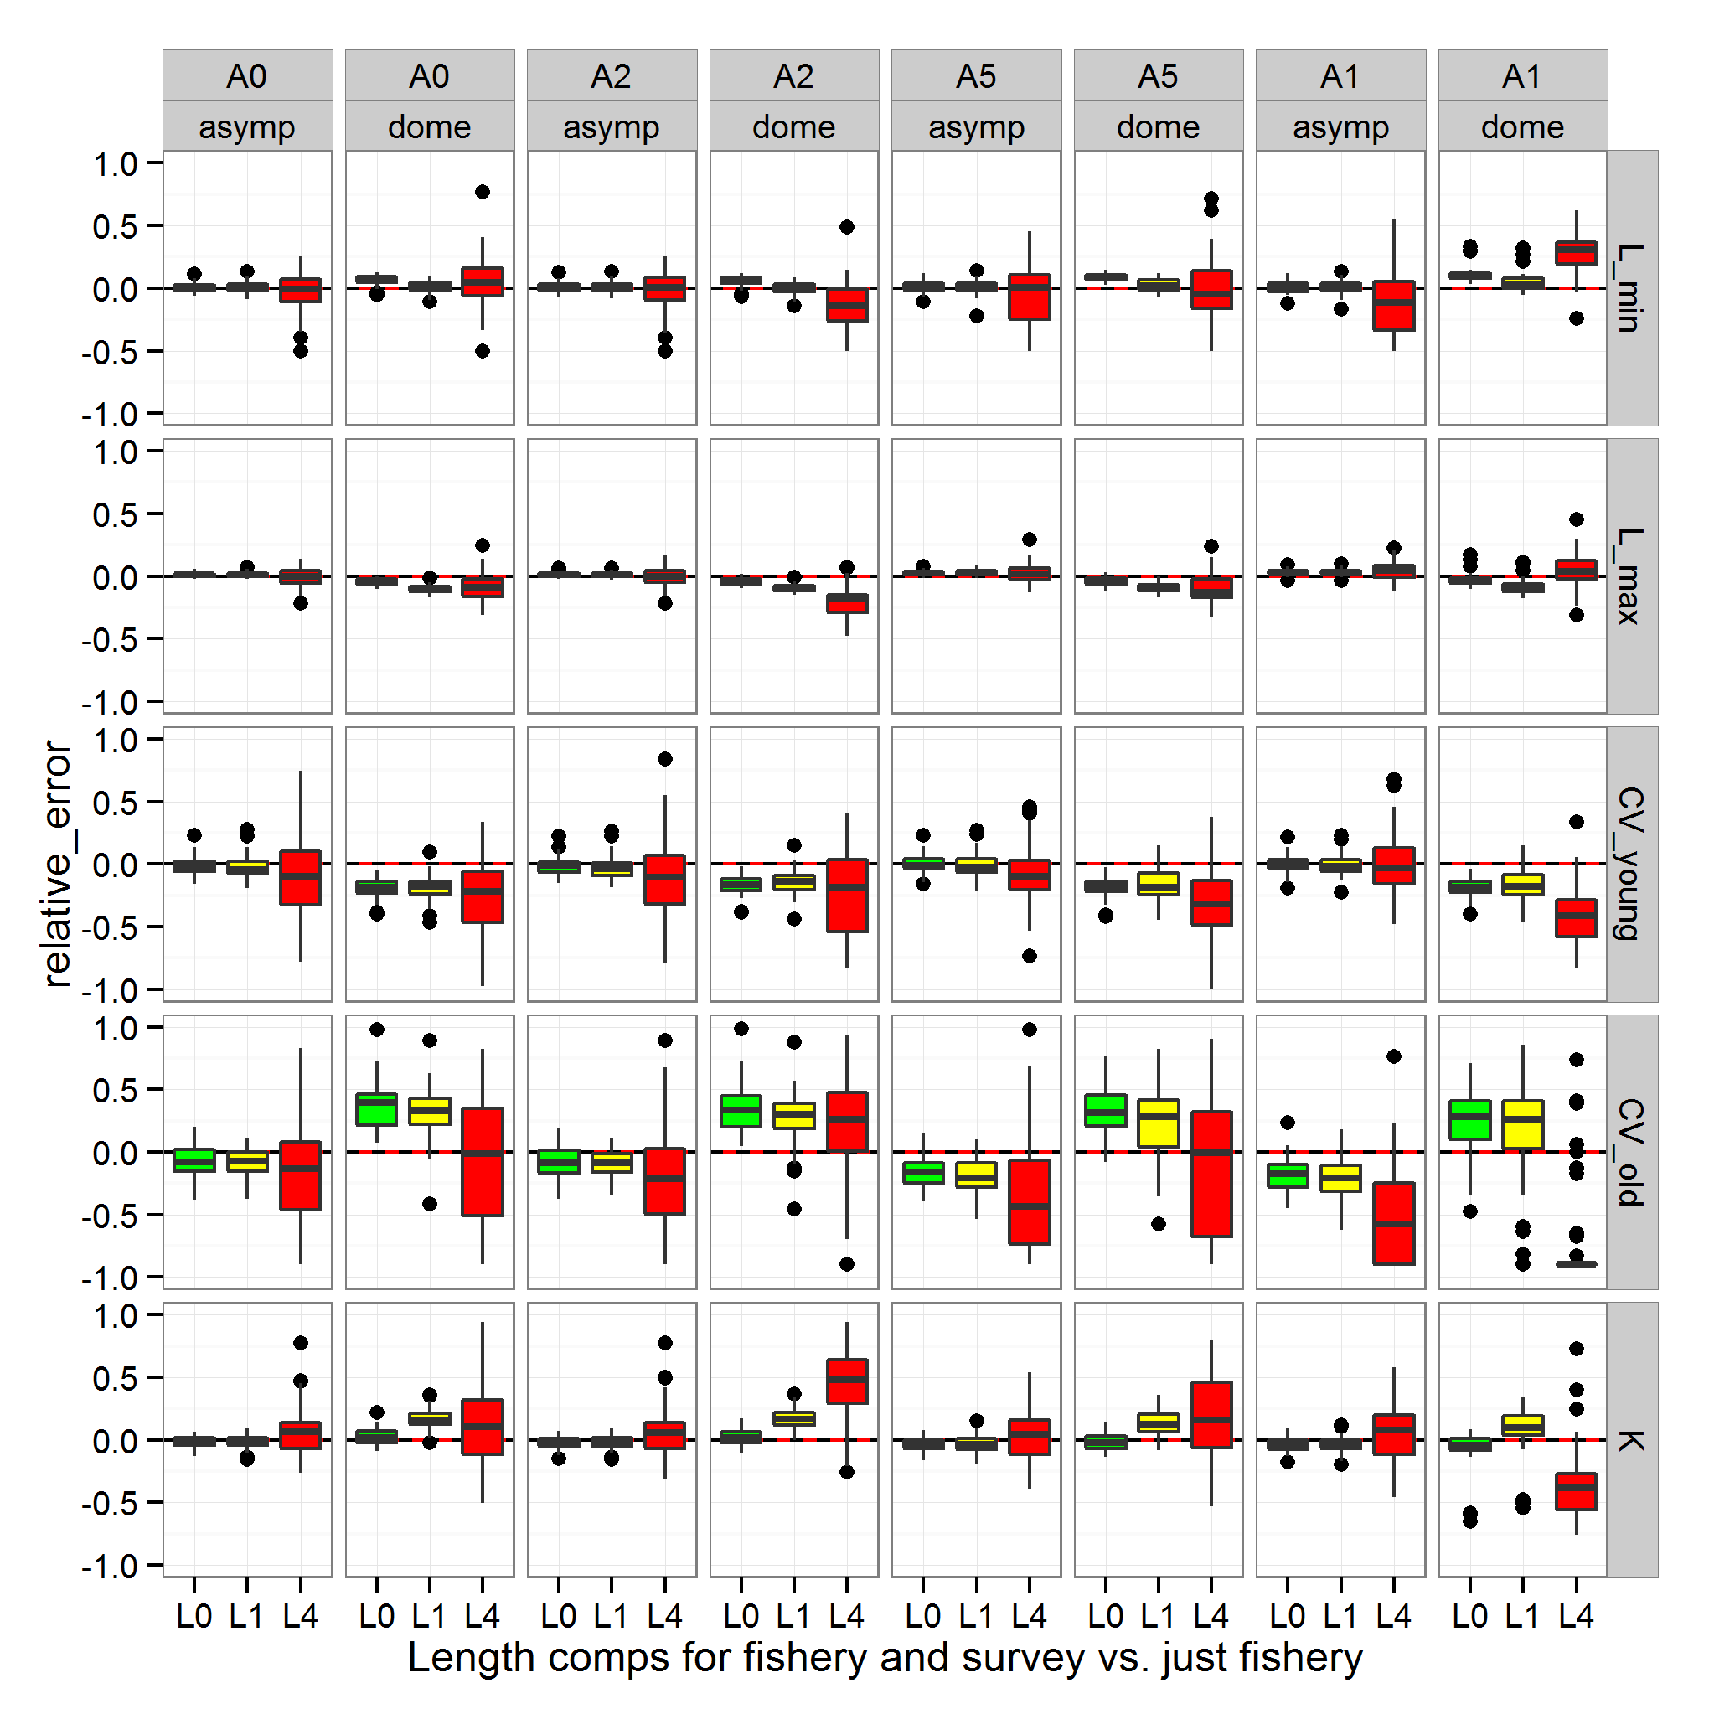
high-fish-surv
high-fish
low-fish
no age
Age comps
Fishery selectivity
Relative Error

Slide 16
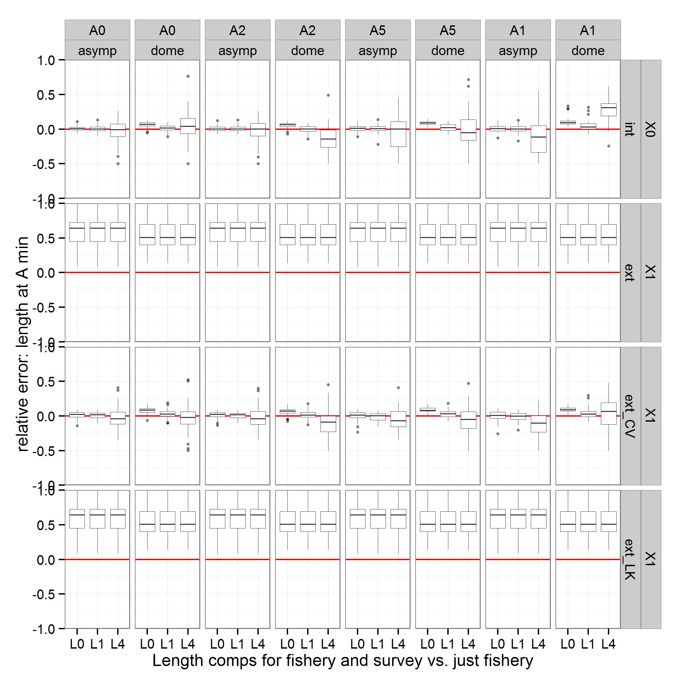
high-fish-surv
high-fish
low-fish
no age
Age comps
Fishery selectivity
Internal
External
Ext_CV
Ext_LK

Slide 17
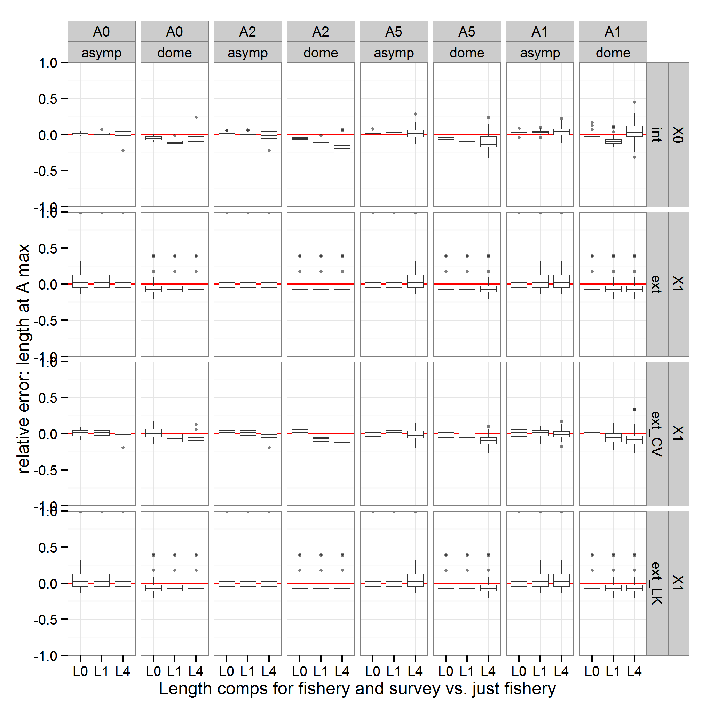
high-fish-surv
high-fish
low-fish
no age
Age comps
Fishery selectivity
Internal
External
Ext_CV
Ext_LK

Slide 18
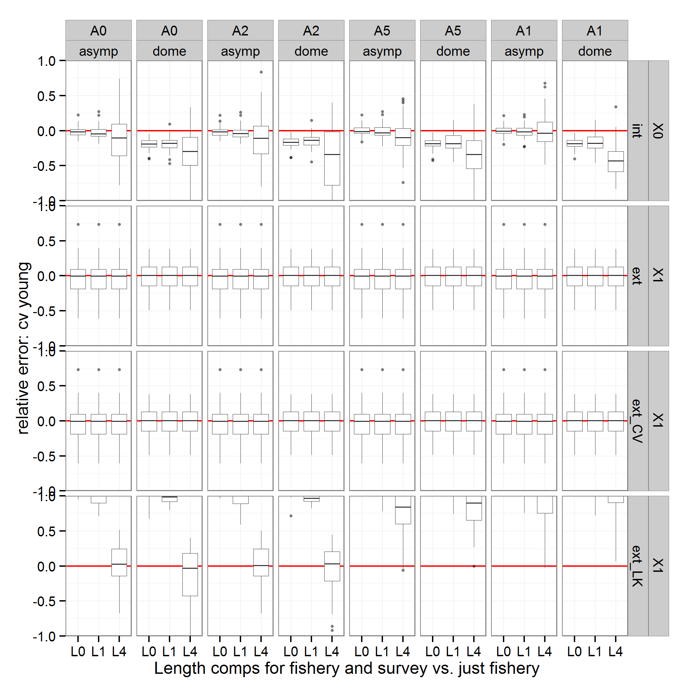
high-fish-surv
high-fish
low-fish
no age
Age comps
Fishery selectivity
Internal
External
Ext_CV
Ext_LK

Slide 19
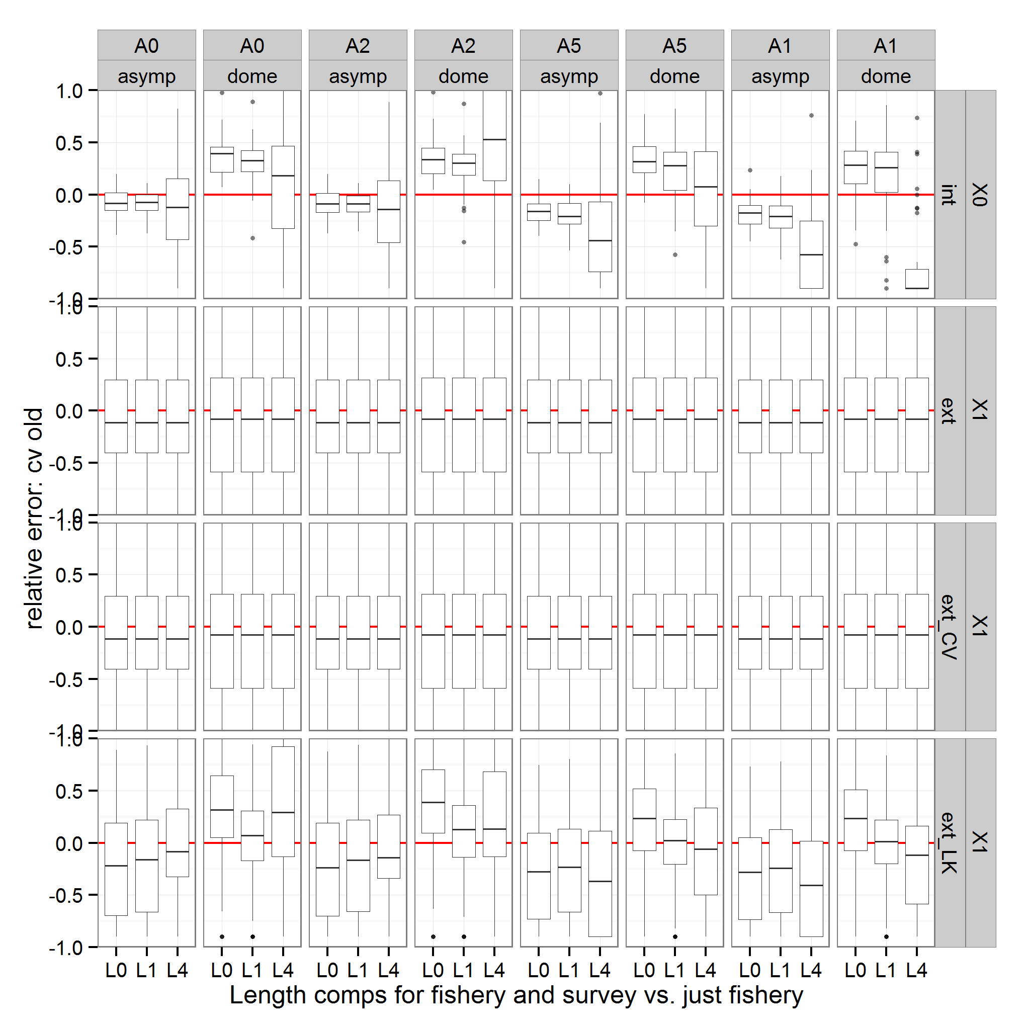
high-fish-surv
high-fish
low-fish
no age
Age comps
Fishery selectivity
Internal
External
Ext_CV
Ext_LK

Slide 20
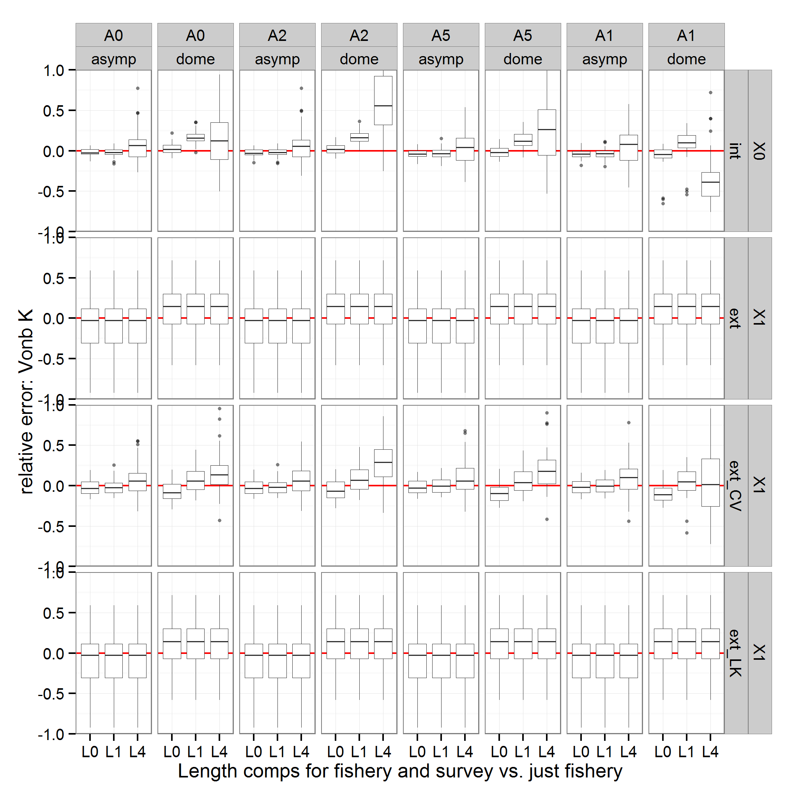
high-fish-surv
high-fish
low-fish
no age
Age comps
Fishery selectivity
Internal
External
Ext_CV
Ext_LK

Slide 21
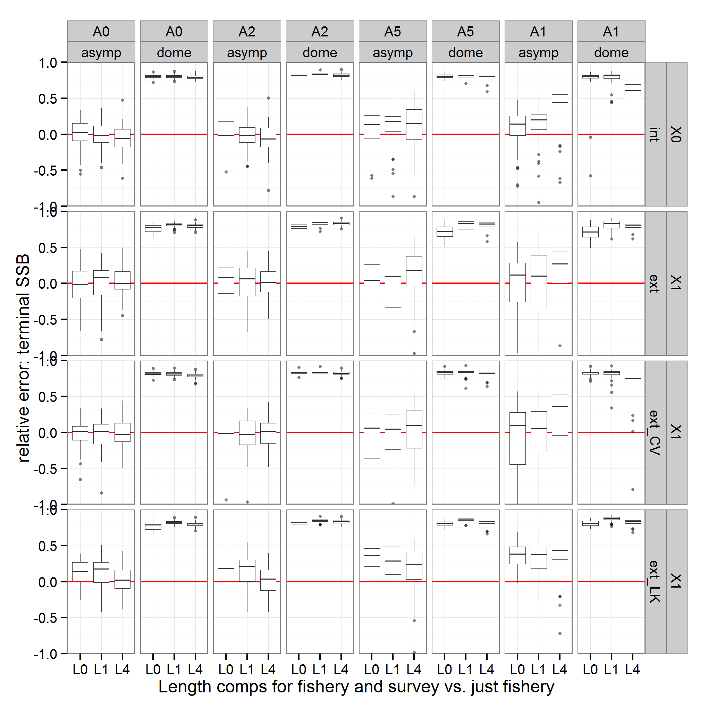
high-fish-surv
high-fish
low-fish
no age
Age comps
Fishery selectivity
Internal
External
Ext_CV
Ext_LK

Slide 22
Summary of results
*Selectivity misspecification
*Positive bias in LAmin and K in external estimator
*Fewer length data results in biased internal estimates of growth, particularly with no age data
*External estimates perform comparably to internal estimates with poor data and selectivity misspecification

Slide 23
Future research
Incorporate Conditional Age-at-Length
Incorporate alternatives to the data used externally
Expand analyses to 3 life histories
Short-lived, fast-growing small pelagic (P. mackerel)
Long-lived, slow-growing (Rockfish)
Medium-lived, moderate-growing type (P. hake)

