Slide 1
Evaluating the impacts of fixing or estimating growth parameters, across life histories and data availability
Juan L. Valero, Kelli F. Johnson, Christine Stawitz, Roberto Licandeo, Sean C. Anderson, Allan Hicks, Felipe Hurtado- Ferro, Peter Kuriyama, Cole C. Monnahan, Kotaro Ono, Ian Taylor, Merrill Rudd

Slide 2
Data
mean size-at-age
Resample from the truth
Year | Length | Weight | Sex | Age
Available data w/ bold indicating used data

Slide 3
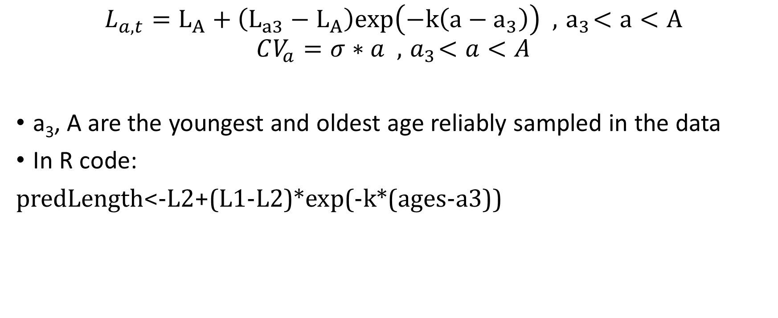
External growth estimation
$$L_{a,t}=L_{A}+\left(L_{a3}−L_{A}\right)exp\left(−k\left(a−a_{3}\right)\right) , { a}_{3}<a<A$$
$$CV_{a}=σ∗a , { a}_{3}<a<A$$
a₃, A are the youngest and oldest age reliably sampled in the data
In R code:
predLength<-L2+(L1-L2)*exp(-k*(ages-a3))

