Slide 1

ss3sim: An R package for stock assessment simulation with SS3
Kelli Johnson (kellifayejohnson@gmail.com)

Slide 2
Outline
Install package framework and get familiar with basics
Run simple example and explore results
Modify simulation and rerun
Explore a few features
Goal: Learn what ss3sim is capable of

Slide 3
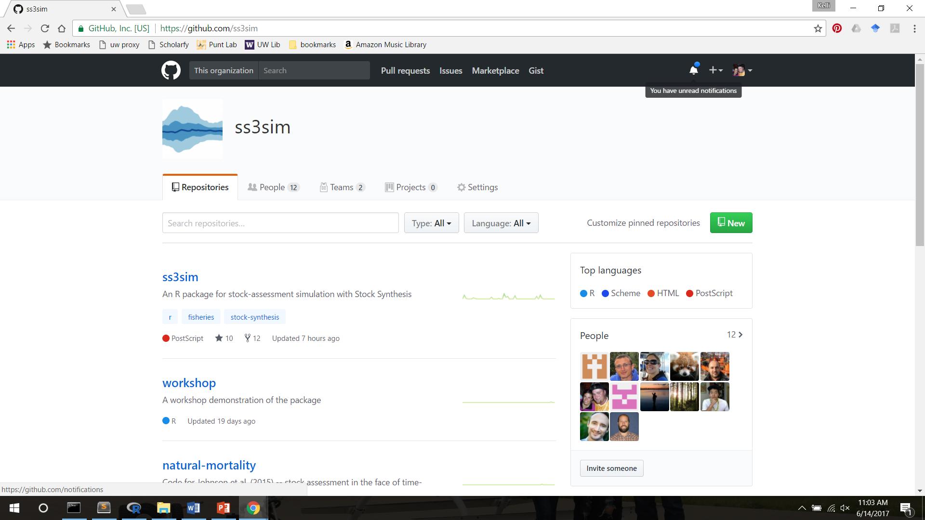
ss3sim: Big picture
What is it?
End-to-end simulation framework in R: OM -> Data -> EM -> analysis

Slide 4



Model OM
starter
control
data
forecast
Text files
Model EM
starter
control
forecast
Scenario
OM
EM
SS3
process error
observation error
bias adjustment

Slide 5
ss3sim: Big picture
Software Details
Open source, cross platform (Windows, OS X, Linux).
Available from
CRAN (http://cran.r-project.org/package=ss3sim)
Development version (www.github.com/ss3sim/ss3sim)
Requires:
SS3.24o
R (version >= 3.3.3)
r4ss

Slide 6
ss3sim: Big picture
Documentation
Anderson et al. (2014; http://doi.org/10.1371/journal.pone.0092725):
Introduces the package
Describes the philosophy and goals
Details basic functionality with a toy example
Vignette
R help files for individual function (?ss3sim , etc.)
Manuscript repositories
https://github.com/ss3sim/natural-mortality
https://github.com/ss3sim/binning

Slide 7
Step 0
Install package with:
if(!“devtools” %in% installed.packages()[, “Package”]) {
install.packages(“devtools”)
}
devtools::install_github(“ss3sim/ss3sim”, dependencies = TRUE,
build_vignettes = TRUE)
Make sure libraries can be loaded
<Look at SS3 model (OM and EM) files>

Slide 8
Step 1
Run the first example
<Look at r4ss output>
Rerun with more iterations in parallel
So what is ‘D0-F1-cod’?

Slide 9
Model OM
starter
control
data
forecast
Text files
Model EM
starter
control
forecast
Scenario
OM
EM
SS3
process error
observation error
bias adjustment

Slide 10
ss3sim Cases
D0-F0-cod
“D” case
“F” case
species
scenarios
D0-F1-cod
D0-F0-M0-S1-R2-cod
D1-F0-M2-S1-R2-cod
D0-F0-M2-S1-R2-cod
D0-F1-sar

Slide 11
ss3sim Cases
D0-F1-cod
Conceptually: mechanism to manipulate SS3 model structure
In practice: R case arguments passed to internal R functions during execution of OM and EM
Cases are specific to a species (e.g., cod)
mandatory: Fishing (F) and Data (D)
optional: e.g., change estimated parameters, process noise, retrospective, etc.

Slide 12
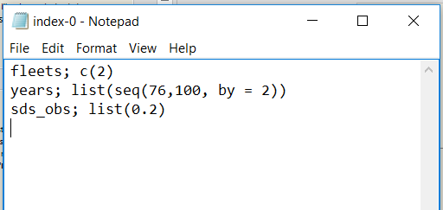
ss3sim Cases
Case D0 – to sample the data
lognormal samples from the second fleet every 2 years, with σ = 0.2
sample_index
sample_agecomp
sample_lcomp
OM
(expected values)
data
EM

Slide 13
ss3sim Cases
Different arguments to the same functions create case numbers
fleets;c(2)
years;list(seq(76,100, by=2))
sds_obs;list(0.2)
D0
“High survey effort”
fleets;c(2)
years;list(seq(76,100, by=2))
sds_obs;list(0.4)
D1
“Low survey effort”

Slide 14
ss3sim Scenarios
Scenarios: unique combinations of case numbers
Data (D)
Fishing effort (F)
Model (species)
Scenario="D0-E0-F0-R0-cod”
Estimation (E)
Retrospective (R)

Slide 15
Step 1
Run the first example
Look at r4ss output
Rerun with more iterations in parallel
So what is ‘D0-F1-cod’?
Read in results
<Look at scalar and time-series files>

Slide 16
Result File Structure
D0-F1-cod
D0-F1-cod
…
ScenarioN
ss3sim_scalar.csv
ss3sim_ts.csv
results_scalar_D0-F1-cod.csv
results_ts_D0-F1-cod.csv
…
bias
1
2
N
…
OM
EM
log.txt
(case arguments)
1
Nbias
AdjustBias.DAT
AvgBias.DAT
SS3 Model files
SS3 Model files

Slide 17
Collecting Results
get_results_all(directory, overwrite_files, user_scenarios)
Uses r4ss and extracts from all scenarios in directory
Returns
Simulation metrics (scenario, replicate, etc.)
OM and EM params and derived quantities
Convergence metrics (invertible Hessian, params_on_bounds, max_grad, runtime)
Stored in two files:
ss3sim_scalars.csv (M, MSY, etc.)
ss3sim_ts.csv (SSB(y), F(y), etc.)

Slide 18
Plotting Results
plot_scalar_points(data, x, y, horiz, horiz2,
vert, vert2, color, relative.error, axes.free)
Makes liberal use of ggplot and aes_string. Arguments are:
x,y: Character columns to plot, where x can be a factor or not
horiz, horiz2: Character columns for how to facet by horizontal rows
vert, vert2: Character columns for how to facet by vertical columns
color: Character column for the color of points or lines (via an aesthetic)
relative.error: TRUE/FALSE whether to set ylim=(-1,1)
axes.free: TRUE/FALSE whether to set facet y-limits to be free of fixed
[see also plot_scalar_boxplot, plot_ts_points, plot_ts_lines, plot_ts_boxplot which have the same syntax and arguments]

Slide 19
Step 2
Goals:
Explore how cases are read in and used in R
Explore what sample_agecomp does in text editor
Task: Add a new case D1 and run new scenarios

Slide 20
Step 3
We won’t have time to run it, but let’s design and look at the results of a more complicated simulation.
Suppose you are interested in the interaction of process error and data weighting:
Does process error influence the effect of improperly weighted comp data?
How does this change with what params are estimated?

Slide 21
Changing estimated params
We will explore 3 cases of estimation:
Neither h nor M estimated (fixed at truth)
h estimated
M estimated
Use change_e function (change estimation)

Slide 22
Process Error
Recruitment deviations:
Automatically generated (lognormal corrected)
OR specified by the user (e.g., miniscule, autocorrelated or heteroskedastic)
Recdevs reused across scenarios, such that all iteration 1’s use the same recdevs
Use change_tv to add process error to OM parameter

Slide 23
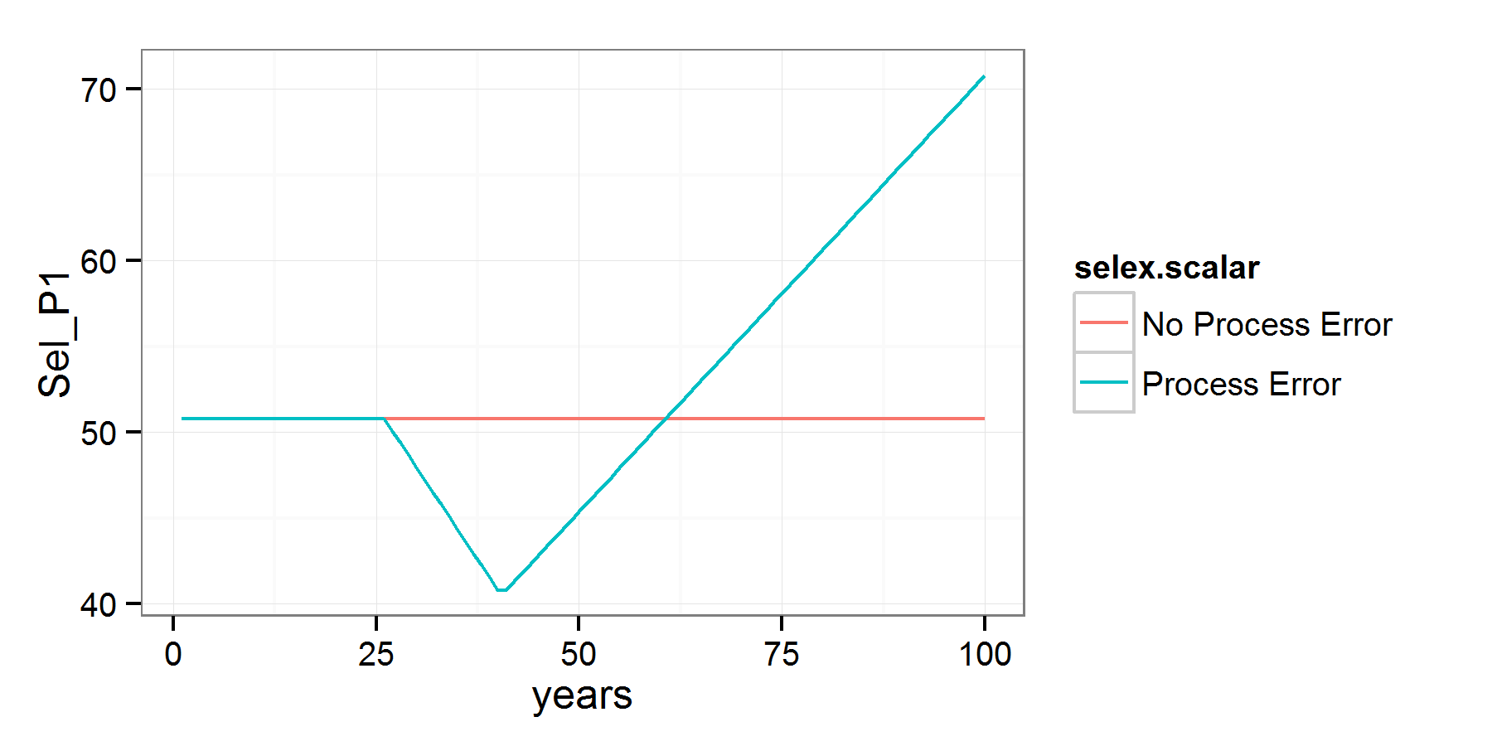
Step 3: Adding process error
Trend added to fishery selex to simulate, e.g., shifts in fishing gear¹.
¹ parameterized as double normal but setup to be logistic

Slide 24
Observation Error
Length, age, CAAL, empirical W@A, mean L@A, and index data, for arbitrary fleets, years, sample sizes
Indices: lognormal with specified σ
Compositions:
Multinomial or Dirichlet (overdispersed) samples
Dynamic binning: programmatically set bin widths.
Effective sample size: calculated internally or supplied by user
Note: SS3 bootstrapping is NOT used

Slide 25
Step 3: Varying data weights
Comp ESS varies from 10% to 1000% for all fleets and years.
Index is unchanged, and everything is (as always) unbiased.
¹ Growth and many other params fixed for all scenarios

Slide 26
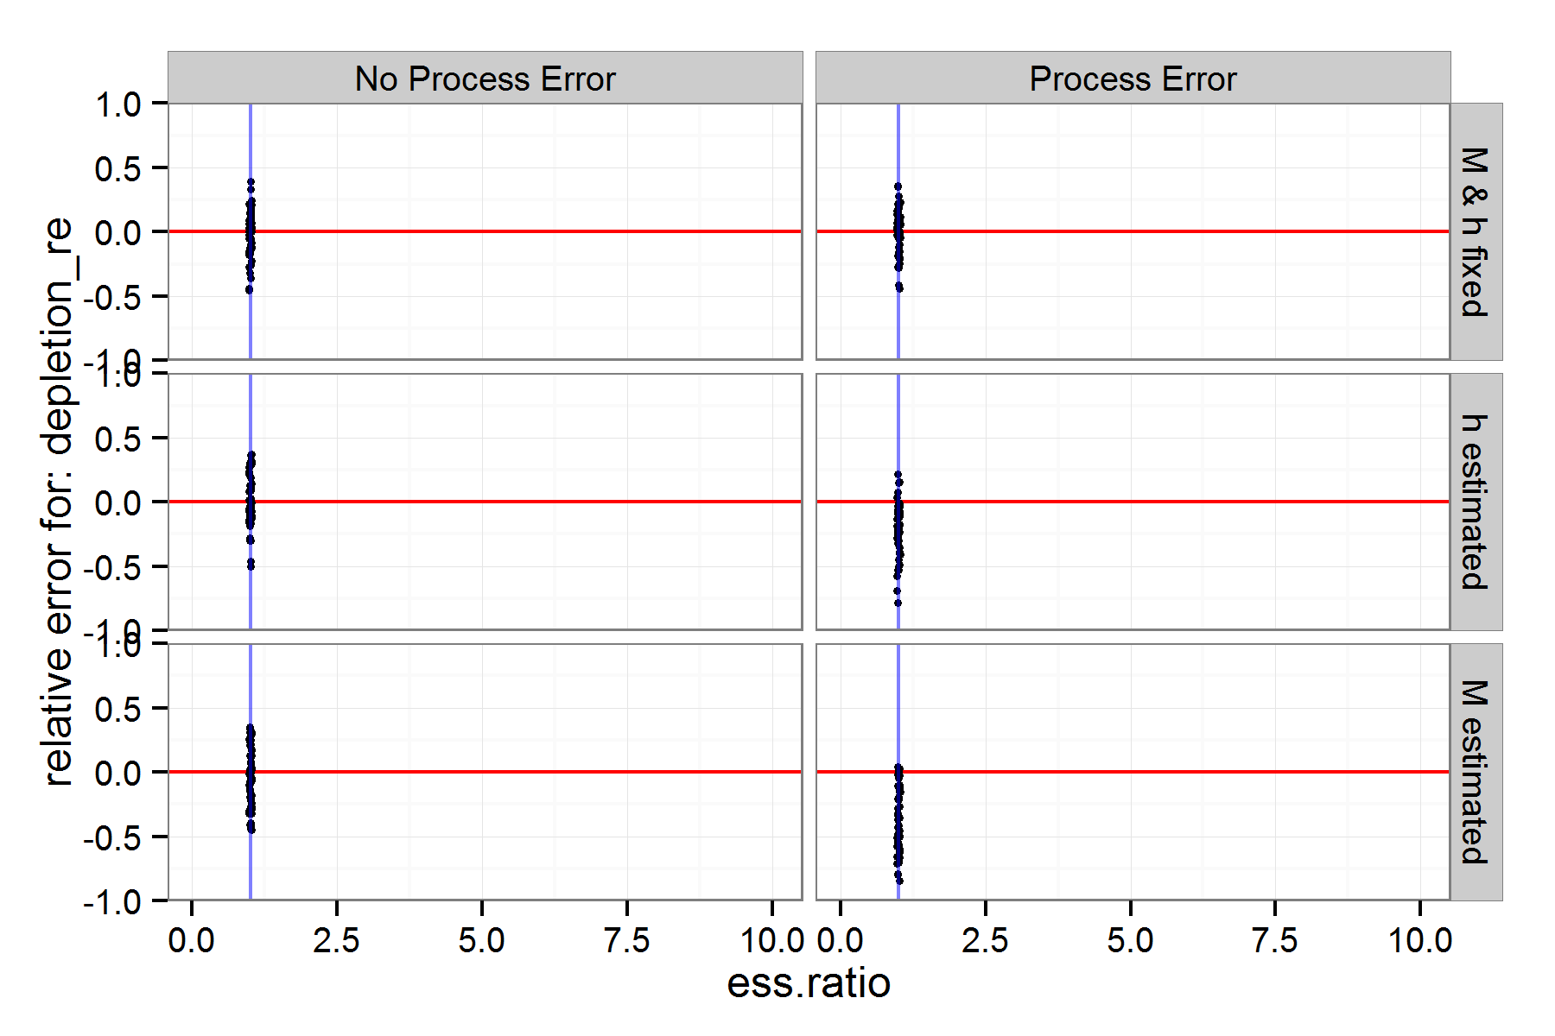
Step 3: What happens w/ ESS?
???

Slide 27
How ss3sim can be used
Functions
Top level: run_ss3sim
Low level: change_e change_f can be used separately in custom simulation frameworks
Models (github.com/ss3sim/ss3models)
Packaged (cod, flatfish, sardine, rockfish, hake)
Build your own (see vignette, share it with us!)

Slide 28
Final Thoughts
To build a simulation, we recommend:
Start with a simple simulation like this one
Add complexity slowly, a piece at a time
At each step, check individual model files and overall results
Think of cases as dimensions of a simulation. Ss3sim is designed to easily add and create factorial combinations of cases.
Because of the complexity of SS3, it is difficult to produce a generic tool on top of it.
It is not designed to test specific “real” models, instead use it to test general properties of simplified models.

Slide 29
Final Thoughts
Think of cases as dimensions of a simulation. ss3sim is designed to easily add factorial combinations of cases.
Because of the complexity of SS3, it is difficult to produce a generic tool on top of it.
It is not designed to test specific “real” models, instead use it to test general properties of simplified models.

Slide 30
Final Thoughts
ss3sim can be used as an end-to-end simulation framework, or just the individual functions for other tasks
ss3sim is designed to be reproducible, flexible and rapid. We believe this can be a valuable alternative to custom frameworks.
Actively and consistently maintained, and open for new contributors

