Slide 1

ss3sim: An R package for stock assessment simulation with SS3
A demo at the 2015 CAPAM workshop
Cole Monnahan (monnahc@uw.edu)
Kelli Johnson (kfjohns@uw.edu)

Slide 2
Outline
Install package framework and get familiar with basics
Run simple example¹ and explore results
Modify simulation and rerun
Explore process error and data weighting interaction
Goal: Learn what the tool is capable of, and whether it may be useful for future projects
¹ A set of files accompany this presentation: an R script, case files, and archived results

Slide 3
ss3sim: Big picture
What is it?
End-to-end simulation framework in R: OM -> Data -> EM -> analysis
Software Details
Open source, cross platform (Windows, OS X, Linux).
Requires: SS3.24o, R >= 3.2.0, r4ss
CRAN (http://cran.r-project.org/package=ss3sim)
Development version (www.github.com/ss3sim/ss3sim) [recommended]
Documentation
PLoS One Paper: Introduces the package, describes the philosophy and goals, and details basic functionality with a toy example
Vignette and R help files for individual function (?ss3sim , etc.)

Slide 4
ss3sim: Big picture
Input files
starter
control
data
forecast
Output for debugging
warning.sso
echoinput.sso
ParmTrace.sso
r4ss
SS3
Output with results
Report.sso
CompReport.sso
covar.sso
Forecast-report.sso
Mirrored Output
starter.ss_new
control.ss_new
data.ss_new
forecast.ss_new
r4ss
ss3sim
Adapted from Juan Valero, SS workshop materials

Slide 5
Step 0
Install package with:
if(!require(devtools)) install.packages('devtools')
devtools::install_github('ss3sim/ss3sim', dependencies = TRUE,
build_vignettes = TRUE)
Make sure libraries can be loaded
<Look at model (OM and EM) files>

Slide 6
Step 1
Run the first example (<look at CPU usage>)
<Look at r4ss output>
Rerun with more iterations in parallel (<look at CPU usage>)
So what is ‘D0-F1-cod’?

Slide 7
ss3sim Cases
Conceptually: Mechanism which manipulates model structure
In practice: R function arguments to modify OM/EM files
The case arguments are passed to internal R functions during execution
Cases are specific to a model (e.g., ‘cod’)
Two are mandatory: Fishing (F) and Data (D)
Some are optional: Which params to estimate, OM process noise, retrospective, etc.

Slide 8
ss3sim Cases
Cases sample the data (D)
sample_index
sample_agecomp
smaple_lcomp
OM
(expected values)
data
EM
lognormal samples every 2 years, with σ=.2
fleets;c(2)
years;list(seq(76,100, by=2))
sds_obs;list(.2)

Slide 9
ss3sim Cases
Different arguments to the same functions create case numbers
fleets;c(2)
years;list(seq(76,100, by=2))
sds_obs;list(0.2)
D0
“High survey effort”
fleets;c(2)
years;list(seq(76,100, by=2))
sds_obs;list(0.4)
D1
“Low survey effort”

Slide 10
ss3sim Scenarios
Scenarios: unique combinations of case numbers
Data (D)
Fishing effort (F)
Model (species)
Scenario="D0-E0-F0-R0-cod”
Estimation (E)
Retrospective (R)

Slide 11
Step 1
Run the first example (look at CPU usage)
Look at r4ss output
Rerun with more iterations in parallel (look at CPU usage)
So what is ‘D0-F1-cod’?
Read in results
<Look at scalar and timeseries files>

Slide 12
Result File Structure
All Results:
ss3sim_scalar.csv
ss3sim_ts.csv
Scenario1
(D0-F1-cod)
Scenario2
(D0-F1-cod)
…
ScenarioN
results_scalar_scenario2.csv
results_ts_scenario2.csv
…
bias
Replicate 1
2
N
…
AdjustBias.DAT
AvgBias.DAT
OM
EM
log.txt
(case arguments)
1
Nbias
SS Model files
SS Model files

Slide 13
Collecting Results
get_results_all(directory, overwrite_files, user_scenarios)
Uses r4ss and extracts from all scenarios in directory
Returns:
Simulation metrics (scenario, replicate, etc.)
OM and EM params and derived quantities
Convergence metrics:
invertible Hessian, params_on_bounds, max_grad, runtime
Stored in two files:
ss3sim_scalars for scalar quantities (M, MSY, etc.)
ss3sim_ts for time-varying quantities (SSB(y), F(y), etc.)

Slide 14
Plotting Results
plot_scalar_points(data, x, y, horiz, horiz2,
vert, vert2, color, relative.error, axes.free)
Makes liberal use of ggplot and aes_string. Arguments are:
x,y: Character columns to plot, where x can be a factor or not
horiz, horiz2: Character columns for how to facet by horizontal rows
vert, vert2: Character columns for how to facet by vertical columns
color: Character column for the color of points or lines (via an aesthetic)
relative.error: TRUE/FALSE whether to set ylim=(-1,1)
axes.free: TRUE/FALSE whether to set facet y-limits to be free of fixed
[see also plot_scalar_boxplot, plot_ts_points, plot_ts_lines, plot_ts_boxplot which have the same syntax and arguments]

Slide 15
Step 2
Goals:
Explore how cases are read in and used in R
Explore what sample_agecomp does in text editor
Task: Add a new case D1 and run new scenarios

Slide 16
Step 3
We won’t have time to run it, but let’s design and look at the results of a more complicated simulation.
Suppose you are interested in the interaction of process error and data weighting:
Does process error influence the effect of improperly weighted comp data?
How does this change with what params are estimated?

Slide 17
Changing estimated params
We will explore 3 cases of estimation¹:
Neither h nor M estimated (fixed at truth)
h estimated
M estimated
This is done with the change_e function (change estimation).

Slide 18
Process Error
Recruitment deviations:
Automatically generated (lognormal corrected)
OR specified by the user (e.g., miniscule, autocorrelated or heteroskedastic).
Recdevs reused across scenarios, such that all iteration 1’s use the same recdevs
Use change_tv to add process error to OM parameter.

Slide 19
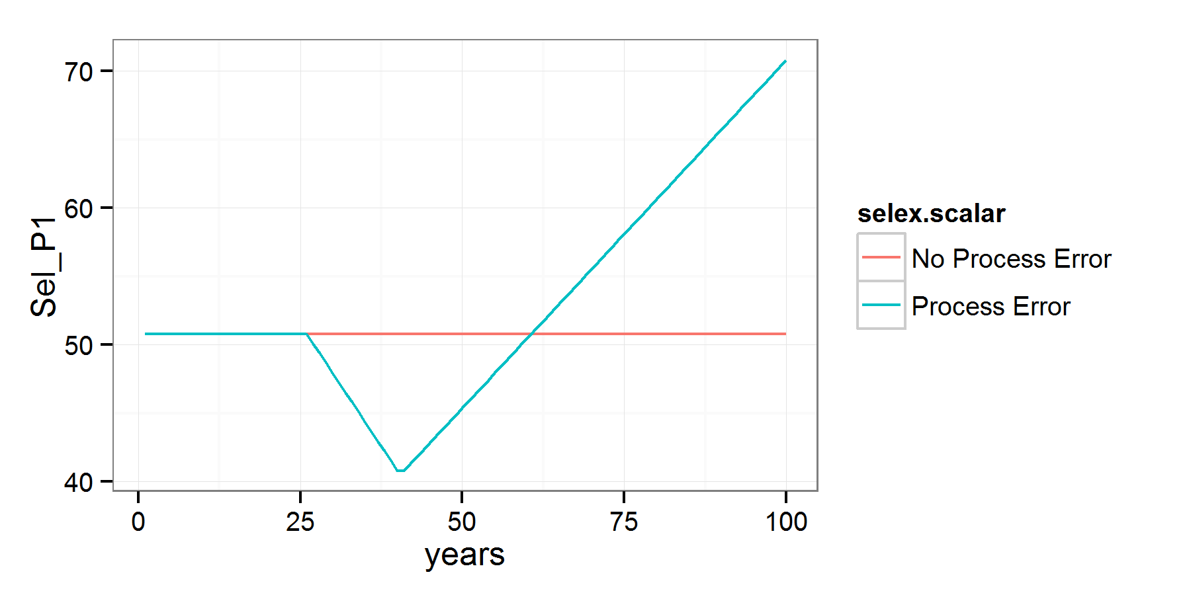
Step 3: Adding process error
Trend added to fishery selex to simulate, e.g., shifts in fishing gear¹.
¹ parameterized as double normal but setup to be logistic

Slide 20
Observation Error
Length, age, CAAL, empirical W@A, mean L@A, and index data, for arbitrary fleets, years, sample sizes
Indices: lognormal with specified σ
Compositions:
Multinomial or Dirichlet (overdispersed) samples
Dynamic binning: programmatically set bin widths.
Effective sample size: calculated internally or supplied by user
Note: SS3 bootstrapping is NOT used

Slide 21
Step 3: Varying data weights
Comp ESS varies from 10% to 1000% for all fleets and years.
Index is unchanged, and everything is (as always) unbiased.
¹ Growth and many other params fixed for all scenarios

Slide 22
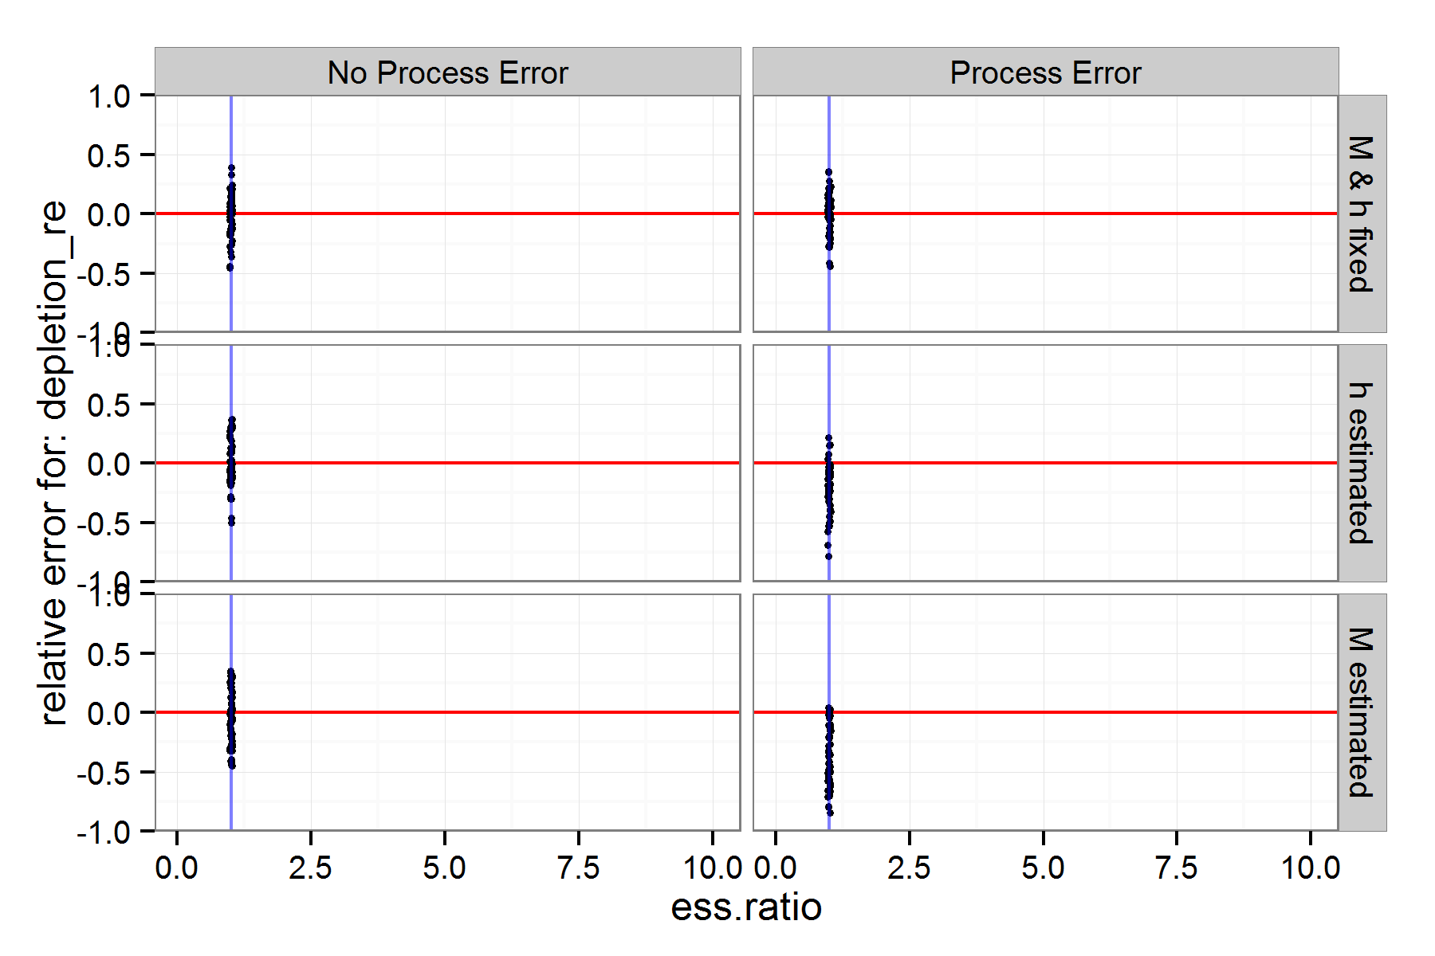
Step 3: What happens w/ ESS?
???

Slide 23
How ss3sim can be used
Functions
Top level: run_ss3sim
Mid level: ss3sim_base, takes cases as function calls instead of text files
Low level: separately in custom simulation frameworks
Models¹
Packaged (cod, flatfish, sardine, rockfish, hake)
Build your own (see vignette, share it with us!)
¹ See github.com/ss3sim/ss3models for more info

Slide 24
Final Thoughts
To build a simulation, we recommend:
Start with a simple simulation like this one
Add complexity slowly, a piece at a time
At each step, check individual model files and overall results
Think of cases as dimensions of a simulation. Ss3sim is designed to easily add and create factorial combinations of cases.
Because of the complexity of SS3, it is difficult to produce a generic tool on top of it.
It is not designed to test specific “real” models, instead use it to test general properties of simplified models.

Slide 25
Final Thoughts
Think of cases as dimensions of a simulation. ss3sim is designed to easily add factorial combinations of cases.
Because of the complexity of SS3, it is difficult to produce a generic tool on top of it.
It is not designed to test specific “real” models, instead use it to test general properties of simplified models.

Slide 26
Final Thoughts
ss3sim can be used as an end-to-end simulation framework, or just the individual functions for other tasks
ss3sim is designed to be reproducible, flexible and rapid. We believe this can be a valuable alternative to custom frameworks.
Actively and consistently maintained, and open for new contributors

