Slide 1

ss3sim: An R package for stock assessment simulation with SS3
A demo at the 2015 CAPAM workshop
Cole Monnahan (monnahc@uw.edu)
Kelli Johnson (kfjohns@uw.edu)

Slide 2
Outline
Install package framework and get familiar with basics
Run simple example¹ and play with results
Modify simulation and rerun
Explore process error and data weight interaction
Goal: Learn what the tool is capable of, and whether it may be useful for future projects
¹ A set of files accompany this presentation: an R script, case files, and archived results

Slide 3
ss3sim: Big picture
What is it?
End-to-end simulation framework in R: OM -> Data -> EM -> analysis
Software Details
Open source, cross platform (Windows, OS X, Linux).
Requires: SS3.24O, R >= 3.0.0, r4ss
CRAN (http://cran.r-project.org/package=ss3sim)
Development version (www.github.com/ss3sim/ss3sim) [recommended]
Documentation
PLoS One Paper: Introduces the package, describes the philosophy and goals, and details basic functionality with a toy example
Vignette and R help files for individual function (?ss3sim , etc.)

Slide 4
ss3sim: Big picture
Input files
starter
control
data
forecast
Output for debugging
warning.sso
echoinput.sso
ParmTrace.sso
r4ss
SS3
Output with results
Report.sso
CompReport.sso
covar.sso
Forecast-report.sso
Mirrored Output
starter.ss_new
control.ss_new
data.ss_new
forecast.ss_new
r4ss
ss3sim
Adapted from Juan Valero, SS workshop materials

Slide 5
Step 0
Install package with:
if(!require(devtools)) install.packages('devtools')
devtools::install_github('ss3sim/ss3sim', dependencies = TRUE,
build_vignettes = TRUE)
Make sure libraries can be loaded
<Look at model (OM and EM) files>

Slide 6
Step 1
Run the first example (<look at CPU usage>)
<Look at r4ss output>
Rerun with more iterations in parallel (<look at CPU usage>)
So what is ‘D0-F1-cod’?

Slide 7
ss3sim Cases
Conceptually: Mechanism which manipulates model structure
In practice: R function arguments to modify OM/EM files
The case arguments are passed to internal R functions during execution
Cases are specific to a model (e.g., ‘cod’)
Two are mandatory: Fishing (F) and Data (D)
Some are optional: Which params to estimate, OM process noise, retrospective, etc.

Slide 8
ss3sim Cases
Cases sample the data (D)
sample_index
sample_agecomp
smaple_lcomp
OM
(expected values)
data
EM
lognormal samples every 2 years, with σ=.2
fleets;c(2)
years;list(seq(76,100, by=2))
sds_obs;list(.2)

Slide 9
ss3sim Cases
Different arguments to the same functions create case numbers
fleets;c(2)
years;list(seq(76,100, by=2))
sds_obs;list(0.2)
D0
“High survey effort”
fleets;c(2)
years;list(seq(76,100, by=2))
sds_obs;list(0.4)
D1
“Low survey effort”

Slide 10
ss3sim Scenarios
Scenarios: unique combinations of case numbers
Data (D)
Fishing effort (F)
Model (species)
Scenario="D0-E0-F0-R0-cod”
Estimation (E)
Retrospective (R)

Slide 11
Step 1
Run the first example (look at CPU usage)
Look at r4ss output
Rerun with more iterations in parallel (look at CPU usage)
So what is ‘D0-F1-cod’?
Read in results
<Look at scalar and timeseries files>

Slide 12
Result File Structure
All Results:
ss3sim_scalar.csv
ss3sim_ts.csv
Scenario1
(D0-F1-cod)
Scenario2
(D0-F1-cod)
…
ScenarioN
results_scalar_scenario2.csv
results_ts_scenario2.csv
…
bias
Replicate 1
2
N
…
AdjustBias.DAT
AvgBias.DAT
OM
EM
log.txt
(case arguments)
1
Nbias
SS Model files
SS Model files

Slide 13
Collecting Results
get_results_all(directory, overwrite_files, user_scenarios)
Uses r4ss and extracts from all scenarios in directory
Returns:
Simulation metrics (scenario, replicate, etc.)
OM and EM params and derived quantities
Convergence metrics:
invertible Hessian, params_on_bounds, max_grad, runtime
Stored in two files:
ss3sim_scalars for scalar quantities (M, MSY, etc.)
ss3sim_ts for time-varying quantities (SSB(y), F(y), etc.)

Slide 14
Plotting Results
plot_scalar_points(data, x, y, horiz, horiz2,
vert, vert2, color, relative.error, axes.free)
Makes liberal use of ggplot and aes_string. Arguments are:
x,y: Character columns to plot, where x can be a factor or not
horiz, horiz2: Character columns for how to facet by horizontal rows
vert, vert2: Character columns for how to facet by vertical columns
color: Character column for the color of points or lines (via an aesthetic)
relative.error: TRUE/FALSE whether to set ylim=(-1,1)
axes.free: TRUE/FALSE whether to set facet y-limits to be free of fixed
[see also plot_scalar_boxplot, plot_ts_points, plot_ts_lines, plot_ts_boxplot which have the same syntax and arguments]

Slide 15
Step 2
Goals:
Explore how cases are read in and used in R
Explore what sample_agecomp does in text editor
Task: Add a new case D1 and run new scenarios

Slide 16
Step 3
We won’t have time to run it, but let’s design and look at the results of a more complicated simulation.
Suppose you are interested in the interaction of process error and data weighting:
Does process error influence the effect of improperly weighted comp data?
How does this change with what params are estimated?

Slide 17
Process Error
Recruitment deviations:
Automatically generated (lognormal corrected)
OR specified by the user (e.g., miniscule, autocorrelated or heteroskedastic).
Recdevs reused across scenarios, such that all iteration 1’s use the same recdevs
Use change_tv to add process error to OM parameter.

Slide 18
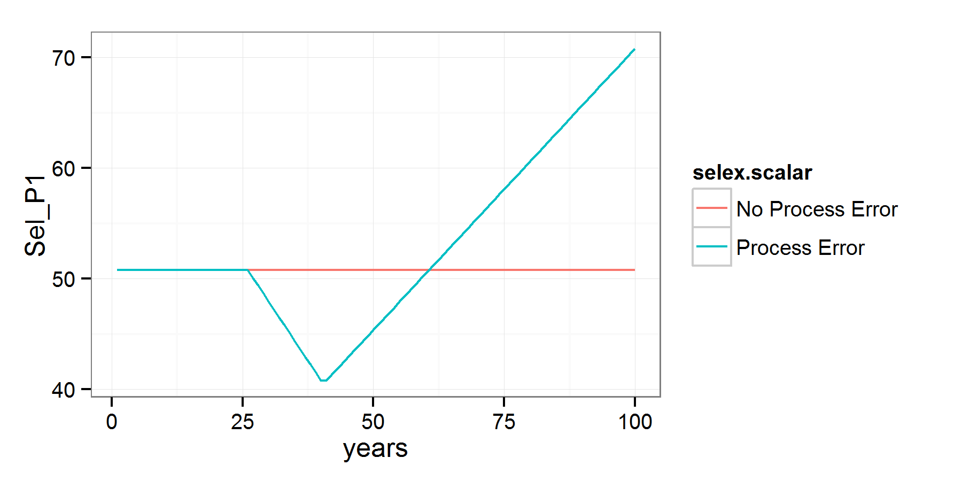
Step 3: Adding process error
Trend added to fishery selex to simulate, e.g., shifts in fishing gear¹.
¹ parameterized as double normal but setup to be logistic

Slide 19
Observation Error
Length, age, CAAL, empirical W@A, mean L@A, and index data, for arbitrary fleets, years, sample sizes
Indices: lognormal with specified σ
Compositions:
Multinomial or Dirichlet (overdispersed) samples
Dynamic binning: programmatically set bin widths.
Effective sample size: calculated internally or supplied by user
Note: SS3 bootstrapping is NOT used

Slide 20
Step 3: Varying data weights
Comp ESS varies from 10% to 1000% for all fleets and years.
Index is unchanged, and everything is (as always) unbiased.
Also have 3 cases of estimation¹:
Neither h nor M estimated (fixed at truth)
h estimated
M estimated
¹ Growth and many other params fixed for all scenarios

Slide 21
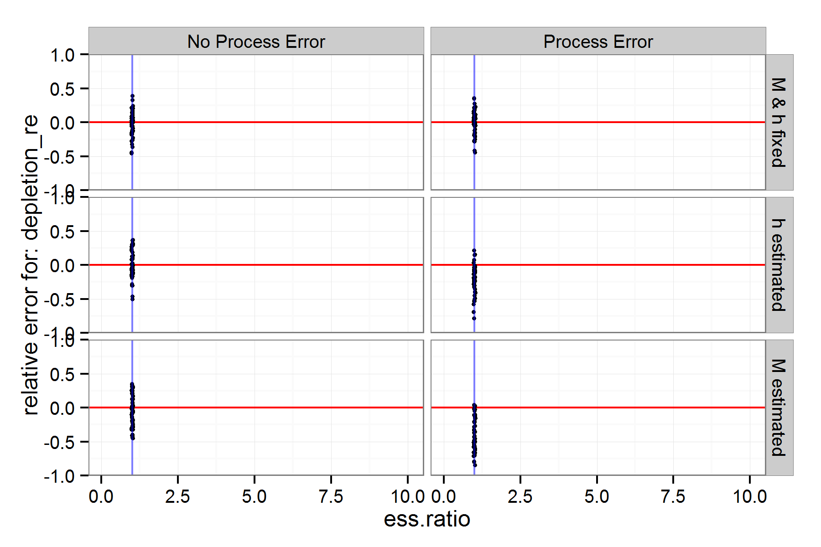
Step 3: What happens w/ ESS?
???

Slide 22
How ss3sim can be used
Functions
Top level: run_ss3sim
Mid level: ss3sim_base, takes cases as function calls instead of text files
Low level: separately in custom simulation frameworks
Models¹
Packaged (cod, flatfish, sardine, rockfish, hake)
Build your own (see vignette, share it with us!)
¹ See github.com/ss3sim/ss3models for more info

Slide 23
Final Thoughts
ss3sim can be used as an end-to-end simulation framework, or just the individual functions for other tasks
ss3sim is designed to be reproducible, flexible and rapid. We believe this can be a valuable alternative to custom frameworks.
Actively and consistently maintained, and open for new contributors

