Slide 1

ss3sim: An R package for stock assessment simulation with SS3
Kelli Johnson (kellifayejohnson@gmail.com)

Slide 2
Goal: Learn capabilities of ss3sim
Big picture
Install package
Basics
Run example
Modify simulation
Explore some features

Slide 3
Big picture
End-to-end simulation framework in R
Operating model (OM)
Data
Estimation method (EM)
Analysis

Slide 4
Big picture
Open source
Cross platform (Windows, OS X, Linux)
Available from
CRAN
github (Development version)

Slide 5
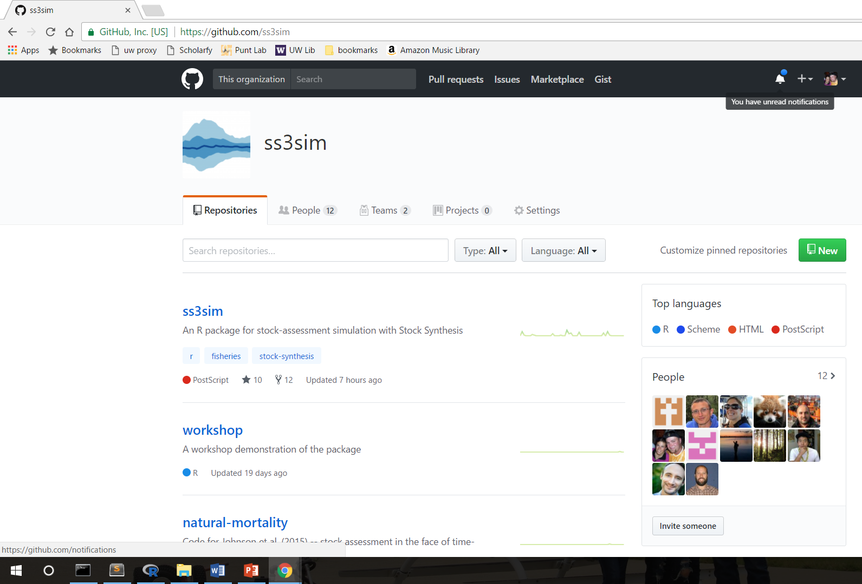
Big picture
R package on github

Slide 6


Big picture
ss3sim
SS3
v. SS3.24o
v. 1.27.0

Slide 7
Model OM
starter
control
forecast
data
Cases
Text files
Model EM
starter
control
forecast
Scenario
OM
EM
process error
observation error
bias adjustment

Slide 8
Big picture
Anderson et al. (2014)
Describes goals
Toy example
Vignette
R help files (e.g., ?ss3sim)
ss3sim repositories
workshop
Manuscripts (e.g., Monnahan et al. 2016)

Slide 9
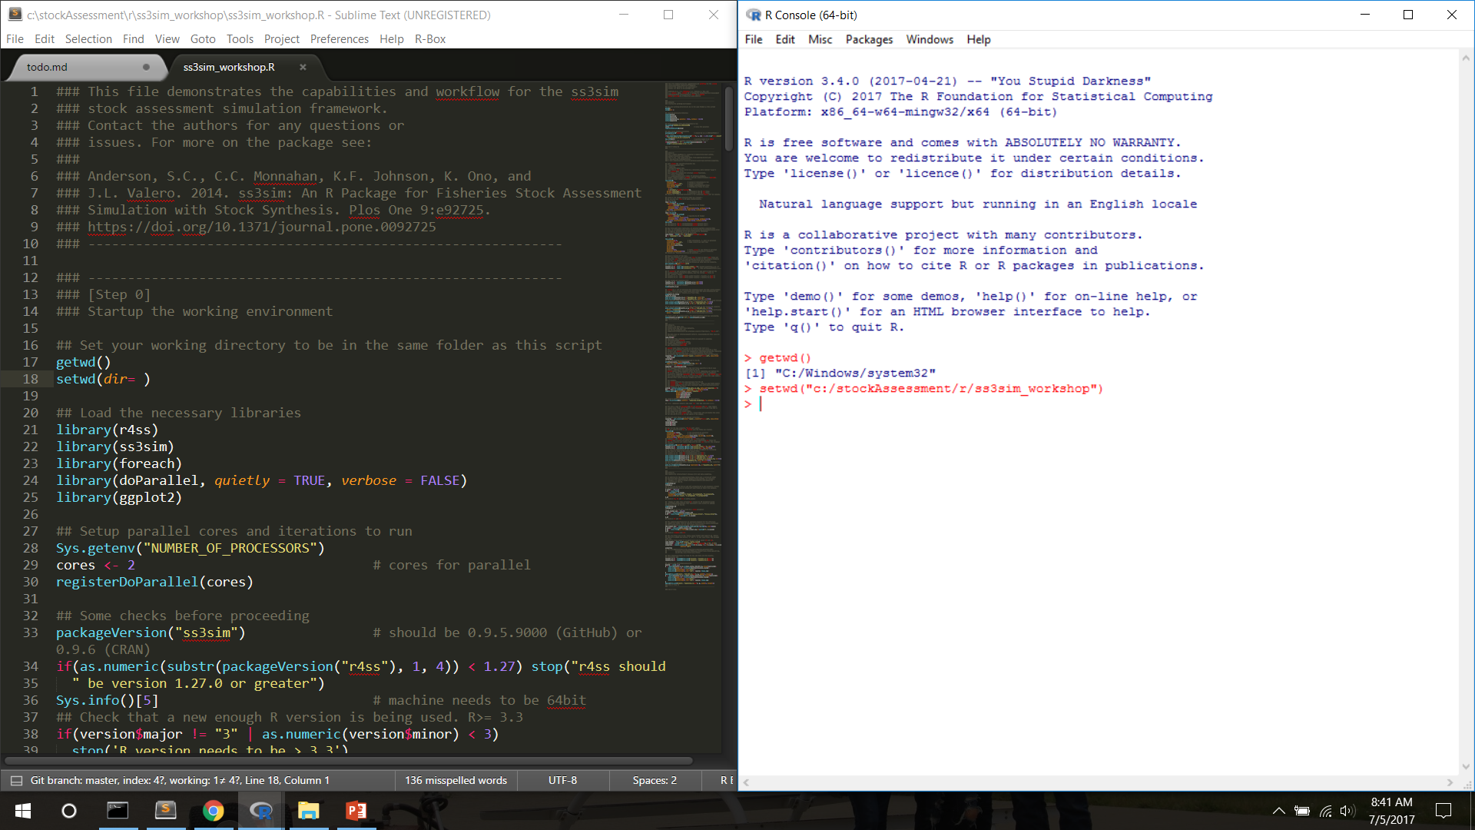
ss3sim_workshop.R

Slide 10
Step 0
Install package
install.packages(“devtools”)
devtools::install_github(“ss3sim/ss3sim”, dependencies = TRUE,
build_vignettes = TRUE)
Load libraries
<Look at SS3 model files>

Slide 11
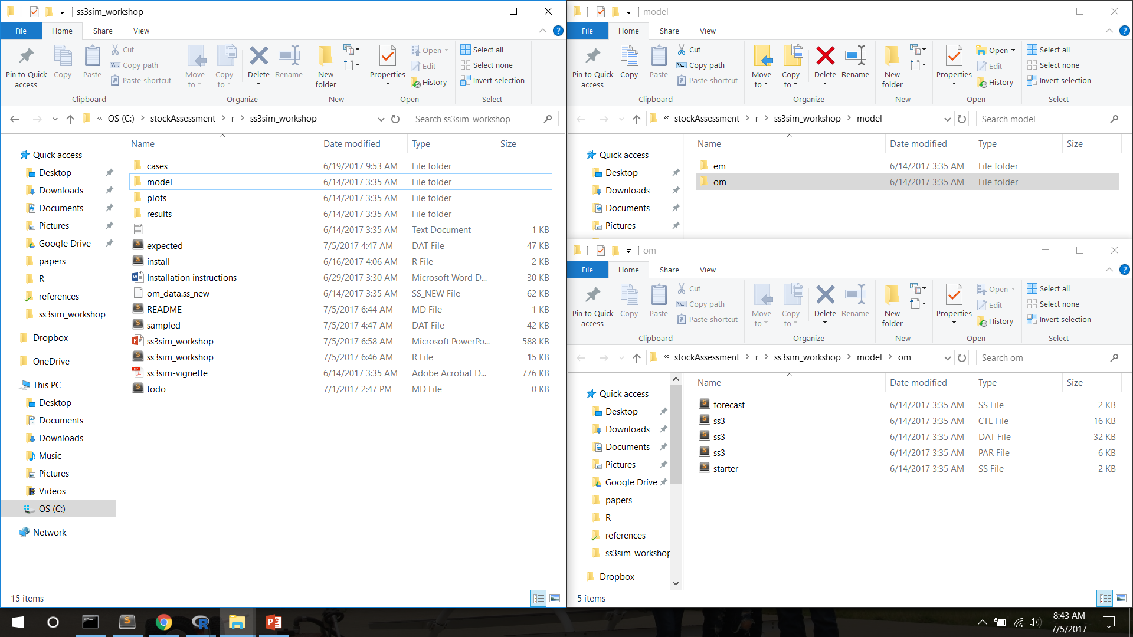
ss3sim_workshop.R

Slide 12
Step 1
Run example
<Look at r4ss output>
Rerun example in parallel
Look at ‘D0-F1-cod’

Slide 13
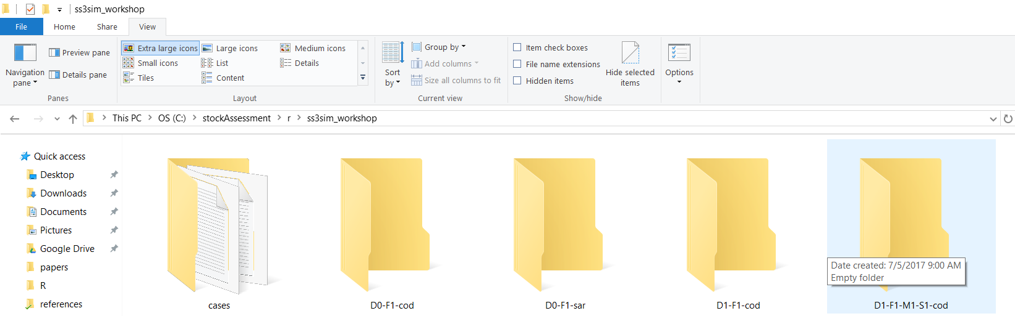
Cases
D0-F0-cod
‘D’ case
‘F’ case
species

Slide 14

Cases
Mechanism to manipulate SS3 model
R arguments passed to internal R functions during execution of OM and EM
Cases are specific to a species (e.g., cod)
Mandatory: Fishing (F) and Data (D)
Optional: specify new letter for retrospective

Slide 15
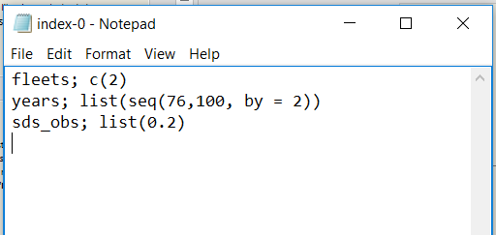
Case D0 –sample index data
lognormal bi-yearly samples (σ=0.2) from fleet 2

Slide 16
Case D0 – to sample the data
sample_index(
dat_list,
outfile,
fleets,
years,
sds_obs,
make_plot = FALSE,
write_file = TRUE)
OM
(expected values)
data
EM

Slide 17
Case numbers == different arguments
D0 (index0-cod.txt); “High survey effort”
fleets;c(2)
years;list(seq(76,100, by=2))
sds_obs;list(0.2)
D1 (index1-cod.txt); “Low survey effort”
fleets;c(2)
years;list(seq(76,100, by=2))
sds_obs;list(0.4)

Slide 18
ss3sim Scenarios
Scenarios: unique combinations of case numbers
Data (D)
Fishing effort (F)
Model (species)
Scenario="D0-E0-F0-R0-cod”
Estimation (E)
Retrospective (R)

Slide 19
Step 1
Run example
<Look at r4ss output>
Rerun example in parallel
Look at ‘D0-F1-cod’

Slide 20
Result File Structure
D0-F1-cod
D0-F1-cod
…
ScenarioN
ss3sim_scalar.csv
ss3sim_ts.csv
results_scalar_D0-F1-cod.csv
results_ts_D0-F1-cod.csv
…
bias
1
2
N
…
OM
EM
log.txt
(case arguments)
1
Nbias
AdjustBias.DAT
AvgBias.DAT
SS3 Model files
SS3 Model files

Slide 21
Collecting results
get_results_all(directory, overwrite_files, user_scenarios)
Uses r4ss and extracts from all scenarios in directory
Returns
Simulation metrics (scenario, replicate, etc.)
OM and EM params and derived quantities
Metrics (Hessian, pars on bounds, gradient, runtime)
Stored in two files:
ss3sim_scalars.csv (M, MSY, etc.)
ss3sim_ts.csv (SSB(y), F(y), etc.)

Slide 22
Plotting Results
plot_scalar_points(data, x, y, horiz, horiz2,
vert, vert2, color, relative.error, axes.free)
Uses ggplot2 and aes_string
x,y: Character columns to plot, x can be a factor
horiz, horiz2: Character columns of facet by rows
vert, vert2: Character columns of facet by columns
color: Character column to color
relative.error: TRUE/FALSE to set ylim=(-1,1)
axes.free: TRUE/FALSE to set free or fixed y-limits
see also: plot_scalar_boxplot, plot_ts_points, plot_ts_lines, plot_ts_boxplot

Slide 23
Step 2
Goals:
Explore how cases are read in and used in R
Explore what sample_agecomp does
Task: Add a new case D1
Task: Run iterations in parallel

Slide 24
Step 3
Design and look at the results of a more complicated simulation.
E.g., interaction of process error and data weighting:
Does process error influence the effect of improperly weighted composition data?
How does this change with what parameters are estimated?

Slide 25
Changing estimated parameters
Explore 3 cases of estimation:
Neither h nor M estimated (fixed at truth)
h estimated
M estimated
Use ‘change estimation’ function (change_e)

Slide 26
Process Error
Recruitment deviations:
Automatically generated (lognormal corrected)
User specified (e.g., miniscule, autocorrelated or heteroskedastic)
All iteration 1’s use the same recdevs, …
change_tv: adds process error to OM

Slide 27
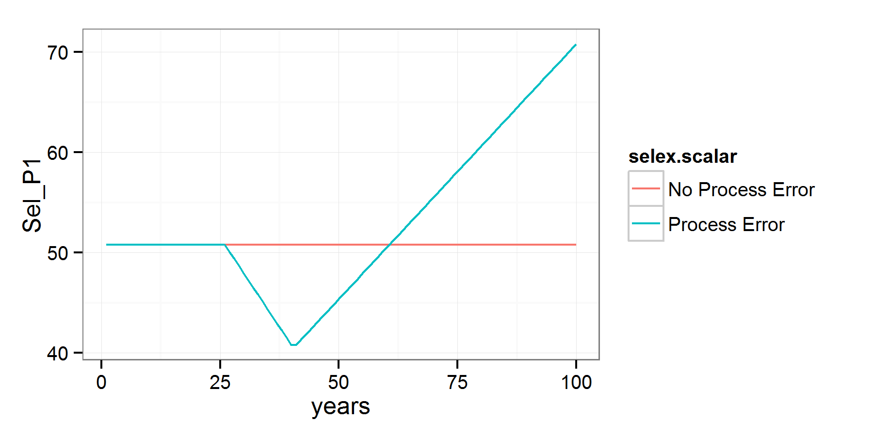
Step 3: Adding process error
Trend added to fishery selectivity to simulate, shifts in fishing gear.
¹ parameterized as double normal but setup to be logistic

Slide 28
Observation Error
Length, age, CAAL, empirical W@A, mean L@A, and index data, for arbitrary fleets, years, sample sizes
Indices: lognormal with specified σ
Compositions:
Multinomial or Dirichlet (overdispersed) samples
Dynamic binning: programmatically set bin widths.
Effective sample size: calculated internally or supplied by user
Note: SS3 bootstrapping is NOT used

Slide 29
Step 3: Varying data weights
Composition effective sample size (ESS) varies from 10% to 1000% for all fleets and years.
Index is unchanged, and everything is unbiased.

Slide 30
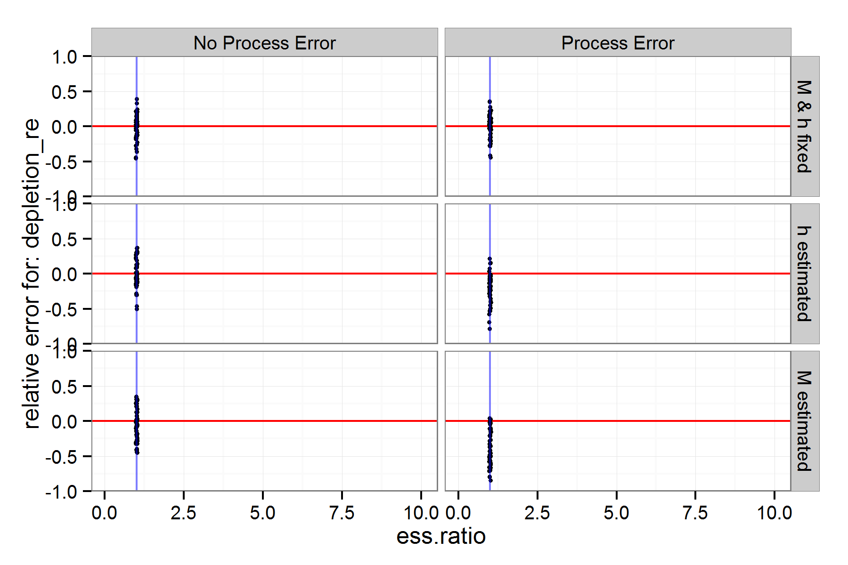
Step 3: What happens w/ ESS?
???

Slide 31
How ss3sim can be used
Top-level functions: run_ss3sim
Low-level functions: (e.g., change_e change_f) can be used separately in custom simulation frameworks
Models
cod, flatfish, sardine, rockfish, hake
Build your own (see vignette, share it with us!)

Slide 32
Final Thoughts
Start simple
Add complexity slowly, one piece at a time
At each step, check individual model files and overall results
Think of cases as dimensions of a simulation
ss3sim is designed to easily add and create factorial combinations of cases
ss3sim is designed to test general properties of simplified models

Slide 33
Final Thoughts
ss3sim is an end-to-end simulation framework or can provide individual functions
ss3sim is designed to be reproducible, flexible and rapid
Actively and consistently maintained

