Slide 1


CSR
name country email
sig algorithm
…

Slide 2
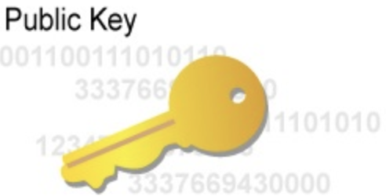



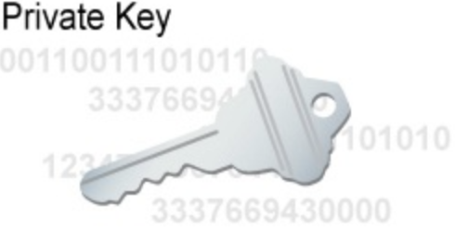
CSR
name country email
sig algorithm
…
키체인 접근
키 쌍, CSR 생성
인증기관에서 인증서 발급

Slide 3
App ID
Device IDs

Slide 4
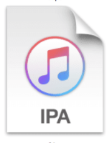

<code>
<resource>
<entitlement>
<plist>

Slide 5
apns
google push provider
1. request token
4. send push using token
2. get token
5. receive push
app
server
3. register token

