Slide 1


CSR
name country email
sig algorithm
…

Slide 2
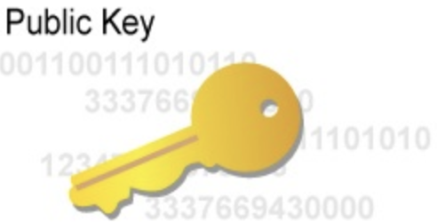

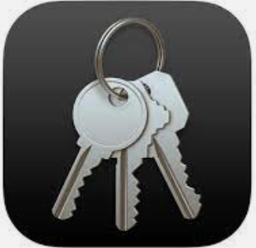

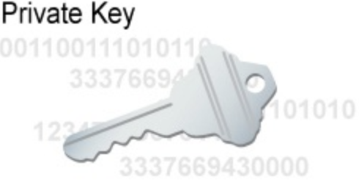
CSR
name country email
sig algorithm
…
키체인 접근
키 쌍, CSR 생성
인증기관에서 인증서 발급

Slide 3
App ID
Device IDs

Slide 4
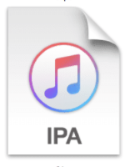

<code>
<resource>
<entitlement>
<plist>

Slide 5
apns
google push provider
1. request token
4. send push using token
2. get token
5. receive push
app
server
3. register token

Slide 6
apns
4. wake up
3. send push (token, pushMagic)
device (MDM profile)
2. mdm protocol
server (MDM SP)
check-in (auth, updateToken)
5. mdm protocol
1. Install mdm profile
command(idle, ack, error, notNow)

