Slide 1


From Raw Readings to Reliable Forecasts & Beyond
Why meter level prediction matters
Satyabrat Srikumar (ss7172)
Department of Computer Science,
Columbia University
Advisor: Prof. Dr. Alp Kucukelbir

Slide 2

Motivation
&
Agenda
Part 1
Data
Part 2
EDA
Part 3
Modelling
Part 4
Insights

Slide 3
Aspect | Key Details
Origin | Kaggle contest – Electricity usage prediction inspired by ASHRAE GEP III
Scope | Hourly Meter readings for 1 year (Jan – Dec 2016)
Granularity | 630k hourly meter readings
Target | meter_reading (kWh) → modeled in log-space (y_log = log1p(meter_reading))
Features (16 raw columns) | Building metadata — building_id, primary_use, square_feet, year_built, floor_count Timestamp — hourly timestamp (TZ-agnostic) Weather — air_temperature, dew_temperature, cloud_coverage, precip_depth_1_hr, sea_level_pressure, wind_direction, wind_speed
Data Quirks | Zeros & spikes in meter reading – heavy left skewed data Weather gaps - cloud_coverage – 304,516 values ≈ 44 % missing, wind_direction – 19,922 values ≈ 3 % missing and so on) Buildings span multiple climate zones but no explicit location identifiers
Dataset Snapshots
Goal
Build accurate hour-ahead electricity predictor for 100-building portfolio
TBD- Analysis to study what electricity consumption reduction potential might exist per building

Slide 4
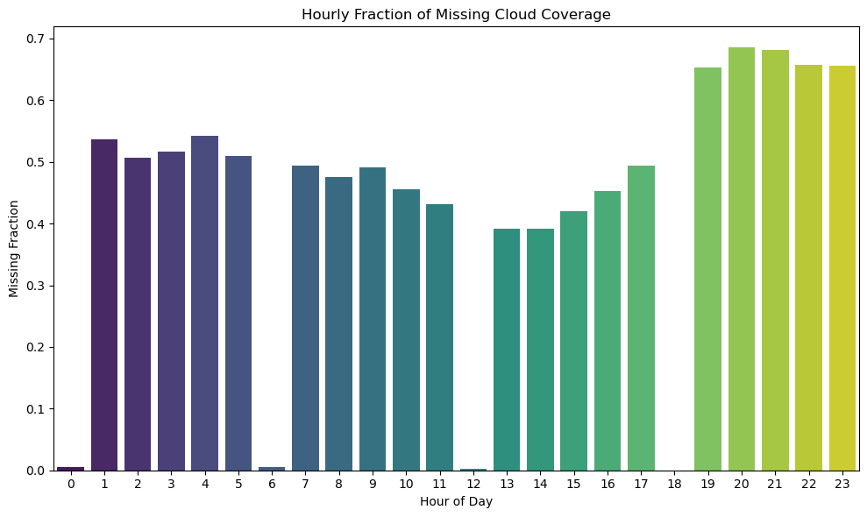
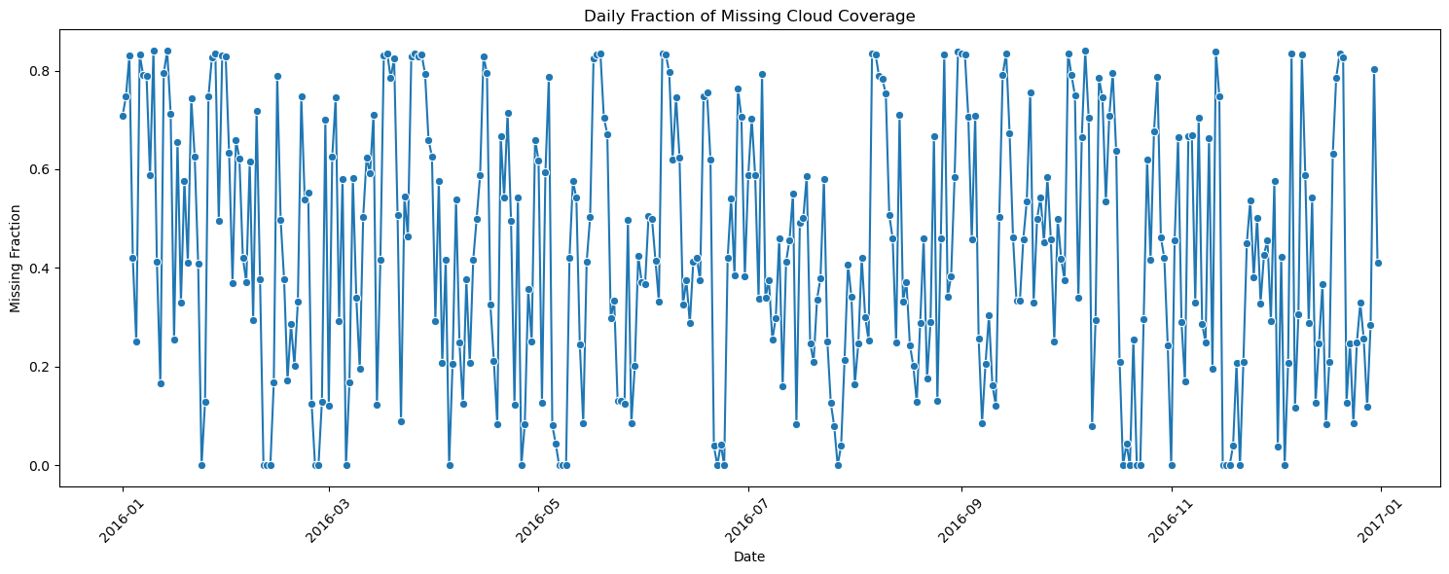
Navigating Missing Data Landmines
These bars show cloud-coverage missing fraction by hour. Note how it’s almost fine at sunrise but two-thirds gone after 7 pm – that’s a sensor power-down, not random noise.
The line plot at the bottom tells the same story per day – big zero-coverage streaks whenever that weather station went dark.
A blind median fill would break the physics
Hour-of-day pattern ⇒ temporal autocorrelation we can leverage.

Slide 5
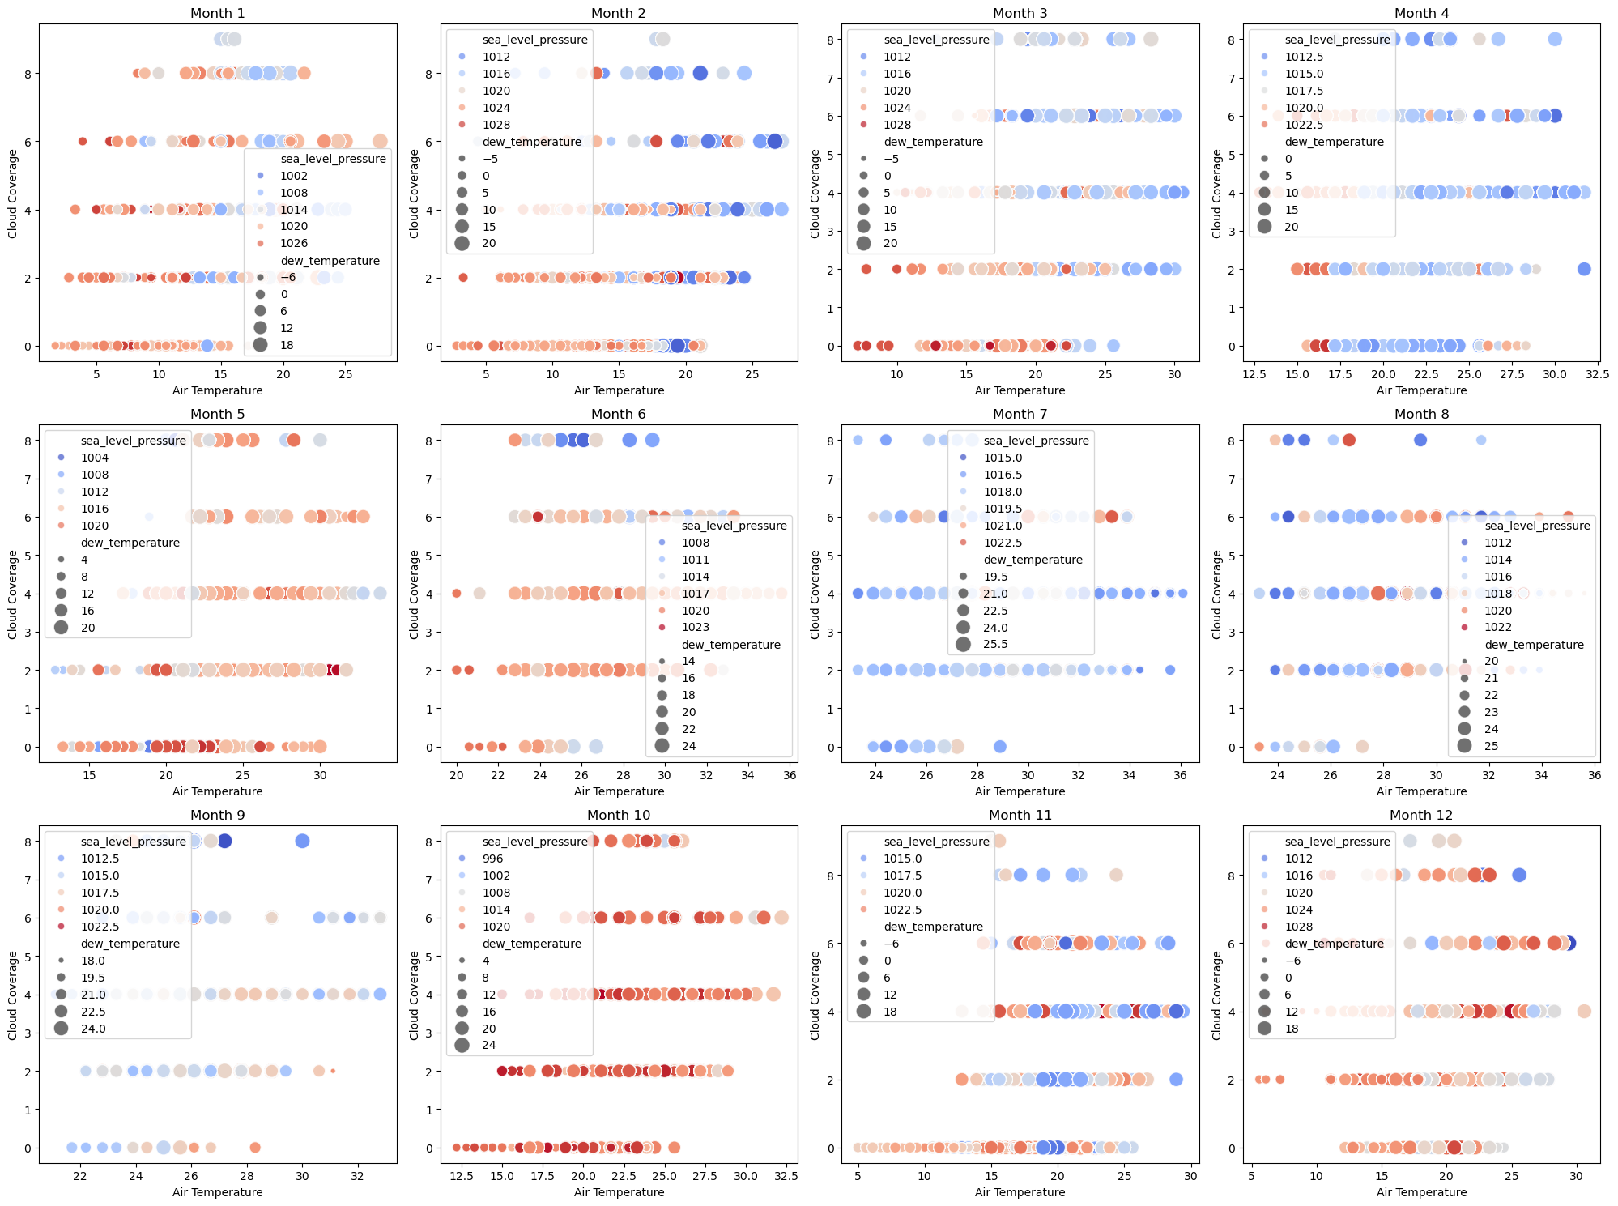
Navigating Missing Data Landmines
Scatter-matrix (Air T° vs Cloud, colour = SLP, size = Dew T°) shows strong multivariate coupling – cloudy hours cluster at lower T° / higher pressure.
Because the drivers flip seasonally, a univariate fill (e.g., median by hour) would miss structure.
Notes:
“Scatter-matrix shows the ‘seasonal dance’: in winter, cloudy hours = cool + humid + high-pressure fog decks; in summer, cloudy hours = humid + low-pressure storm cells. These flip-flops convinced us to let an Iterative Imputer learn the joint relationship instead of hard-coding a rule. Linear interpolation fixed very short gaps; the multivariate model filled the rest with ∼25 % lower RMSE on a blind-holdout of cloud-coverage.”

Slide 6
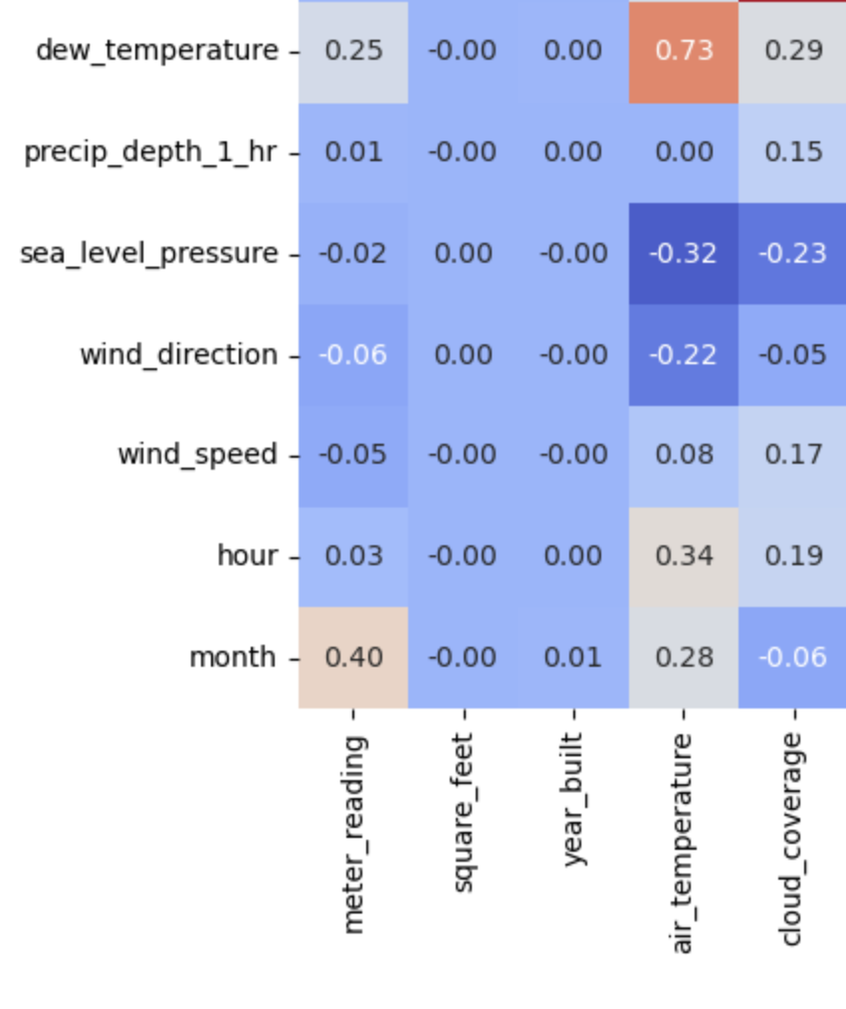
Strategies for Navigating Missing Data Landmines
Time-based interpolation
Keeps short gap continuity – forward/backward fill up to 3 h gaps → restores ~70 % of cloud_coverage NaNs before feature engineering.
Protects sequence models and lags - maintains evenly-spaced series so rolling-mean, lag-24 h, LSTM windows work out-of-the-box.
Iterative Imputer
Captures cross-weather coupling – cloud-coverage, dew-point, pressure, etc. co-vary in season-specific ways (see scatter matrix). Iterative Imputer learns those relationships instead of a one-size-fits-all average.
Reduces bias in downstream models – preserves realistic joint distributions, so tree-boosters don’t over- or under-estimate rare weather regimes.
Notes:
“Scatter-matrix shows the ‘seasonal dance’: in winter, cloudy hours = cool + humid + high-pressure fog decks; in summer, cloudy hours = humid + low-pressure storm cells. These flip-flops convinced us to let an Iterative Imputer learn the joint relationship instead of hard-coding a rule. Linear interpolation fixed very short gaps; the multivariate model filled the rest with ∼25 % lower RMSE on a blind-holdout of cloud-coverage.”

Slide 7
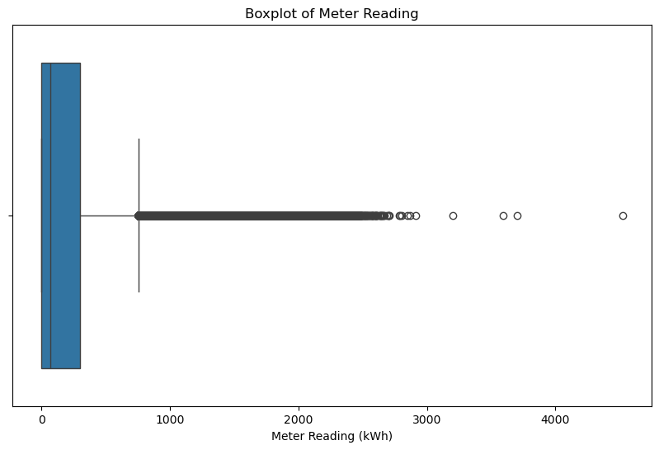
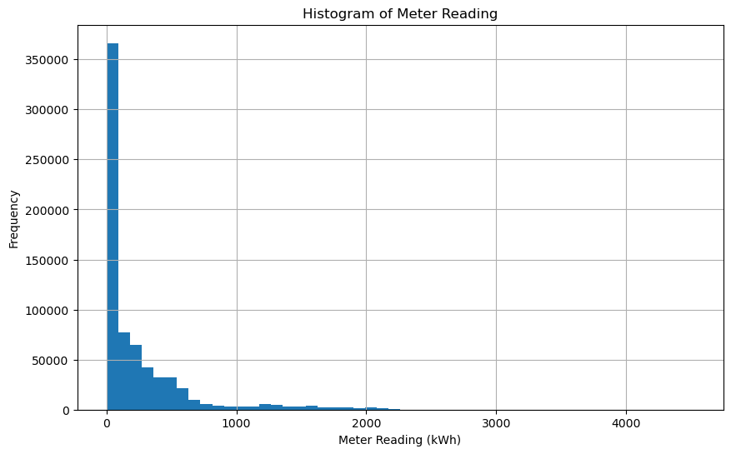
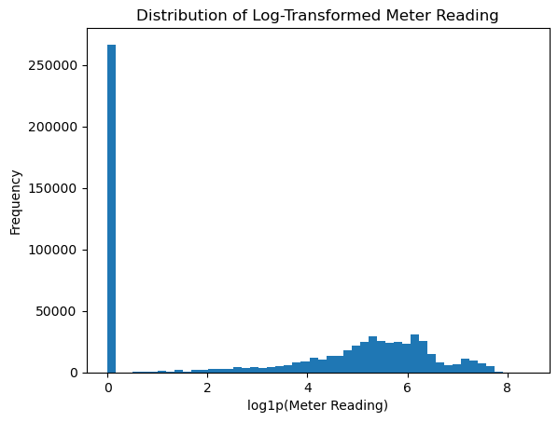
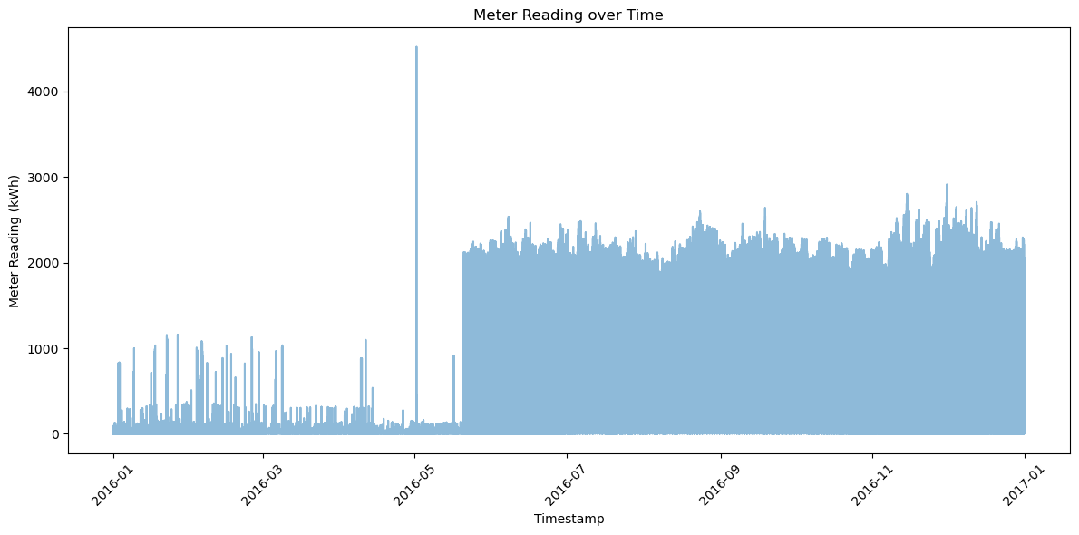
Untangling the Target: meter reading (kWh)

Slide 8
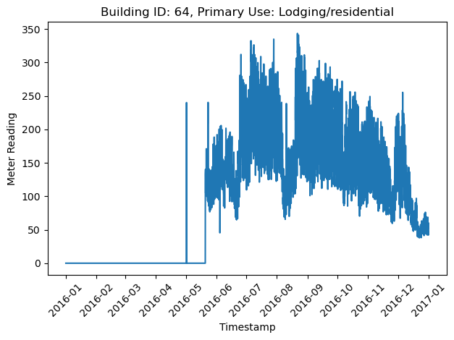
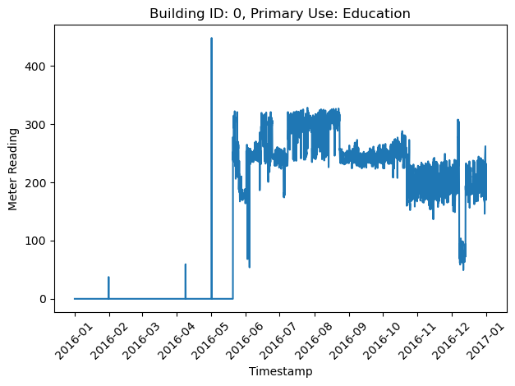
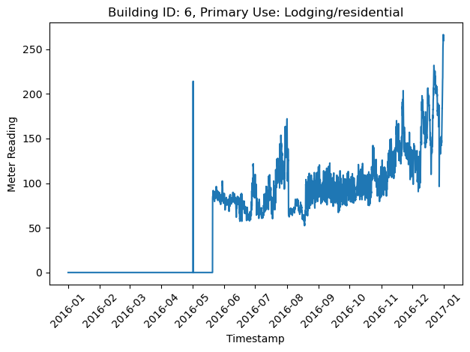
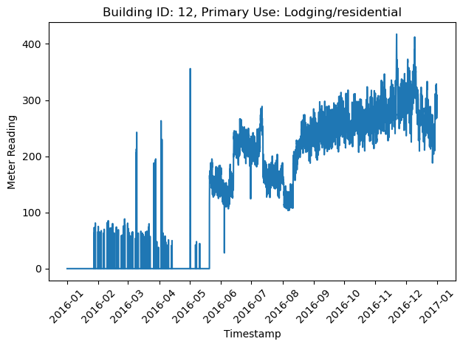
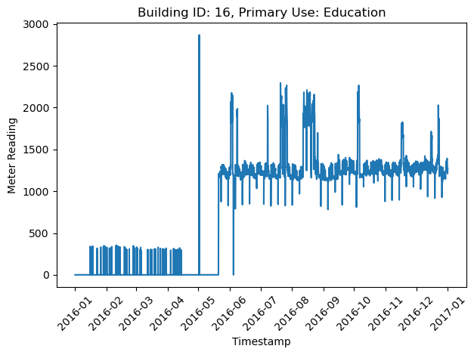
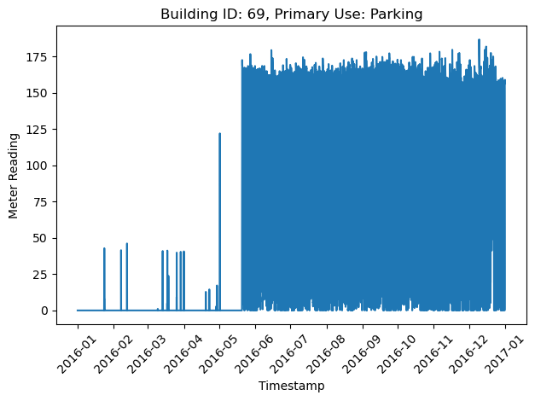
Individual building level profiles

Slide 9
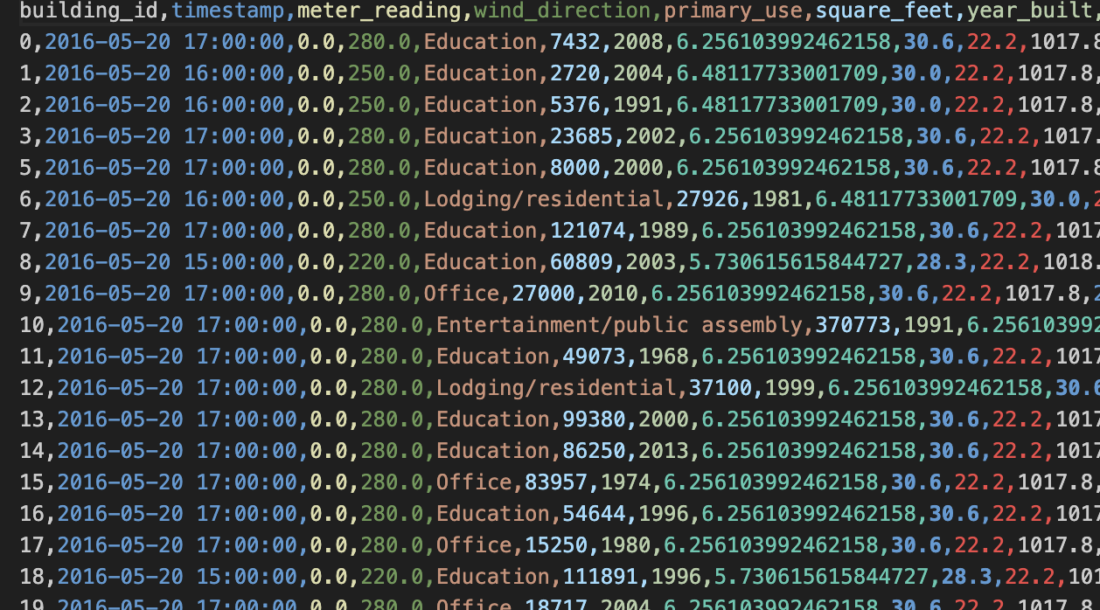
What we discovered after sorting by building_id + timestamp
System-wide “cold start” until 20 May 2016 17:00 – nearly every building reports meter_reading = 0 before that instant.
Isolated pre-start “spikes” (one-hour bursts up to 4 500 kWh)
Post-start data behave normally (seasonal drift, weekday patterns, but no all-zero stretches).
Insights: Zeros before May 20 are a data-collection artifact, not true low usage. Removing & flagging them removes the artifacts and prevents the model from wasting capacity on sensor noise.

Slide 10
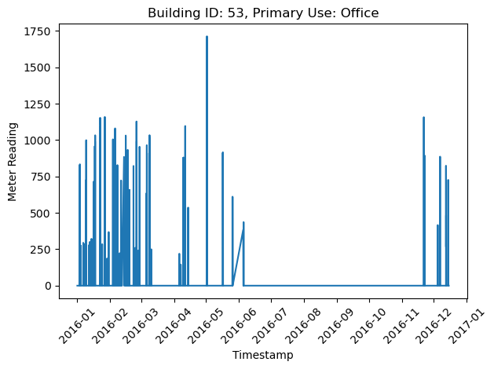
Identifying outliers

Slide 11
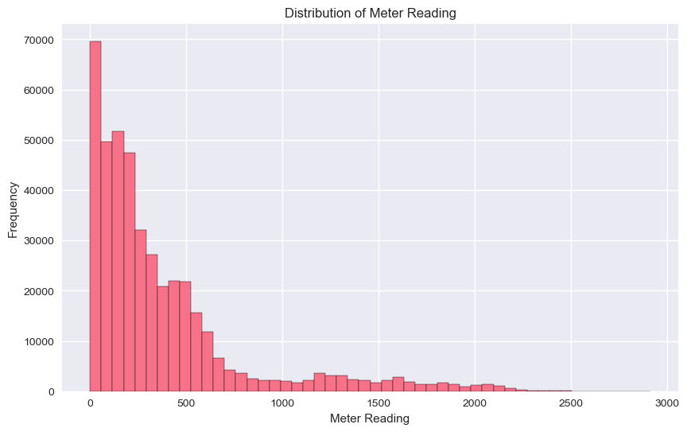
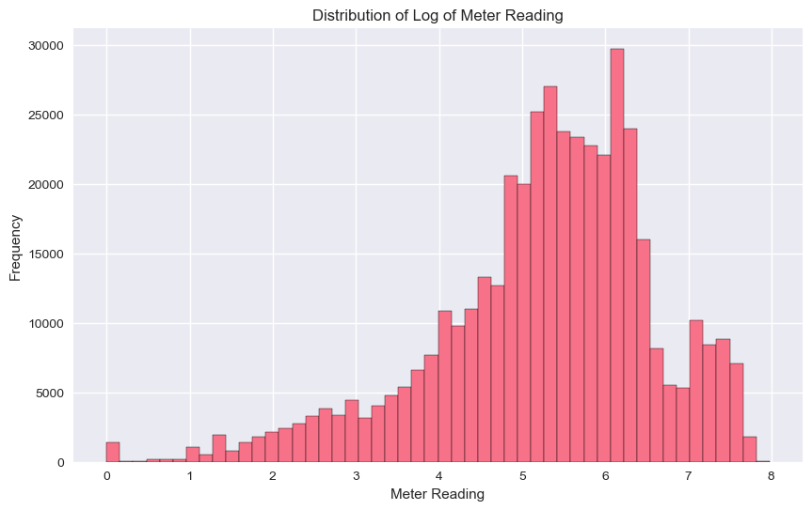
Comparison of Target distribution pre and post cleaning (Discard data before May 20 17:00:00)

Slide 12
Train – Validate – Test Split
Rows kept: 432k (267k dropped)
Phase | Duration | Rows | Purpose
Train | May 20 – Oct 31 | 313,836 | Fit model, early stop
Validate | Nov 1 – Nov 30 | 57,702 | Hyperparameter optimization
Test | Dec 1 – Dec 31 | 60,996 | Final score

Slide 13
Baseline Models Benchmark
Model | Objective | RMSE (kWh)
LightGBM | Tweedie objective Basic datetime features + raw weather, no lag/rolling | ~ 117
XGBoost Regressor | Square-error loss, learning rate 0.5 Sane unput features | ~ 116

Slide 14
Features | Comment
Time-of-day & seasonality ‣ hour_sin, hour_cos (captures 24-h cycle) ‣ month_sin, month_cos (annual cycle) ‣ weekday, is_weekend | Make tree/NN models “see” smooth periodic patterns
Meter autoregression ‣ meter_lag_1h, 24h ‣ meter_last_week (t-168 h) ‣ Rolling stats: mean / std / min over 24 h & 168 h | Energy use is highly persistent; these lags give the model a fast proxy for occupancy & process schedules. Rolling stats dampen noise and signal load ramp-ups.
Weather context ‣ Lags and 24 h / 168 h means for air T°, dew T°, wind, pressure, precip | Smooths sensor spikes and aligns weather dynamics with building thermal inertia.
Building descriptors ‣ log_sqft, building_age ‣ primary_use (one-hot) | Normalises scale (log) and turns year-built into a usable linear age signal.
Quality flags ‣ spike_flag – 1 if reading > 99.9th pct. of that building | Allows the learner to treat occasional metering glitches separately.
Feature engineering

Slide 15
Benchmark – Feature based models under 2 cleaning strategies
Model | Iterative-Imputer clean(RMSE kWh) | Time-interp. clean(RMSE kWh) | Δ (RMSE) | % Improvement from baseline models
LightGBM | 49.58 | 49.13 | -0.45 | ~ 58%
XGBoost | 54.85 | 57.80 | ▲ +2.95 | ~ 51%
Random Forest | 53.90 | 53.94 | +0.04 | NA
Ensemble (LGBM+XGB) | ★ 48.15 | ★ 48.62 | +0.47 | NA

Slide 16
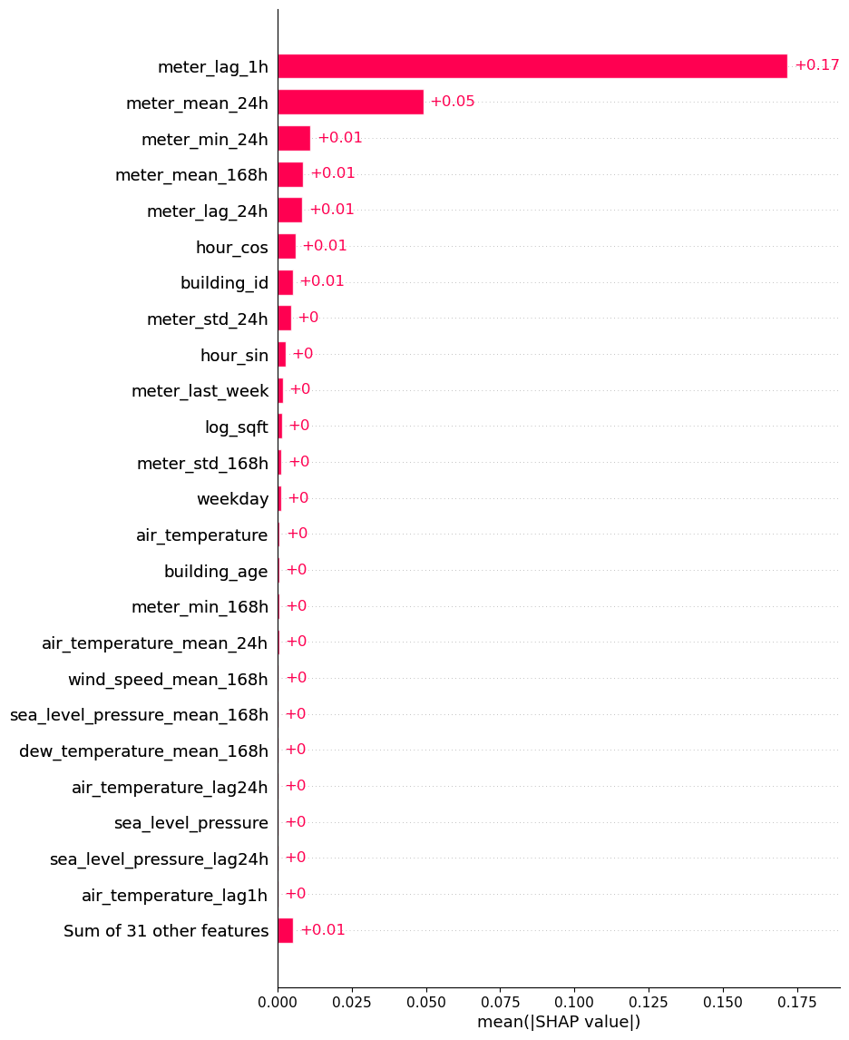
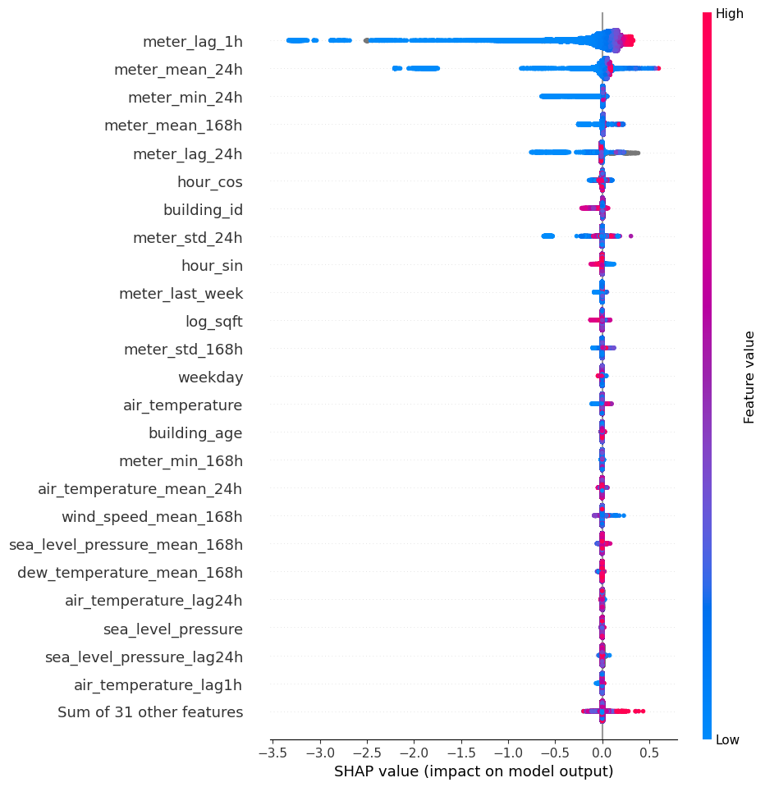
Which signals really move the needle? SHAP analysis for the LightGBM benchmark
Weekly-history features do matter – they rescue the model on regime-change days (holidays, festivals) – but SHAP under-credits them because their information overlaps with daily lags.

Slide 17
Summary & Future work Roadmap
We delivered:
117 kWh -> 48 kWh (~60% improvement) with feature engineered boosters
Next loop:
Deep sequence models (LSTMs)
Translating predictions into actionable efficiency leads (Building energy saving potential)

Slide 18
Thank you!

