Slide 1
Proving the Correctness of the Normal Equations with Dafny
Samuel Sanft

Slide 2
1.
Introduction
2.
Overview
3.
Implementation
4.
Proofs
5.
Conclusion/Further Work

Slide 3



What are the Normal Equations?
Solution to ordinary least squares.
Applications in statistics, optimization, machine learning, etc.

Slide 4
1.
Introduction
2.
Overview
3.
Implementation
4.
Proofs
5.
Conclusion/Further Work

Slide 5
Goals:
Specification / Implementation
Implement ADT for Vectors/Matrices
Implement functions for linear algebraic operations
Write proofs for basic properties of functions
Write proof that normal equations minimize OLS
Proofs

Slide 6
1.
Introduction
2.
Overview
3.
Implementation
4.
Proofs
5.
Conclusion/Further Work

Slide 7

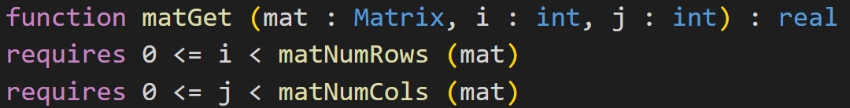

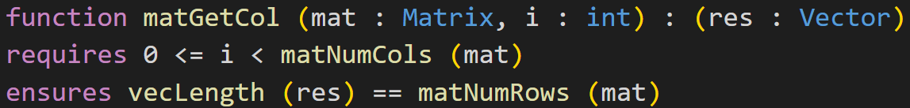
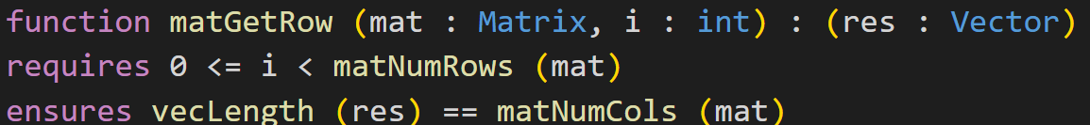
Data Types:
Define types using inductive datatypes (lists)
Don’t access/allocate memory in heap (no arrays)

Slide 8
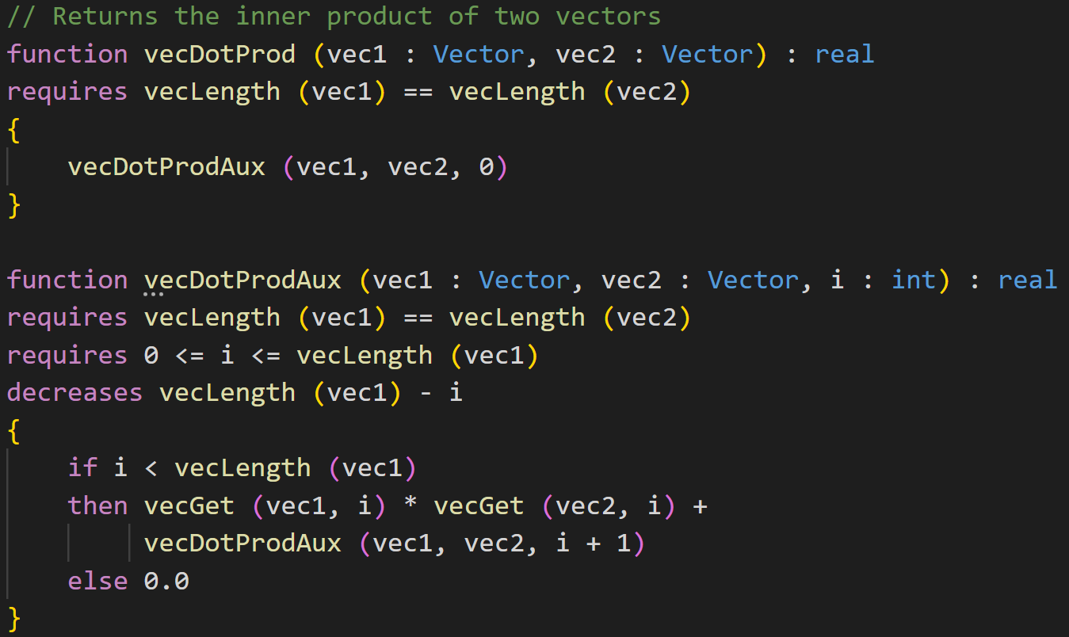
Vector Functions:
Dot-Product
Vector Scaling
Vector Addition/ Subtraction

Slide 9
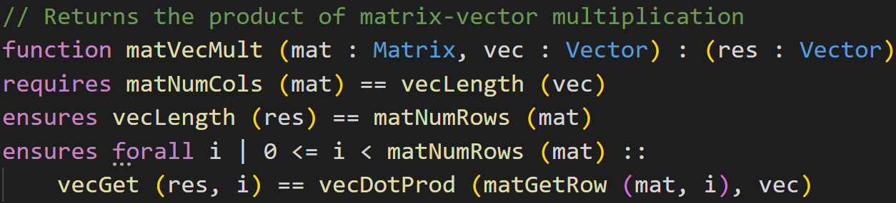
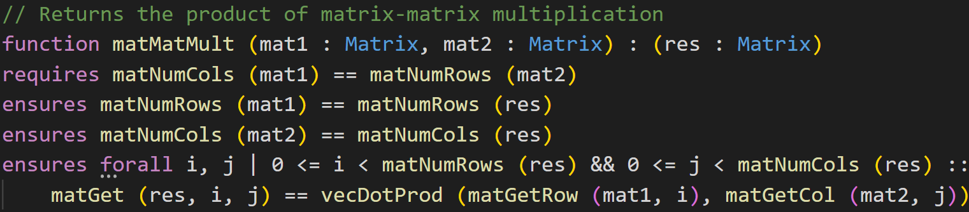
Multiplication Functions:
Matrix-Vector
Matrix-Matrix

Slide 10
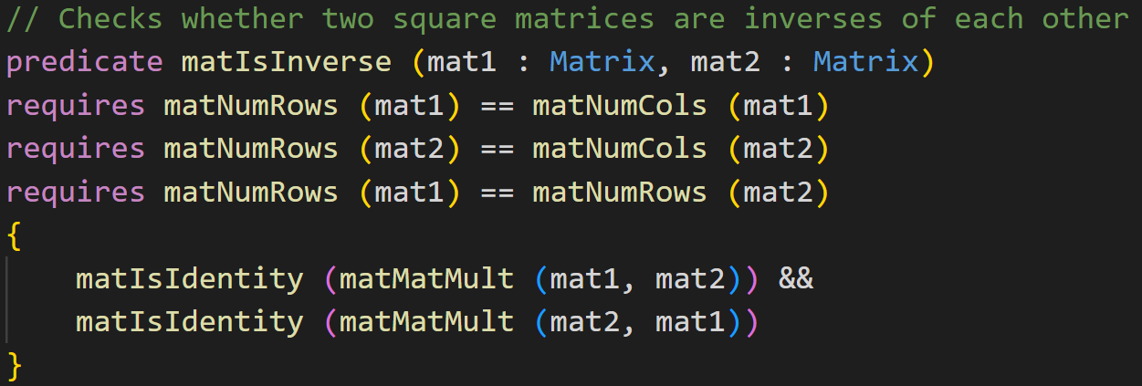
Matrix Functions:
Predicates:
Equality
Transpose
Identity
Symmetry
Inverse

Slide 11
1.
Introduction
2.
Overview
3.
Implementation
4.
Proofs
5.
Conclusion/Further Work

Slide 12
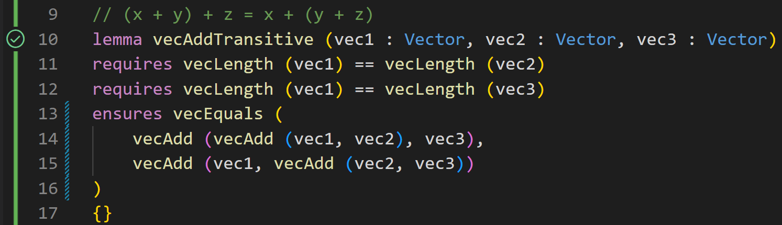
Basic Properties:
Prove basic properties using lemmas (vector addition, dot products, matrix-vector/ matrix-matrix multiplication)

Slide 13
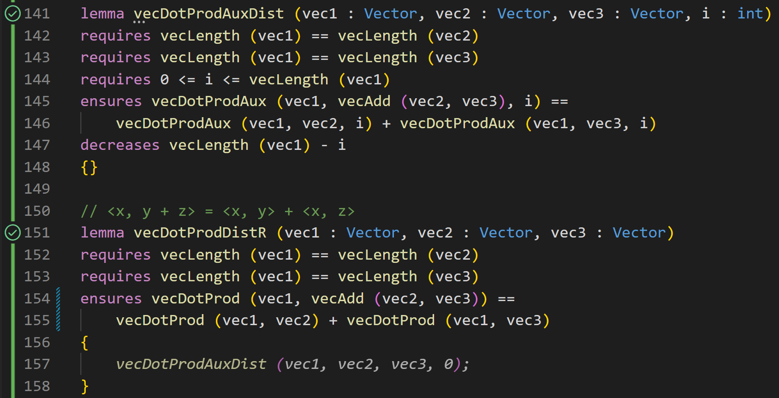
Basic Properties:
Prove basic properties using lemmas (vector addition, dot products, matrix-vector/ matrix-matrix multiplication)

Slide 14
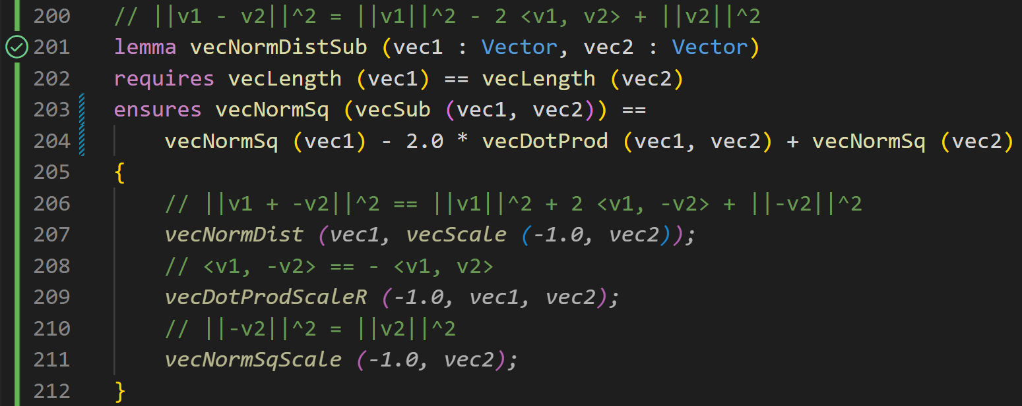
Basic Properties:
Prove basic properties using lemmas (vector addition, dot products, matrix-vector/ matrix-matrix multiplication)

Slide 15
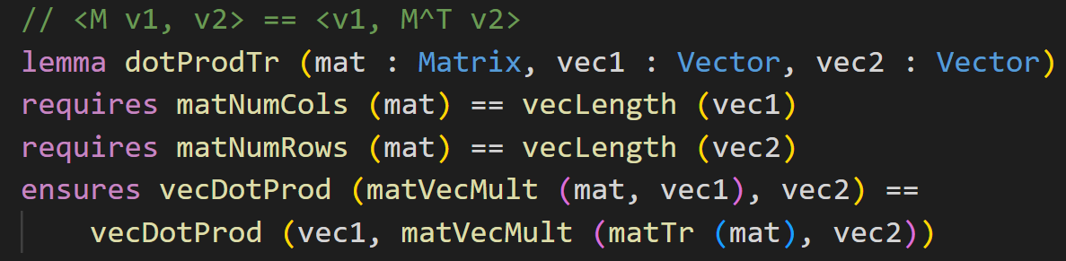
Basic Properties:
Prove basic properties using lemmas (vector addition, dot products, matrix-vector/ matrix-matrix multiplication)
~80 loc
4 auxiliary lemmas
Used secondary implementation of matrix-vector multiplication

Slide 16
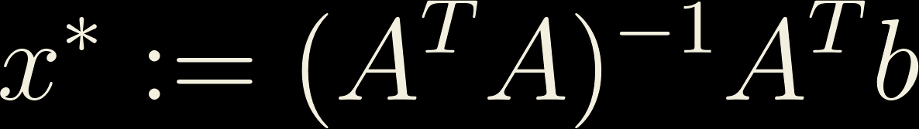
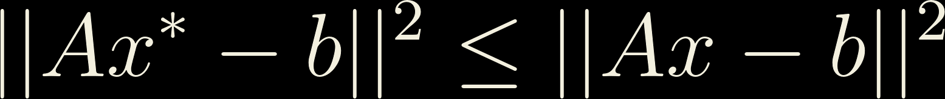

Optimality of the Normal Equations
Combine lemmas of basic properties
9 different lemmas
24 total lemma applications

Slide 17
1.
Introduction
2.
Overview
3.
Implementation
4.
Proofs
5.
Conclusion/Further Work

Slide 18
Further Work
Implement inverses
Prove solutions for similar optimization problems (e.g. Ridge Regression)
Write more efficient implementation for matrix/vector types

Slide 19
Takeaways
~2 line of proof/line of code in implementation
Possible to formally prove optimality of normal equations for OLS!
Kind of fun?

Slide 20
Thank you!

