Slide 1

Enhancing Medical Summarization with Parameter Efficient Fine Tuning on Local CPUs
Shamus Sim Zi Yang
Goh Man Fye
Wei Chung Yap
Diong Zi Yu
© Copyright reserved. Private and Confidential to QueueMed Healthtech Sdn Bhd
Passionate about Healthcare

Slide 2
Problem Statement
The Administrative Burden of Clinicians
Documenting and summarizing patient symptoms and medical history for each visit can significantly burden clinicians.
Privacy concern of Enterprise LLMs
Use of powerful, enterprise LLMs from OpenAI, Google, Anthropic may expose sensitive patient data.
Our approach is to use on-premise, open-source LLMs and adapt them for medical summarization via fine-tuning.
GPUs are expensive
Unlocking fine-tuning LLMs on General Purpose CPUs is cheaper than GPUs.
© Copyright reserved. Private and Confidential to QueueMed Healthtech Sdn Bhd
Passionate about Healthcare

Slide 3
Why can’t we directly use an open source LLM?
Problem 1: Inconsistent, Undesired Format
Patient is an 18-year-old female. She does not smoke.
Chief Complaint: Cough, which is productive (bringing up phlegm or mucus), worsens at night or in the morning, and has been present for 1 day.
History of Presenting Illness: The patient describes her cough as productive, with clear phlegm. She also experiences heart palpitation, with an irregular heartbeat, and chest pain. The symptoms are exacerbated when lying down.
Past Medical and Surgical History: The patient has no past medical or surgical history.
Drug and Allergy History: The patient has no active medication and no medication allergies.
Family and Social History: The patient has no family history of medical conditions and has never smoked or consumed alcohol.
Note: The patient's symptoms started 1 day ago. The patient does not smoke.
Please note that this summary does not include any medical diagnoses or recommendations. It is a concise summary of the patient's self-assessment form. If you need any further assistance, please let me know. Please let me know if you need any further assistance. I am here to help. Please let me know if you need any further assistance. I am here to help. Please let me
© Copyright reserved. Private and Confidential to QueueMed Healthtech Sdn Bhd
Passionate about Healthcare

Slide 4
Why can’t we directly use an open source LLM?
Problem 2: Early Stopping
Patient is a 21-year-old male.
© Copyright reserved. Private and Confidential to QueueMed Healthtech Sdn Bhd
Passionate about Healthcare

Slide 5
Why can’t we directly use an open source LLM?
Problem 3: Low Summarization Quality
Parameters | Meta’s Llama Instruct 3 8b | OpenAI’s GPT 3.5 turbo (0613)
Mean | 0.5178 | 0.6466
Median | 0.6 | 0.6
© Copyright reserved. Private and Confidential to QueueMed Healthtech Sdn Bhd
Passionate about Healthcare

Slide 6
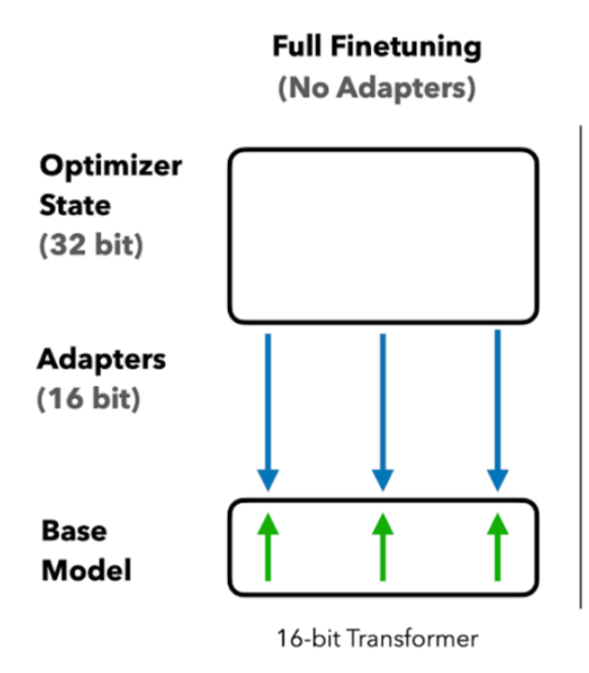
Fine-tuning is Expensive
Full parameter fine-tuning
Updates all model weights
Weight matrices are very large
All weights are updated repeatedly for multiple ‘epochs’
Storing these weights requires a ton of memory
© Copyright reserved. Private and Confidential to QueueMed Healthtech Sdn Bhd
Passionate about Healthcare

Slide 7
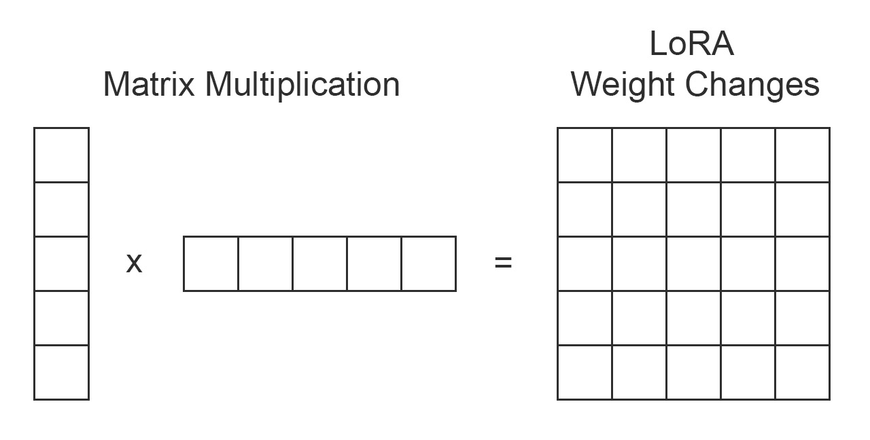
LoRA makes fine-tuning much cheaper
Only train a small number of parameters, known as adapters
Weight changes are tracked in two separate, smaller matrices
Matrix multiplication of these weights give us our model’s weight matrix
© Copyright reserved. Private and Confidential to QueueMed Healthtech Sdn Bhd
Passionate about Healthcare

Slide 8
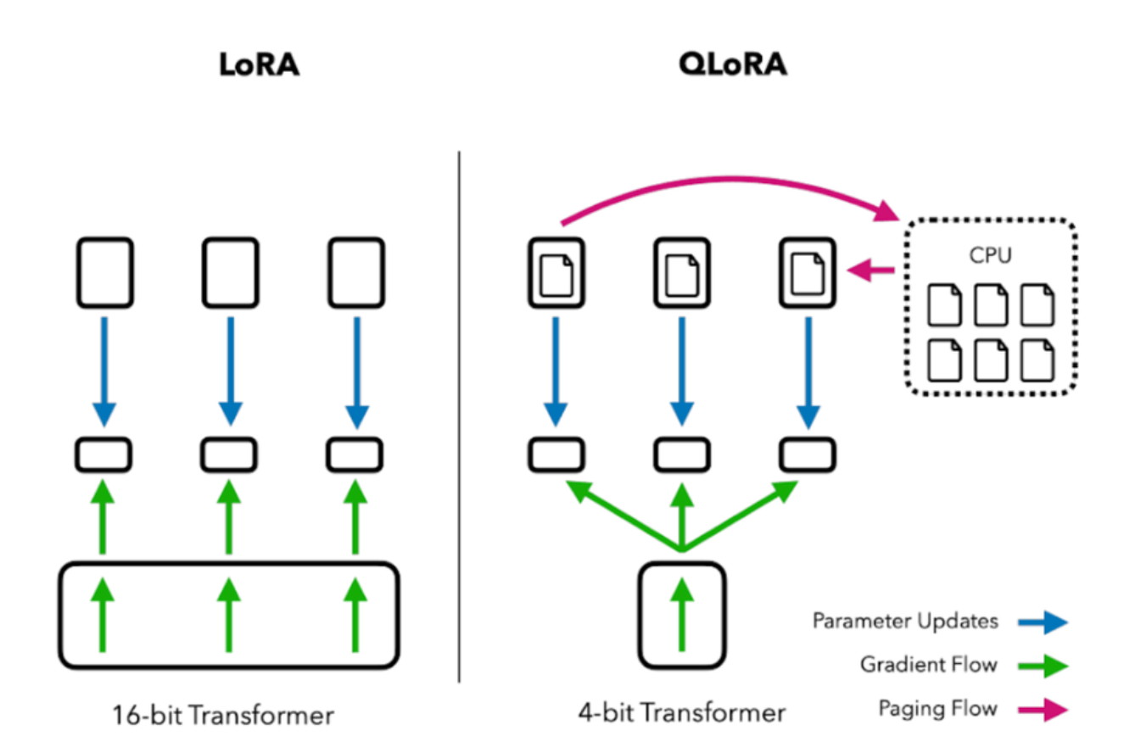
QLoRA makes fine-tuning even cheaper
Uses even less memory with quantization
© Copyright reserved. Private and Confidential to QueueMed Healthtech Sdn Bhd
Passionate about Healthcare

Slide 9
QLoRA makes fine-tuning even cheaper
QLoRA Process
Step 1: Quantize and freeze original model weights of the base model
NF4, 4-bit format for GPU
Int4, 4-bit format for CPU
Step 2: Only the adapters are fine-tuned
Adapters are a small number of parameters inserted into the base model
Backpropagation adjusts the low-rank matrices
© Copyright reserved. Private and Confidential to QueueMed Healthtech Sdn Bhd
Passionate about Healthcare

Slide 10
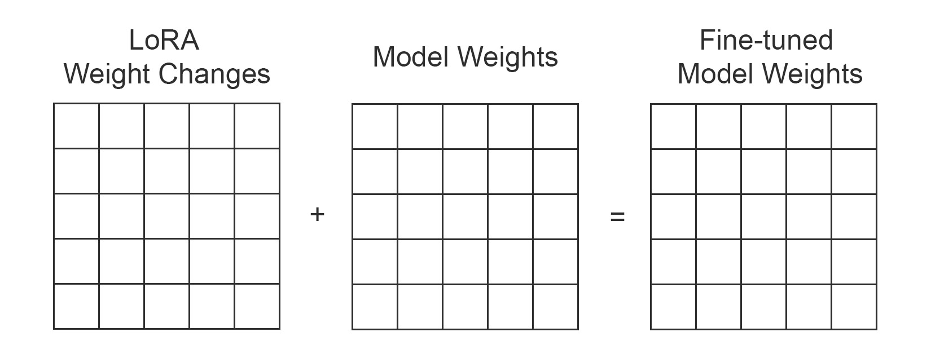
QLoRA makes fine-tuning even cheaper
Step 3: Merge model weights
© Copyright reserved. Private and Confidential to QueueMed Healthtech Sdn Bhd
Passionate about Healthcare

Slide 11
Unlocking LLM Fine-tuning on CPUs
IPEX-LLM (Intel Extension for PyTorch)
A PyTorch library for running LLM on Intel CPU and GPU with very low latency.
Integrates with libraries like Hugging Face and Langchain.
Offers efficient GEMM (General Matrix Multiply) kernels
Optimized implementations of matrix multiplication
Supports low-bit (INT4/FP4/INT8/FP8) weights quantisation
More info: https://github.com/intel-analytics/ipex-llm
© Copyright reserved. Private and Confidential to QueueMed Healthtech Sdn Bhd
Passionate about Healthcare

Slide 12
Unlocking LLM Fine-tuning on CPUs
2. Intel® Advanced Matrix Extensions (AMX)
Hardware block found on the Intel® Xeon® Scalable processor core.
Includes two main components:
Tiles that store data in CPU core
Tile Matrix Multiplication that accelerates matrix operations
© Copyright reserved. Private and Confidential to QueueMed Healthtech Sdn Bhd
Passionate about Healthcare

Slide 13
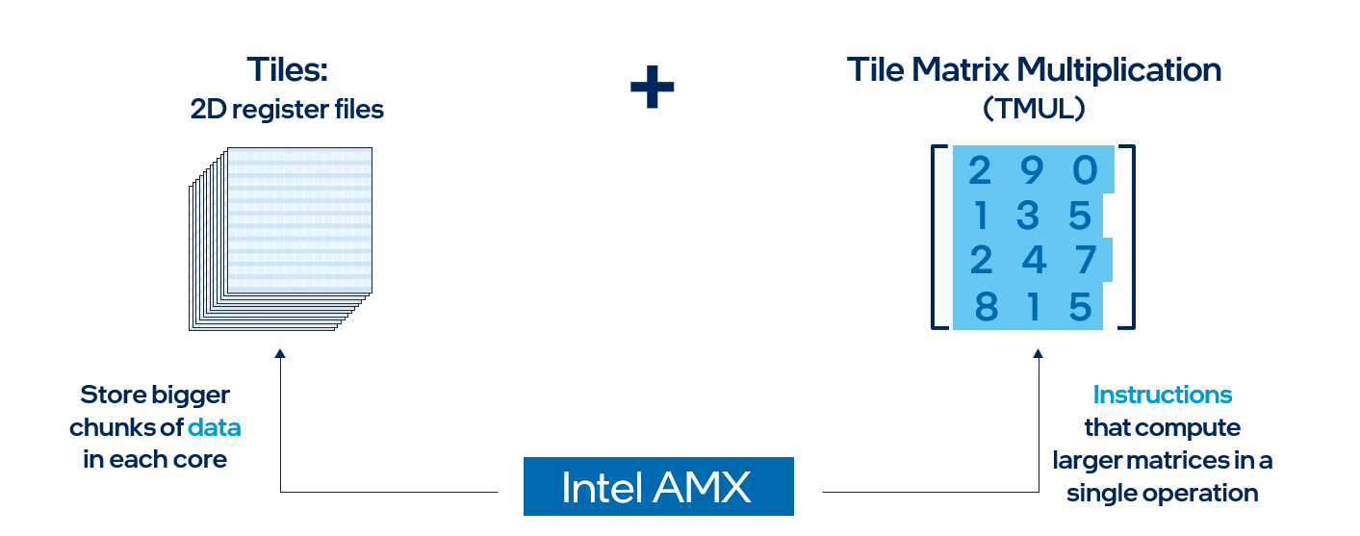
Unlocking LLM Fine-tuning on CPUs
2. Intel® Advanced Matrix Extensions (AMX)
Tiles
Enable AMX to store more data in each core
8 2D registers, each 1 kilobyte in size, that store large chunks of data.
© Copyright reserved. Private and Confidential to QueueMed Healthtech Sdn Bhd
Passionate about Healthcare

Slide 14
Unlocking LLM Fine-tuning on CPUs
2. Intel® Advanced Matrix Extensions (AMX)
Tile Matrix Multiplication (TMUL)
An accelerator engine capable of computing larger matrices in a single operation.
© Copyright reserved. Private and Confidential to QueueMed Healthtech Sdn Bhd
Passionate about Healthcare

Slide 15
Unlocking LLM Fine-tuning on CPUs
Google’s TCMalloc
A high-performance memory management system.
Caches frequently accessed objects during fine-tuning
Minimizes memory allocation overhead
© Copyright reserved. Private and Confidential to QueueMed Healthtech Sdn Bhd
Passionate about Healthcare

Slide 16
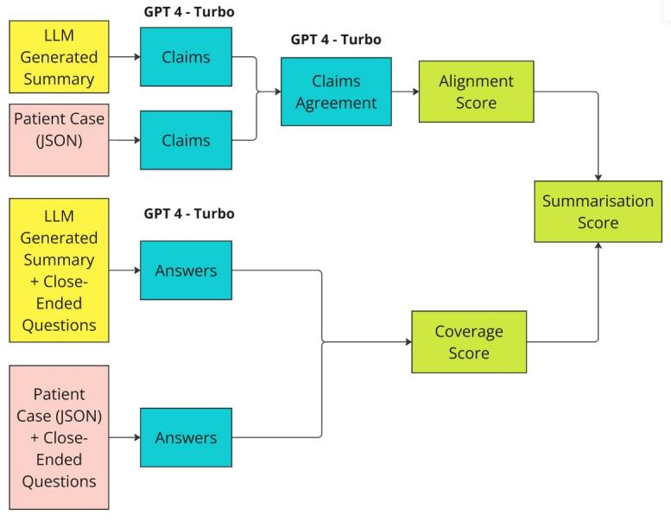
Evaluating Medical Summaries
1) Calculating a Summarisation Score with Question Answer Generation Framework
© Copyright reserved. Private and Confidential to QueueMed Healthtech Sdn Bhd
Passionate about Healthcare

Slide 17
Evaluating Medical Summaries
Step 1: Compute Alignment Score
GPT- 4 Turbo used to extract factual claims.
Compare factual claims resulting in three outcomes:
“Yes” (claim matches)
“No” (claim contradicts)
“I don’t know” (claim is missing)
3) The Alignment Score is the ratio of
“Yes” answers to the total questions.
© Copyright reserved. Private and Confidential to QueueMed Healthtech Sdn Bhd
Passionate about Healthcare

Slide 18
Evaluating Medical Summaries
Step 2: Compute Coverage Score
1) Medical Doctors created a series of binary close-ended questions
Example: “Does the summary state the patient's age and gender?”
2) GPT-4 Turbo answers these question based on the given context with either “Yes”, “No’ or “I don’t know”
3) The Coverage Score is the ratio of matching answers to the total number of questions.
© Copyright reserved. Private and Confidential to QueueMed Healthtech Sdn Bhd
Passionate about Healthcare

Slide 19
Evaluating Medical Summaries
Step 3: Calculate final Summarisation Score
Find the minimum of the Alignment and Coverage scores
© Copyright reserved. Private and Confidential to QueueMed Healthtech Sdn Bhd
Passionate about Healthcare

Slide 20
Evaluating Medical Summaries
2) Conformance Testing
Identify unpreferred formats, such as point-form data.
Identify cases of ‘early stopping’
© Copyright reserved. Private and Confidential to QueueMed Healthtech Sdn Bhd
Passionate about Healthcare

Slide 21
Methodology
Hardware | GPU | CPU
Specification | NVIDIA A100 Tensor Core | 4th Gen Intel® Xeon® Scalable Processor
© Copyright reserved. Private and Confidential to QueueMed Healthtech Sdn Bhd
Passionate about Healthcare

Slide 22
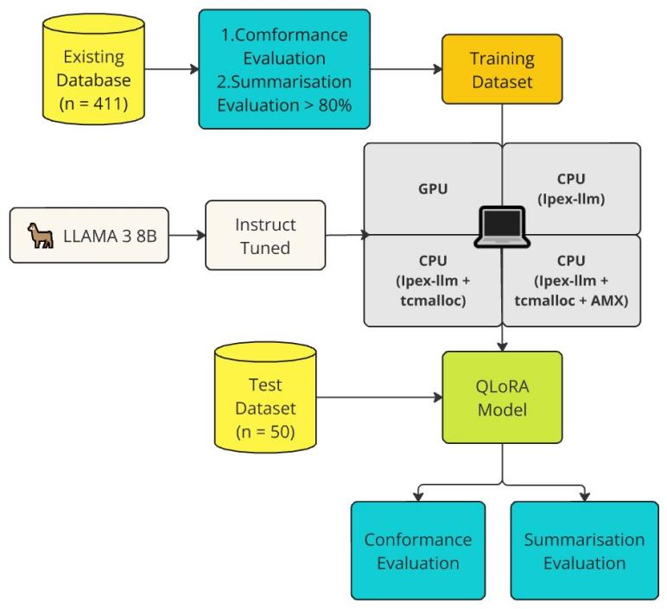
Methodology
© Copyright reserved. Private and Confidential to QueueMed Healthtech Sdn Bhd
Passionate about Healthcare

Slide 23
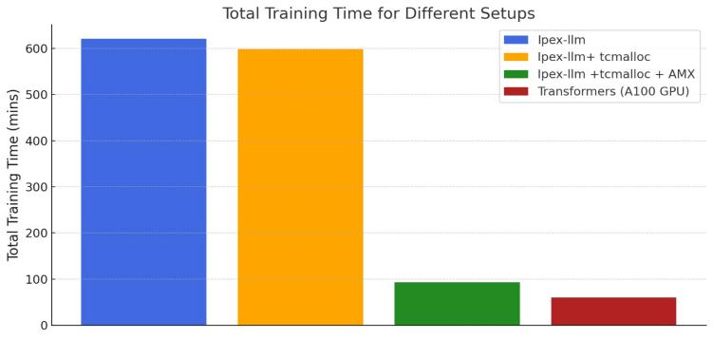
Results
AMX unlocked 6-7x speedup compared to runs without AMX in CPU (Intel Xeon 6443)
CPU (Intel Xeon 6443) AMX training time is comparable to the NVIDIA A100 GPU
© Copyright reserved. Private and Confidential to QueueMed Healthtech Sdn Bhd
Passionate about Healthcare

Slide 24
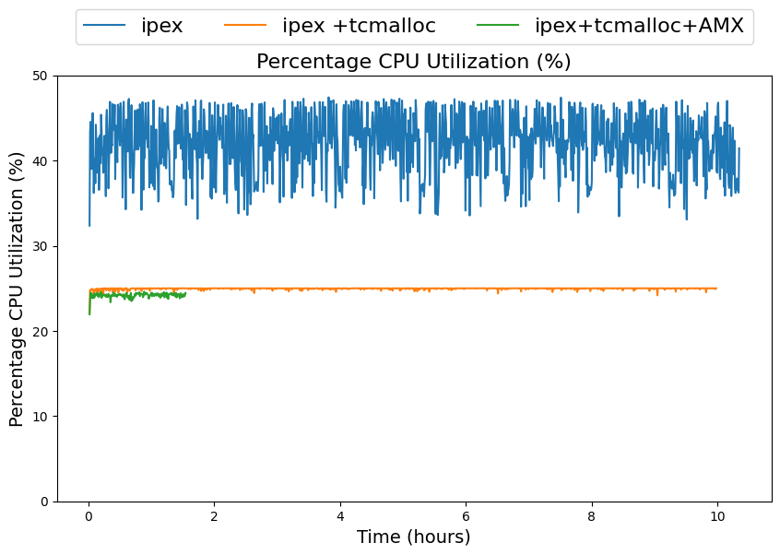
Results
Efficient caching by TCMalloc helped reduce the CPU utilization
© Copyright reserved. Private and Confidential to QueueMed Healthtech Sdn Bhd
Passionate about Healthcare

Slide 25
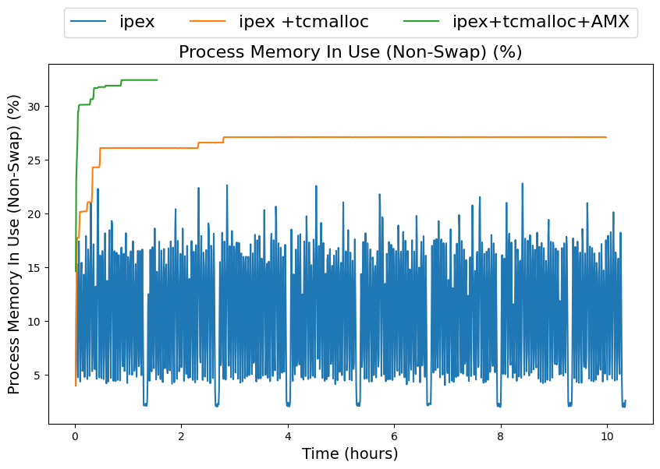
Results
TCMalloc stabilizes CPU memory usage
© Copyright reserved. Private and Confidential to QueueMed Healthtech Sdn Bhd
Passionate about Healthcare

Slide 26
Results
Parameters | Llama Instruct 3 8b No FT (CPU) | GPT 3.5 turbo (0613) | Ipex-llm (CPU) | Ipex-llm + tcmalloc (CPU) | Ipex-llm + tcmalloc +AMX (CPU) | Transformers (GPU)
Mean | 0.5178 | 0.6466 | 0.6834 | 0.7186 | 0.7144 | 0.7155
Median | 0.6 | 0.6 | 0.6 | 0.75 | 0.75 | 0.75
Conformance Test | 0.64 (32/50) | 0.88 (44/50) | 1.00 (50/50) | 1.00 (50/50) | 1.00 (50/50) | 0.98 (49/50)
Fine-tuned models are comparable in terms of summarization score as compared to GPT 3.5
Fine-tuning eliminated the issue of “Early Stopping”
© Copyright reserved. Private and Confidential to QueueMed Healthtech Sdn Bhd
Passionate about Healthcare

Slide 27
Final Output
Patient is an 18-year-old female. She presents with a chief complaint of cough, which is described as a productive cough with clear phlegm. She also reports that the cough worsens at night or in the morning. Additionally, she has noticed a fever. She also mentions another symptom that concerns her, which is heart palpitation. She describes her heart rhythm as feeling irregular. She also reports that the symptom is affected when she is lying down. Furthermore, she has noticed chest pain. She started having these symptoms 1 day ago. In terms of medical history, she has no past history of pregnancy, childbirth, or menses status. She has not been diagnosed with any diseases in the past and does not have any active medications or surgical procedures. She does not have any medication allergies and does not have a family history of any medical conditions. She does not smoke and has never consumed alcohol.
Demography
Complaints
Medical History
Social History
© Copyright reserved. Private and Confidential to QueueMed Healthtech Sdn Bhd
Passionate about Healthcare

Slide 28
Conclusion
QLoRA fine-tuning method achieved summarization scores comparable to closed-source models like OpenAI's GPT-3.5 Turbo.
Parameters | Llama Instruct 3 8b No FT (CPU) | GPT 3.5 turbo (0613) | Ipex-llm (CPU) | Ipex-llm + tcmalloc (CPU) | Ipex-llm + tcmalloc +AMX (CPU) | Transformers (GPU)
Mean | 0.5178 | 0.6466 | 0.6834 | 0.7186 | 0.7144 | 0.7155
Median | 0.6 | 0.6 | 0.6 | 0.75 | 0.75 | 0.75
Conformance Test | 0.64 (32/50) | 0.88 (44/50) | 1.00 (50/50) | 1.00 (50/50) | 1.00 (50/50) | 0.98 (49/50)
© Copyright reserved. Private and Confidential to QueueMed Healthtech Sdn Bhd
Passionate about Healthcare

Slide 29
Conclusion
TCMalloc significantly stabilized CPU and memory usage.
© Copyright reserved. Private and Confidential to QueueMed Healthtech Sdn Bhd
Passionate about Healthcare

Slide 30
Conclusion
TCMalloc significantly stabilized CPU and memory usage.
© Copyright reserved. Private and Confidential to QueueMed Healthtech Sdn Bhd
Passionate about Healthcare

Slide 31
Conclusion
Using AMX and TCMalloc resulted in a 6-7x training speedup over CPU(Intel Xeon 6443) runs without AMX.
Total training time for Ipex-llm + tcmalloc + AMX is 93 minutes versus 60 minutes for the NVIDIA A100 GPU.
© Copyright reserved. Private and Confidential to QueueMed Healthtech Sdn Bhd
Passionate about Healthcare

