Slide 1

2018 WSDM - KKBOX music recommendation challenge
2017 Data Mining Final Project Proposal
Group 12 - NCTUEE
0310109 曾上恩
0310122 黃彥嘉
0310120 陳家煒
0310139 曾敏原

Slide 2


Background
WSDM has challenged the Kaggle ML community to help solve these problems and build a better music recommendation system. The dataset from KKBOX holds the world’s most comprehensive Asia-Pop music library with over 30 million tracks, based on a collaborative filtering algorithm with matrix factorization and word embedding in their recommendation system. However, new techniques are believed to have better results.

Slide 3
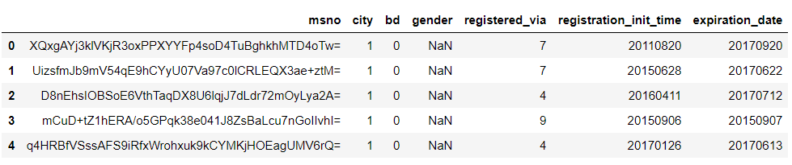
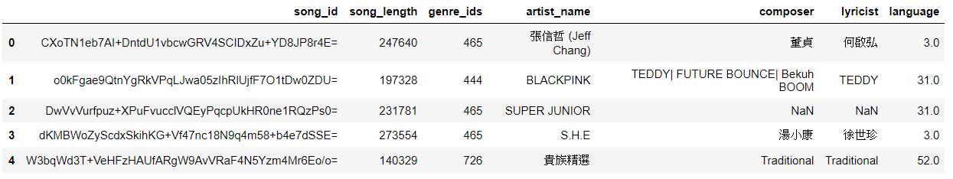
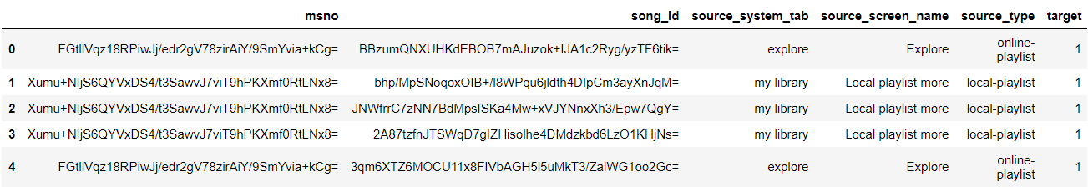
Dataset Description
members.csv
songs.csv
train.csv

Slide 4
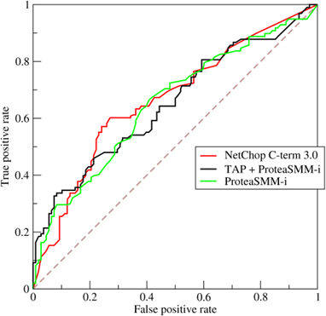
Problem Definition
To evaluate the result, area under the ROC curve between the predicted probability and the observed target is considered.
Our problem is to predict the chances of a user listening to a song repetitively after the first observable listening event within a time window was triggered.
A training data set is given, consisting of information of the first observable listening event for each unique user-song pair within a specific time duration. Metadata of each unique user and song pair is also provided.
In short, given training feature X and target y, train a model fed with testing feature, and predict the probability of chance (Binary classification)

Slide 5
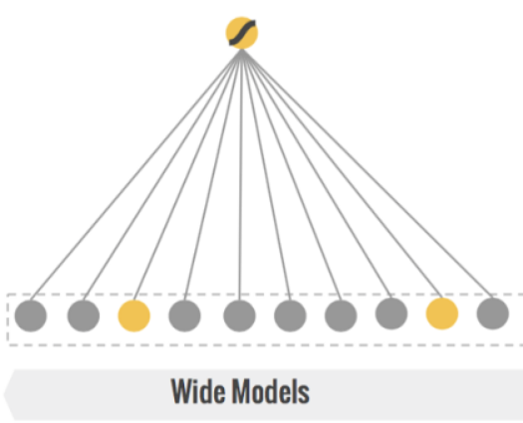
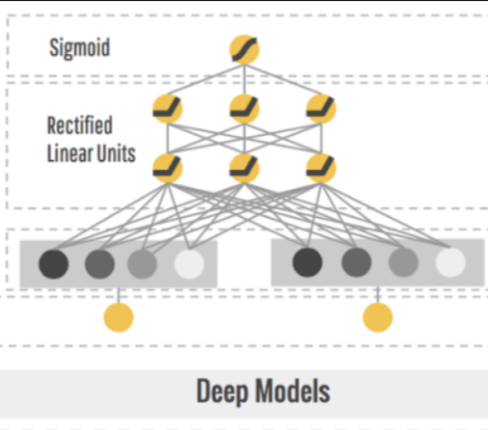
Existing Works - Wide & Deep Learning for Recommendation Systems
Wide Model
Logistic Regression with ALL data
Good for memorization
Not general
Deep Model
Deep Learning with CATEGORICAL data
Good for generalization
Convert sparse features to embedding

Slide 6
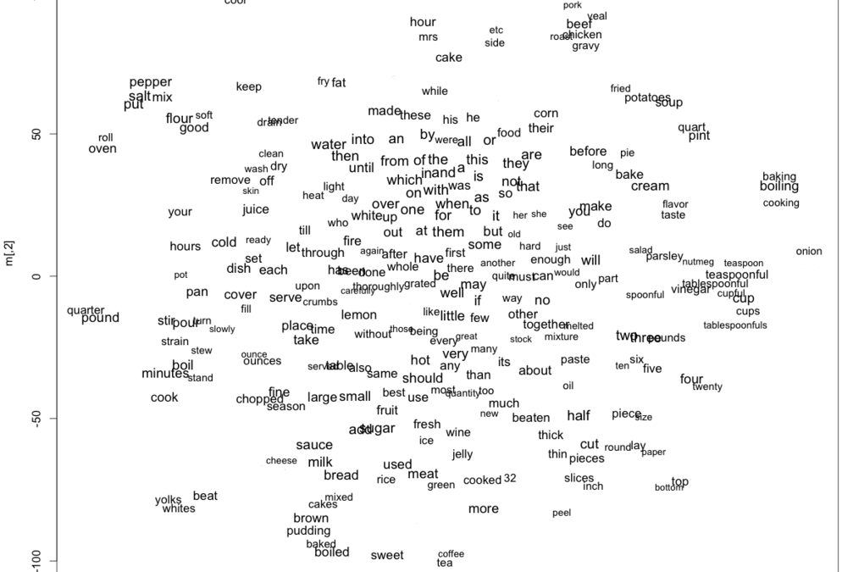
Why General?
word2vec
The embeddings of two close features are similar
King : Man = Queen : Woman

Slide 7
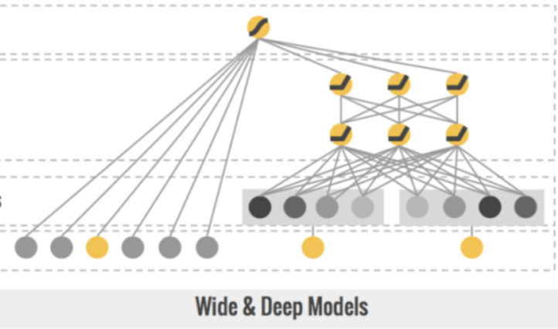
Wide & Deep Model
Combine two models
Get memorization & generalization

Slide 8
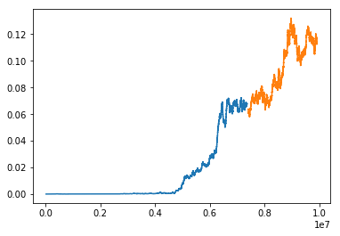
Exploratory data analysis
Chronology in Train / Test data
Both training and testing data are chronologically.
Training data is followed by testing data in time domain.

Slide 9
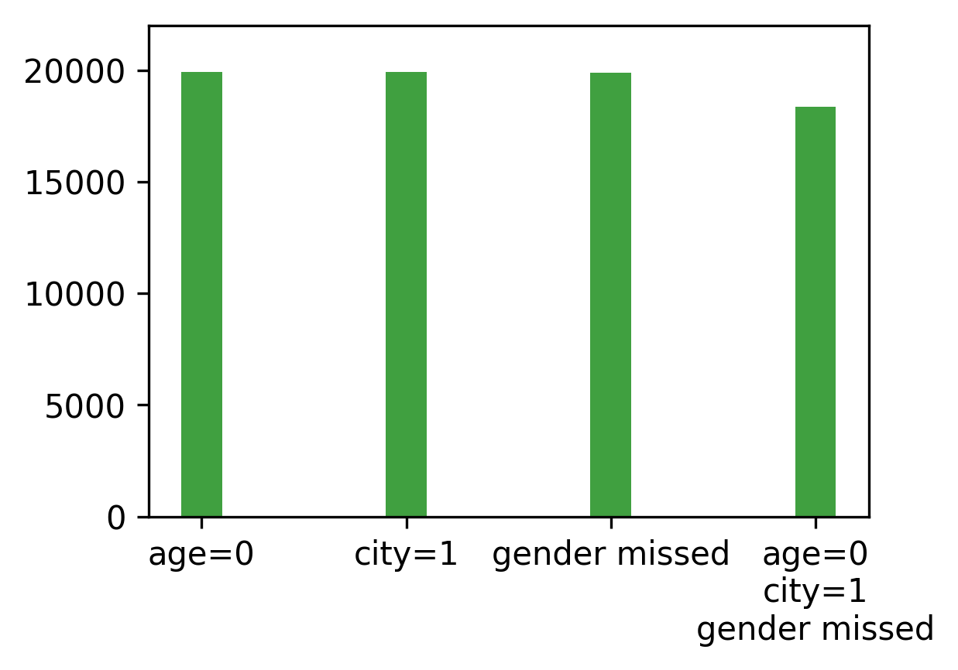
Exploratory data analysis
Members tend to skip filling age, city, and gender simultaneously.
Members’ Age vs City vs Gender

Slide 10
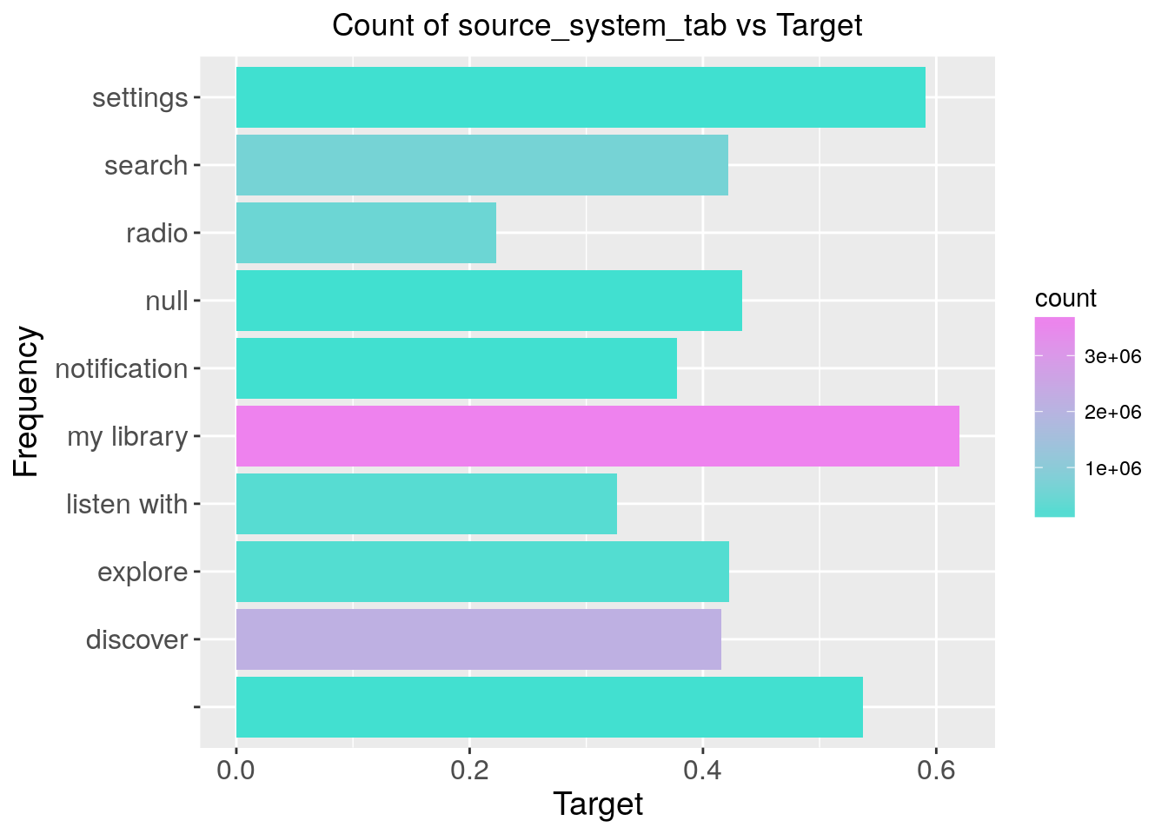
Exploratory data analysis
User liked the song so much to include in their local playlist that positively affects repeatability.
Train column count vs target

Slide 11
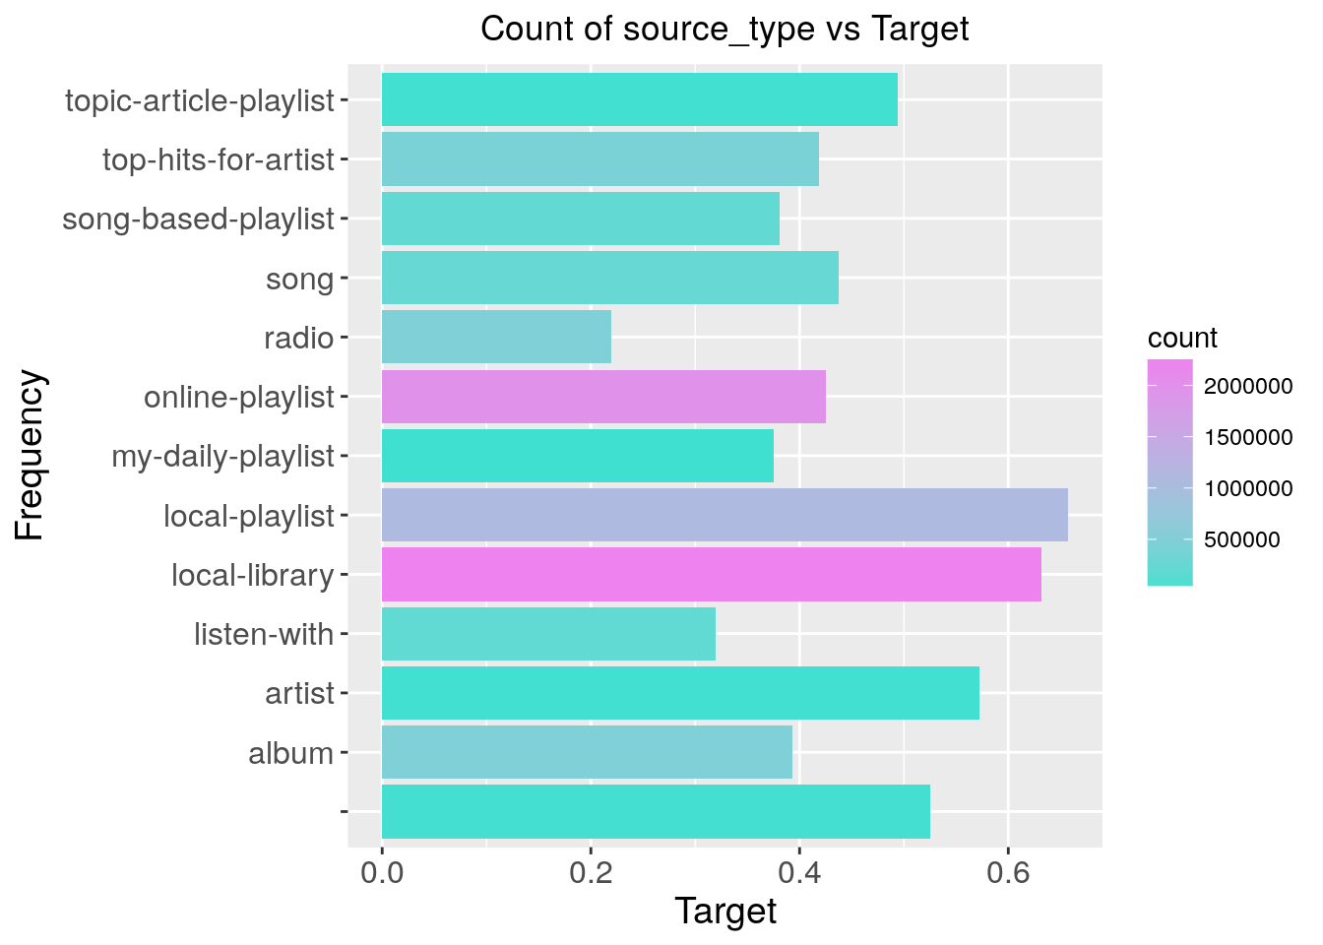
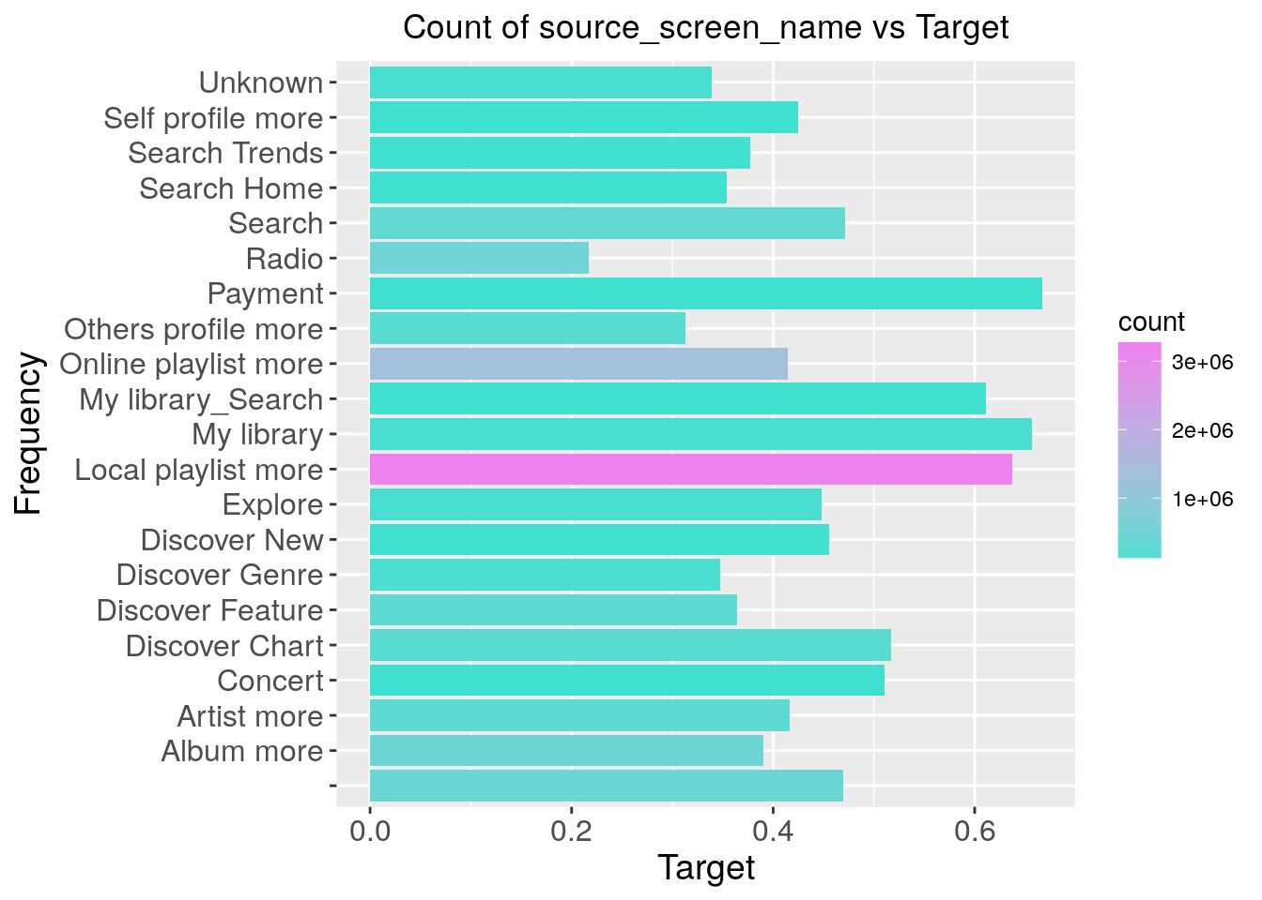
Members’ Age vs City vs Gender

Slide 12
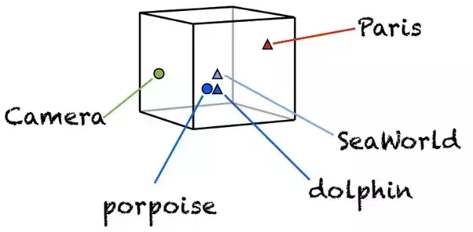
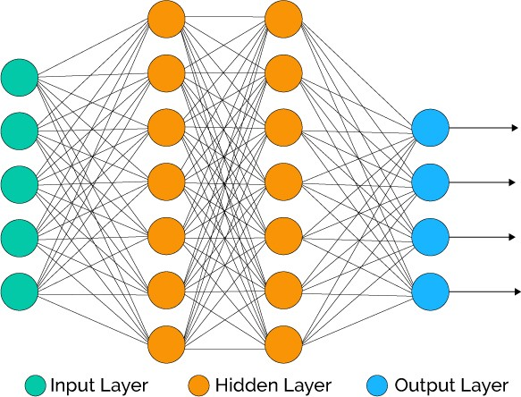
Proposed Solution(s)
Matrix Factorization and Word Embedding (KKBOX method)
Microsoft-LightGBM
with Feature Engineering
Neural Network Method
Deep / Wide & Deep

Slide 13

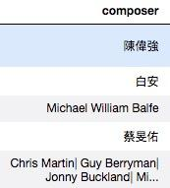
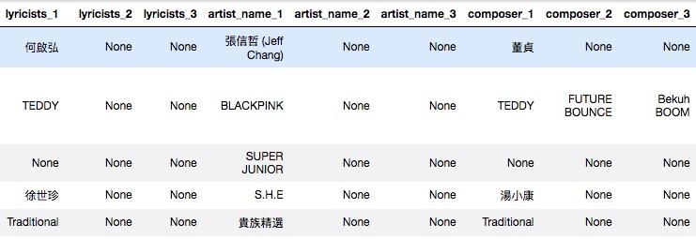
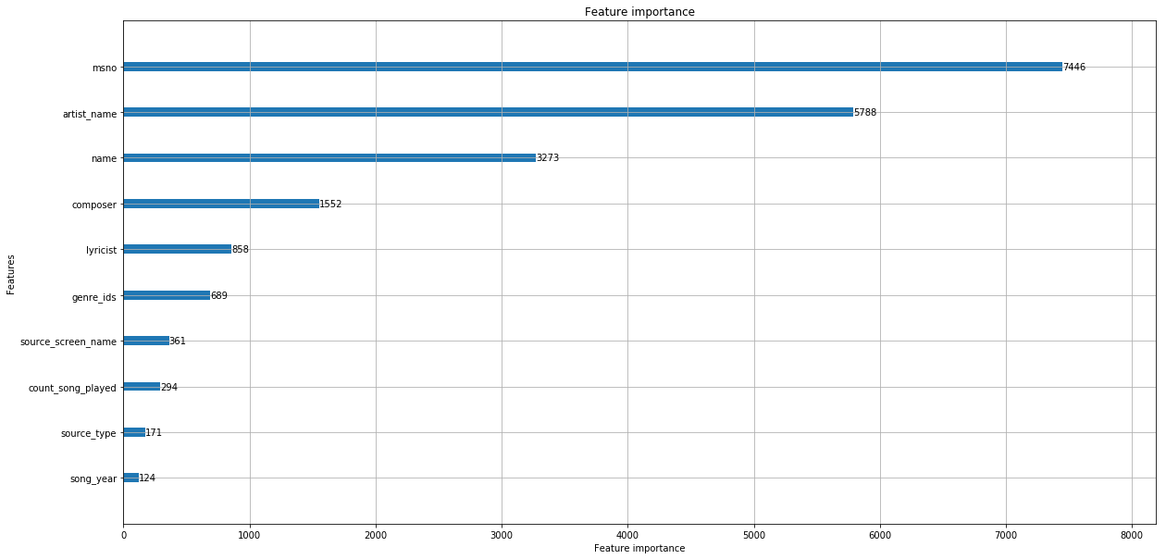
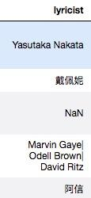
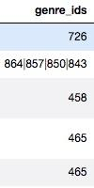
Feature Engineering – single decomposition
Score from 0.66363 improve to 0.68341

Slide 14
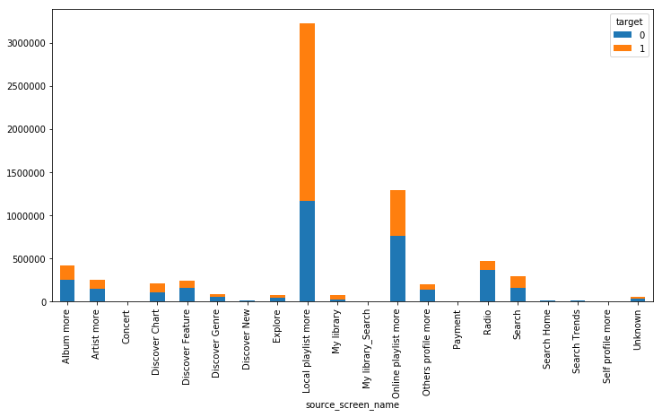
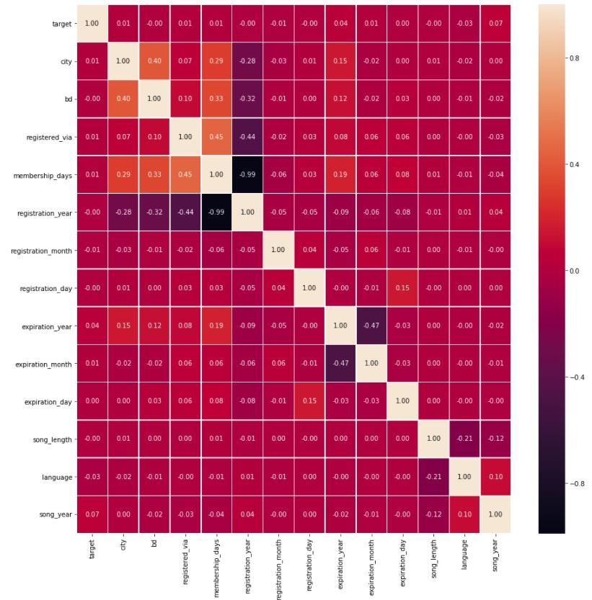
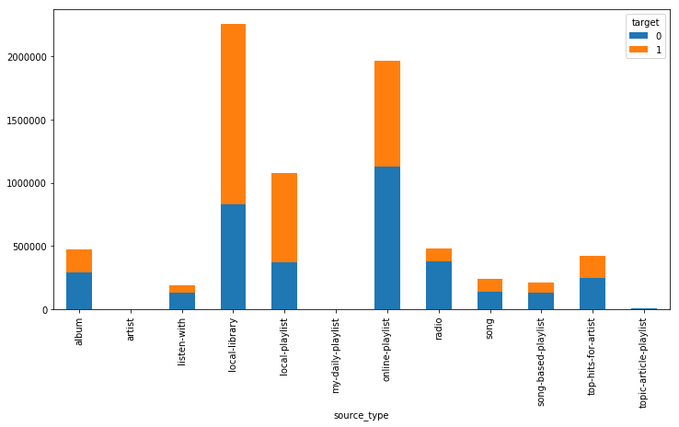
Feature Engineering – other approach
Expiration_year vs Song_year

Slide 15
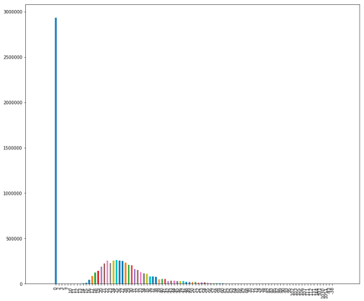
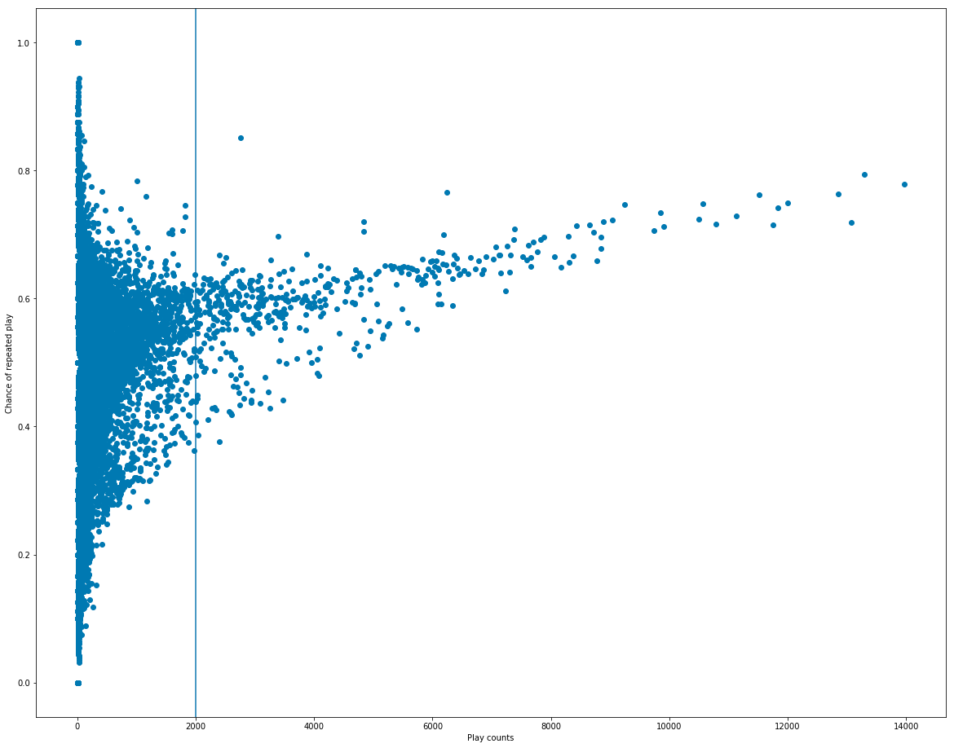
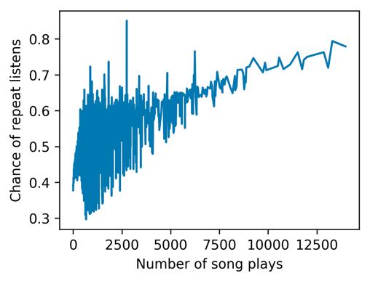
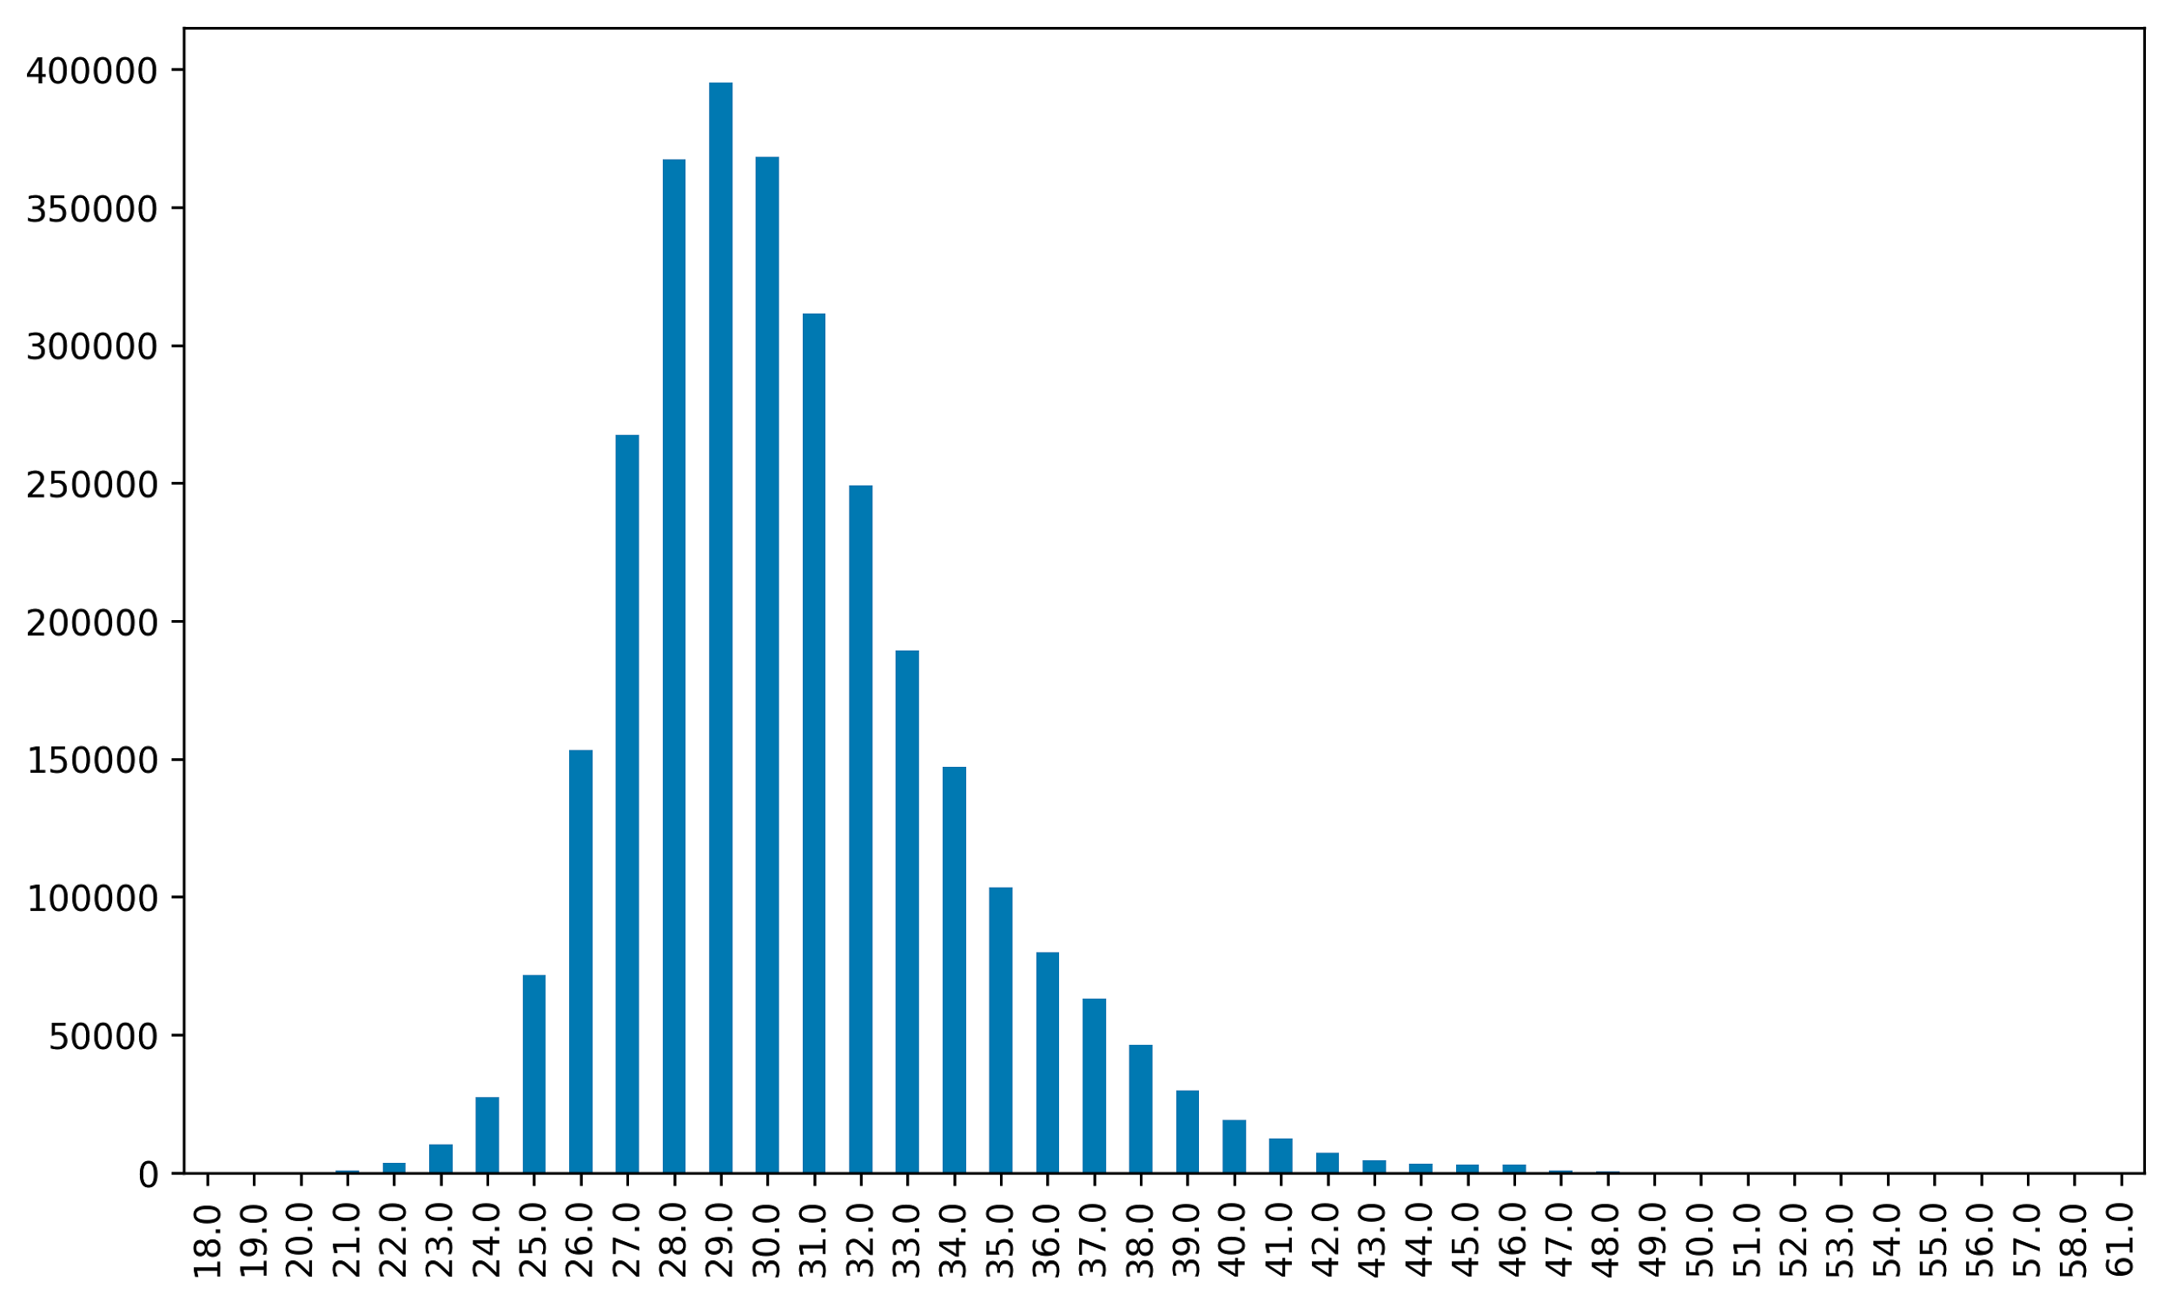
Feature Engineering – other approach

Slide 16
Feature Engineering - Summary
Raw feature 19 → after Feature Engineering 50
Raw feature with LightGBM 0.65249 -> after Feature Engineering 0.69167
Rank: 10% (113/1081)

Slide 17
Challenges – Feature engineering
msno category source_system_tab category source_screen_name category source_type category target int64 city int64 bd int64 gender category registered_via int64 membership_days int32 registration_year int64 registration_month int64 registration_day int64 expiration_year int64
expiration_month int64 expiration_day int64 song_length float64 genre_ids category artist_name category composer category lyricist category language float64 name category song_year float64 genre_ids_count int64 lyricists_count int32 composer_count int32 is_featured int64 artist_count int32 artist_composer int32 count_song_played int32
lyricists_1 int32 lyricists_2 int32 lyricists_3 int32 artist_name_1 int32 artist_name_2 int32 artist_name_3 int32 composer_1 int32 composer_2 int32 composer_3 int32 chinese bool popular int64 quant_age int64 Chinese_artist bool Chinese_composer bool Chinese_lyricist bool city_age_gender bool msno_dup bool local_source bool local_source_screen bool
Note:
Black features are raw features
Red features are new features

Slide 18









Tools

Slide 19
SVD – user/song pair

Slide 20
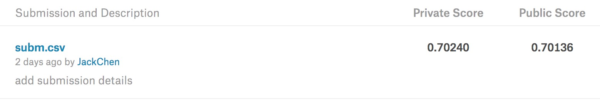
SVD – user/song pair
Leader board from No.113 to No.45

Slide 21
Result
Before Deadline
0.66343 lightgbm with raw-feature
0.67732 lightgbm with 10 most important features
0.68154 lightgbm with 20 most important features
0.68823 lightgbm with 30 most important features
0.68907 lightgbm with all features (appro. 50)
0.68930 lightgbm with all features (appro. 50) with msno processing 0.69024 lightgbm with all features (appro. 50) with msno processing plus model ensembling
After Deadline
0.70136 lightgbm with old + new (SVD) features

Slide 22
Reference
[1] H.-T. Cheng, L. Koc, J. Harmsen, T. Shaked, T. Chandra, H. Aradhye, G. Anderson, G. Corrado, W. Chai, M. Ispir, et al. Wide & deep learning for recommender systems. arXiv preprint arXiv:1606.07792, 2016.
[2] Tomas Mikolov, Kai Chen, Greg Corrado, and Jeffrey Dean. 2013a. Efficient Estimation of Word Representations in Vector Space. In ICLR Workshop Papers.
[3] Competition website:
https://www.kaggle.com/c/kkbox-music-recommendation-challenge
[4] LGBM:
https://www.kaggle.com/kamilkk/simple-fast-lgbm-0-6685
https://github.com/Microsoft/LightGBM

