Slide 2
Outline
Introduction
Algorithm
Data Augmentation
PCA
Model: SVM
Validation
Conclusion

Slide 3
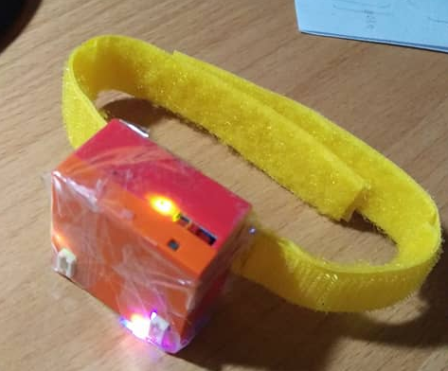
Introduction
揪Ｉ打球
穿戴式裝置
搭配App使用

Slide 4
Algorithm
Extract first 20 dynamic moving data of
(AccX, AccY, AccZ, GyoX, GyoY, GyoZ)
Apply PCA dimension reduction from 120-d to 5-d
Training with SVM (RBF kernel)

Slide 5

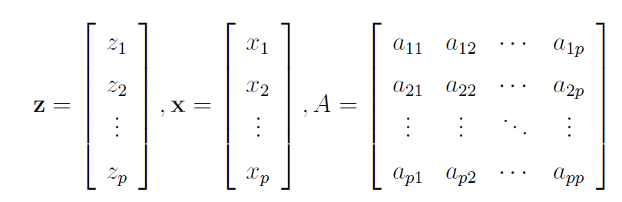
PCA (1/2)
Dimension Reduction
Coordinate Transformation

Slide 6
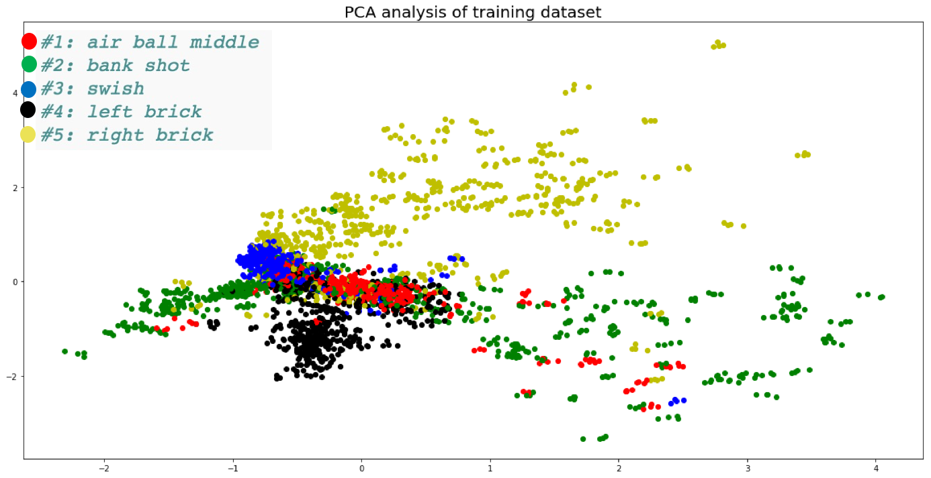
PCA (2/2)

Slide 7
Model (1/4)
Label the Data
There’re 5 kinds of data:
Air Ball
Bank shot
Swish
Left
Right

Slide 8
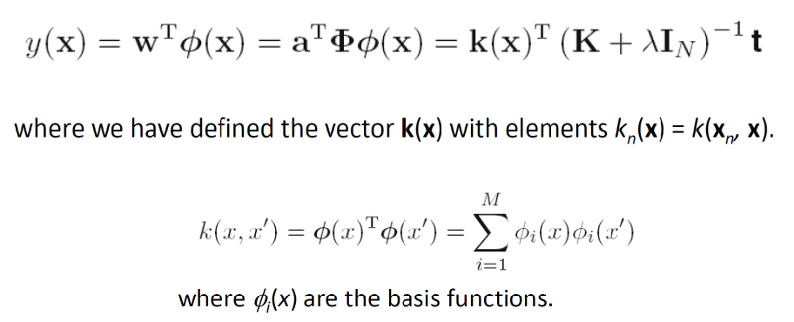
Model (2/4)
Using SVM
Kernel: Radial Basis Function

Slide 9
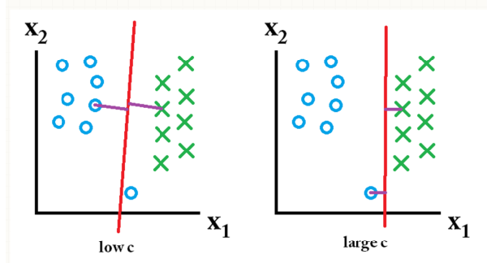
Model (3/4)
C-SVM:
C ↑: Smaller Margin (Lower Cost)
C ↓: Larger Margin (Higher Cost)

Slide 10
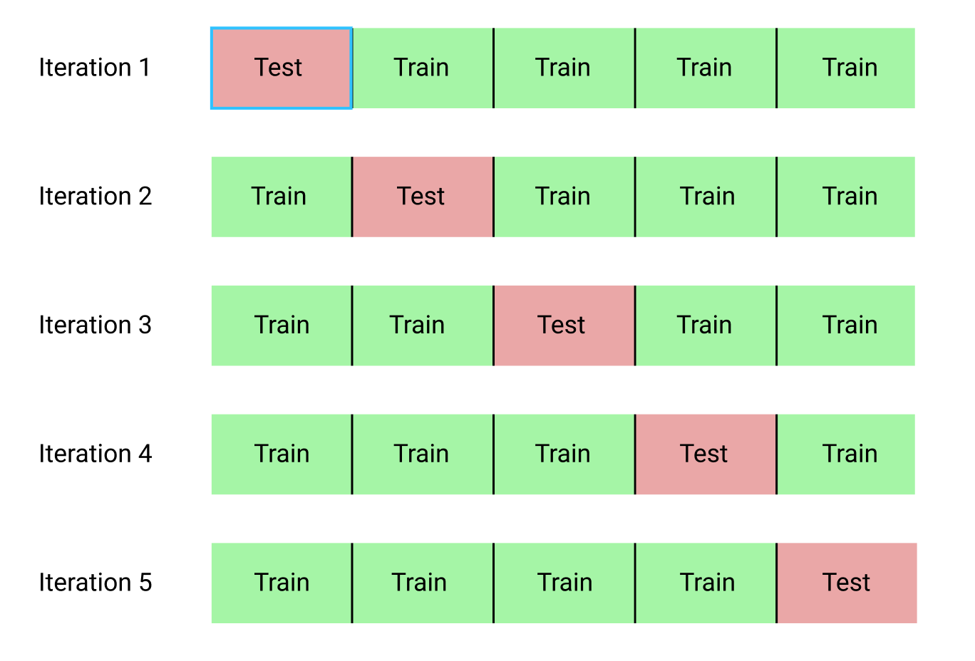
Model (4/4)
 | 1 | 2 | 3 | 4 | 5
Accuracy | 0.88 | 0.89 | 0.9 | 0.83 | 0.89

Slide 11
Conclusion
不受天氣、距離影響，隨時隨地都能投籃
搭配App，人人都可練習
透過互動式操作，增加大眾對於籃球的興趣。
協助使用者找出最符合自己出手姿勢的力道及出手角度。
用科學的角度追蹤投籃動作，讓出手不再是「感覺來了」，而是精準的分析。

Slide 12
Reference
Bishop, C. M. (2006). Pattern recognition and machine learning. New York: Springer.
CIC MorSensor tutorial pdf, ppt

