Slide 1
Spreadsheet Application
Prof. Jonathan Lee (李允中)
Department of Computer Science and Information Engineering
National Taiwan University

Slide 2
Homework 1: Requirements Statements₁
In a spreadsheet application,
A spreadsheet object, bar chart object, and pie chart object can depict information in the same application data object by using different presentations.
When the user changes the information in the spreadsheet, the bar chart reflects the changes immediately, and vice versa.

Slide 3
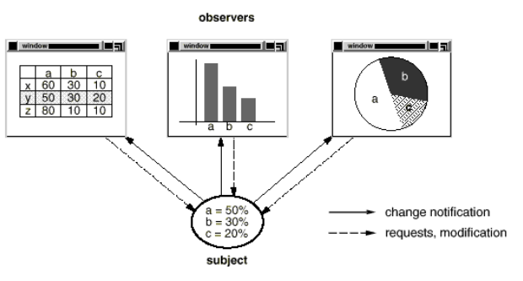
Homework 1: Requirements Statements₂
Both a spreadsheet object and bar chart object can depict information in the same application data object by using different presentations.

