Slide 1
web2py

Slide 2
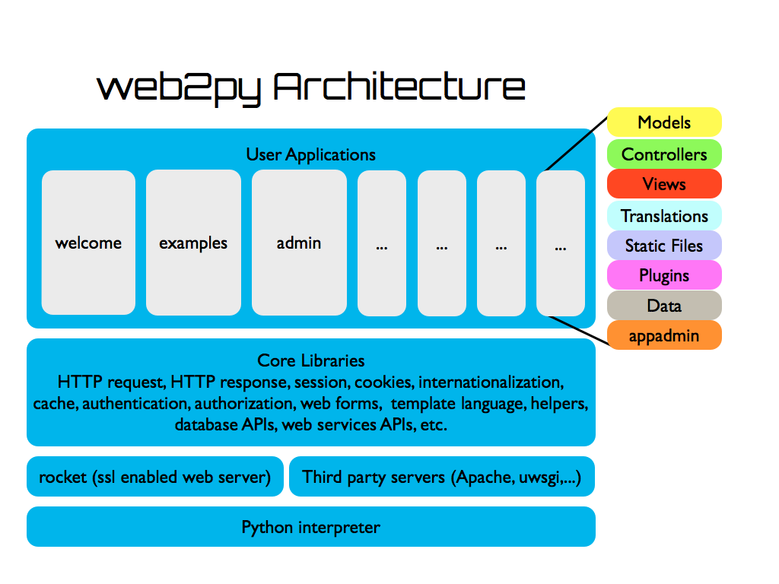
web2py structure

Slide 3
Core Libraries
server: main.py rocket.py fcgi.py
HTTP: contenttype.py http.py global.py
session & cookies: globals.py
internationalization: languages.py
cache: memcache.py cache.py cfs.py
authentication & authorization: login_methods/*.py tools.py
web forms: sqlhtml.py validators.py
view helper: html.py highlight.py fpdf/*.py yatl(submodule)
helpers: imageutils.py fileutils.py utils.py serializers.py
database APIs: memdb.py sql.py
extensions & add-ons: paymentech.py google_wallet.py
application execution: compileapp.py restricted.py shell.py
detailed classification：https://hackmd.io/T-gPTCQwT4Wo9ishRSsnzQ?view

Slide 4
Folder structure
gluon/
*.py
packages/
dal/
yatl/
applications/
app1/
models/
views/
controller/
app2
admin

Slide 5
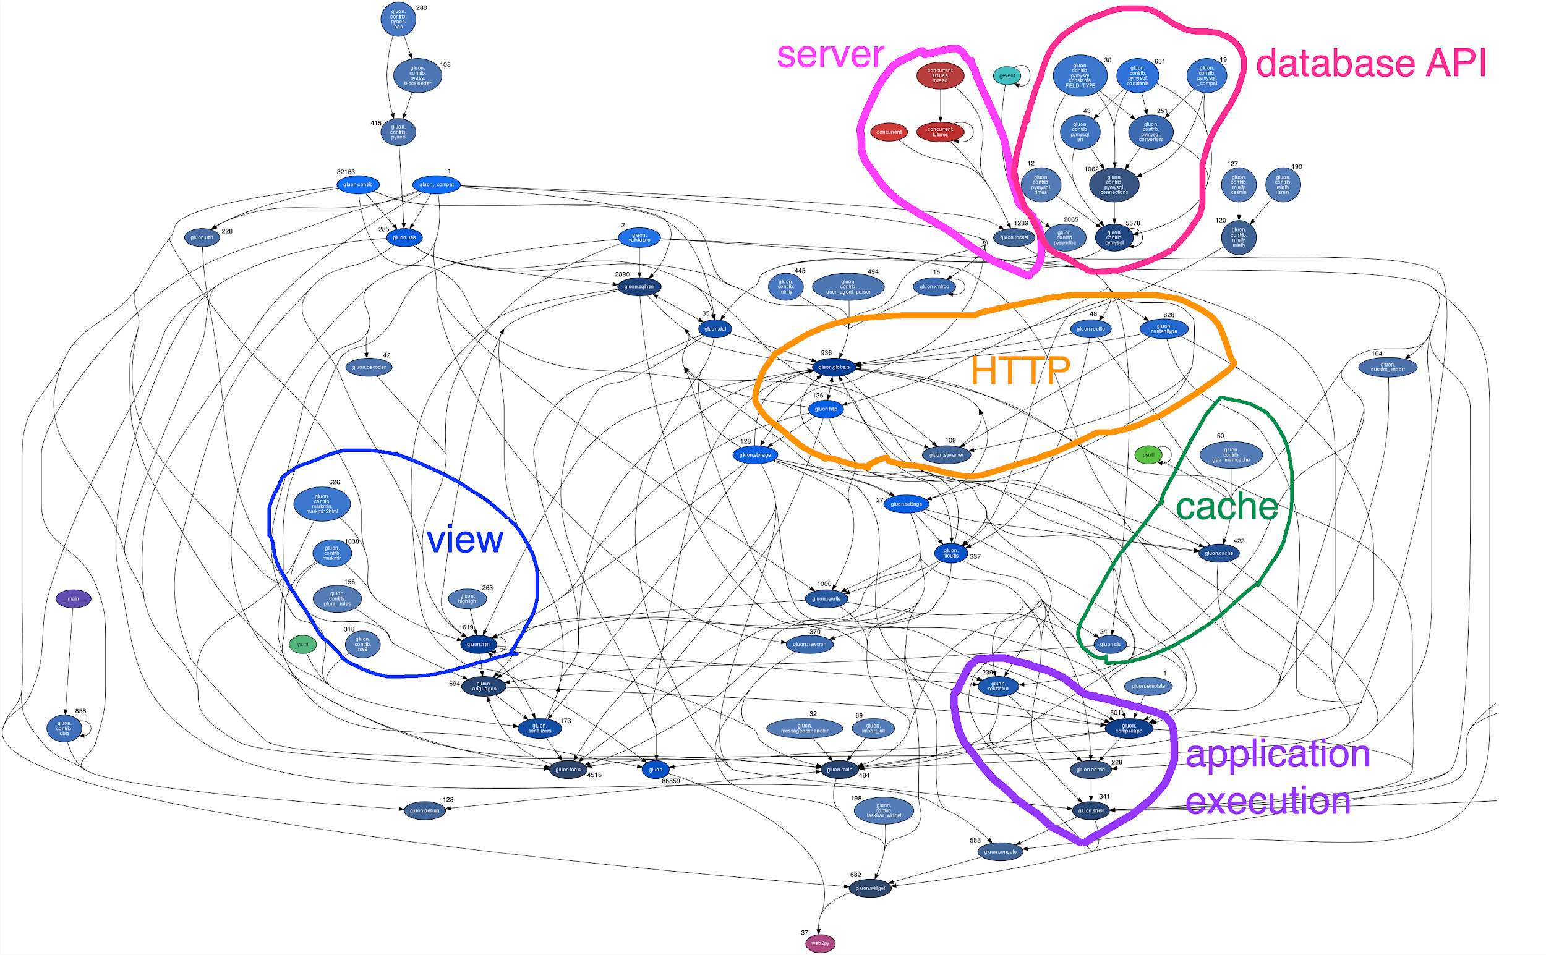
Overall structure
https://pydeps.readthedocs.io/en/latest/
https://www.csie.ntu.edu.tw/~b05902108/web2py_5_Fotor.png

Slide 6
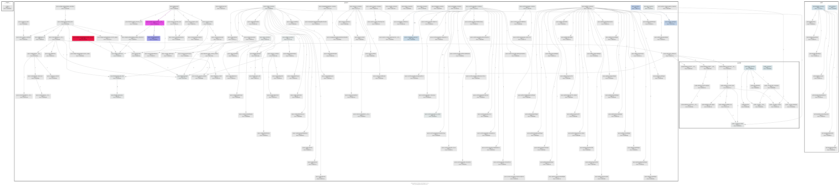
runtime diagram
By using runtime analysis (pycallgraph --include "gluon.*" --include "pydal.*" --include "yatl.*" graphviz -- ./web2py.py)
operation used：start webserver, login as admin, add new app, interact with that app
By specifying the dependencies between codes, we can distribute our work according to:
lines of code
code dependency, just need to read the adjacent codes
personal preference
more detailed diagram：
https://www.csie.ntu.edu.tw/~b05902108/wide.png
pycallgraph：
https://github.com/gak/pycallgraph

Slide 7
code not in runtime diagram
gluon/
authapi.py 808
debug.py 123
import_all.py 69
sanitizer.py 1
scheduler.py 1325
sql.py 16
tools.py 4516
utf8.py 220
contrib/fpdf/ 3378
contrib/gateways/ 859
contrib/login_methods/ 2052
contrib/markdown/ 1388
contrib/memcache/ 981
contrib/pyrtf/ 1517
contrib/pysimplesoap/ 2704
contrib/pyuca/ 80
contrib/
AuthorizeNet.py 193
DowCommerce.py 192
__init__.py 0
appconfig.py 96
autolinks.py 136
dbg.py 858
feedparser.py 3035
gae_memcache.py 50
gae_retry.py 34
generics.py 60
google_wallet.py 14
heroku.py 19
hypermedia.py 280
imageutils.py 43
memdb.py 563
ordereddict.py 1
pam.py 74
paymentech.py 82
pbkdf2.py 64
pbkdf2_ctypes.py 139
pdfinvoice.py 148
populate.py 237
contrib/
pyfpdf.py 3
redis_cache.py 182
redis_scheduler.py 572
redis_session.py 162
redis_utils.py 37
shell.py 126
simplejson.py 3
simplejsonrpc.py 106
sms_utils.py 109
spreadsheet.py 504
stripe.py 108
taskbar_widget.py 198
timecollect.py 71
user_agent_parser.py 494
webclient.py 150
websocket_messaging.py 132
Imply that：
Lots of codes under contrib/ are not called.
Most of codes there are add-ons and have little thing to do with basic web operations.

Slide 8
Request-response Flow

Slide 9
Browser
Server
Main
Model
Controller
View
Database
HTTP Request
map url, validate input, dispatch, start session, start transaction
Request
1
Request
DAL connect (define or alter tables)
2
globals
DAL insert, update, delete
3
DAL select
4
dictionary
HTML, XML, RSS, JSON, etc
5
6
Response
reverse map url, save seesion, close transaction
HTTP Response
Browser
Server
Main
Model
Controller
View
Database

Slide 10
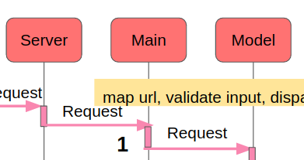
Dispatching
URLs are mapped to Python modules and function calls
Before calling the action, a few things happen:
Session object is created/retrieved
An execution environment for the request is created
map url, validate input, dispatch,
start session, start transaction

Slide 11
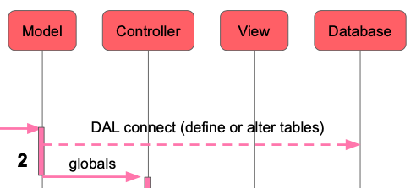
Migration / Glabal Variables Access
Migration
Check whether or not the corresponding table exists
If it does not, it generates the SQL to create it and executes the SQL
If the table does exist but differs from the one being defined, it generates the SQL to alter the table and executes it
Access all global variables in Model

Slide 12
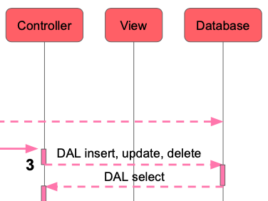
Database Query
The dashed arrows represent communication with the database engine(s)
The database queries can be written in
Raw SQL (discouraged)
web2py Database Abstraction Layer (recommended),
web2py application code is not dependent on the specific database engine

Slide 13
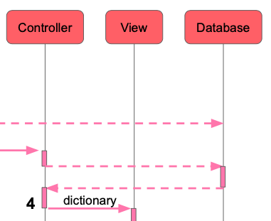
Controller Function Execution
URLs are mapped to Python modules and function calls
The controller may contain one or more functions (or “actions”)
An controller actions is executed and may return a string, an iterable, a Python dictionary, etc.

Slide 14
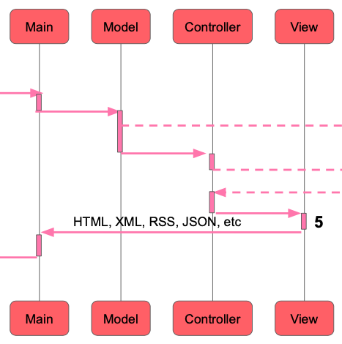
Rendering
web2py tries to locate a view to the returned dictionary
The view must have the same name as action and the same extension as the requested page
Generates a generic view on failure
The view sees global variables defined in model but not the global variables defined in controller

Slide 15
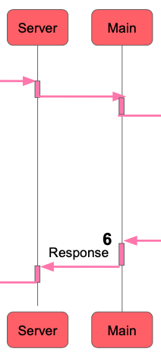
Committing Transaction
All calls are wrapped into a transaction, and any uncaught exception causes the transaction to be rolled back. If the request succeeds, the transaction is committed
web2py also handles sessions and session cookies automatically, and when a transaction is committed, the session is also stored, unless specified otherwise

Slide 16
PyDAL

Slide 17
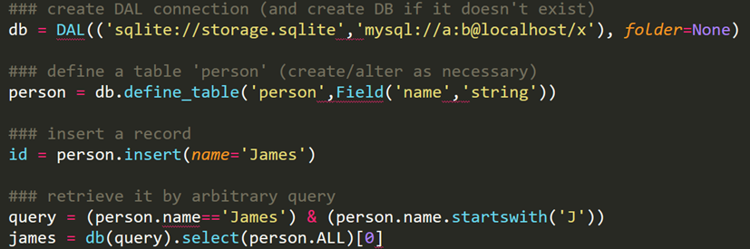
PyDAL
Introduction :
This package dynamically translates database languages to python in realtime.
It supports MySQL, MongoDB, Oracle and 12 other database languages.
Example :

Slide 18
