Slide 1
Meta Programming
Reference: https://www.youtube.com/watch?v=sPiWg5jSoZI&t=5344s

Slide 2
Outline
Examples help to deliver why metaclass exists
Metaclass in web2py
Notes:
帶一些example
講一下web2py用metaclass的用意

Slide 3
Some Python thing
# Special Methods
class Array:
def __getitem__(self, index):
...
def __setitem__(self, index, value):
...
def __delitem__(self, index):
...
def __contains__(self, item):
...
def func(*args, **kwargs):
# args is tuple of position args
# kwargs is dict of keyword args
...
func(1, 2, x=2, y=3, z=5)
# args = (1, 2)
# kwargs = {'x':2, 'y':3, 'z':5}
# Named arguments appearing after "*" can only
# be passed by keyword
def recv(maxize, *, block=True):
...
recv(8192, block=False) # OK
recv(8192, False) # Error
Notes:
args, kwargs
* 後面
Special method

Slide 4
Start from debugging function
def add(x, y):
print('add')
return x + y
def sub(x, y):
print('sub')
return x - y
def mul(x, y):
print('mul')
return x * y
def div(x, y):
print('div')
return x / y
def add(x, y):
return x + y
def sub(x, y):
return x - y
def mul(x, y):
return x * y
def div(x, y):
return x / y
annoying
Notes:
用debug及舉例子來說
太冗

Slide 5
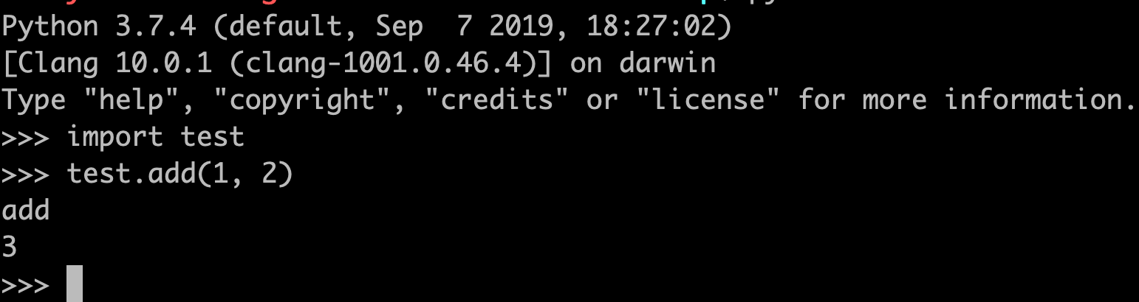
Decorator
A function that creates a wrapper around another function
@debug
def add(x, y):
return x + y
@debug
def sub(x, y):
return x - y
@debug
def mul(x, y):
return x * y
@debug
def div(x, y):
return x / y
def debug(func):
# func is function to be wrapped
def wrapper(*args, **kwargs):
print(func.__name__)
return func(*args, **kwargs)
return wrapper
Notes:
Function decorator

Slide 6
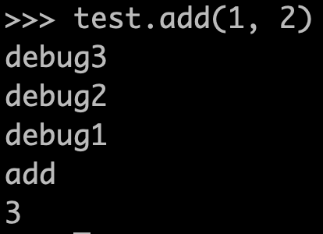
More about decorator
def debug(func):
# func is function to be wrapped
def wrapper(*args, **kwargs):
print(func.__qualname__)
return func(*args, **kwargs)
return wrapper
def debug1(func):
# func is function to be wrapped
def wrapper(*args, **kwargs):
print('debug1')
return func(*args, **kwargs)
return wrapper
def debug2(func):
# func is function to be wrapped
def wrapper(*args, **kwargs):
print('debug2')
return func(*args, **kwargs)
return wrapper
def debug3(func):
# func is function to be wrapped
def wrapper(*args, **kwargs):
print('debug3')
return func(*args, **kwargs)
return wrapper
@debug3
@debug2
@debug1
@debug
def add(x, y):
return x + y
Notes:
可以包很多層，執行順序是外面到裡面

Slide 7
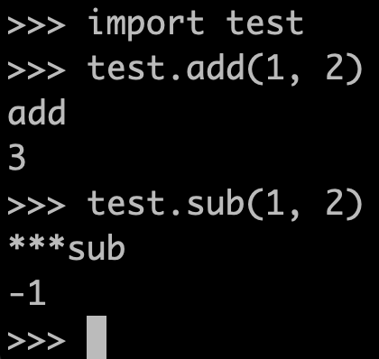
More about decorator
@debug
def add(x, y):
return x + y
@debug(prefix='***')
def sub(x, y):
return x - y
from functools import wraps, partial
def debug(func=None, *, prefix=''):
if func is None:
# Wasn't passed
return partial(debug, prefix=prefix)
msg = prefix + func.__qualname__
# func is function to be wrapped
@wraps(func)
def wrapper(*args, **kwargs):
print(msg)
return func(*args, **kwargs)
return wrapper
Notes:
Decorator可以傳參數，上面所呈現的手法可以做到overloading

Slide 8
Decorator in class function
class Test:
@debug
def a(self):
pass
@debug
def b(self):
pass
@debug
def c(self):
pass
annoying
Notes:
Class 裡有多個 function

Slide 9
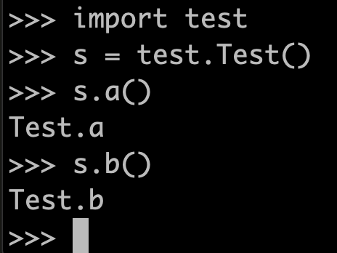
Class decorator
def debugmethods(cls):
# cls is a class
for key, val in vars(cls).items():
if callable(val):
setattr(cls, key, debug(val))
return cls
@debugmethods
class Test:
def a(self):
pass
def b(self):
pass
def c(self):
pass
Notes:
一個一個抓出來塞

Slide 10
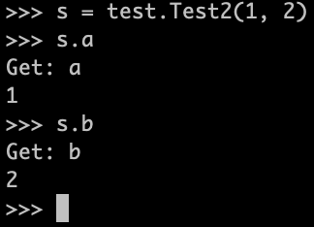
Supplementary notes to class decorator
def debugattr(cls):
orig_getattribute = cls.__getattribute__
def __getattribute__(self, name):
print('Get:', name)
return orig_getattribute(self, name)
cls.__getattribute__ = __getattribute__
return cls
@debugattr
class Test2:
def __init__(self, a, b):
self.a = a
self.b = b
Notes:
除了decorate method, 還可以decorate attribute

Slide 11
So far
def add(x, y):
print('add')
return x + y
def sub(x, y):
print('sub')
return x - y
def mul(x, y):
print('mul')
return x * y
def div(x, y):
print('div')
return x / y
@debug
def add(x, y):
return x + y
@debug
def sub(x, y):
return x - y
@debug
def mul(x, y):
return x * y
@debug
def div(x, y):
return x / y
class Test:
@debug
def a(self):
pass
@debug
def b(self):
pass
@debug
def c(self):
pass
@debugmethods
class Test:
def a(self):
pass
def b(self):
pass
def c(self):
pass

Slide 12
What if we want to debug more class
@debugmethods
class Fruit:
...
@debugmethods
class Apple(Fruit):
...
@debugmethods
class Banana(Fruit):
...
@debugmethods
class Carrot(Fruit):
...
annoying
Notes:
還是太冗

Slide 13
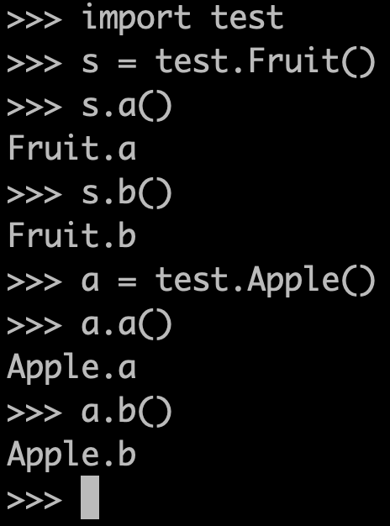
Metaclass
class debugmeta(type):
def __new__(cls, clsname, bases, clsdict):
# create the class
clsobj = super().__new__(cls, clsname,
bases, clsdict)
# wrap the class
clsobj = debugmethods(clsobj)
return clsobj
class Fruit(metaclass=debugmeta):
def a(self):
pass
def b(self):
pass
class Apple(Fruit):
def a(self):
pass
def b(self):
pass
class Banana(Fruit):
def a(self):
pass
def b(self):
pass
Notes:
Metaclass可以解決

Slide 14
How Metaclass works (I)
class debugmeta(type):
def __new__(cls, clsname, bases, clsdict):
# create the class
clsobj = super().__new__(cls, clsname,
bases, clsdict)
# wrap the class
clsobj = debugmethods(clsobj)
return clsobj
Body of class is isolated
(before calling __new__)
class Banana(Fruit):
def a(self):
pass
def b(self):
pass
body = """
def a(self):
pass
def b(self):
pass
"""
Notes:
Body of class is isolated

Slide 15
How Metaclass works (II)
class debugmeta(type):
def __new__(cls, clsname, bases, clsdict):
# create the class
clsobj = super().__new__(cls, clsname,
bases, clsdict)
# wrap the class
clsobj = debugmethods(clsobj)
return clsobj
class Banana(Fruit):
def a(self):
pass
def b(self):
pass
class dictionary is created
(before calling __new__)
clsdict = type.__prepare__('Apple', (Base,))

Slide 16
How Metaclass works (III)
class debugmeta(type):
def __new__(cls, clsname, bases, clsdict):
# create the class
clsobj = super().__new__(cls, clsname,
bases, clsdict)
# wrap the class
clsobj = debugmethods(clsobj)
return clsobj
class Banana(Fruit):
def a(self):
pass
def b(self):
pass
Body is executed in return clsdict
(before calling __new__)
exec(body, globals(), clsdict)

Slide 17
How Metaclass works (IV)
class debugmeta(type):
def __new__(cls, clsname, bases, clsdict):
# create the class
clsobj = super().__new__(cls, clsname,
bases, clsdict)
# wrap the class
clsobj = debugmethods(clsobj)
return clsobj
Do things here
class Banana(Fruit):
def a(self):
pass
def b(self):
pass
Class is constructed from its name,
bases and clsdict (in the __new__
using type __new__ method)
Notes:
前面看到可以exec，就代表exec前，可以在body亂插code，做到很多事情。

Slide 18
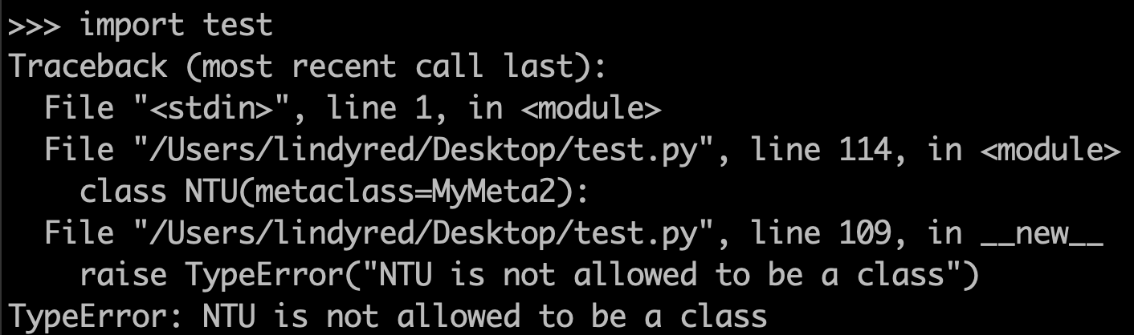
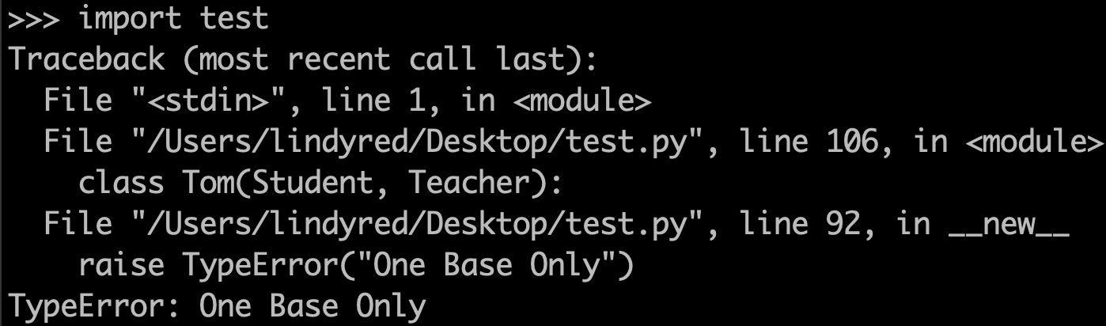
Additional example
class MyMeta(type):
def __new__(cls, clsname, bases, clsdict):
if len(bases) > 1:
raise TypeError("One Base Only")
return super().__new__(cls, clsname,
bases, clsdict)
class MyMeta2(type):
def __new__(cls, clsname, bases, clsdict):
if clsdict['__qualname__'] is 'NTU':
raise TypeError("NTU is not allowed to be a class")
return super().__new__(cls, clsname,
bases, clsdict)
class Person(metaclass=MyMeta):
pass
class Student(Person):
pass
class Teacher(Person):
pass
class Tom(Student, Teacher):
pass
class NTU(metaclass=MyMeta2):
pass

Slide 19
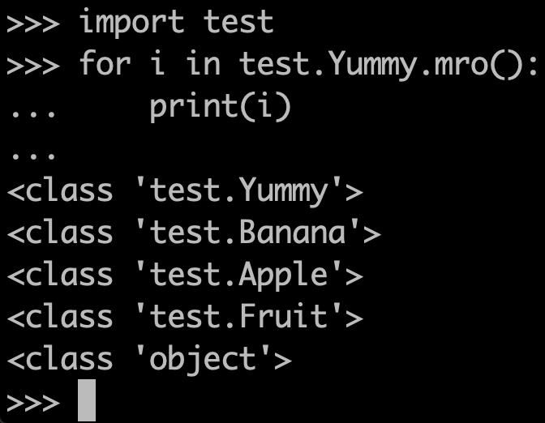
Supplementary notes to multiple inheritance
class Fruit(metaclass=debugmeta):
def a(self):
pass
def b(self):
pass
class Apple(Fruit):
def a(self):
pass
def b(self):
pass
class Banana(Fruit):
def a(self):
pass
def b(self):
pass
class Yummy(Banana, Apple):
def a(self):
pass
def b(self):
pass
Notes:
繼承順序
mro : method resolution order
super()的順序

Slide 20
Overall
class Test:
@debug
def a(self):
pass
@debug
def b(self):
pass
@debug
def c(self):
pass
def add(x, y):
print('add')
return x + y
def sub(x, y):
print('sub')
return x - y
def mul(x, y):
print('mul')
return x * y
def div(x, y):
print('div')
return x / y
@debugmethods
class Fruit:
...
@debugmethods
class Apple(Fruit):
...
@debugmethods
class Banana(Fruit):
...

Slide 22
Overall
class Test:
@debug
def a(self):
pass
@debug
def b(self):
pass
@debug
def c(self):
pass
@debugmethods
class Test:
def a(self):
pass
def b(self):
pass
def c(self):
pass
def add(x, y):
print('add')
return x + y
def sub(x, y):
print('sub')
return x - y
def mul(x, y):
print('mul')
return x * y
def div(x, y):
print('div')
return x / y
@debug
def add(x, y):
return x + y
@debug
def sub(x, y):
return x - y
@debug
def mul(x, y):
return x * y
@debug
def div(x, y):
return x / y
class Fruit(metaclass=debugmeta):
def a(self):
pass
def b(self):
pass
class Apple(Fruit):
def a(self):
pass
def b(self):
pass
class Banana(Fruit):
def a(self):
pass
def b(self):
pass
@debugmethods
class Fruit:
...
@debugmethods
class Apple(Fruit):
...
@debugmethods
class Banana(Fruit):
...

Slide 23
Metaclass conslusion
Metaclasses get information about class definitions at the time of definition
Can inspect this data
Can modify this data
Essentially, similar to class decorator
Metaclass propagate down hierarchies (debugmeta->Fruit->Apple)
It’s like generaic mutation
Comparison
Decorators: Functions
Class Decorators: Classes
Metaclasses: Class hierarchy
Notes:
Code level abstraction

Slide 24
Metaclass in web2py

Slide 25
Seems to only appear in pydal
# in base.py
class MetaDAL(type):
# in adapters/__init_.py
class AdapterMeta(type):
# in adapters/postgres.py
class PostgreMeta(AdapterMeta):
# in dialects/__init__.py
class MetaDialect(type):
# in parsers/__init__.py
class MetaParser(type):
# in representers/__init__.py
class MetaRepresenter(type):

Slide 26
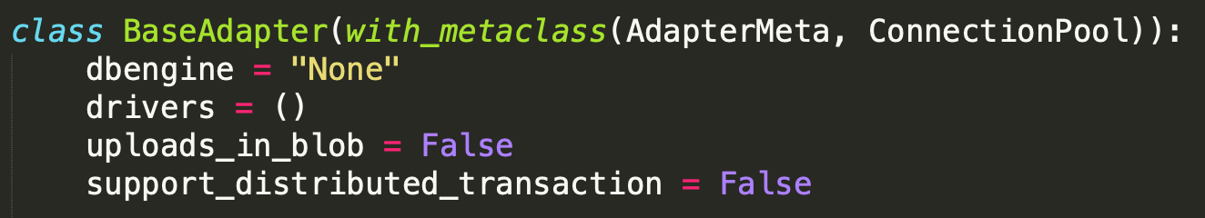
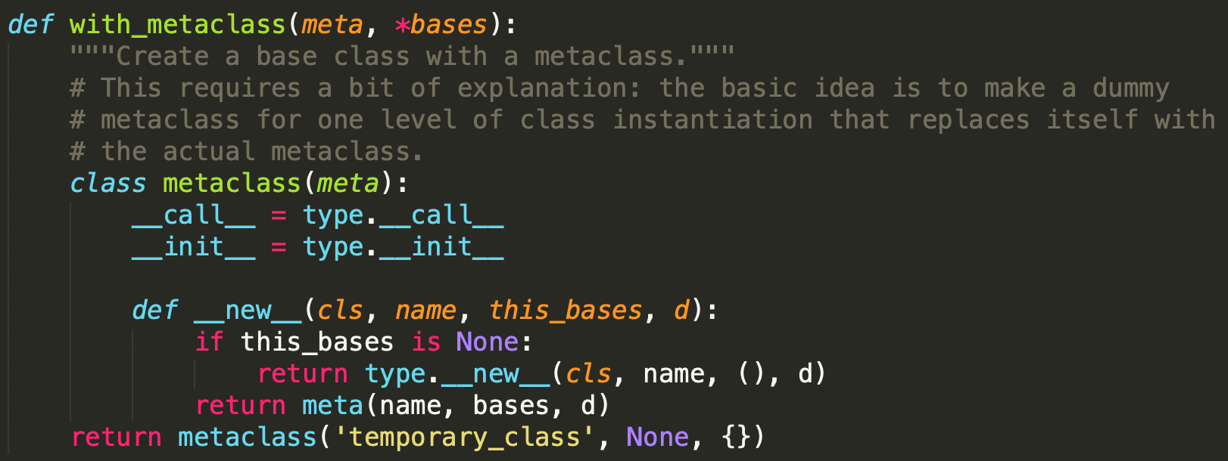
One more thing: with_metaclass()
https://stackoverflow.com/questions/18513821/python-metaclass-understanding-the-with-metaclass

Slide 27
with_metaclass()
A utility class factory function to make it easier to develop code for Python 2 and 3
It uses a little slight of hand with a temporary metaclass, to attach a metaclass to a regular class in a way that's cross-compatible with both Python 2 and Python 3.
Not going to trace
# Python 2
class MyClass(object):
__metaclass__ = Meta
# Python 3
class MyClass(metaclass=Meta):
pass

Slide 28
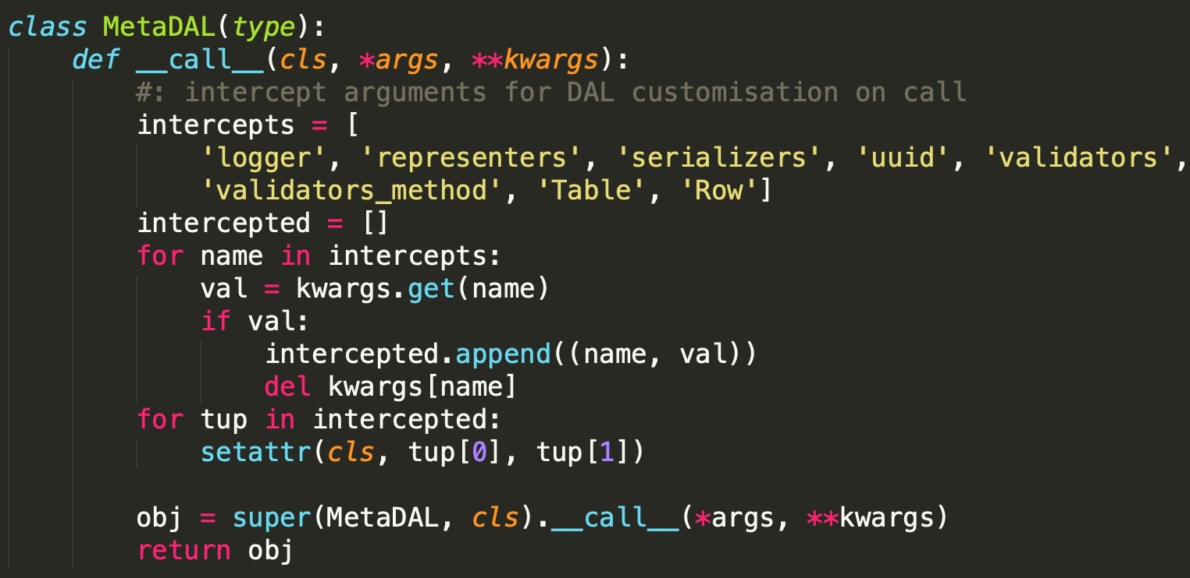
Example: DAL
Inheritance from Serializable and BasicStorage, using MetaDAL

Slide 29
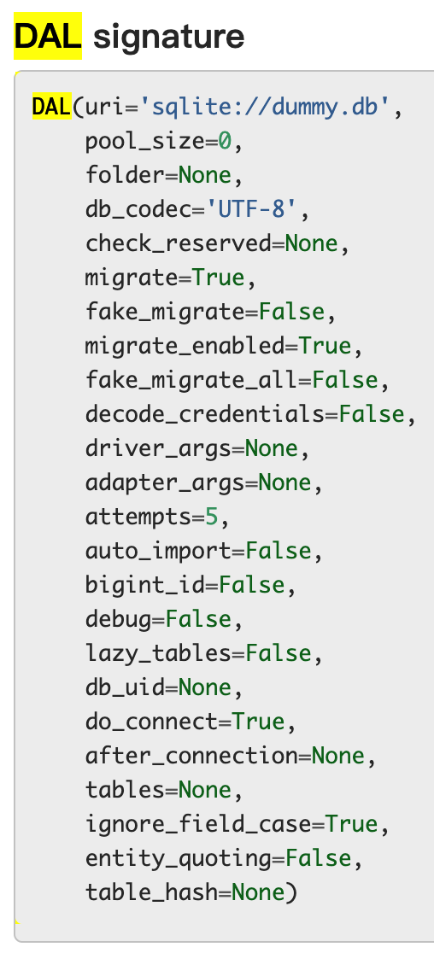
DAL
# way to initialize
db = DAL(**{"uri": ..., "tables": [...]...})
db = DAL('sqlite://storage.sqlite', pool_size=0)
Notes:
如果是kwargs傳進來，攔截起來，set attribute，create class，最後return
Not gonna trace the other meta class

Slide 30
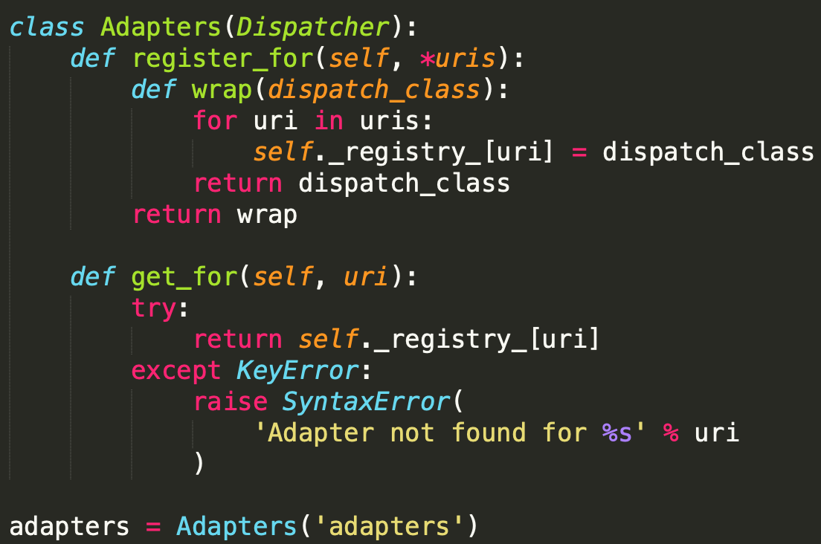
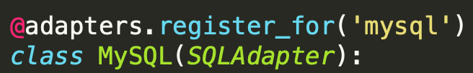


More: decorator in web2py

Slide 31
Thanks for listening

