Slide 1
Rocket Server
Build-in web server for web2py

Slide 2
Rocket Server
Rocket is a light-weight open source server
Included in web2py as default web server

Slide 3
Design of Rocket

Slide 4
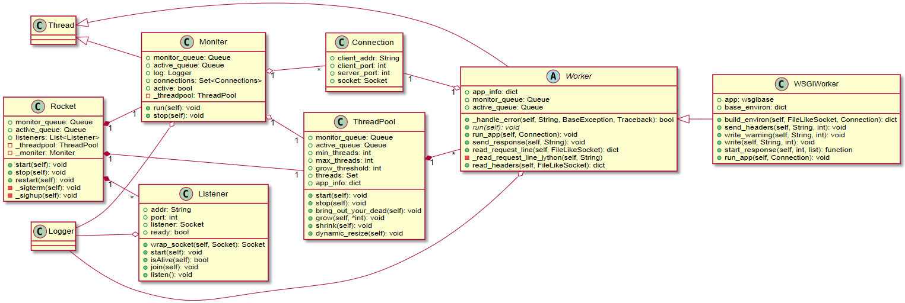
Class diagram

Slide 5
Rocket: responsibility of each class
Listener: listen on interface and accept incoming connections.
Worker: subclass of Thread. Reads request header & contents from socket.
WSGIWorker: subclass of Worker, implements run_app(). Is responsible of executing the WSGI application.
ThreadPool: pool of worker threads.
Monitor: Monitor connections, manages the size of ThreadPool.

Slide 6
Rocket: two important queues
Active queue: Active connections are put into this queue by Listeners, and retrieved from this queue by Workers
Monitor queue: Stalled or timeout connections are put into this queue, the monitor?

Slide 7
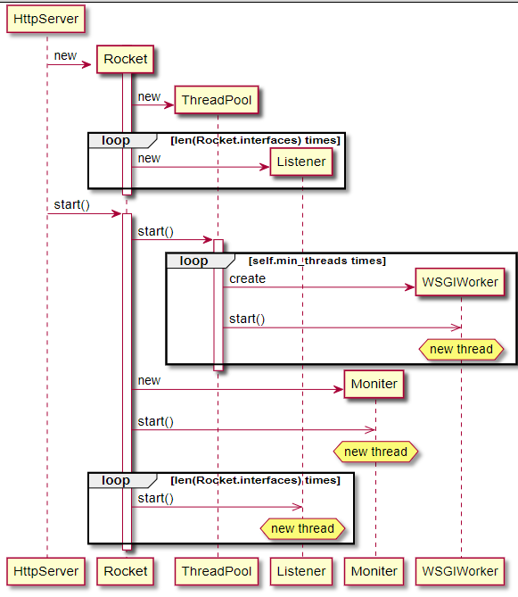
Sequence diagram: start-up

Slide 8
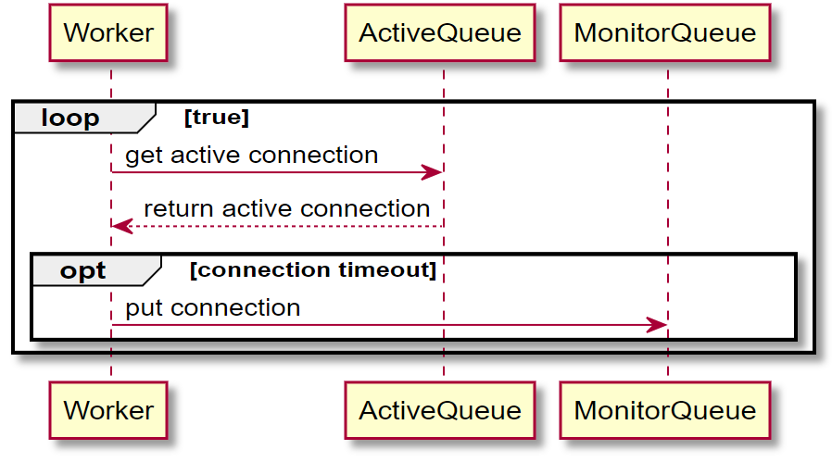
Sequence diagram: process connection

Slide 9
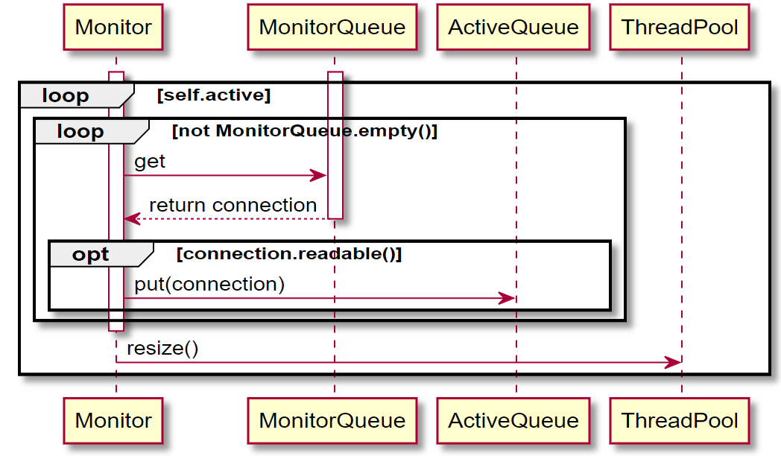
Sequence diagram: monitor connection status

Slide 10
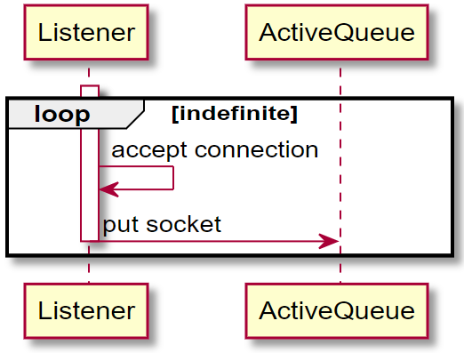
Sequence diagram: listening for incoming connections

Slide 11
Design Patterns

Slide 12
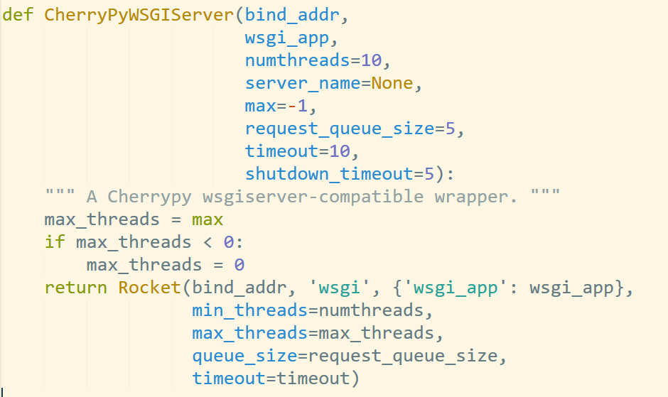
Adapter pattern
Wraps Rocket’s constructor into CherryPyWSGIServer’s constructor.

