Slide 1
PyDAL

Slide 2
Outline
Introduction and usage
Analyze the whole database access workflow through examples
Mixed with some class diagrams and sequence diagrams

Slide 3
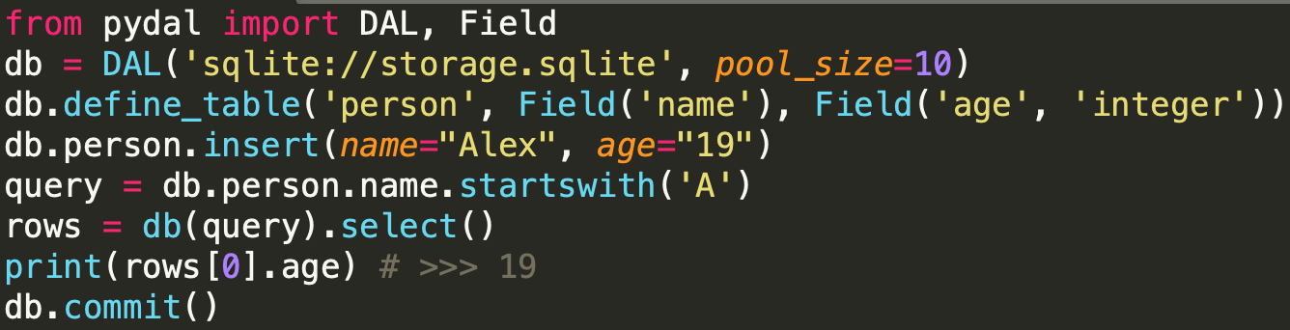
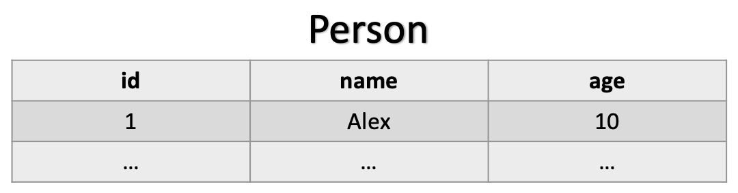
What is PyDAL
PyDAL stands for Python Data Abstraction Layer
A python module that can access different types of database
Written by web2py author and can be used alone

Slide 4
DAL
Able to access different types of database
SQLite, MySQL, Oracle, MongoDB, PostgreSQL, MSSQL, FireBird, ...

Slide 5
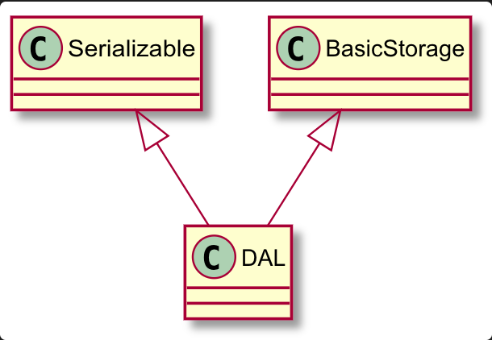
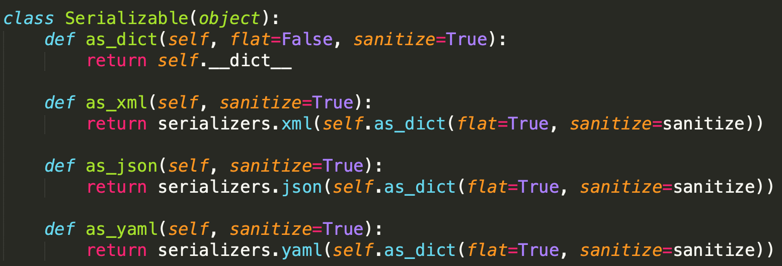
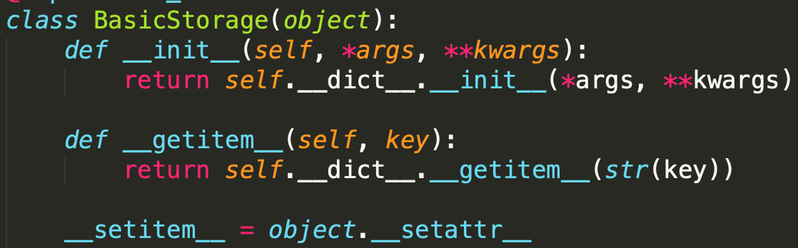

DAL class
adapt DAL with SQLite adapter

Slide 6
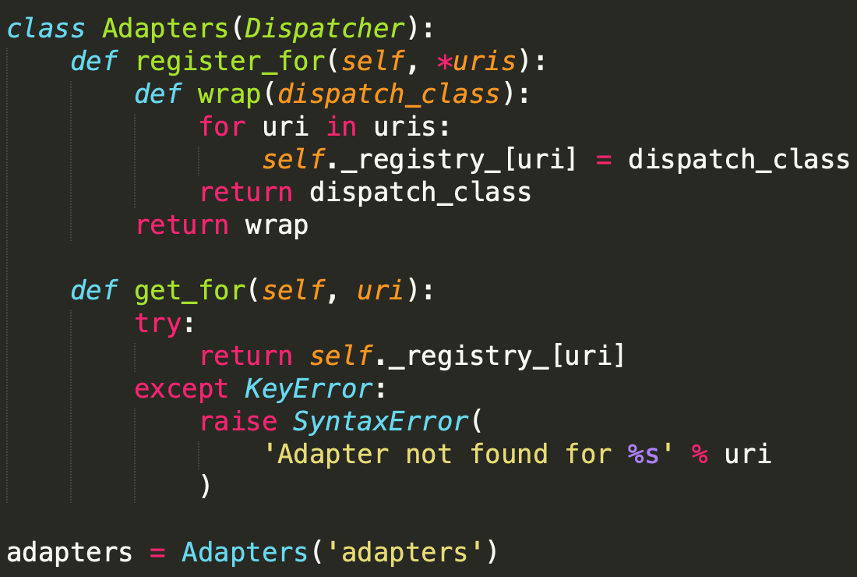
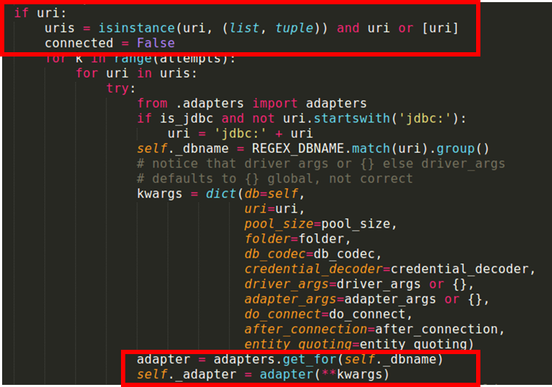
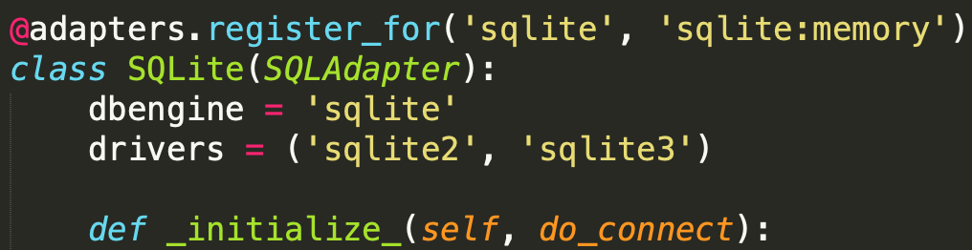
parse

Slide 7
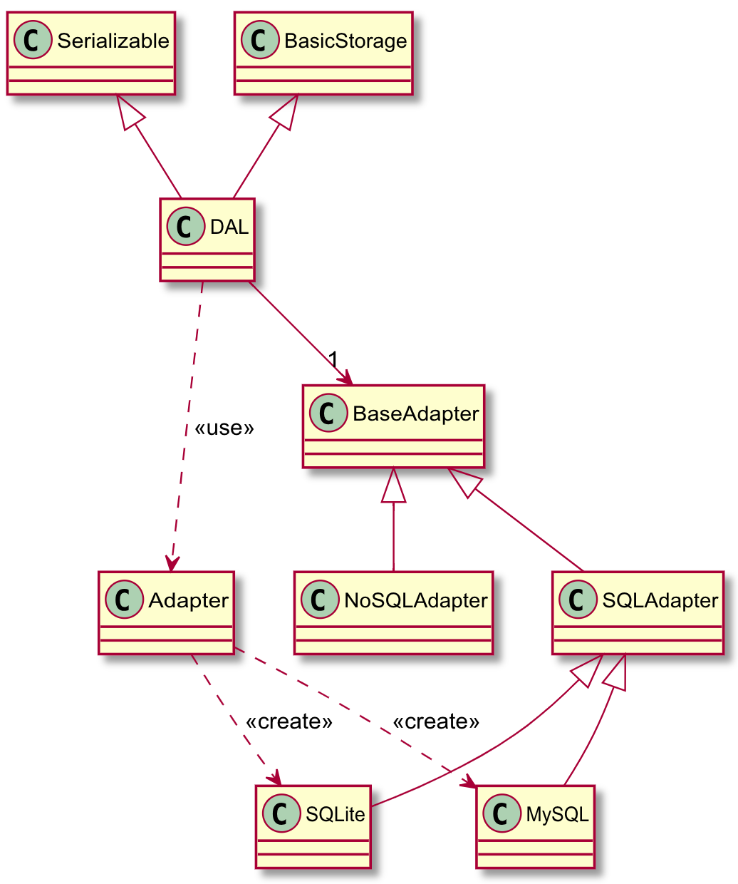
Dependency Injection
Inject SQLite class
Adapter has different adapters
Dependency Pool:
MySQL, Oracle
SQLite, ...

Slide 8
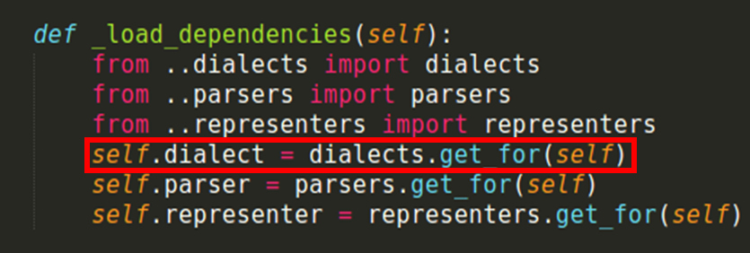
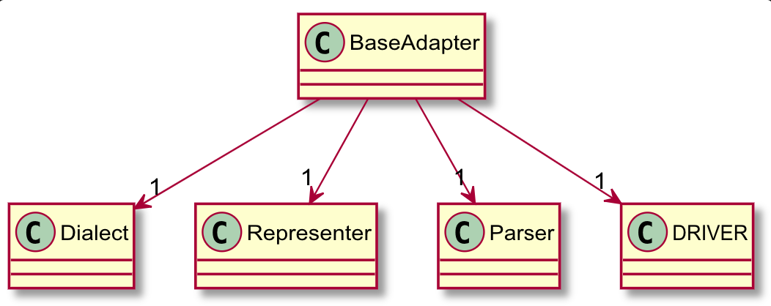
What adapters can do
Translate all fields’ operations into its own dialect (SQLiteDialect)
Connect to the database via specific module (from sqlite3 import dbapi2)
Parse response string using (if needed) based on its own parser (SQLiteParser)
Extra query (ST_Geomtry) using its representers (SQLiteRepresenter)

Slide 9
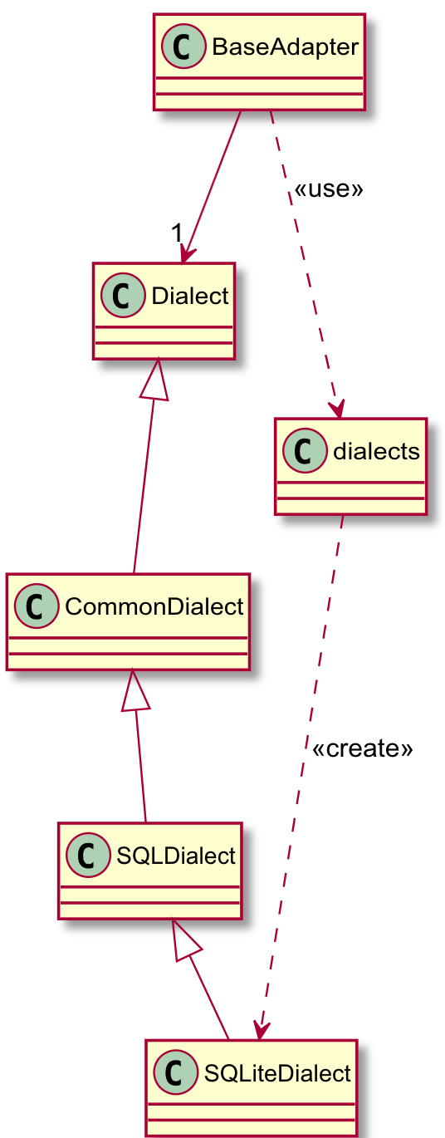
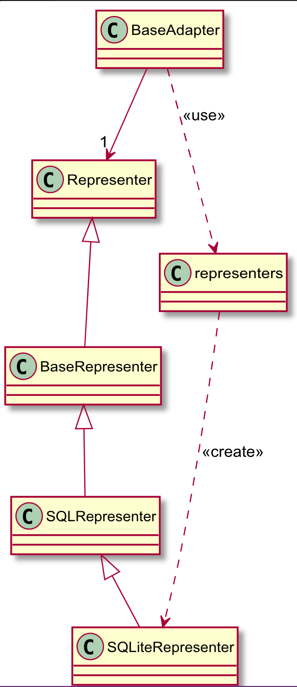
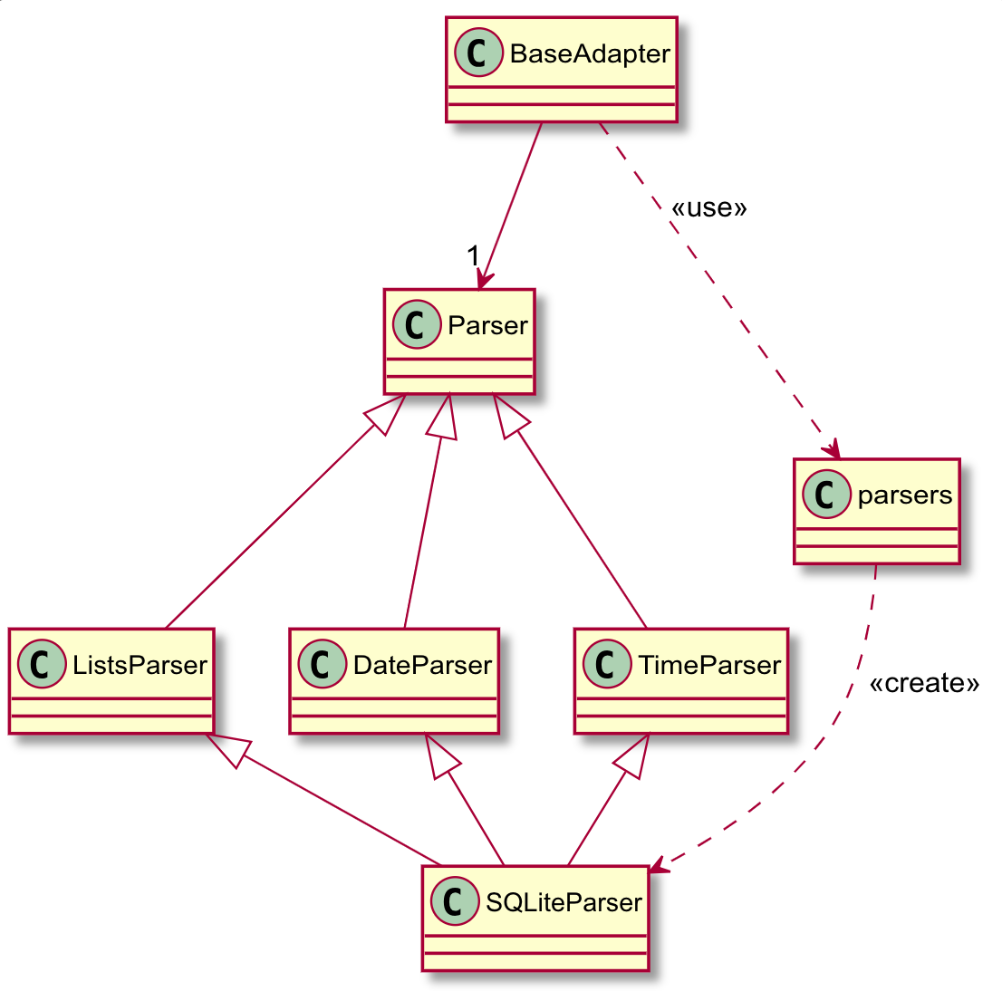
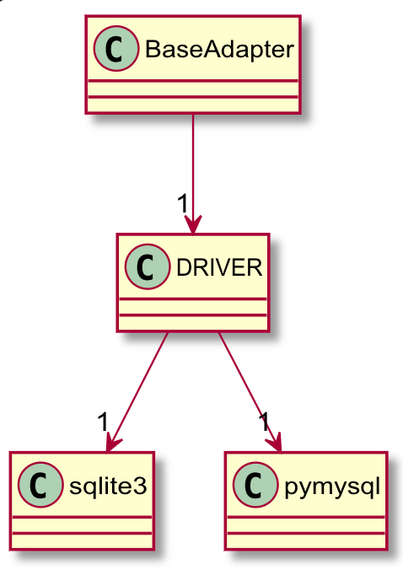
Injection of Dialect, Parserm, Representer, Connection module

Slide 10
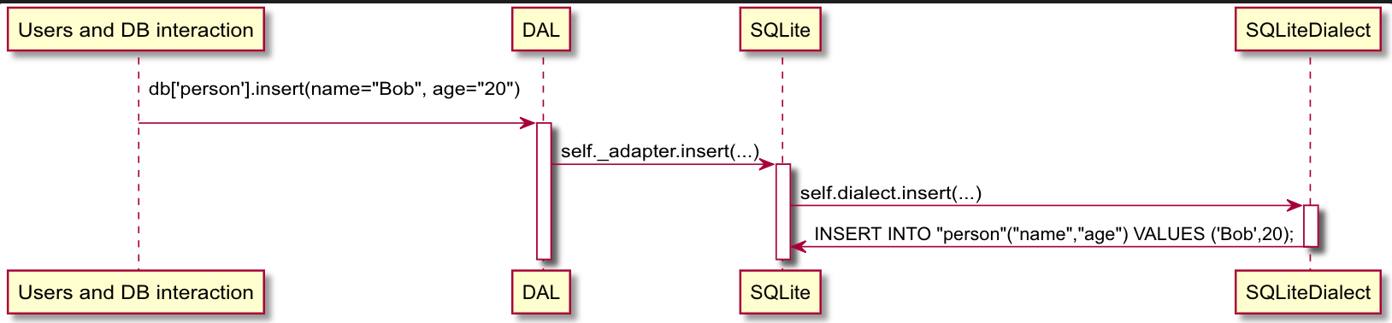
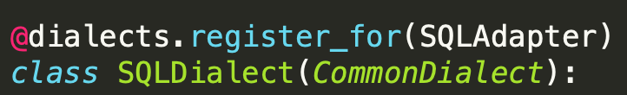
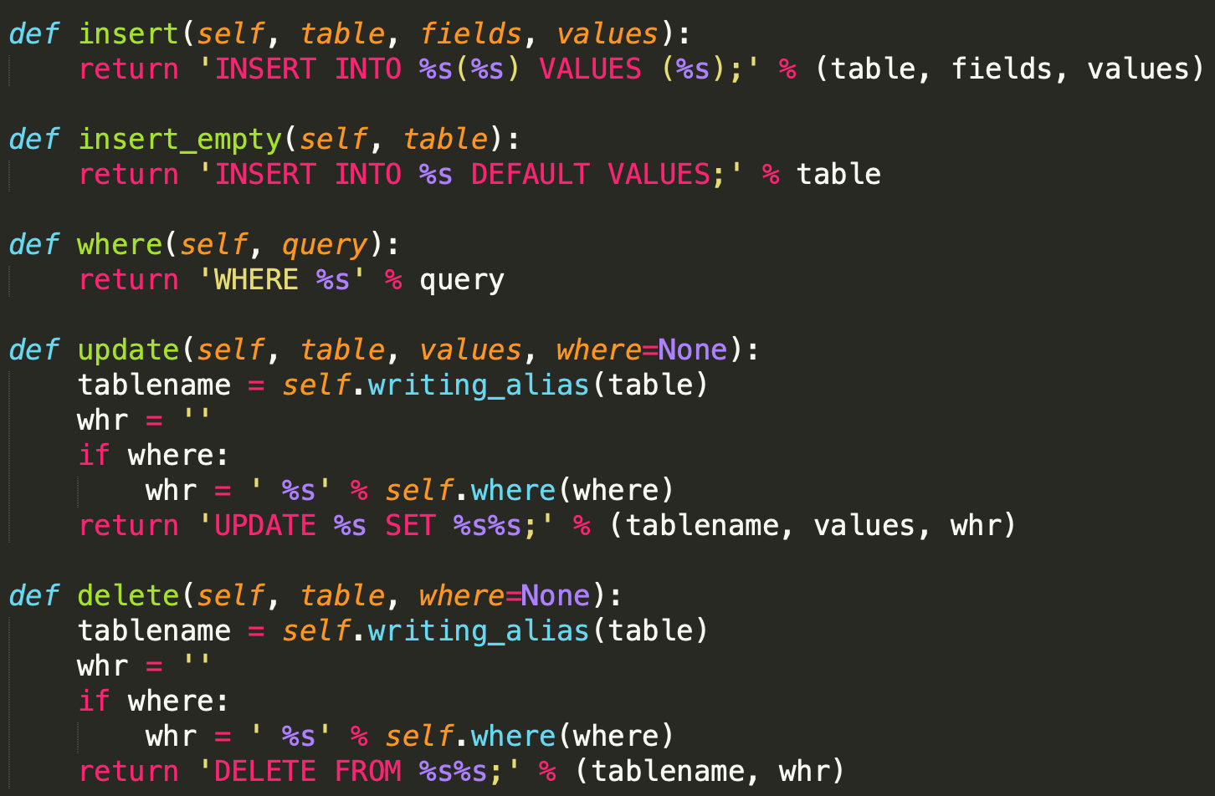
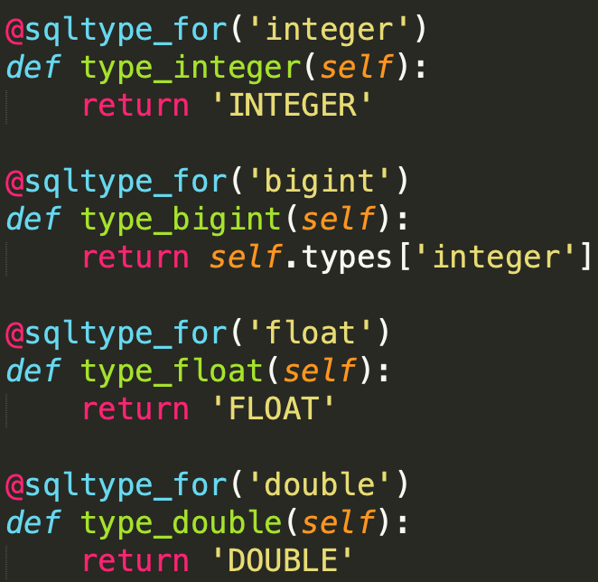
Dialect
map types and operation into specific string
prepare query string

Slide 11
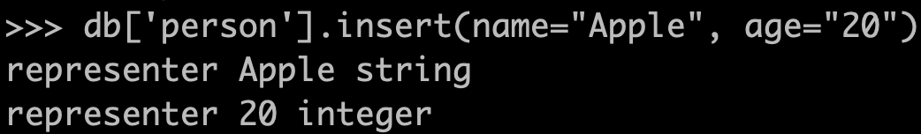
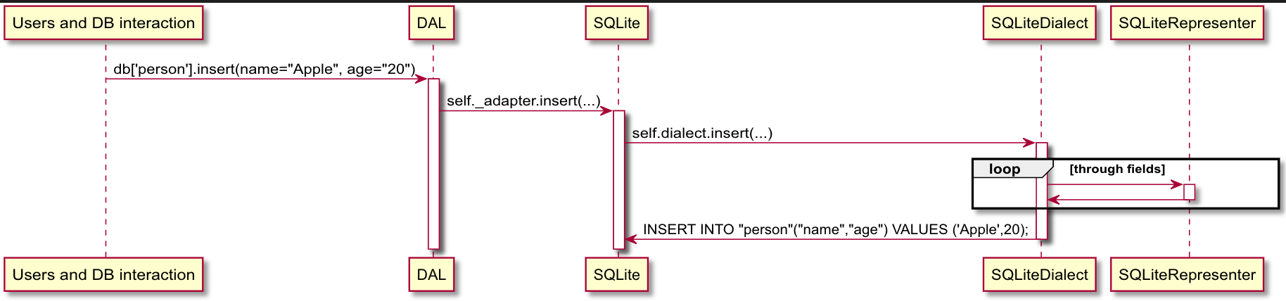
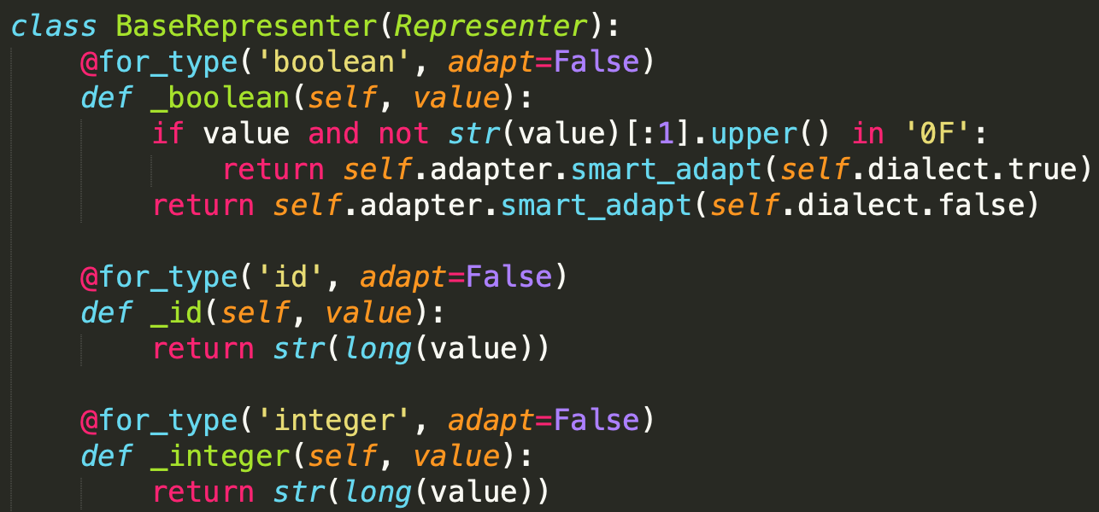
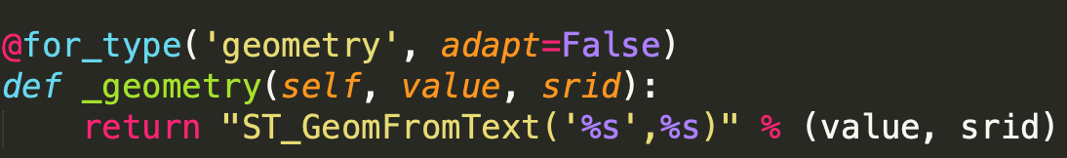
Representer
type definition (string, int)
custom type, ex: ST_Geomtry
used by Dialect to determine transformed string

Slide 12

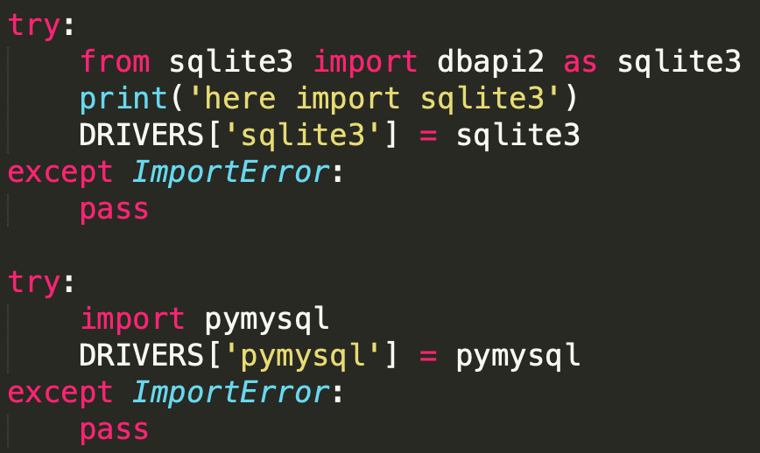
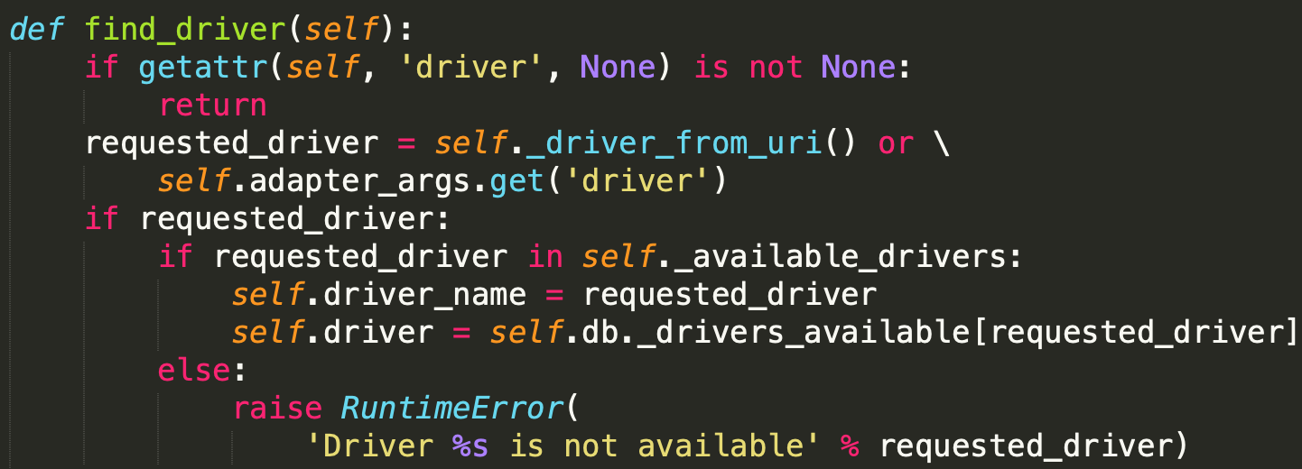
DRIVER
connect to database
send request and receive response

Slide 13
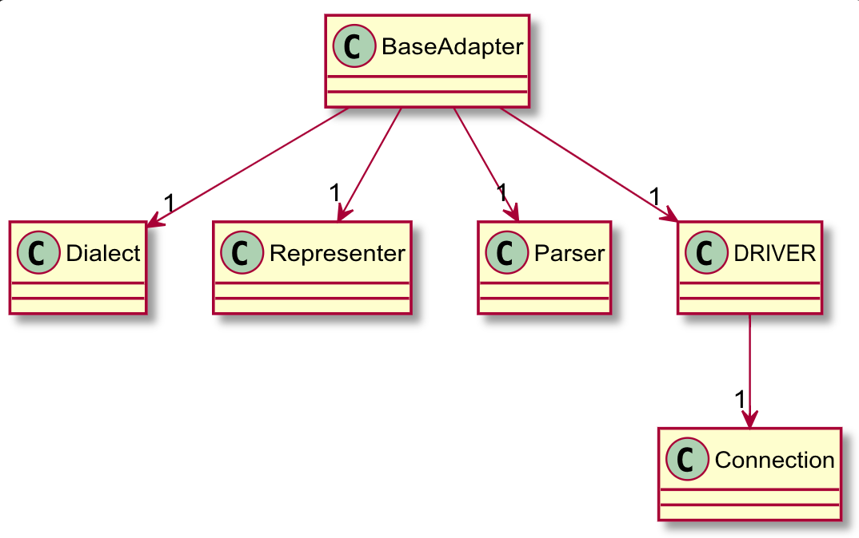
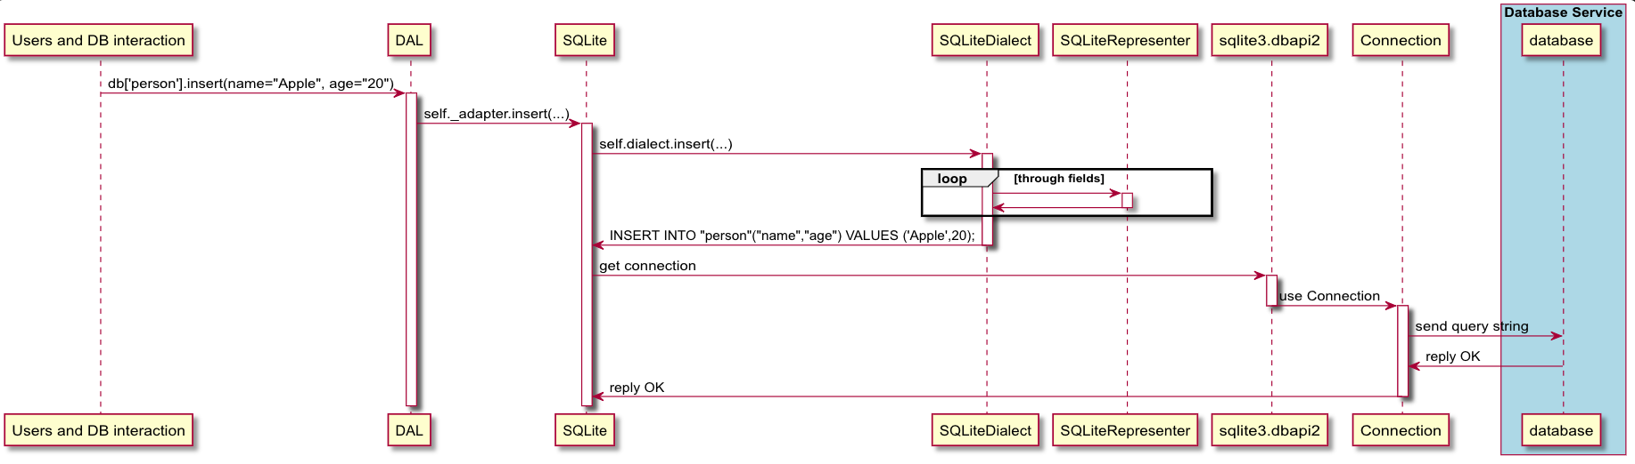
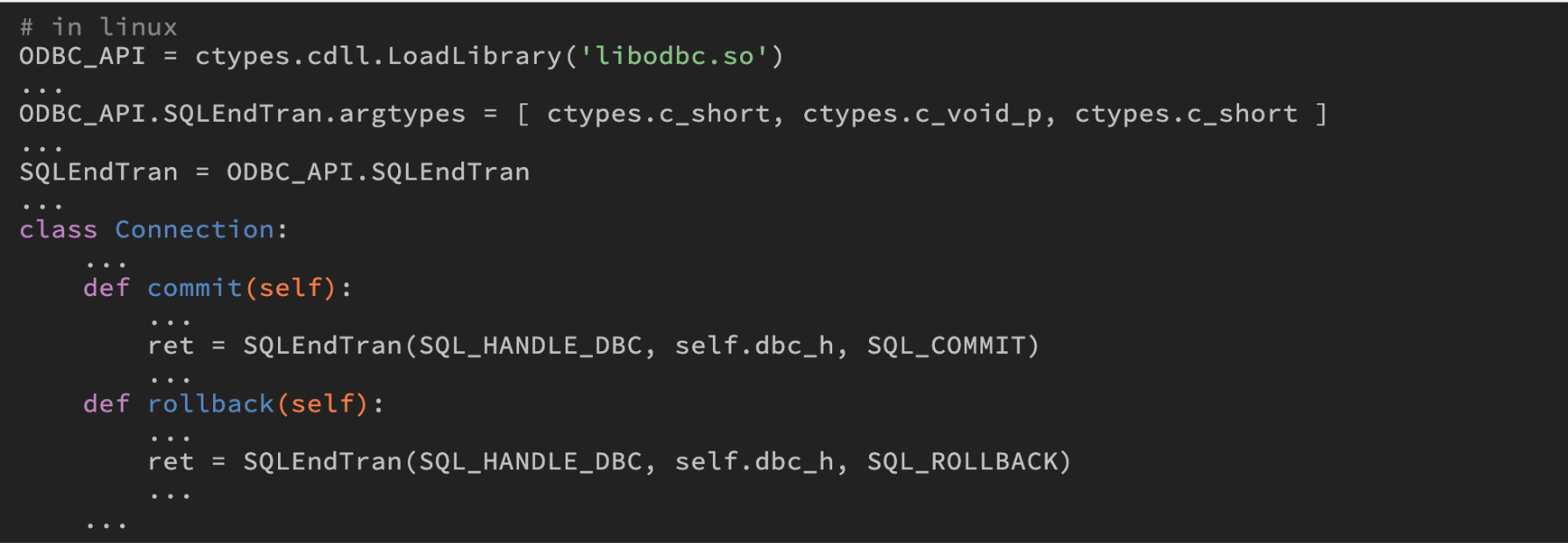
Connection
defined in pyodbc
odbc
open database connectivity
support standard API to access DBMS

Slide 14
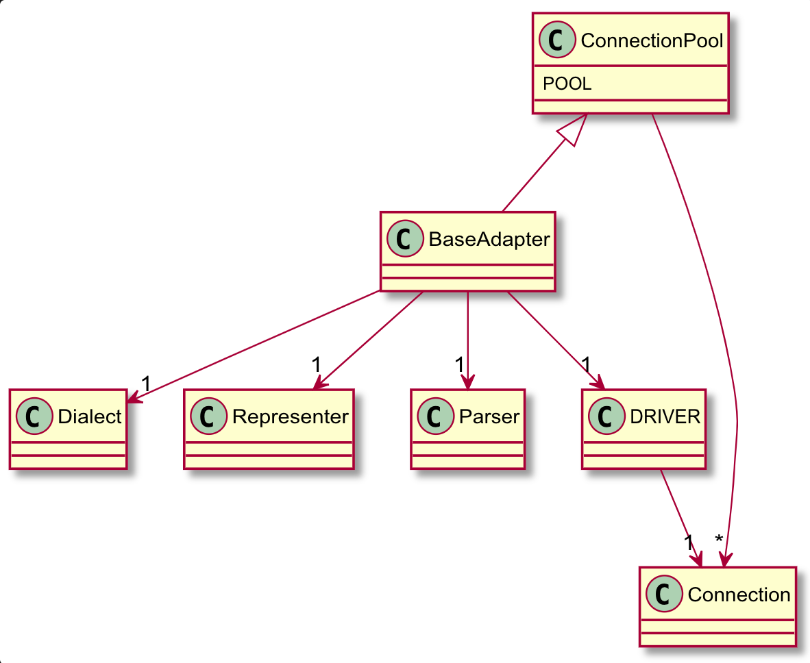
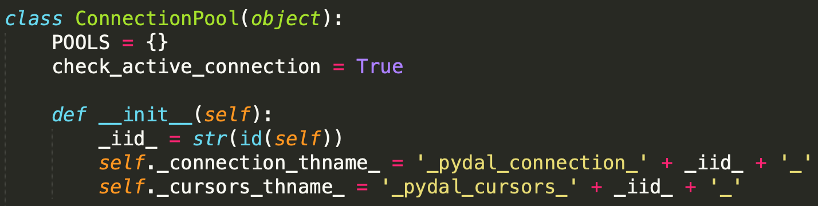
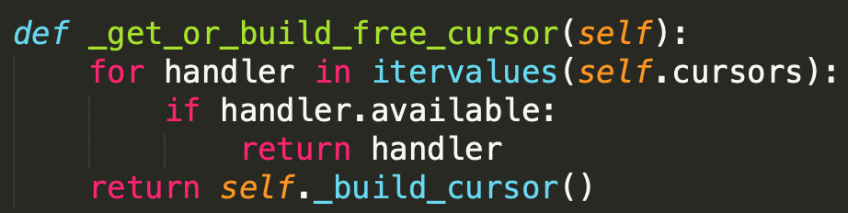
ConnectionPool
instantiate connection beforehand
pop up available worker to access DB
Notes:
use cursor to not load lots of return results immediately
each cursor represent that holding a row in a table
can operate simultaneously (holding a cursor in a row, others can still read, update or delete other rows in same table)
should deal with concurrency issues

Slide 15
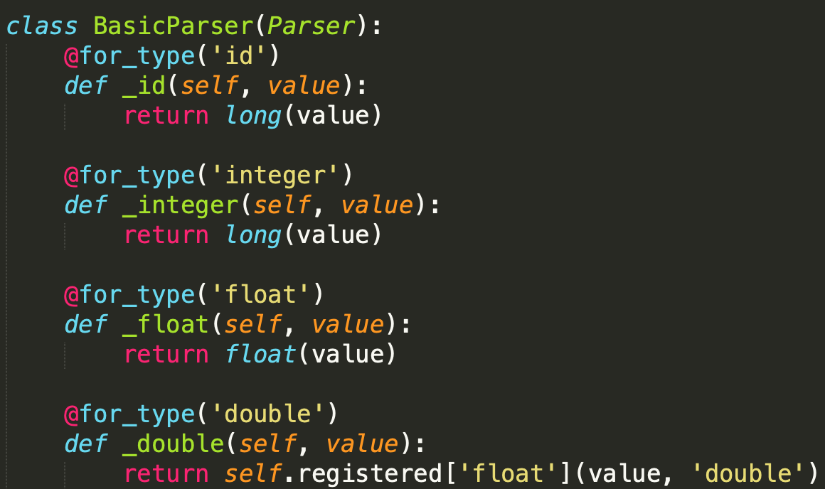
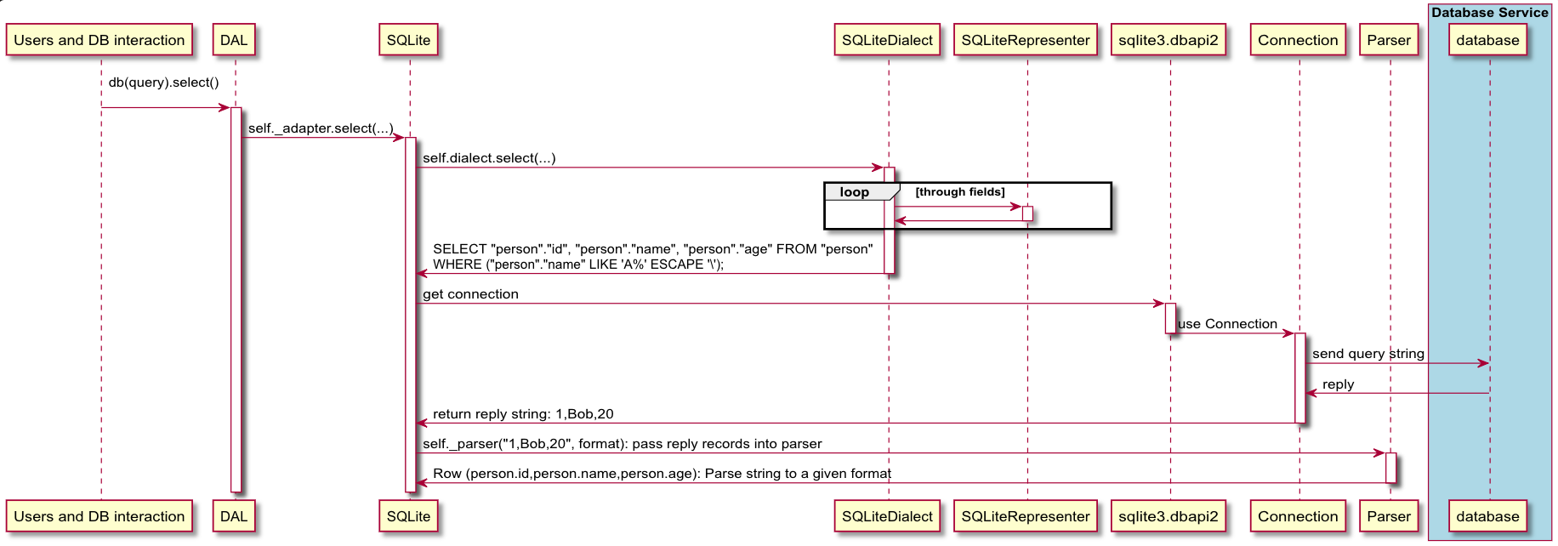
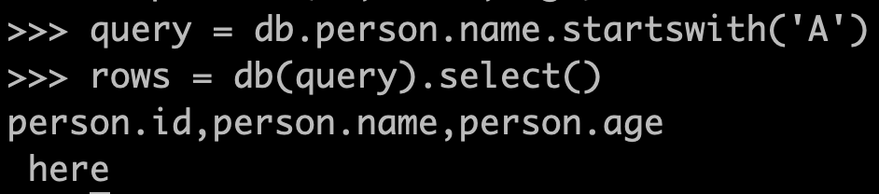
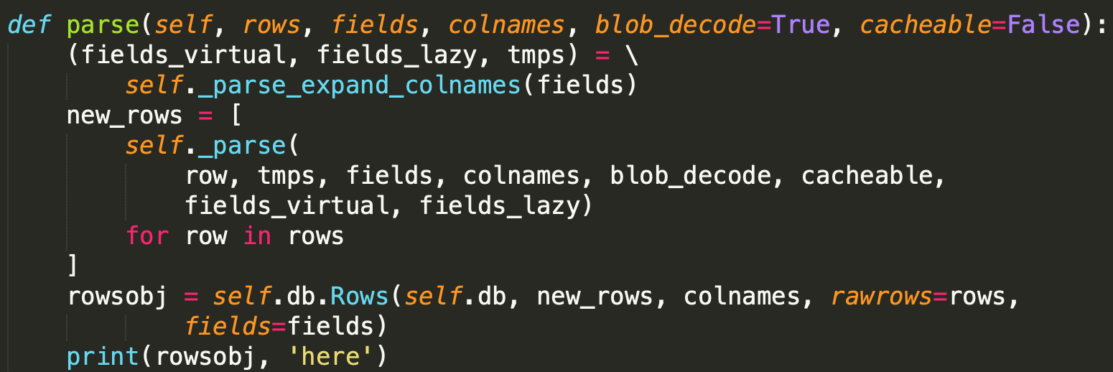
Parser
Parse the return string iterativelly
to a specific format

Slide 16
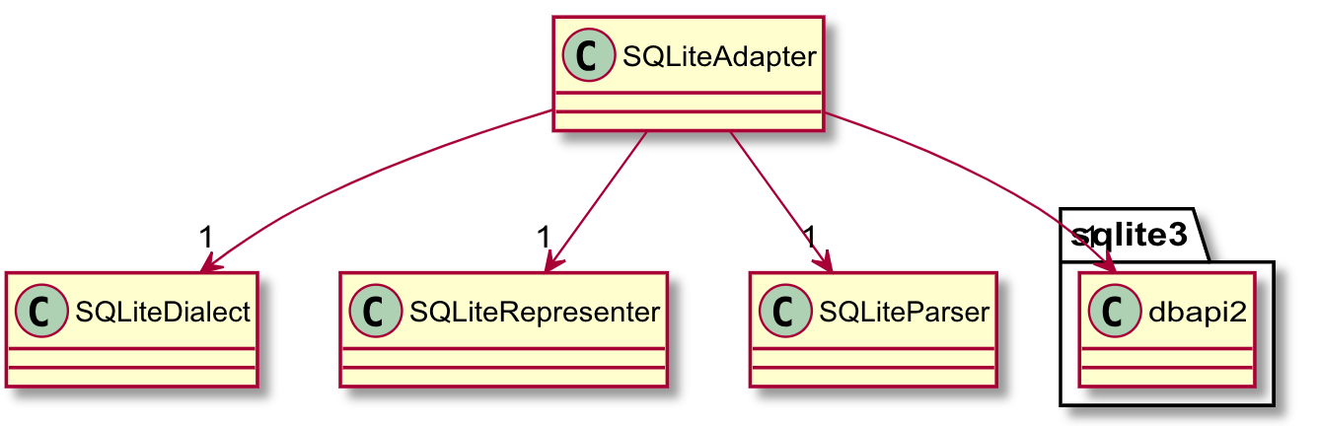
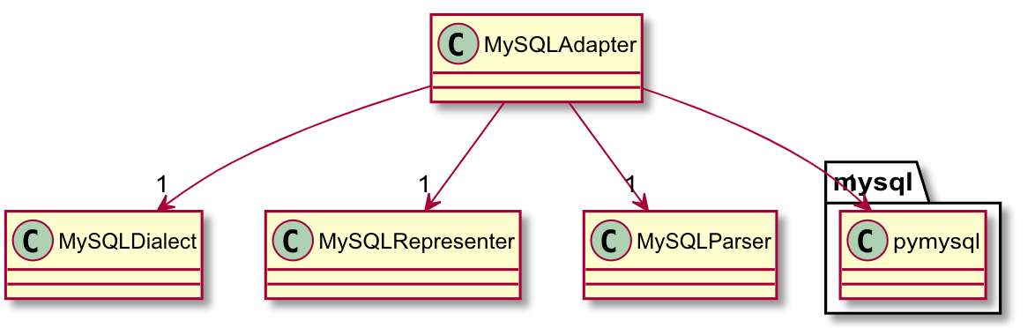
Subsystem

Slide 17
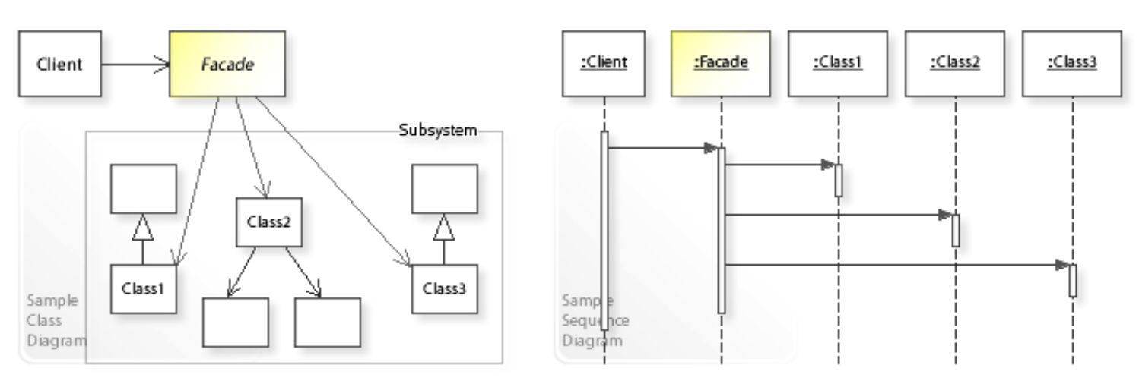
Facade

Slide 18
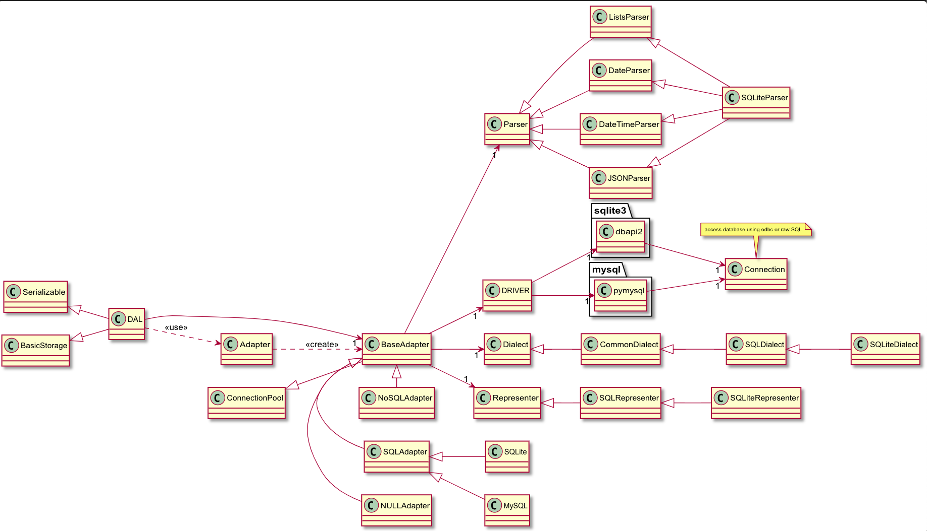
Base Class Subsystem
SQLite Subsystem

Slide 19
Base Adapter

Slide 20
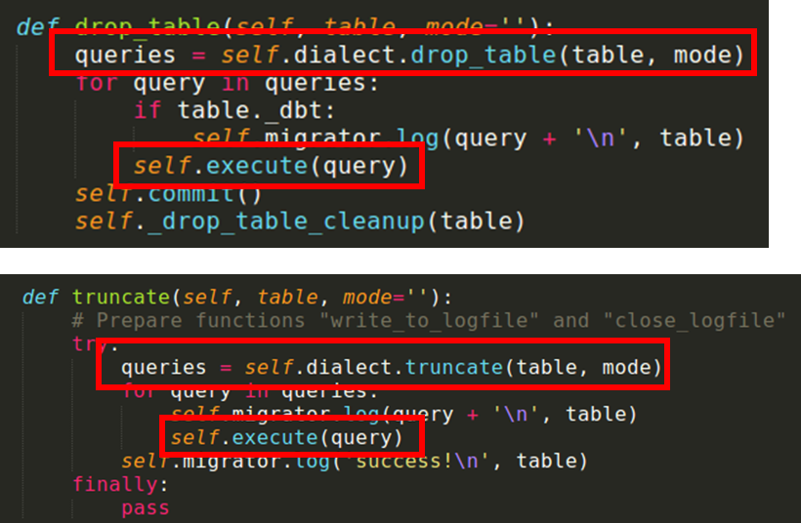
Base Adapter
find the specific dialect in backend
Execute the specific dialect
in backend

Slide 21
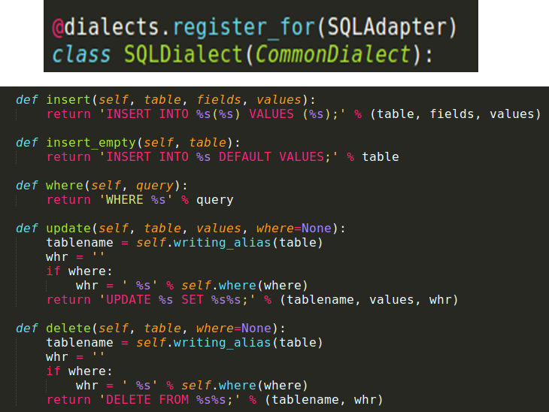
Adaptee (Dialect)

Slide 22

Target
db = DAL('sqlite://storage.db')
db.commit()
db.person.insert(name="Alex")
db.rollback()

Slide 23
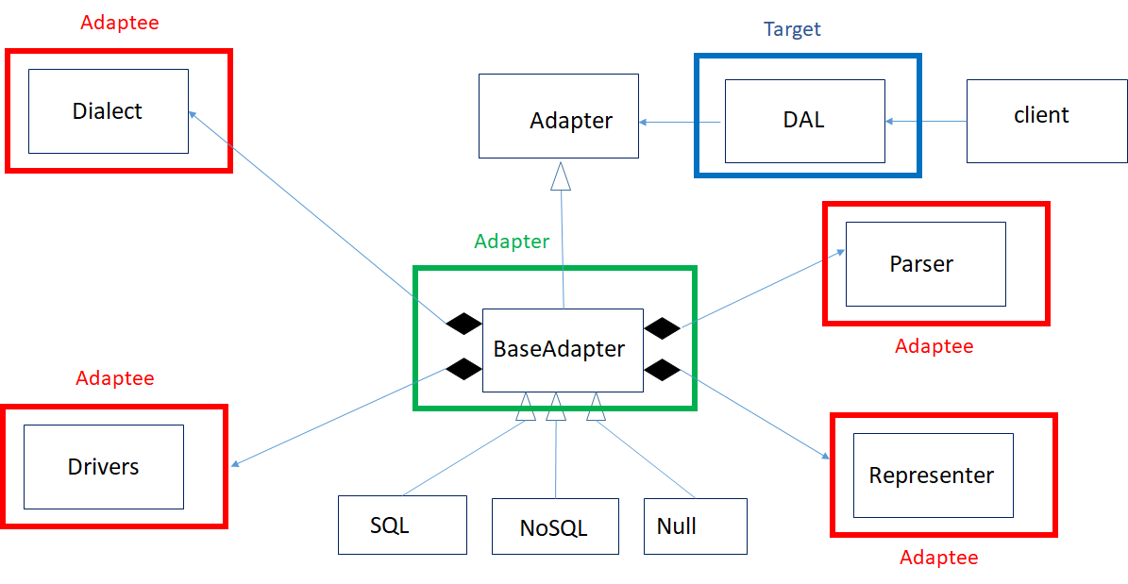
Class Digram

Slide 24
To be continued ...
(12/22 or 12/24)

