Slide 1
Yolo v1

Slide 2
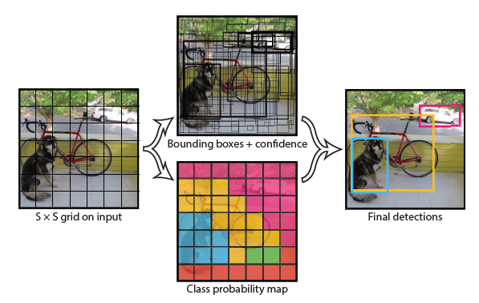
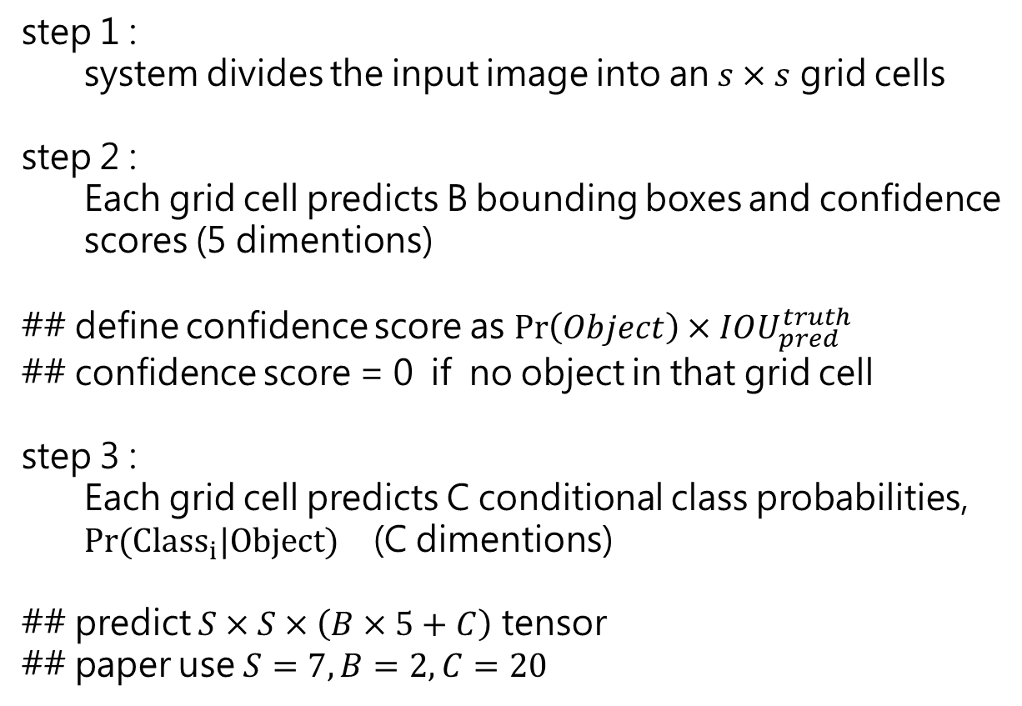
物件偵測方法架構
step 1 :
system divides the input image into an $s×s$ grid cells
step 2 :
Each grid cell predicts B bounding boxes and confidence
scores (5 dimentions)
## define confidence score as $\operatorname{Pr}\left(Object\right)×IOU_{pred}^{truth}$
## confidence score = 0 if no object in that grid cell
step 3 :
Each grid cell predicts C conditional class probabilities, $Pr⁡(Class_{i}|Object)$ (C dimentions)
## predict $S×S×\left(B×5+C\right)$ tensor
## paper use $S=7, B=2, C=20$

Slide 3
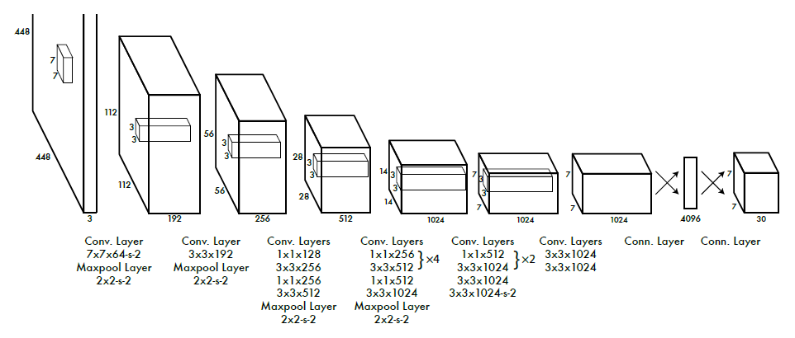
模型架構
Our network has 24 convolutional layers followed by 2 fully connected layers
use 11 reduction layers followed by 3*3 convolutional layers,

Slide 4
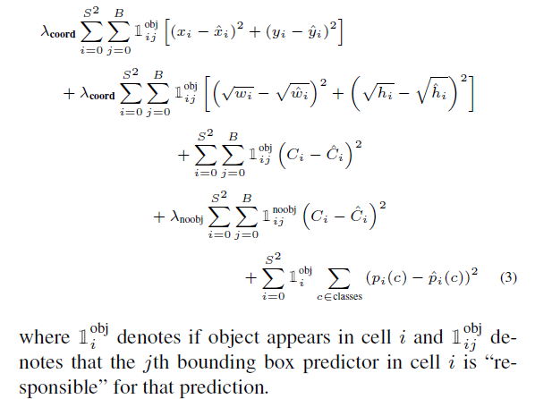
模型訓練 : 損失函式
We use a linear activation function for the final layer and
all other layers use the leaky rectified linear
we increase the loss from bounding box coordinate predictions and decrease the loss from confidence predictions for boxes that do not contain objects

Slide 5
Yolo v2

Slide 6
演算法改良
point 1 : Batch Normalization
adding batch normalization on all of the convolutional layers in YOLO
point 2 : High Resolution Classifier and pretrain
All state-of-the-art detection methods use classifier pre-trained on ImageNet
For YOLOv2 we first fine tune the classification network at the full 448448 resolution for 10 epochs on ImageNet
point 3 : Convolutional With Anchor Boxes
remove the fully connected layers from YOLO and use anchor boxes to predict bounding boxes
shrink the network to operate on 416 input images Using anchor boxes we get a small decrease in accuracy. But YOLO only predicts 98 boxes per image but with anchor boxes our model predicts more than a thousand.
可參考 : https://zhuanlan.zhihu.com/p/63024247、https://didi3310781.medium.com/faster-r-cnn-%E5%AD%B8%E7%BF%92%E7%AD%86%E8%A8%98-4917d59edb55
point 4 : Dimension Clusters
run k-means clustering on the training set bounding boxes to automatically find good anchor box.

Slide 7
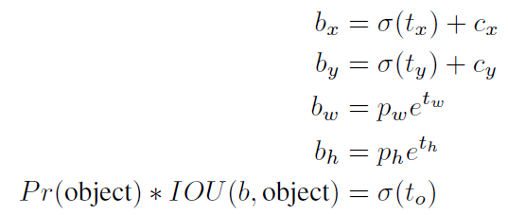
演算法改良
point 5 : Direct location prediction (原來預測 offset 不夠穩定)
Instead of predicting offsets we follow the approach of YOLO and predict location coordinates relative to the location of the grid cell. This bounds the ground truth to fall between 0 and 1
The network predicts 5 coordinates for each bounding box, tx, ty, tw, th, and to. If the cell is
offset from the top left corner of the image by (cx; cy) and the bounding box prior has width and height pw, ph, then the predictions correspond to
point 6 : Fine-Grained Features
The passthrough layer concatenates the higher resolution features with the low resolution features by stacking adjacent features into different channels instead of spatial locations

Slide 8
演算法改良
point 7 : Multi-Scale Training
We want YOLOv2 to be robust to running on images of different sizes so we train this into the model.
Every 10 batches our network randomly chooses a new image dimension size. Since our
model downsamples by a factor of 32, we pull from the following multiples of 32:
[320、352、…、608]
## darknet-19

Slide 9
Yolo v3

Slide 10

演算法改良
point 1 : class prediction
use multiple sigmoid instead of softmax (資料及有人與性別時需要多分類)
point 2 : predictions across scales
YOLOv3 predicts boxes at 3 different scales, From our base feature extractor we add several convolutional layers. The last of these predicts a 3-d tensor encoding bounding box, objectness,
and class predictions.
Next we take the feature map from 2 layers previous and upsample it by 2. We also take a feature map from earlier in the network and merge it with our upsampled features using concatenation.
then add a few more convolutional layers to process this combined feature map, and eventually predict a similar tensor, although now twice the size
point 3 : feature extractor
hybrid approach between the network used in YOLOv2, Darknet-19
darknet 53

Slide 11
Yolo v4

Slide 12
演算法討論
object detection 架構
Input : Image, patches, Image Pyramid
backbones : feature extractor 架構
neck : feature map 集合 (以那些層 feature map 進行集合)
heads : object detection 核心方法 (one-stage, two-stage、anchor base, anchor free)
bag of freebies : 訓練模型實用的技巧、無關模型本身
data augmentation :
data augmentation on feature map : dropout、dropconnect、dropblock
data imbalance
label relationship
bbox regression : IoU loss
bag of special : 模型設計或後處理時用的技巧
enlarging receptive field : SPP、ASPP、RFB (CNN 模型架構)
attention module :
feature integration : FPN
activation function : ReLU、LReLU、PReLU、ReLU6、SELU、Swish、hard-Swish、Mish
post-processing : NMS (針對 bounding box)

Slide 13
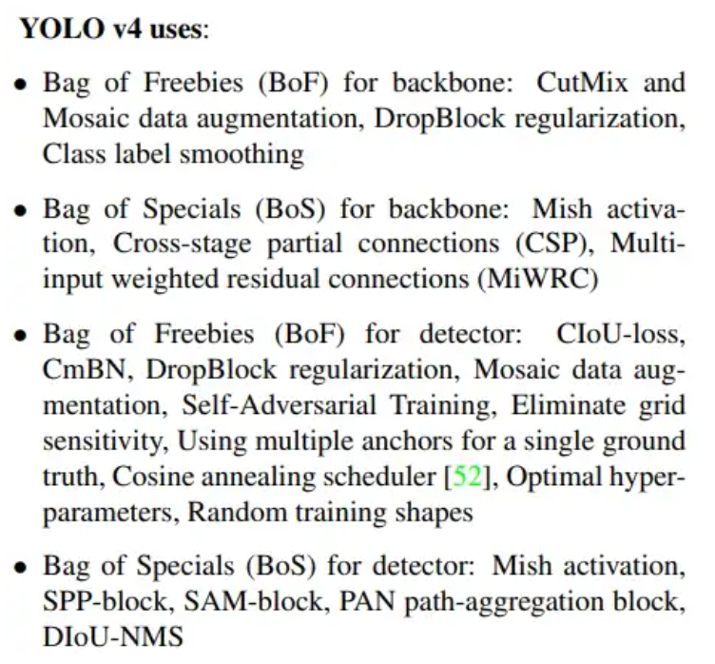
演算法架構
BackBone : CSPDarknet53
Neck : SPP+PAN
Head : YOLOv3 head
參考:
https://medium.com/ching-i/yolo%E6%BC%94%E9%80%B2-3-yolov4%E8%A9%B3%E7%B4%B0%E4%BB%8B%E7%B4%B9-5ab2490754ef

Slide 14
Yolo v4-csp

