Slide 1

Federal Texas Contracts Overspending Analysis
United States Government Budgeting Office
Are we giving unlimited amounts to contractors ?
Predicting which Contracts will go over Original Contract Signed Amount
Patricia Stone
December 6 , 2017

Slide 2
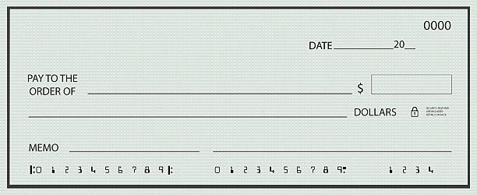
SOLUTION
NoBlankChecks
NoBlankChecks product predicts contracts that are going to exceed the estimated amount.
NoBlankChecks gives the comptroller the opportunity to communicate with the corresponding agencies to avoid this situation.

Slide 3
Identifying patterns or causes of Overspending
Supervised Learning
Classification Problem
------------------
Overspending Contracts
Algorithms:
Logistic Regression
Decision Tree &
Non parametric Random Forest
---------------------------
Random Forest deployed
Hyper-parameter tuning
Accuracy :
92.8 %

Slide 4
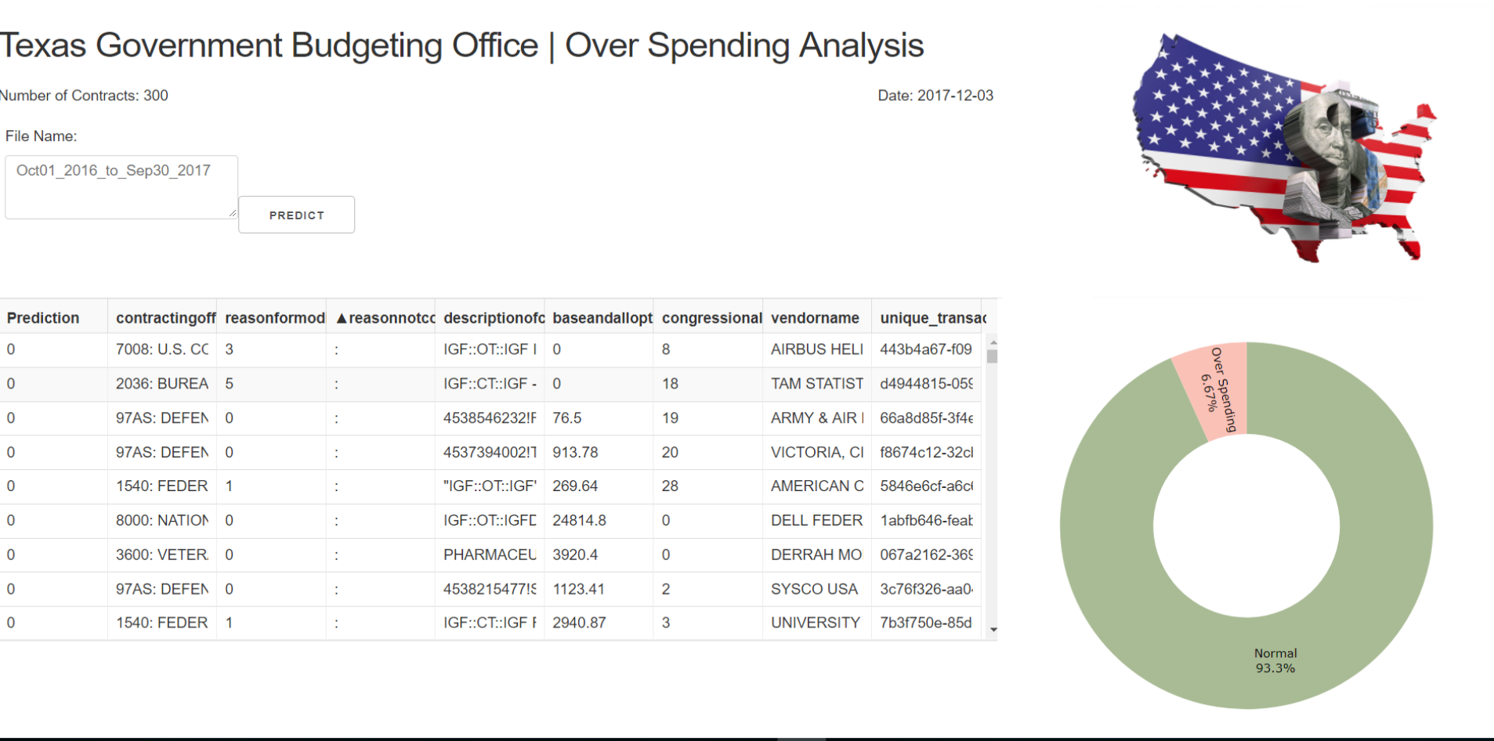

Slide 5
Texas Contracts - Historical Data
www.usaspending.gov
Training Data
CSV Files | GB | Observations | Columns
Oct_01_2012_to_Sep30_2013 | 193 | 118,308 | 225
Oct_01_2013_to_Sep30_2014 | 255 | 115,555 | 225
Oct_01_2014_to_Sep30_2015 | 455 | 195,387 | 225
Oct_01_2015_to_Sep30_2016 | 531 | 225,249 | 225
Test Data
CSV File | GB | Observations | Columns
Oct_01_2016_to_Sep30_2017 | 452 | 191,750 | 225

Slide 6
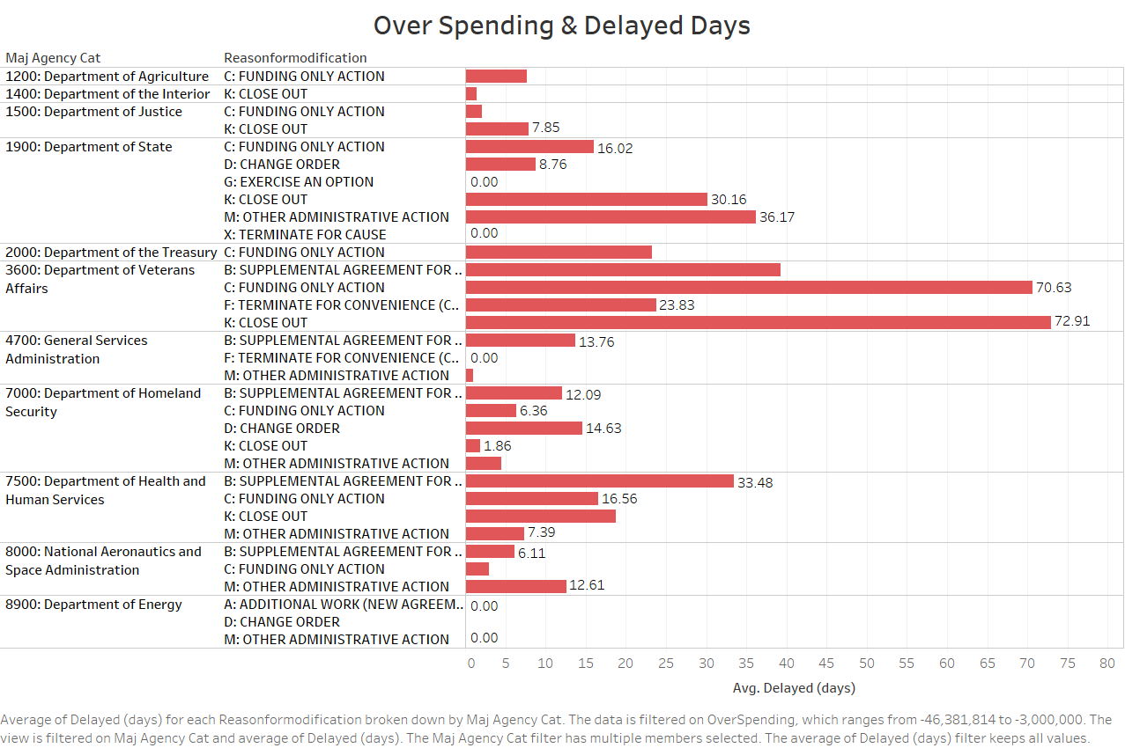

Slide 7
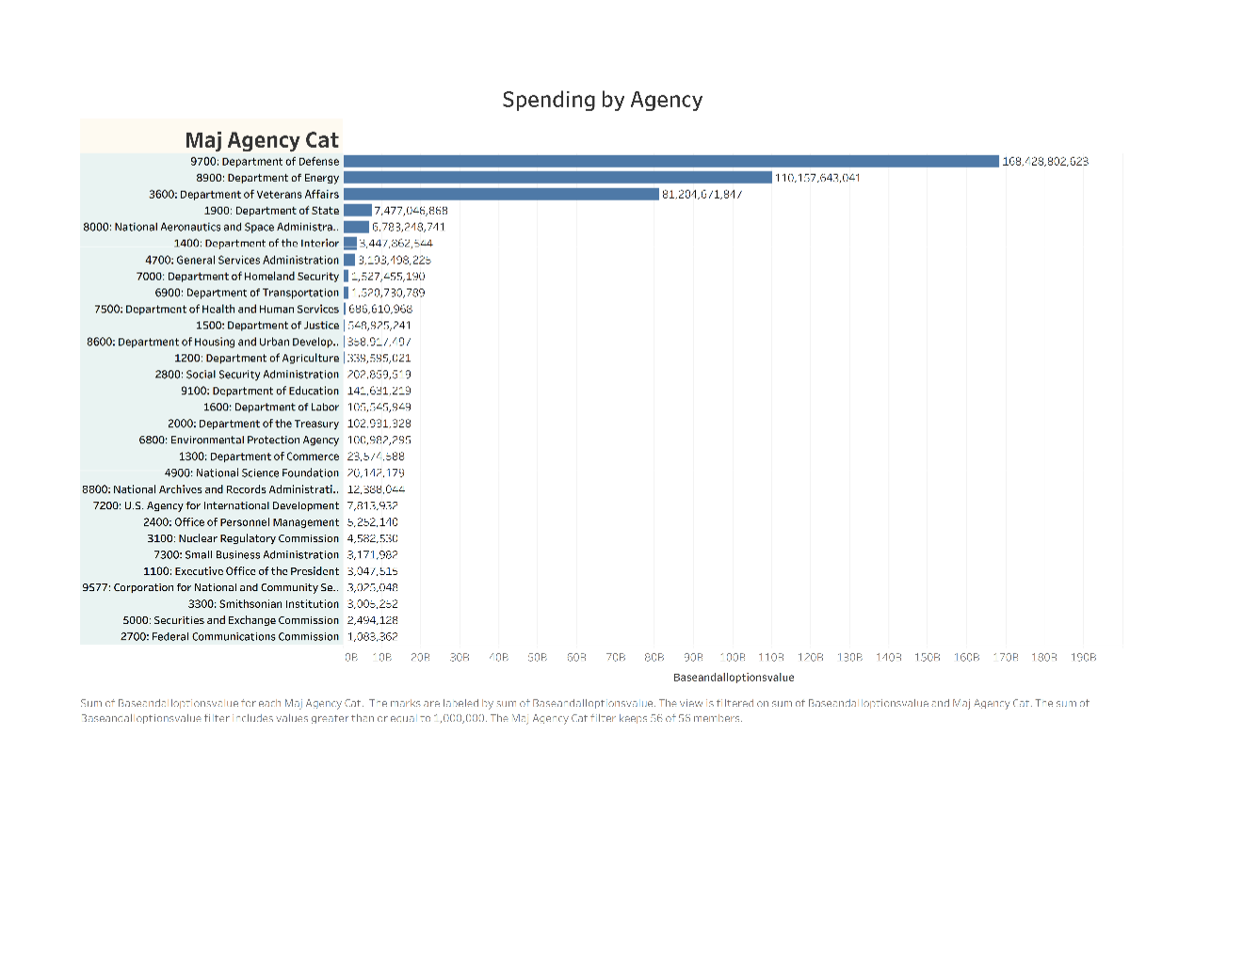
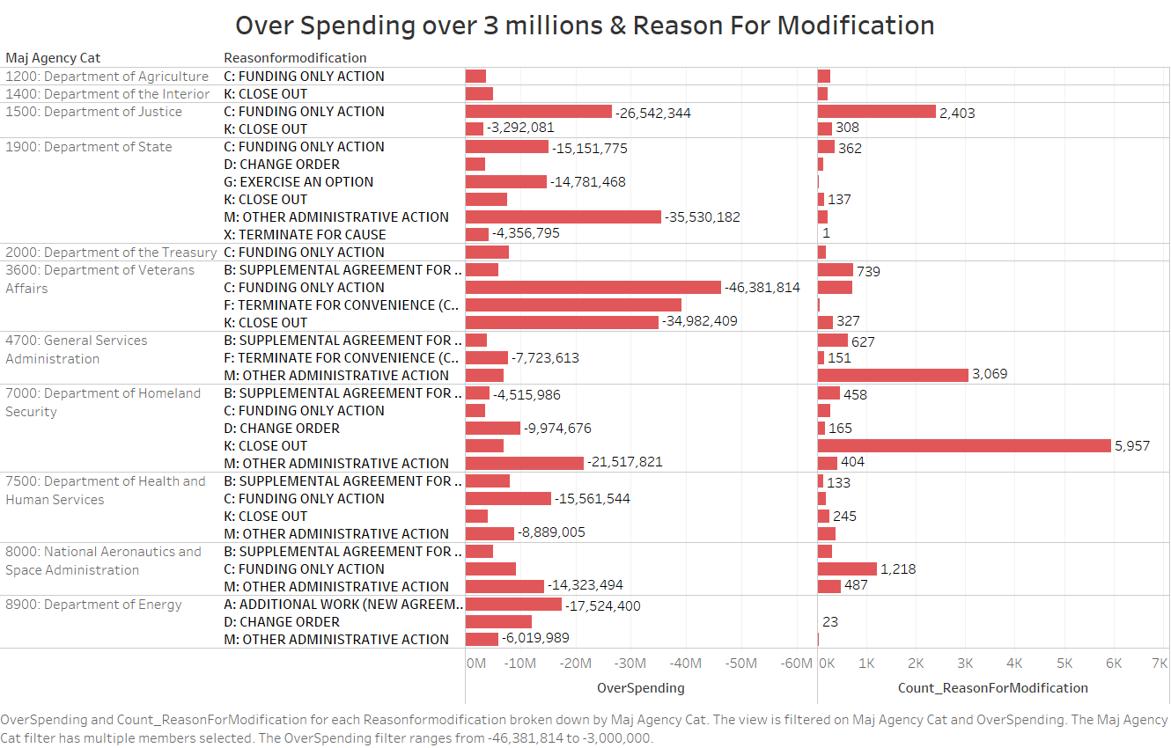

Slide 8
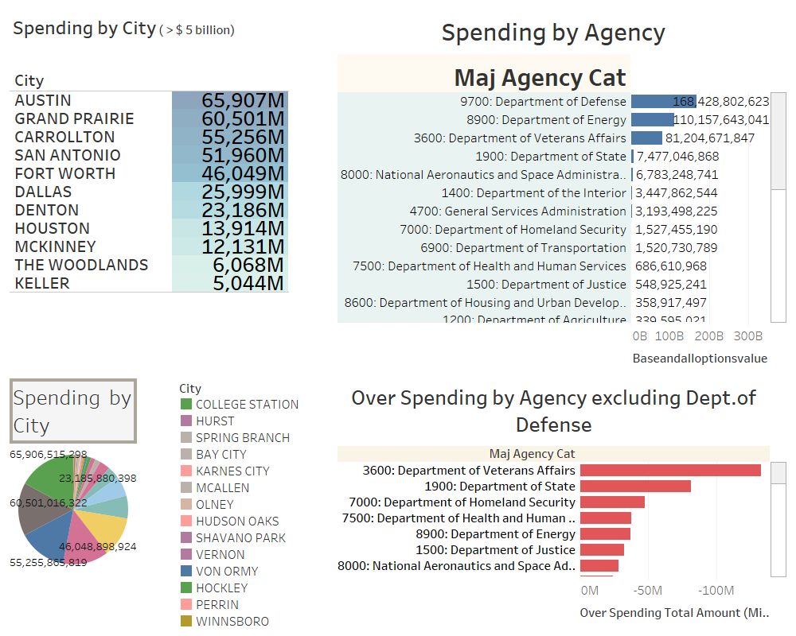

Slide 9
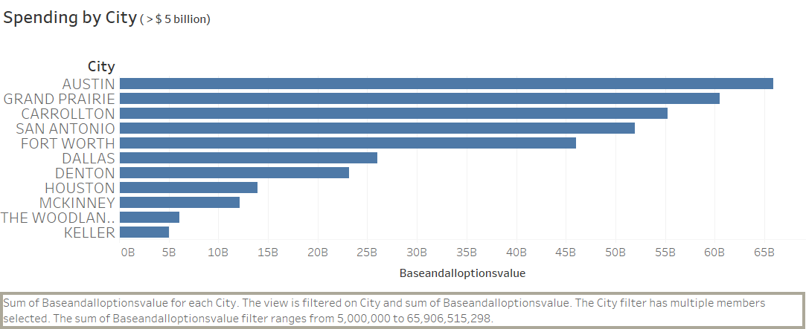

Slide 10
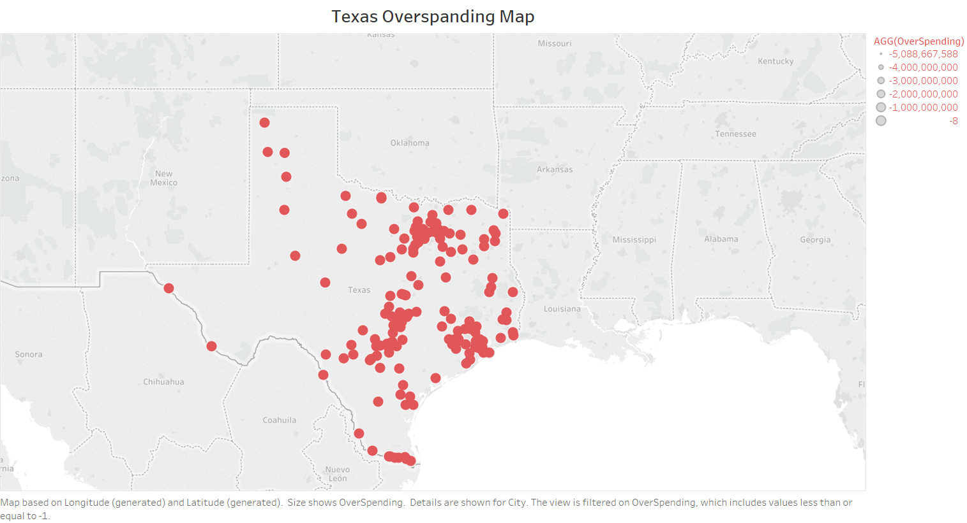

Slide 12
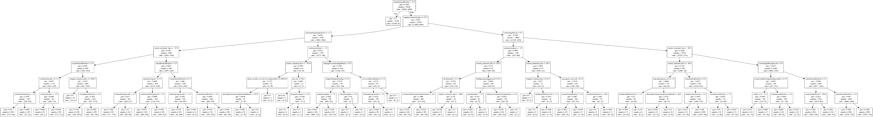

Slide 13
Other Opportunities
Any Company or Institution
Anomaly Detection
Customer classification
Contracts
Customers
(underpayment)
Contractors
(overpayment)

Slide 14
Contracts
2013
Contracts 2014
Contracts 2015
Contracts 2016
Contracts
2017
Data Acquisition
Train Data (75%)
Test Data (25%)
Data Transformation & Feature Engineering
Transformed Data

Slide 15
Transformed Data
Test Data (25%)
DecisionTreeClassifier
Random Forest
GridSearch
CrossValidation
Best Features (hyperparameters)
Test
Best Features & Estimator
Random Forest
Accuracy = 95
& Confusion Matrix
Validation
Accuracy 92
Model Pickle File

Slide 16
Contracts
2017
Test
Accuracy = 93

Slide 17
Performance Measurements
Accuracy 92.8
Specificity: Correctly identified as Not Overspending
True Negative Rate: 96%
Sensitivity : Correctly identified as Overspending
True Positive Rate : 67%

Slide 18
Model and Categories Pickle Files
DATA PRODUCT

Slide 19
Patricia Stone
Sr. Software Engineer
Software Supervisor
Data Scientist
Converting your Data Needs and Problems into Software Solutions

