Slide 1
Electrical Safety Training

Slide 2
1) Equipment 2) General Safety Procedures 3) Emergencies
Electrical Safety Training

Slide 3
1) Equipment 2) General Safety Procedures 3) Emergencies
Electrical Safety Training

Slide 4
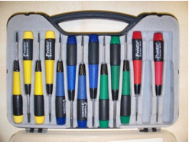
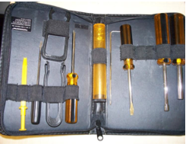
Equipment – Tools
Use insulated tools to avoid danger of shock
Always use the right tools for the job
Using the wrong screwdriver type or size
May damage the screw head or screwdriver, making it impossible to remove the screw at all
May cause you to slip and cause damage to surrounding hardware

Slide 5
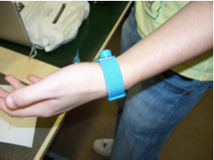
Equipment
Anti-Static Wrist Band
Wear at all times when handling electronic components
Earth yourself when you put it on and before you touch anything vulnerable to shock
This will discharge all static
To do this grab a table leg or something that will conduct static from you
Remember that Electrostatic Discharge (ESD) can damage an electronic component in less than a second

Slide 6
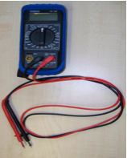
Equipment - Multimeter
A multimeter is a device used to make various different electrical measurements
e.g. voltage, current, resistance etc.
It has two probes
Negative (Black)
Positive (Red)
Voltage measures the potential energy of an electric field to cause an electric current in an electrical conductor
DC fields are indicated by
Resistance – the measure of the degree to which an object opposes electric current
Amps – The amount of electric charge per second

Slide 7
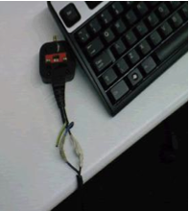
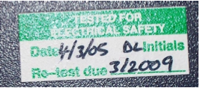
Equipment – PAT (Portable Appliance Testing)
Ensure equipment is safe to use and conforms to health and safety regulations
PAT tests should be carried out on any item which uses a mains plug to provide its electricity
e.g. Computers, photocopiers, extension leads etc.
The retest date for a tested appliance can range from 3 months to 4 years

Slide 8
1) Equipment 2) General Safety Procedures 3) Emergencies
Electrical Safety Training

Slide 9
Keep It Tidy!
When taking hardware apart it is easy to become distracted
e.g. Forget which screw corresponds to which hardware component
e.g. Forget which cable plugged in where
Help prevent problems by
Reading manuals
Obtaining diagrams from the internet
Taking detailed photos before taking things apart
Keeping screws in a separate container for each piece of hardware worked on
This will be of great help when you finish a job and need to put the hardware back together again

Slide 10
Use Your Head!
Common sense is critical
Some examples…
Remove any power leads before taking hardware apart
Stay away from magnets
Keep drinking containers away from equipment and sockets
Do not open or tamper with transformers
Do not be heavy handed with equipment
Do not stack equipment that may be vulnerable to weight
Do not be too heavy handed taking things apart
Do not do anything you do not feel comfortable with

Slide 11
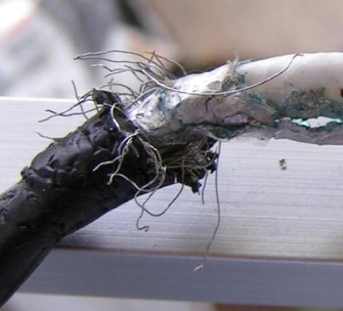
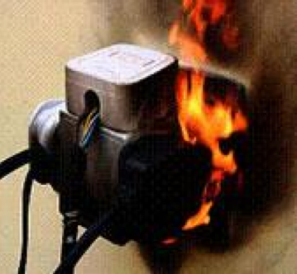
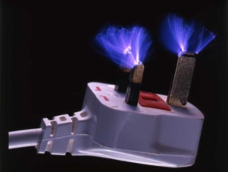
Cables
Check cables before use
All cables should be checked for frays or any other damage prior to use
If a cable is damaged then it is likely to cause disaster if used
No overloading sockets
As this can lead to disaster
Shocks or sparks
If you receive any shocks or see any sparks when using a cable then stop using it immediately
Have the cable safety checked before reuse

Slide 12
1) Equipment 2) General Safety Procedures 3) Emergencies
Electrical Safety Training

Slide 13
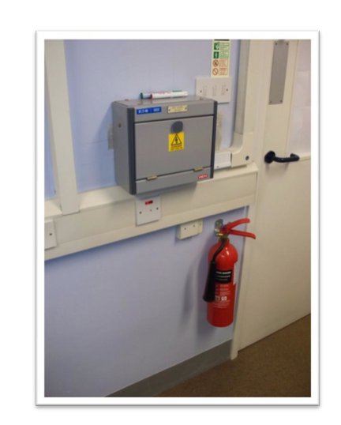
In An Emergency!
If the alarm sounds, leave the building via your nearest assembly point
Be patient when leaving the building since it can result in others being hurt
Do not re-enter the building until the all-clear has been given
Only use fire extinguishers if you are in no danger

Slide 14
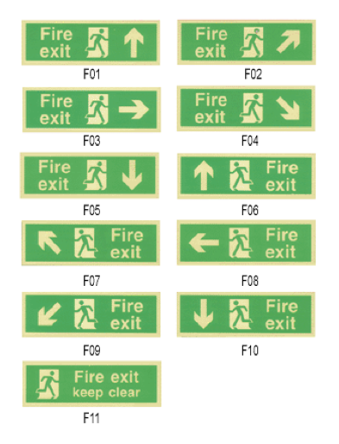
In Case Of Fire!
Follow the signs to the nearest fire exit
The picture shown represents all the possible directions in which a fire exit might be located

Slide 15
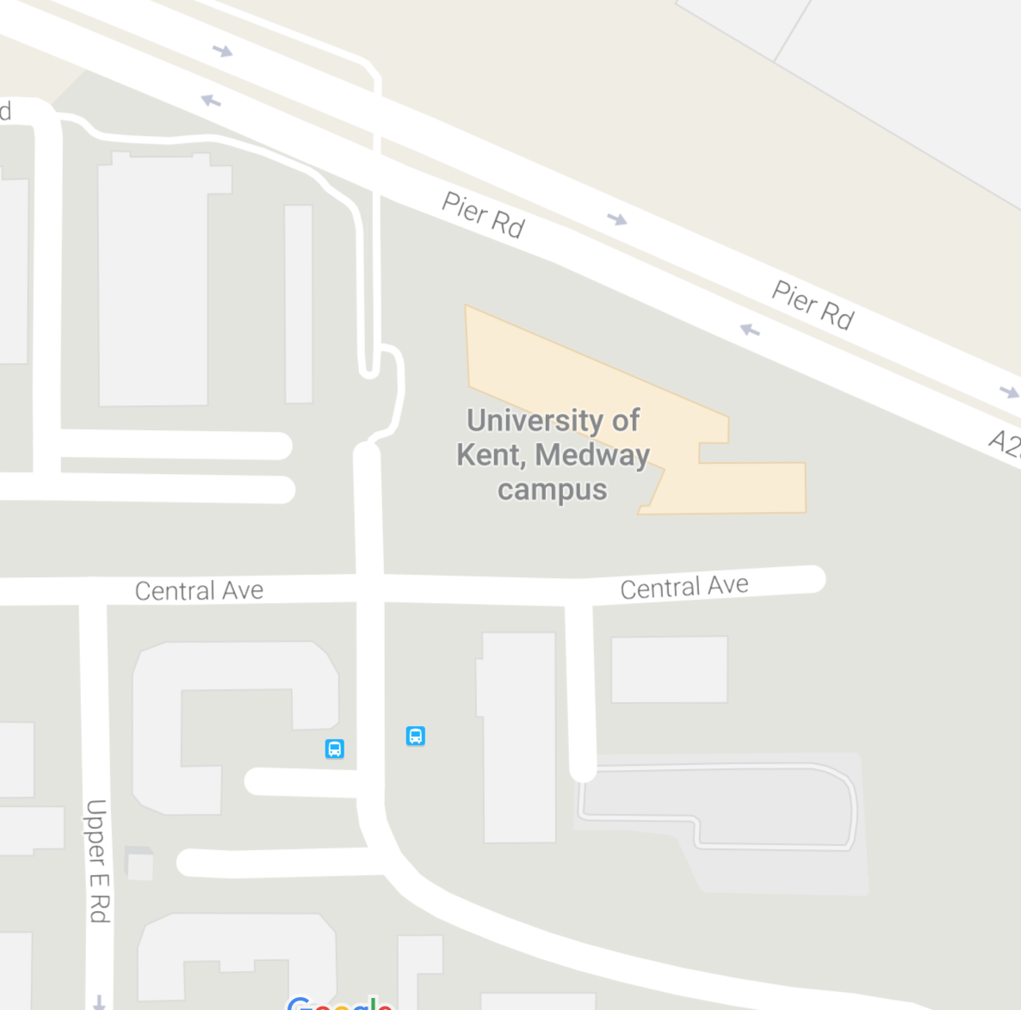
Assembly Points
Each building is assigned an assembly point
This is where all staff and students are advised to meet in the event of an emergency

Slide 16
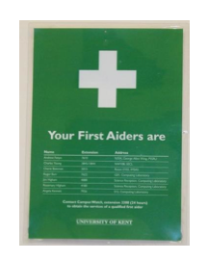
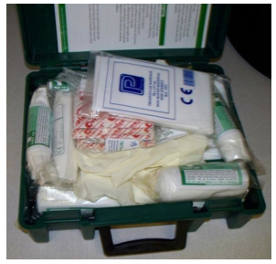
Accidents
In case of an accident do not panic
Look for your nearest First Aiders sign
Contact the nearest first aider
By legislation each building should be supplied with a first aid kit
A first aid kit is located in the kitchen area
Only ever move a casualty if
They are in direct danger
And there is no danger to yourself

Slide 17
Any Questions?

