Slide 1


TERRORISM IN THE UNITED STATES

Slide 2


Business Problem & Context
Terrorism persists as an utmost concern for the USA, which demands immediate strategic action. Understanding historical patterns is vital for proactive and effective security measures, ensuring national safety.
We are a team of skilled security analysts whose task is to meticulously analyze a comprehensive dataset spanning five decades, covering diverse variables related to US-based terrorist incidents.
The goal is to empower the government with informed insights from the dataset, aiding decision-makers in crafting effective national security strategies. Utilizing these insights will significantly improve the country's safety and security.

Slide 3




Tackling Business Problem
How: We can control terrorist attacks
Who: Are the targeted people?
What: Kind of weapon terrorist groups are using?
Identifying and analyzing patterns of terrorist activities.
Understanding the specific groups or individual's terrorists aim to attack.
Investigating the types of weapons employed by terrorist organizations.
Utilizing patterns to strategically deploy security resources.

Slide 4
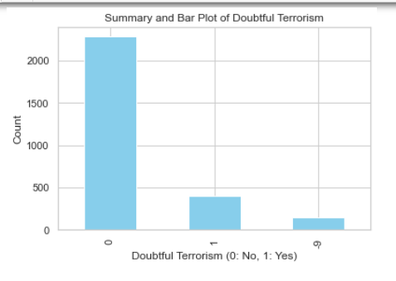
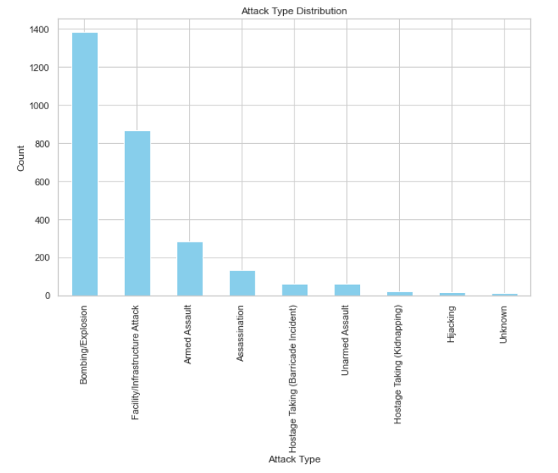
Description of Data & Transformation
List Of variables: provstate, city, latitude, longitude, doubtterr, attacktype1_txt, targtype1_txt, natlty1_txt, gname, claimed,weaptype1_txt, nkill, nkillus, nkillter, nwound, nwoundus, nwoundte, success, president_party, state_governor_party, date, total_casualities
Data Transformation:
The total number of casualties is derived from the columns nkill and nwound.
If the total casualties exceed 10, they are categorized as high; otherwise, they are categorized as low.
The columns Iday, Imonth, and Iyear are combined to create a new column named Date.
One-hot encoding is employed to transform text columns into categorical columns.

Slide 5
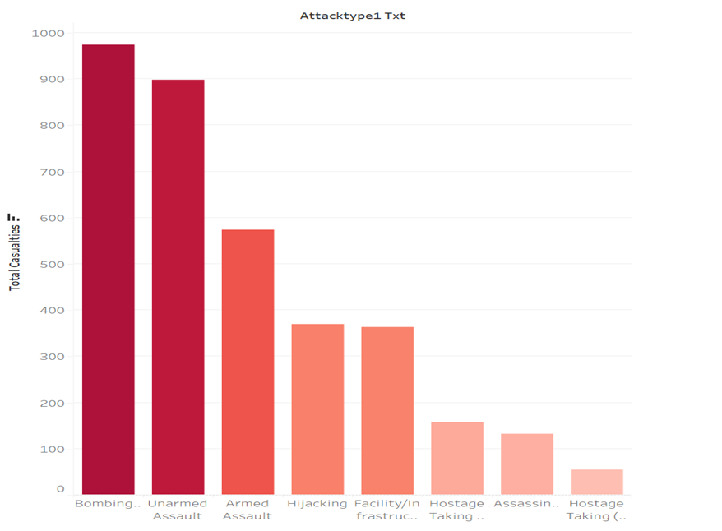
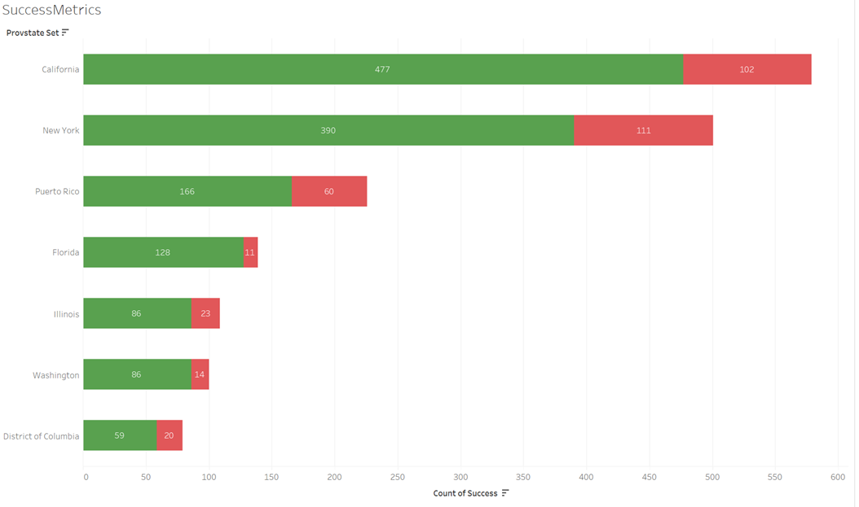
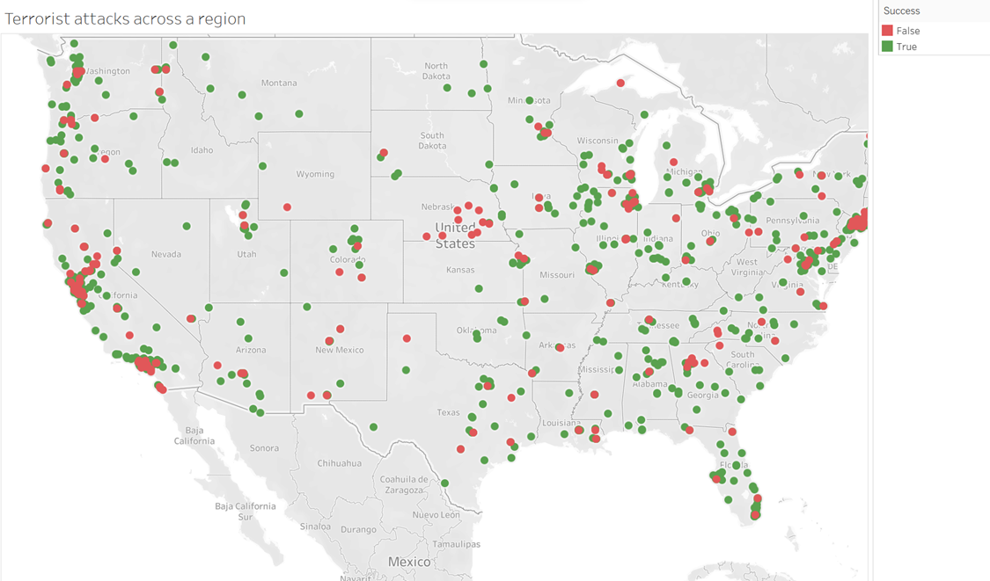
Using Data to Answer Business Problem
California, New York, and Florida exhibit a larger number of attacks.
Urban centers: exhibit green dots, suggesting successful attacks, due to the high-impact targets located there.
The analysis inform federal and local government agencies where to focus their intelligence efforts and allocate resources for prevention and rapid response.
Policymakers can also track the effectiveness of implemented security measures, adjust strategies, and prepare for emerging threats.
Total Casualties from terrorist attacks categorized by attack type
Success rates on states with different attack types

Slide 6
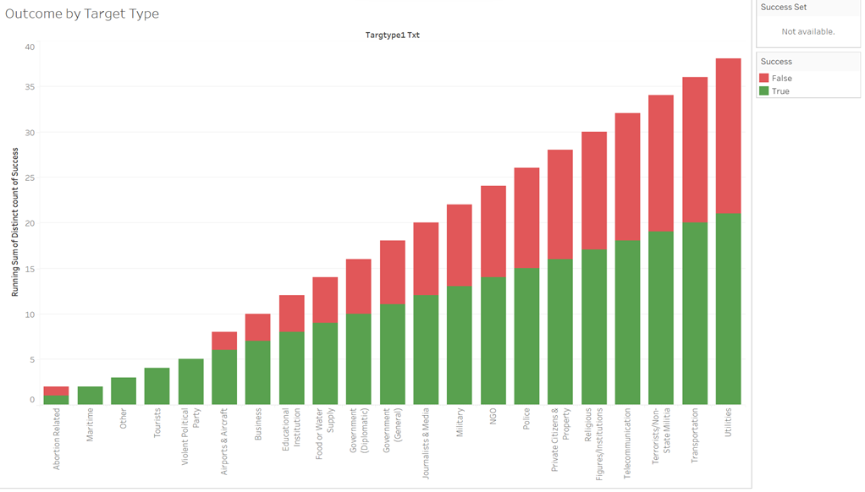
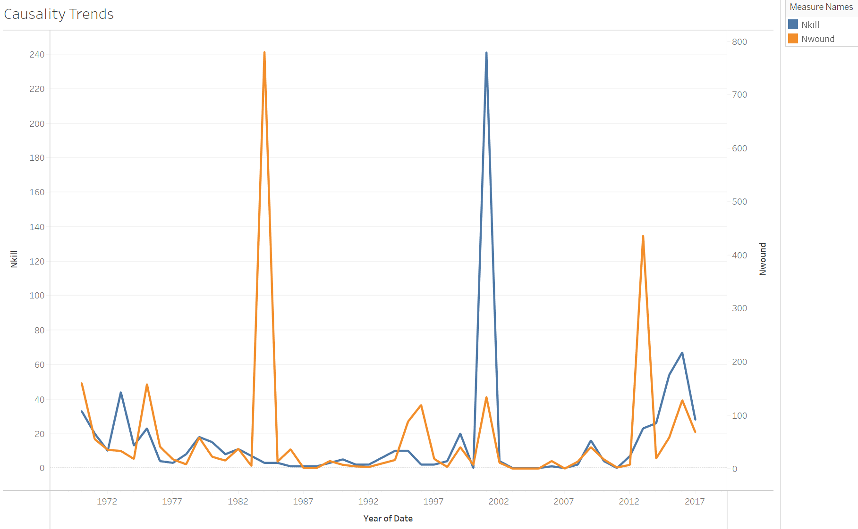
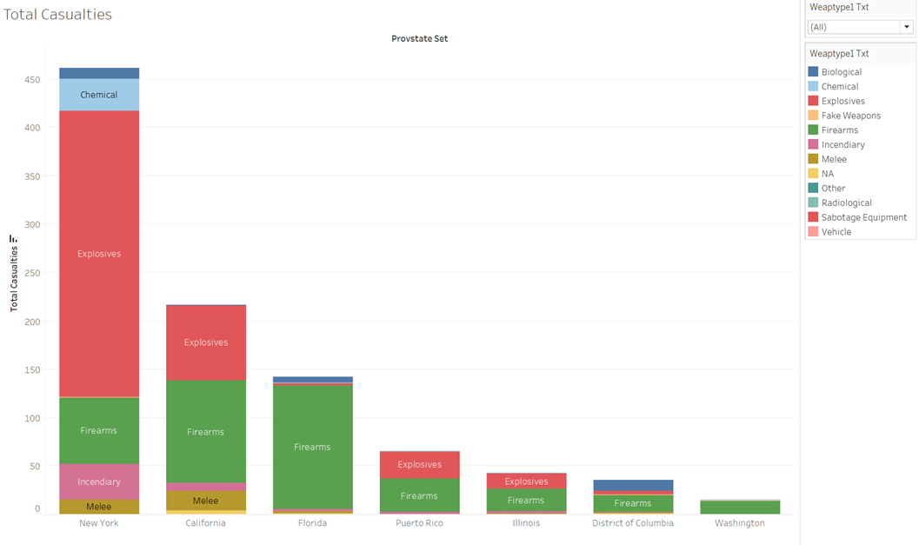
Outcome by Target Type.
People killed in incidents.
Total Casualties from terrorist attacks in the states, broken down by the type of weapon.
Total casualties caused by terrorist attacks in select locations are categorized by the type of weapon used.
California and New York as locations with significant numbers of casualties. The stacked colors in each bar denote different weapon types.
Explosives are the most common cause of casualties in one location, while firearms are predominant.
By understanding which weapons are most commonly associated with higher casualties, policymakers can tailor their regulatory efforts.

Slide 7
Success or Failure of Attack
Logistic Regression:
ln(success) = 14.17 - 28.14 attacktype +25.78targetype + 0.1 weapontype
The equation can predict whether the attack was successful or not
Each predictor has coefficient helps to interpret the impact made on success
Directly models the probability of the target variable
Classification Tree
It considers predictors weapon type, attack type target type, nwound, nkill
Rules where attacktype is bombing and number of wounded are greater than 5 then its success
If attack type is assassination, nkill is less than 0.5, nwound is less than 2 its failure
Logistic Regression gives us better insights, which can be used by government
When the weapon is firearms, incendiary , chemical log odd of success increases by 9
If the target type is telecommunication or transportation the log odds of success decreases by 14
When the attack type is Hostage taking then the log odds of success increases by 25 whereas if it is assassination it decreases by 11

Slide 8
Severity of Attacks
Linear Regression:
nkill = β0 + β1 weapontype + β2 cities
The equation can predict the number of killed
The significant weapon in the weapon types that affects the dependent is firearms
There are few cities which are significant
Logistic Regression:
Categorized the nkill into low and high groups
The model failed to give any significant predictors hence the model cannot be accepted
Linear Regression
nkill = 0.26 + 0.94 Firearms + 13.81 Littleton + 5.81 Oak Creek + 24.38 Orlando + 8.81 Roseburg
+ 15.78 San Bernardino
As seen in visualization explosives is the highest used weapon but from model Firearms is considered significant
The state of California has the most significant cities which can be seen in the visualization

Slide 9
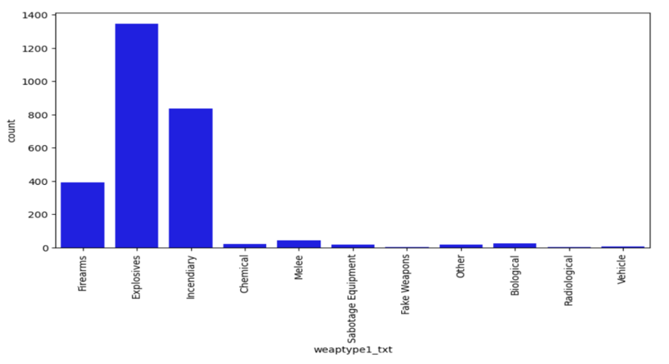
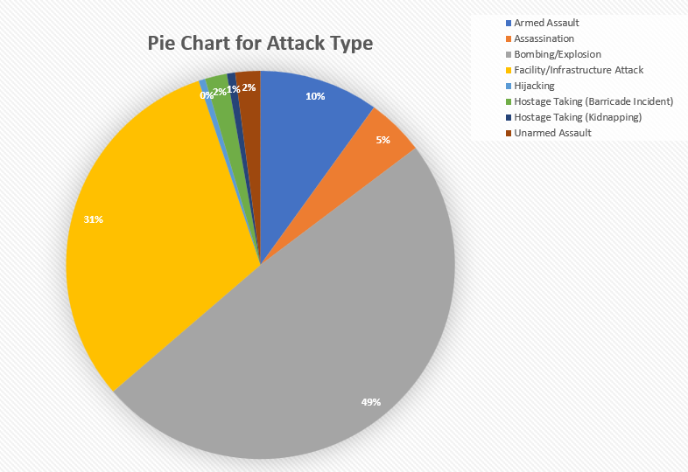
Unconventional Insights
Coefficient for 'Hostage Taking (Kidnapping)': 25.8065, which indicates a strong positive association and a greater likelihood of success.
Odds ratio for 'Armed Assault': exp(-8.3598) - Lower odds of success.
Despite bombing having a high impact, logistic regression reveals other attack types influencing success differently.
‘ Hostage Taking (Kidnapping)' stands out with a significantly higher likelihood of success, than other attack types.
The above graph shows that ‘Explosives’ have the highest impact followed by ‘Incendiary.’
Despite ‘Explosives’ having a high impact, logistic regression reveals ‘Firearms’ has a significant positive effect on the number of people killed. (Estimate = 0.9378, p < 0.0001).
This suggests that incidents involving firearms tend to have higher numbers of killings which was discovered after running the models.
Other weapon types like Biological, Chemical, Explosives, and Incendiary showed no significant effect on the target variable as their p-values were relatively high
This indicates that these weapon types do not significantly affect the number of killings in the model

Slide 10


Managerial Insights
The following cities with the highest terrorist attacks in US are Orlando having 24.38 times people killed followed by San Bernardino with 15.78 times people killed.
Moreover, Littleton had 13.81 times people killed, followed by Roseburg with 8.81 times and lastly Oak Creek with 5.81 times.
Most of the above cities are high populated cities having limited law enforcement and are more prone to terrorist attacks.
To avoid that, there should be an increased representation in law enforcement and security patrolling in the mentioned cities.
The majority of attacks in these cities were done through Firearms, wherein 0.94 times people were killed using Firearms.
Focus on controlling and monitoring Explosives and Firearms.
Firearms must have stricter gun control laws, enhanced background checks and limitations on the types of firearms available to the public.

Slide 11

THANK YOU
Q/A

