Slide 1

B.Tech. (CSE) | BCSE497J – Project-I
Object-Centric Event Log Mining for Academic Capstone Processes:
A Native OCEL 2.0 Approach
Team members:
Aakaash Sathya Saravanan (23BCE0500)
Mitisha Sharma (23BCE0434)
Tanmay Khambete (23BCE0498)
Faculty guide:
Dr. Kalyanaraman P
Notes:
[Sources]
Local: Review_1_Team1_OCEL.pptx, slide 1.
[/Sources]

Slide 2
Approval Mail From Guide
PLACEHOLDER — insert the actual guide approval email screenshot before submission.
Approval should cover attendance, PPT, demonstration, initial draft report, and outcome report.
Notes:
[Sources]
Local: Review 2 guidelines and provided PPT template. Real approval evidence not yet supplied.
[/Sources]

Slide 3
Aim
Model the portal’s documented capstone workflow as OCEL 2.0 while preserving events shared by Project, Team, Student, Faculty, ReportVersion and Score.
Measure information lost by single-case flattening, detect documented state-machine deviations, and test transparent offline interventions.
Validate the research pipeline on deterministic synthetic data now; replace assumptions with de-identified production logs after ethics approval.
Notes:
[Sources]
Local: Review_1_Team1_OCEL.pptx; Educational Capstone Portal audit-trail.md; domain-model.md.
[/Sources]

Slide 4
Abstract
Capstone events cross multiple objects; forcing one case identifier duplicates events and hides supervision, version and scoring relationships.
We map the documented capstone lifecycle to qualified E2O/O2O relations and export three seeded corpora: clean target, current R1-only baseline and gap-injected.
The prototype validates relational OCEL 2.0 output, compares three flattened views, detects six documented risks, predicts next transitions and simulates two interventions.
All measurements are synthetic feasibility evidence—not observed institutional performance or institutional impact.
Notes:
[Sources]
Local: Team1_Review2_Package/data and results; Educational Capstone Portal state-machines.md.
[/Sources]

Slide 5
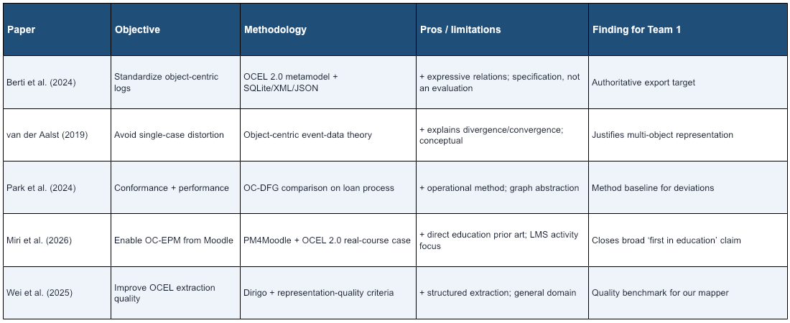
Literature Review
Notes:
[Sources]
OCEL 2.0: https://www.ocel-standard.org/2.0/ocel20_specification.pdf
van der Aalst 2019: https://doi.org/10.1007/978-3-030-30446-1_1
Park et al. 2024: https://doi.org/10.1007/978-3-031-70418-5_11
Miri et al. 2026: https://doi.org/10.1016/j.dajour.2026.100724
Wei et al. 2025: https://doi.org/10.1016/j.datak.2025.102485
[/Sources]

Slide 6
Research Gap
2026 prior art now demonstrates OCEL 2.0 extraction from Moodle; the broad ‘first object-centric educational process mining’ claim is no longer valid.
A capstone lifecycle is a different process class: versioned reports, formal verification states, immutable scores, attempt limits and guide capacity interact transactionally.
Existing studies do not directly evaluate this combination through a documentation-grounded normative–descriptive–adversarial benchmark and executable risk predicates.
Proposed contribution: traceable counterfactual generation plus study-specific Cross-Object Observability Coverage (COOC). COOC measures analysis readiness—not universal OCEL quality.
Notes:
[Sources]
Miri et al. 2026: https://doi.org/10.1016/j.dajour.2026.100724
Wei et al. 2025: https://doi.org/10.1016/j.datak.2025.102485
Local: Educational Capstone Portal known-gaps.md; domain-model.md; state-machines.md.
Inference: targeted-search novelty boundary, not a universal first claim.
[/Sources]

Slide 7


Objectives
Export a validated relational OCEL 2.0 mapping for the portal’s multi-object lifecycle.
Quantify relation loss under Project-, Student- and ReportVersion-centric flattening.
Detect six documented gaps and measure representation-level observability.
Evaluate a grouped next-transition baseline and offline attempt/capacity interventions.
SDGs: 4 — Quality Education; 9 — Industry, Innovation & Infrastructure | Outcome: reusable product + journal/conference paper | Current prototype TRL: 4
Notes:
[Sources]
Local: Review 1 objectives; generated prototype artifacts; TRL assessment is Team 1’s internal estimate and requires guide confirmation.
[/Sources]

Slide 8
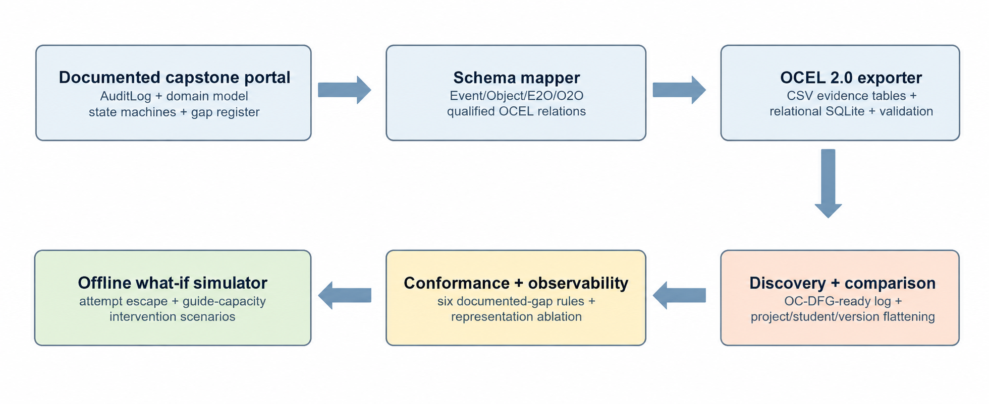
Framework / Architecture
Notes:
[Sources]
Local: Educational Capstone Portal audit-trail.md, domain-model.md, state-machines.md, known-gaps.md; Team1_Review2_Package/src.
OCEL format: https://www.ocel-standard.org/specification/formats/sqlite/
[/Sources]

Slide 9
Functional Requirements
FR1 — Generate clean, R1-only and gap-injected project lifecycles from one recorded seed/configuration.
FR2 — Preserve qualified Event-to-Object and Object-to-Object relations with pseudonymous IDs.
FR3 — Export OCEL 2.0 relational SQLite plus human-auditable CSV evidence tables.
FR4 — Validate references, timestamps, required tables and reproducible file checksums.
FR5 — Compare single-case flattening and detect G5, G9, E5, E10, E12 and E15 conditions.
FR6 — Report grouped next-transition metrics and offline policy scenarios with synthetic labels.
Notes:
[Sources]
Local: Team1_Research_Execution_Prompt.txt; Educational Capstone Portal architecture documents.
[/Sources]

Slide 10
Modules and Review 2 Readiness
Completed (8/12): schema map, seeded generator, CSV evidence export, OCEL SQLite export, integrity validator, flattening comparator, six gap detectors, Markov + offline simulation baseline.
Generated evidence: 120 projects/scenario; 2,083 events and 7,471 E2O links in the gap-injected corpus; zero dangling relations; monotonic project timestamps.
Remaining (4/12): real-log ingestion, PM4Py OC-DFG/conformance integration, object-aware predictor, empirical twin calibration.
Implementation readiness: 67% of the declared Review 2 module scope; production claims remain explicitly out of scope.
Notes:
[Sources]
Local: Team1_Review2_Package/data/manifest.json; results/experiment_summary.json; src scripts.
Implementation percentage is module-count based, not effort-weighted.
[/Sources]

Slide 11
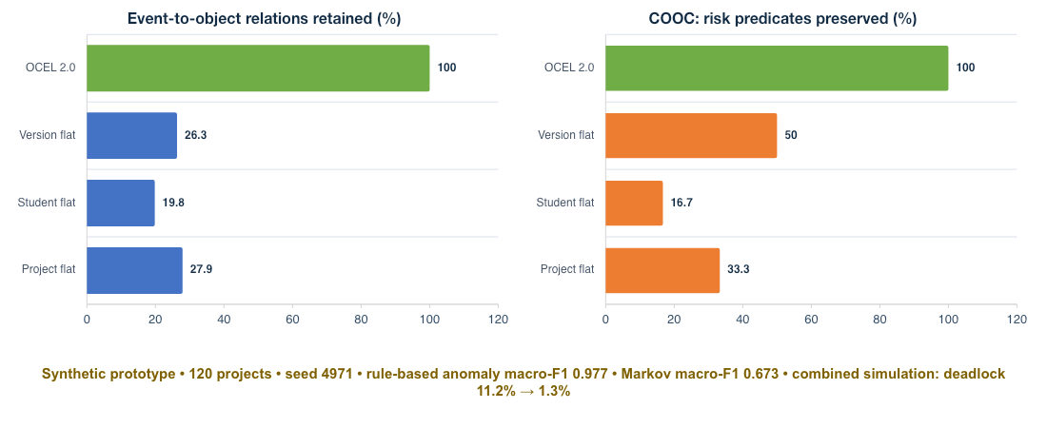
Experiments and Results — Synthetic Prototype
Notes:
[Sources]
Local synthetic results: Team1_Review2_Package/results/experiment_summary.json; seed 4971.
All percentages are generated feasibility results, not institutional operational measurements.
[/Sources]

Slide 12
Conclusion and Outcome
The prototype demonstrates a reproducible portal-to-OCEL 2.0 path and preserves all generated event-object relations with no dangling references.
Under this synthetic design, flat views retain only 19.8–27.9% of E2O links and preserve evidence for 16.7–50.0% of preregistered cross-object risk predicates; OCEL preserves all six.
Rule detectors reach macro-F1 0.977 on injected documented gaps; a first-order Markov baseline reaches macro-F1 0.673 on project-grouped test traces.
Next: integrate PM4Py, ingest de-identified logs, recalibrate assumptions, and test whether the contribution generalizes beyond synthetic traces.
Notes:
[Sources]
Local: Team1_Review2_Package/results/experiment_summary.json and data/manifest.json.
[/Sources]

Slide 13
References
[1] A. Berti et al., ‘OCEL (Object-Centric Event Log) 2.0 Specification,’ arXiv:2403.01975, 2024.
[2] W. M. P. van der Aalst, ‘Object-Centric Process Mining,’ SEFM, LNCS 11724, pp. 3–25, 2019.
[3] G. Park, J. N. Adams, and W. M. P. van der Aalst, ‘Conformance Checking and Performance Analysis Using OC-DFGs,’ BPM Forum, 2024.
[4] G. Park and W. M. P. van der Aalst, ‘Realizing a Digital Twin of an Organization Using Action-Oriented Process Mining,’ ICPM, 2021.
[5] A. Bogarín, R. Cerezo, and C. Romero, ‘A Survey on Educational Process Mining,’ WIREs Data Min. Knowl. Discov., 2018.
[6] D. Calegari and A. Delgado, ‘A Systematic Review on Process Mining for Curricular Analysis,’ WIREs Data Min. Knowl. Discov., 2025.
[7] N. Miri et al., ‘An Object-Centric Approach to Multi-Entity Educational Process Mining,’ Decision Analytics Journal, vol. 19, 100724, 2026.
[8] J. Wei et al., ‘Dirigo: A Method to Extract Event Logs for Object-Centric Processes,’ Data & Knowledge Engineering, vol. 160, 102485, 2025.
Notes:
[Sources]
https://www.ocel-standard.org/2.0/ocel20_specification.pdf
https://doi.org/10.1007/978-3-030-30446-1_1
https://doi.org/10.1007/978-3-031-70418-5_11
https://doi.org/10.1109/ICPM53251.2021.9576846
https://doi.org/10.1002/widm.1230
https://doi.org/10.1002/widm.70005
https://doi.org/10.1016/j.dajour.2026.100724
https://doi.org/10.1016/j.datak.2025.102485
[/Sources]

