Slide 1

B.Tech. (CSE) | BCSE497J – Project-I
Object-Centric Event Log Mining for Academic Capstone Processes:
A Native OCEL 2.0 Approach
Team members:
Aakaash Sathya Saravanan (23BCE0500)
Mitisha Sharma (23BCE0434)
Tanmay Khambete (23BCE0498)
Faculty guide:
Dr. Kalyanaraman P
Notes:
[Sources]
Local: Review_1_Team1_OCEL.pptx, slide 1.
[/Sources]

Slide 2
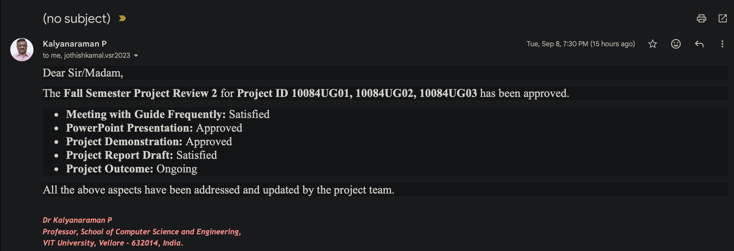
Approval Mail From Guide
PLACEHOLDER — insert the actual guide approval email screenshot before submission.
Approval should cover attendance, PPT, demonstration, initial draft report, and outcome report.
Notes:
[Sources]
Local: Review 2 guidelines and provided PPT template. Real approval evidence not yet supplied.
[/Sources]

Slide 3
Aim
Model the educational portal’s documented workflow as OCEL 2.0 while preserving events shared by Project, Team, Student, Faculty, ReportVersion and Score.
Measure:
information lost by single-case flattening,
detect documented state-machine deviations
test transparent offline interventions.
Notes:
[Sources]
Local: Review_1_Team1_OCEL.pptx; Educational Capstone Portal audit-trail.md; domain-model.md.
[/Sources]

Slide 4
Abstract
Capstone events cross multiple objects; forcing one case identifier duplicates events and hides supervision, version and scoring relationships.
We map the documented capstone lifecycle to qualified E2O/O2O relations and export three seeded corpora: clean target, current R1-only baseline and gap-injected.
The prototype validates relational OCEL 2.0 output, compares flattened views, detects documented risks, predicts next transitions and simulates interventions.
Notes:
[Sources]
Local: Team1_Review2_Package/data and results; Educational Capstone Portal state-machines.md.
[/Sources]

Slide 5
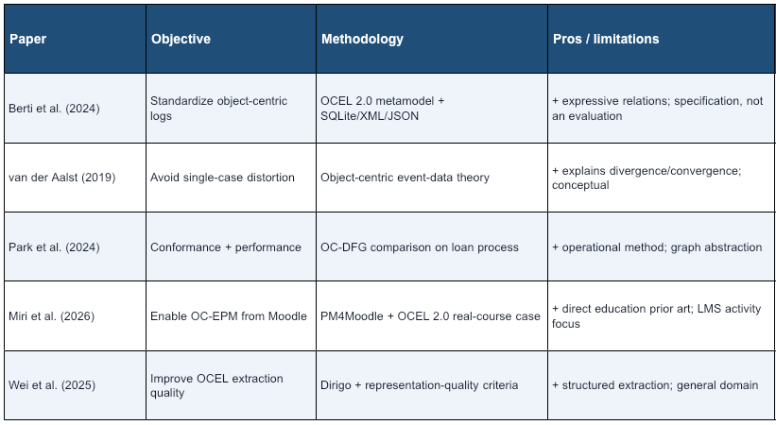
Literature Review
Notes:
[Sources]
OCEL 2.0: https://www.ocel-standard.org/2.0/ocel20_specification.pdf
van der Aalst 2019: https://doi.org/10.1007/978-3-030-30446-1_1
Park et al. 2024: https://doi.org/10.1007/978-3-031-70418-5_11
Miri et al. 2026: https://doi.org/10.1016/j.dajour.2026.100724
Wei et al. 2025: https://doi.org/10.1016/j.datak.2025.102485
[/Sources]

Slide 6
Research Gap
A capstone lifecycle is a different process class: versioned reports, formal verification states, immutable scores, attempt limits and guide capacity interact transactionally.
Existing studies do not directly evaluate this combination through a documentation-grounded normative–descriptive–adversarial benchmark and executable risk predicates.
Proposed contribution: traceable counterfactual generation plus study-specific Cross-Object Observability Coverage (COOC). COOC measures analysis readiness.
Notes:
[Sources]
Miri et al. 2026: https://doi.org/10.1016/j.dajour.2026.100724
Wei et al. 2025: https://doi.org/10.1016/j.datak.2025.102485
Local: Educational Capstone Portal known-gaps.md; domain-model.md; state-machines.md.
Inference: targeted-search novelty boundary, not a universal first claim.
[/Sources]

Slide 7


Objectives
Export a validated relational OCEL 2.0 mapping for the portal’s multi-object lifecycle.
Quantify relation loss under Project-, Student- and ReportVersion-centric flattening.
Detect documented gaps and measure representation-level observability.
Evaluate a grouped next-transition baseline and offline attempt/capacity interventions.
SDGs: 4 — Quality Education; 9 — Industry, Innovation & Infrastructure | Outcome: reusable product + journal paper | Current prototype TRL: 4
Notes:
[Sources]
Local: Review 1 objectives; generated prototype artifacts; TRL assessment is Team 1’s internal estimate and requires guide confirmation.
[/Sources]

Slide 8
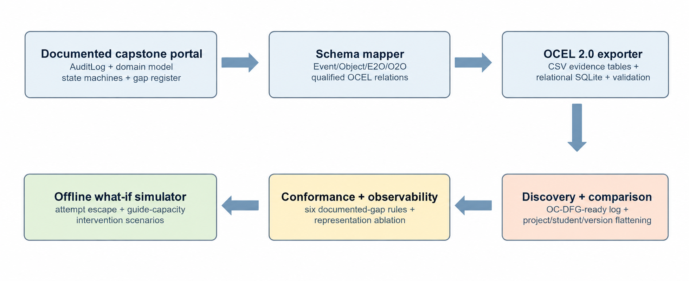
Implemented Research Architecture
Portal documentation model
docs/educational-capstone-platform/
Lifecycle, domain objects, state machines and documented gaps
Deterministic scenario generator
/src/team1_synthetic_ocel.py
Seed 4971; clean, R1-only and gap-injected lifecycles
Generated OCEL corpus
/data/<scenario>/
Objects, events, E2O/O2O, labels, SQLite and manifest
Professor-facing demo
demo/app/page.tsx
Packaged values, scenario controls and WebMCP actions; no portal request
Evidence outputs
/results/
experiment_summary.json plus six auditable CSV result files
Analysis engine
/src/analyze_team1_synthetic.py
Flattening, six rules, COOC, Markov baseline and policy simulation
Notes:
[Sources]
Local code inspected: docs/educational-capstone-platform/; synthetic/src/team1_synthetic_ocel.py; synthetic/src/analyze_team1_synthetic.py; synthetic/data/; synthetic/results/; demo/app/page.tsx; scripts/check_package.py; .github/workflows/validate.yml.
Architecture represents the implemented repository. The demo uses packaged synthetic values and makes no live Educational Capstone Portal request.
[/Sources]

Slide 9
Functional Requirements
FR1 — Generate clean, R1-only and gap-injected project lifecycles from one recorded seed/configuration.
FR2 — Preserve qualified Event-to-Object and Object-to-Object relations with pseudonymous IDs.
FR3 — Export OCEL 2.0 relational SQLite plus human-auditable CSV evidence tables.
FR4 — Validate references, timestamps, required tables and reproducible file checksums.
FR5 — Compare single-case flattening and detect G5, G9, E5, E10, E12 and E15 conditions.
FR6 — Report grouped next-transition metrics and offline policy scenarios with synthetic labels.
Notes:
[Sources]
Local: Team1_Research_Execution_Prompt.txt; Educational Capstone Portal architecture documents.
[/Sources]

Slide 10
Methodology
1 Derive the object-centric model
Map portal documentation to seven object types and qualified E2O/O2O relations.
Register six cross-object risk predicates before evaluation.
4 Measure representation loss
Flatten by Project, Student and ReportVersion, then compare against native OCEL.
Report relation retention and study-specific COOC over six predicates.
Completed (8/12): schema map, seeded generator, CSV evidence export, OCEL SQLite export, integrity validator, flattening comparator, six gap detectors, Markov + offline simulation baseline.
Generated evidence: 120 projects/scenario; 2,083 events and 7,471 E2O links in the gap-injected corpus; zero dangling relations; monotonic project timestamps.
Remaining (4/12): real-log ingestion, PM4Py OC-DFG/conformance integration, object-aware predictor, empirical twin calibration.
Implementation readiness: 67% of the declared Review 2 module scope; production claims remain explicitly out of scope.
2 Generate controlled corpora
Use seed 4971 with 120 projects in each of three scenarios.
Model clean target, documented R1-only baseline and labelled gap injections.
5 Evaluate detection and prediction
Score deterministic rules against injected ground truth.
Evaluate a first-order Markov baseline with a 70/15/15 split by project.
3 Export and validate OCEL evidence
Write auditable CSV tables, relational OCEL SQLite and a manifest with checksums.
Verify tables, relation references and timestamp order per project.
6 Test offline intervention policies
Simulate 5,000 synthetic projects per policy for attempt and capacity changes.
Compare deadlock, capacity, completion and wait-time outcomes without causal claims.
Notes:
[Sources]
Local methodology implementation: synthetic/src/team1_synthetic_ocel.py and synthetic/src/analyze_team1_synthetic.py.
Configuration: seed 4971, 120 projects per scenario, three scenarios, project-grouped 70/15/15 Markov split, and 5,000 synthetic projects per intervention policy.
All outcomes are synthetic prototype evidence, not observed institutional performance or causal effects.
[/Sources]

Slide 11
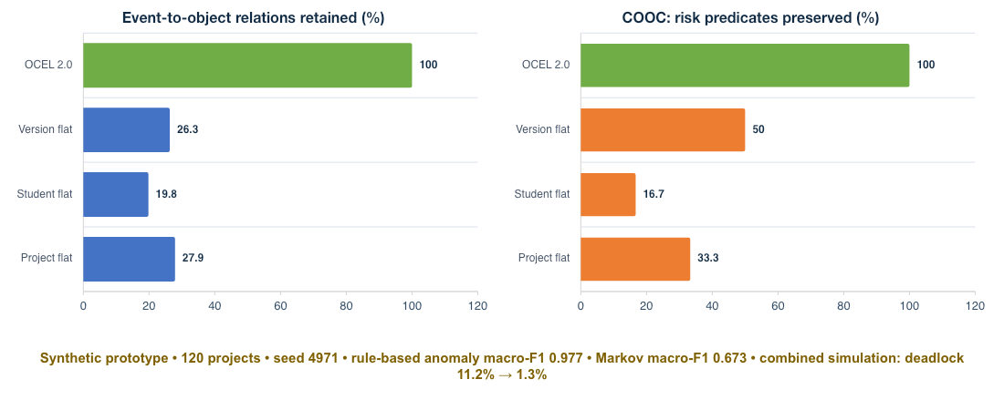

Experiments and Results
Notes:
[Sources]
Local synthetic results: Team1_Review2_Package/results/experiment_summary.json; seed 4971.
All percentages are generated feasibility results, not institutional operational measurements.
[/Sources]

Slide 12
Conclusion and Outcome
The prototype demonstrates a reproducible portal-to-OCEL 2.0 path and preserves all generated event-object relations with no dangling references.
Under this synthetic design, flat views retain only 19.8–27.9% of E2O links and preserve evidence for 16.7–50.0% of preregistered cross-object risk predicates; OCEL preserves all six.
Rule detectors reach macro-F1 0.977 on injected documented gaps; a first-order Markov baseline reaches macro-F1 0.673 on project-grouped test traces.
Next: integrate PM4Py, ingest de-identified logs, recalibrate assumptions, and test whether the contribution generalizes beyond synthetic traces.
Notes:
[Sources]
Local: Team1_Review2_Package/results/experiment_summary.json and data/manifest.json.
[/Sources]

Slide 13
References
[1] A. Berti et al., ‘OCEL (Object-Centric Event Log) 2.0 Specification,’ arXiv:2403.01975, 2024.
[2] W. M. P. van der Aalst, ‘Object-Centric Process Mining,’ SEFM, LNCS 11724, pp. 3–25, 2019.
[3] G. Park, J. N. Adams, and W. M. P. van der Aalst, ‘Conformance Checking and Performance Analysis Using OC-DFGs,’ BPM Forum, 2024.
[4] G. Park and W. M. P. van der Aalst, ‘Realizing a Digital Twin of an Organization Using Action-Oriented Process Mining,’ ICPM, 2021.
[5] A. Bogarín, R. Cerezo, and C. Romero, ‘A Survey on Educational Process Mining,’ WIREs Data Min. Knowl. Discov., 2018.
[6] D. Calegari and A. Delgado, ‘A Systematic Review on Process Mining for Curricular Analysis,’ WIREs Data Min. Knowl. Discov., 2025.
[7] N. Miri et al., ‘An Object-Centric Approach to Multi-Entity Educational Process Mining,’ Decision Analytics Journal, vol. 19, 100724, 2026.
[8] J. Wei et al., ‘Dirigo: A Method to Extract Event Logs for Object-Centric Processes,’ Data & Knowledge Engineering, vol. 160, 102485, 2025.
Notes:
[Sources]
https://www.ocel-standard.org/2.0/ocel20_specification.pdf
https://doi.org/10.1007/978-3-030-30446-1_1
https://doi.org/10.1007/978-3-031-70418-5_11
https://doi.org/10.1109/ICPM53251.2021.9576846
https://doi.org/10.1002/widm.1230
https://doi.org/10.1002/widm.70005
https://doi.org/10.1016/j.dajour.2026.100724
https://doi.org/10.1016/j.datak.2025.102485
[/Sources]

