Slide 1
SteveAndBill

Slide 2
Idea
Analyze actual vs finance data
This services is a Financial Planning & Analysis dashboard delivering a clear view of past performance and future outlook, defaulting to six months or customizable to a year. It presents market trends, identifies areas behind or ahead of forecast, and generates the top five targeted recommendations for improvement. With built-in options to contact co-workers in relevant departments, the dashboard transforms insights into immediate collaboration, helping teams act quickly to improve financial performance and business outcomes.

Slide 4
Tools Used
LlamaIndex
Composio
CopilotKit

Slide 5
Integrations Used
GoogleSheet
Gmail
Slack
OpenAI
LLamaIndex
Composio

Slide 6
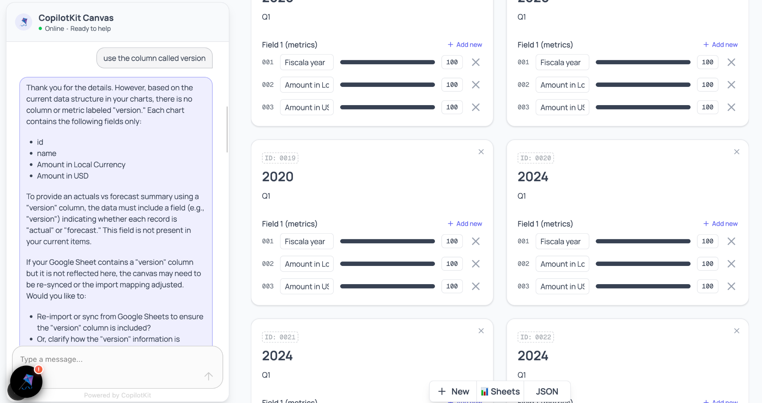
How it looks

Slide 7
Lessons Learned
Google Sheet integration is tricky
Google Sheet can not hand more volume more than 1000 rows
Random terminations
Random data changes to the input sheet

