Slide 1
Recruitment Portal
Shradha Sabhlok MT20069
Pallab Chakraborty MT20063

Slide 2
Project Description
Companies come to an Institution to recruit students.
Each company has its own profile: Name, lovcation, and company ID
Student eligibility criterion is applied for Jobs
Company holds different tests for various Job Profiles
Information about company profile, jobs offered, eligibility, and nature of test is shared with students
Students can view the date and time of the test
The number of students who appeared and cleared the Test are recorded in Database
The Project has 3 Modules broadly:
Administrator: To act as the bridge between Students and the various Companies
Student: Mainly for college students who wishes to be part of recruitment drive
Company: For Companies to manage their recruitment process

Slide 3
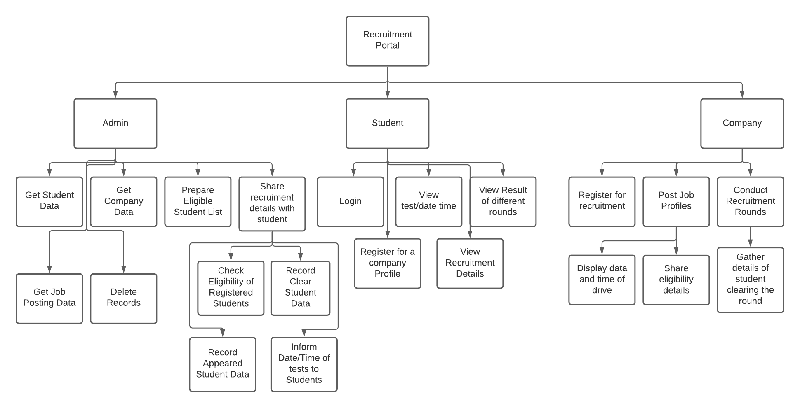
Comparison between Cartesian Decompositions (Implemented vs Submitted)
Submitted Cartesian Decomposition

Slide 4
Implemented Cartesian Decomposition

Slide 5
Differences Highlighted
Made ‘Check Eligibility of Students’ as sub-module of ‘Share Recruitment Details’.
No changes done in Student Module. It’s implemented exactly like the one in submitted version.
Under Company Module, we have added the Login functionality for the company which was earlier not mentioned.
After Login is successful, we are moving forward with sub-modules like:
Posting Job Profile
Display Details of Drive
Conducting Recruitment Drive
Inside ‘Conduct Recruitment Drive’ Module, 2 sub-modules will be called implicitly which are ‘Creation of Appeared Students Table’ and ‘Students who cleared Test Table’ in DB
New functions added in Admin which are:-
Delete Records of student,Company and job postings
Get the job posting data

Slide 6
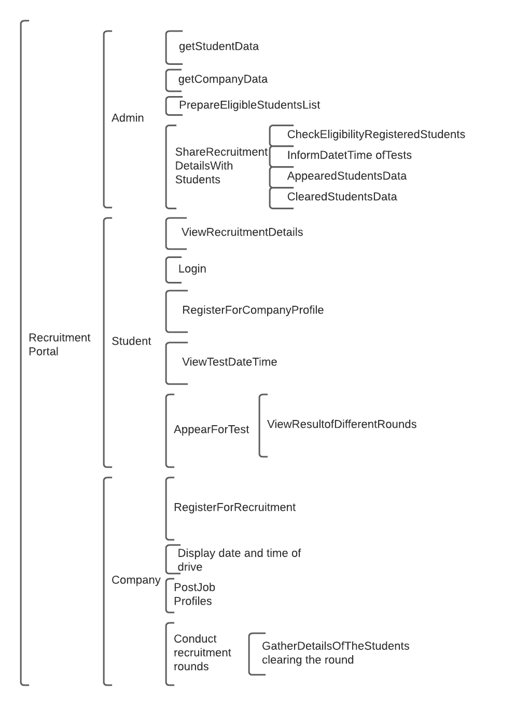
Comparison between Modular Structures (Implemented vs Submitted)
Submitted Modular Structure

Slide 7
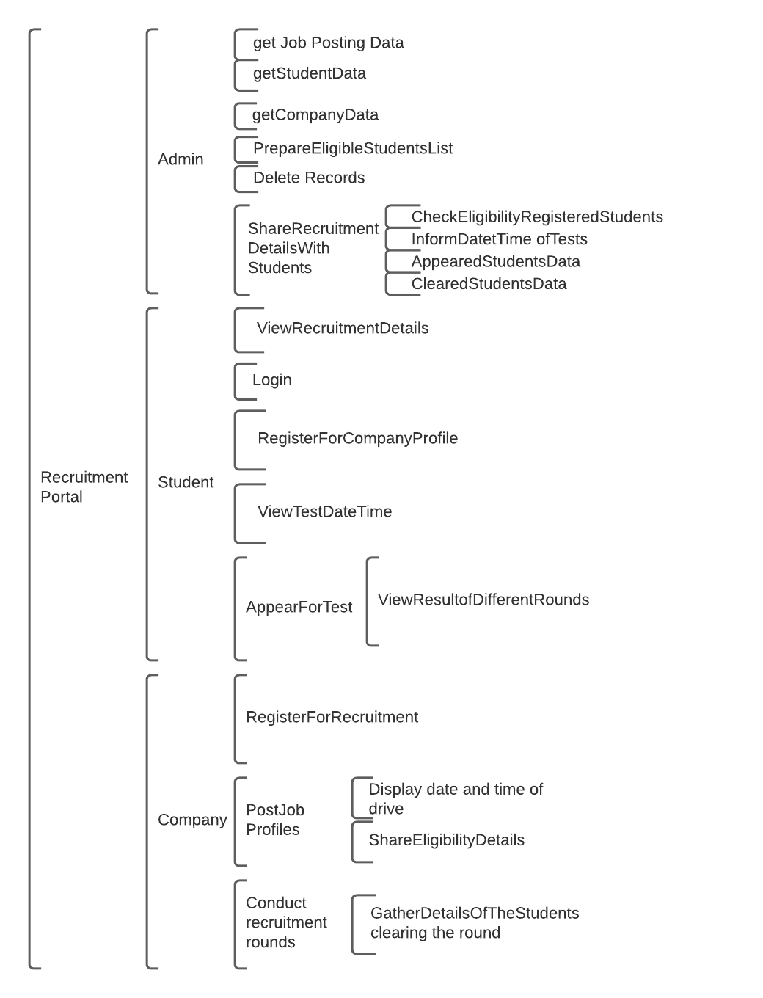
Implemented Modular Structure

Slide 8
List of Features Expected
Administrator:
Get Student Data
Get Company Data
Prepare Eligible Students List
Share Recruitment Details
Check Eligibility of Students
Display Test Date/Time/Venue
Record Appeared Students’ Data
Record Students Data Who Cleared Tests
Student:
Login
View Recruitment Details
Register for Job Profiles
View Test Details
View Results

Slide 9
List of Features Expected
Company:
Register
Post Job Profiles
Display Eligibility Details
Display Test Details
Conduct Recruitment Rounds
Record Students Clearing Each Round

Slide 10
List of Features Implemented
Administrator: (Made Check Eligibility of Students as Sub-Module of Share Recruitment Details)
Get Student Data
Get Company Data
Get Job Posting Data
Delete Records
Prepare Eligible Students List
Share Recruitment Details
Check Eligibility of Students
Display Test Date/Time/Venue
Record Appeared Students’ Data
Record Students Data Who Cleared Tests
Student: (Exact Same as Submitted)
Login
View Recruitment Details
Register for Job Profiles
View Test Details
View Results

Slide 11
List of Features Implemented
Company: (Slight Changes as mentioned in the Cartesian Section above)
Register
Login(Newly added Module)
Post Job Profiles
Conduct Recruitment Rounds
Display Test Details

Slide 12
Object Oriented Design Of Above:
Implemented the above requirements of our project using Object Oriented Design in Python
Made sure that the SOLID Programming Principle is fulfilled while designing the overall structure
Created below 3 Main Classes for our 3 major Modules namely-
Admin
Student
Company
Admin was inherited as parent class by subclass- Recruitment_Task to work on functions related to Recruitment related stuff only

Slide 13
SOLID Principle Fulfillment
We tried to make sure that the below principles are followed and are explained as belows:
Single Responsibility Principle:
says that a class should have only one reason to change
every class should have a single responsibility or single job or single purpose
achieved in our project implementation since all the 3 modules namely Admin, Student and Company have their specific features and functions that are private to these class objects only
any major change due to future needs will not affect the subsequent modules in any way
Open/Closed Principle:
All classes and functions implemented are open for extension, but closed for modification
Liskov’s Substitution Principle:
Inheritance design should make use of child classes and not parent classes
means that clients are completely isolated and unaware of changes in the class hierarchy
achieved by having separate submodules for the extensions required in the classes.
for instance, having a separate class to handle “Recruitment Details Sharing” from Admin’s side
this separate class is actually a subclass of the Admin class and hence can access the Admin Modules only via Admin Access

Slide 14
SOLID Principle Fulfillment(Continued…)
Interface Segregation Principle:
Design interfaces for each client type and not for client
Applicable to Interfaces and not classes
We don’t have this implemented in our project as there was no requirement of the same
Dependency Inversion Principle:
It says make high level modules independent of implementation details of low-level modules
Both should depend upon abstractions
Achieved by making all the class functions as private in Python

Slide 15
High-level OOPD Code STructure & Flow
We get 3 Classes with Admin having a subclass Recruitment_Task, as we have 3 different types of accesses:
Admin
Recruitment_Task
Student
Company

Slide 16
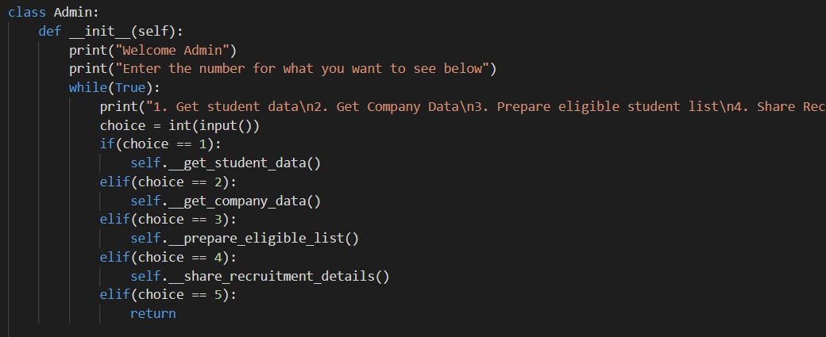
Admin Module:
This is the Admin Class whose object will allow user to select admin related tasks by providing various options as shown in below snippet:

Slide 17
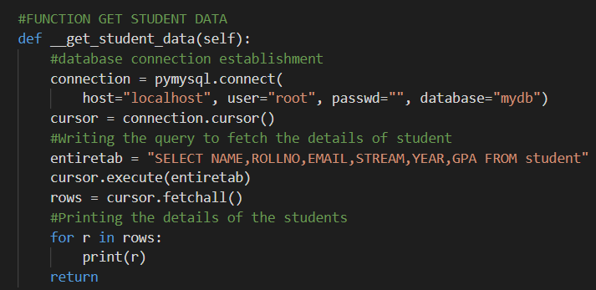
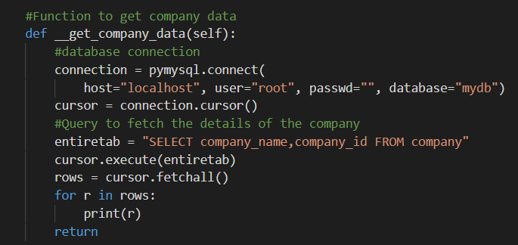
Admin Module(Continued…)
Get Student Data: We have a private function inside Admin Class that is responsible for fetching the student’s details from the Database.
Get Company Data: Similar to above, we have a private function inside Admin Class which other classes can’t access and hence code is secure.

Slide 18
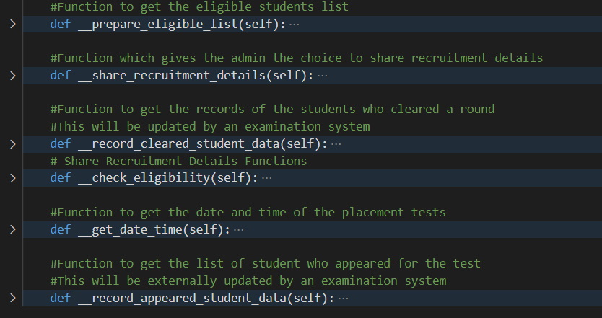
Admin Module(Continued…)
Similarly below functions are implemented inside Admin:
Prepare Eligible Students List
Share Recruitment Details
Check Eligibility of Students
Display Test Date/Time/Venue
Record Appeared Students’ Data
Record Students Data Who Cleared Tests

Slide 19
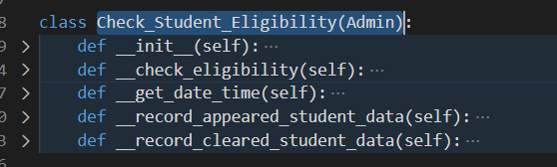
Admin (Continued…)
We have a subclass/child class of Admin namely, Recruitment_Task(Admin) that is mainly calling the parent functions related to the Student Eligibility actions.

Slide 20
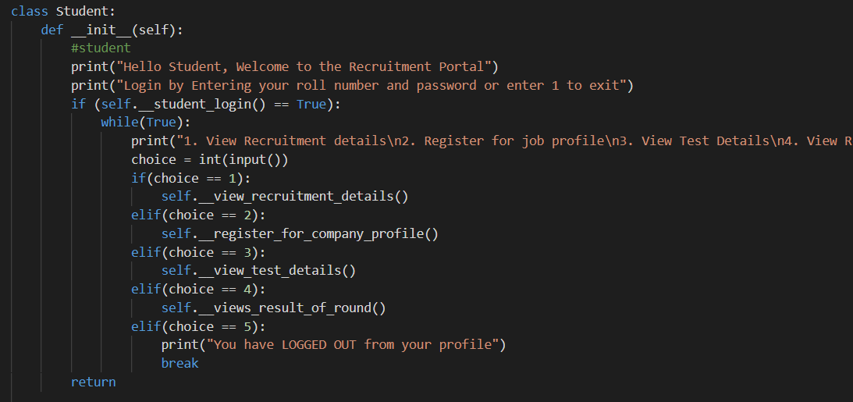
Student Module
Student Class: Similar to the Admin Class we implemented the student class taking care of all the actions related to Student Module in specific. A glimpse of code snippet can be seen below:

Slide 21
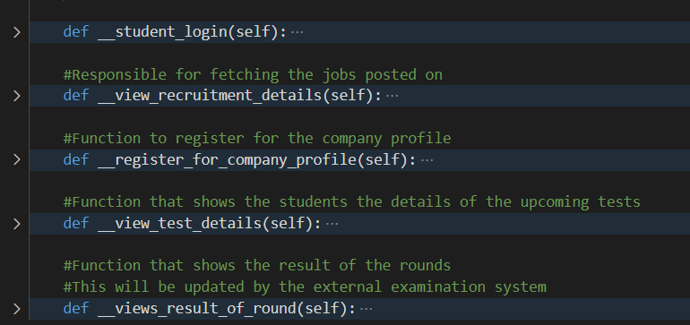
Student Module (Continued…)
The functions it is taking care of are as shown below:

Slide 22
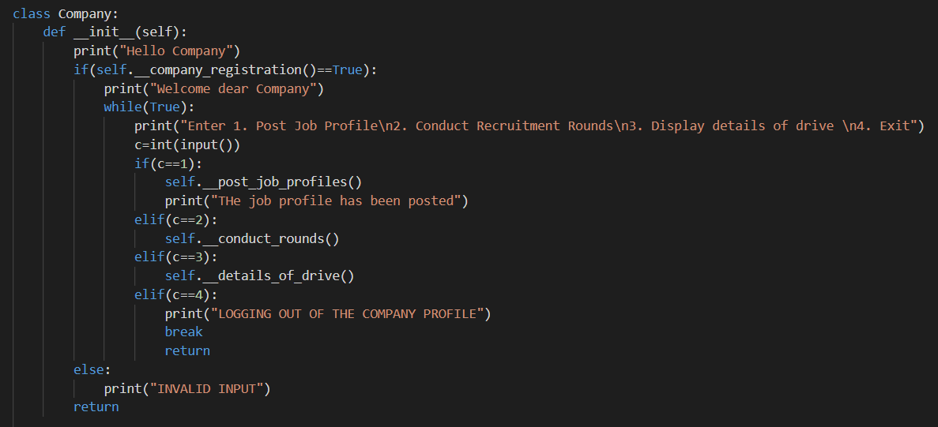
Company Module
Similar to the both the above modules, we implemented the Company class taking care of all the actions related to Company Actions Module in specific. A glimpse of code snippet can be seen below:

Slide 23
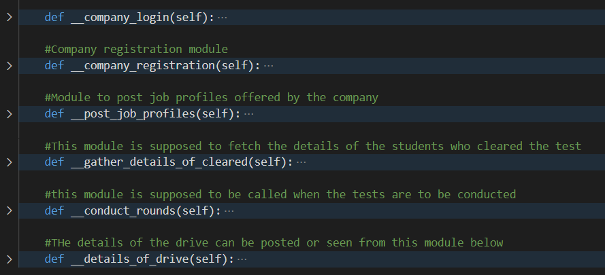
Company Module (Continued…)
The functions it is taking care of are as shown below:

Slide 24
Implementation Setup
The implementation behavior can be seen as below:
Database used: MySQL
Server used: Apache using XAMPP which is a free and open-source cross-platform web server solution stack package developed by Apache Friends, consisting mainly of the Apache HTTP Server, MySQL, PHP and Perl.
IDE: Visual Studio Code version 1.51.1
Python Version: 3.8.5

Slide 25
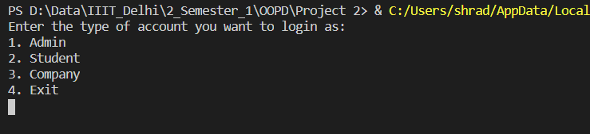
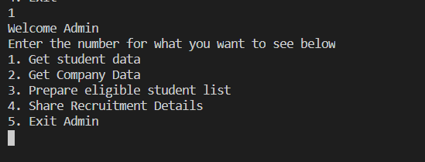
High Level Code Flow(Few snippets)
On Execution:
Inside Admin:

Slide 26
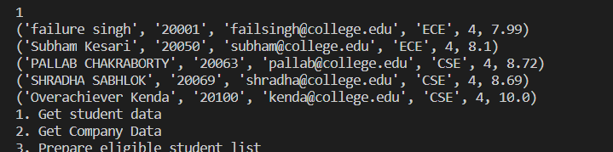

High Level Code Flow(Few snippets)
Get Student Data:
Get Company Details:

Slide 27
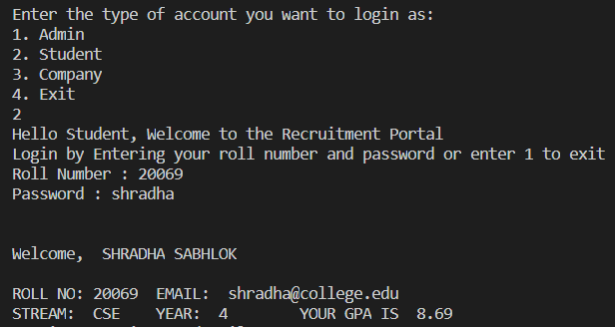
High Level Code Flow(Few snippets)
Student Module: On selecting option 2 Student can Login using the correct credentials and sees the details of Profile, register for companies, sees recruitment drive details etc.

Slide 28
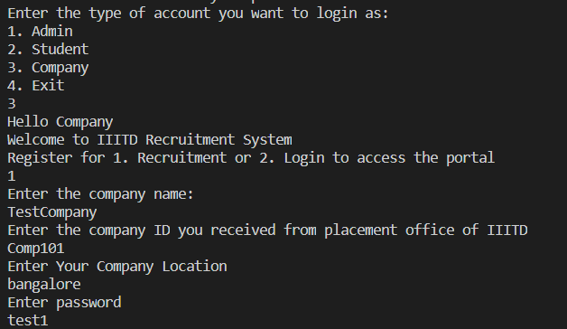
High Level Code Flow(Few snippets)
Company Module: On selecting option 3 Company users can either Register for Recruitment or Login to Access Portal.

Slide 29
Contribution of Members
Both the members were actively involved in the project starting from the brainstorming sessions till the implementation of various modules.
Shedding some light on specific individual contribution, Pallab Chakraborty handled the Admin Modules and the Login functionality of Student Module.
Apart from that, Pallab was responsible for the Cartesian and Modular Structure wireframe creation.
Shradha Sabhlok looked after the rest of the functionalities of Student Module and the Company Module in specific.
Also, she was an active contributor in the Project wireframe creation that laid the foundation of Cartesian and Modular structures.
Both the project members discussed and shared ideas that lead to successful completion of the Project along with a crisp Project Report and this presentation for easier understanding of the implementations involved.
The OOP structure was designed and implemented by Shradha.
Some extra functionality was added as suggested by the primary evaluation in the mid-semester.

Slide 30
Thank You!

