Slide 1
Mutation Clustering
Shuvom Sadhuka*
*PI: Jason Flannick, Mentor: Marcin von Grotthuss

Slide 2
Overview of Presentation
Introduction and Definition of Problem
Overview of Methods
Mathematical/Theoretical
Results
Discussion
Future Directions

Slide 3
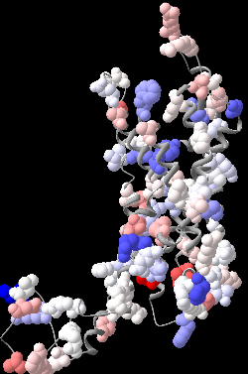
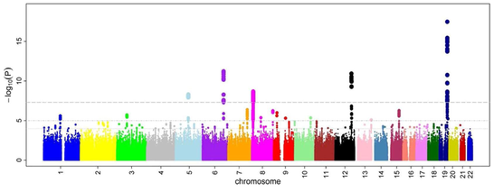
Problem Introduction
Map
Takeaway: We can map GWAS results to amino acid mutations in protein structures.

Slide 4
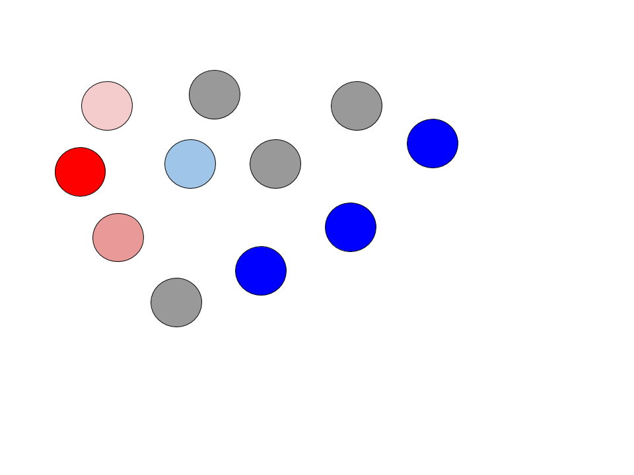
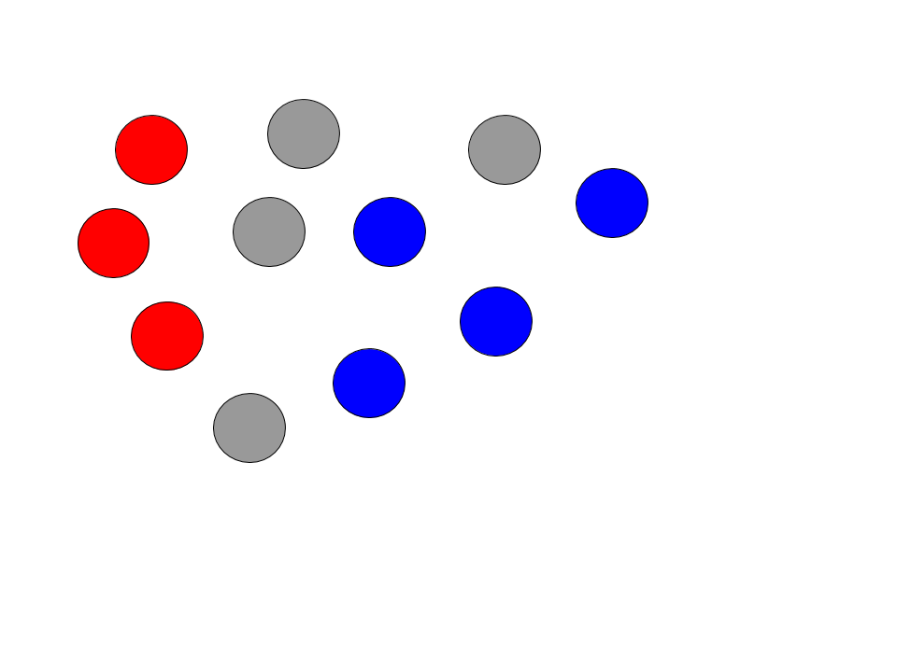
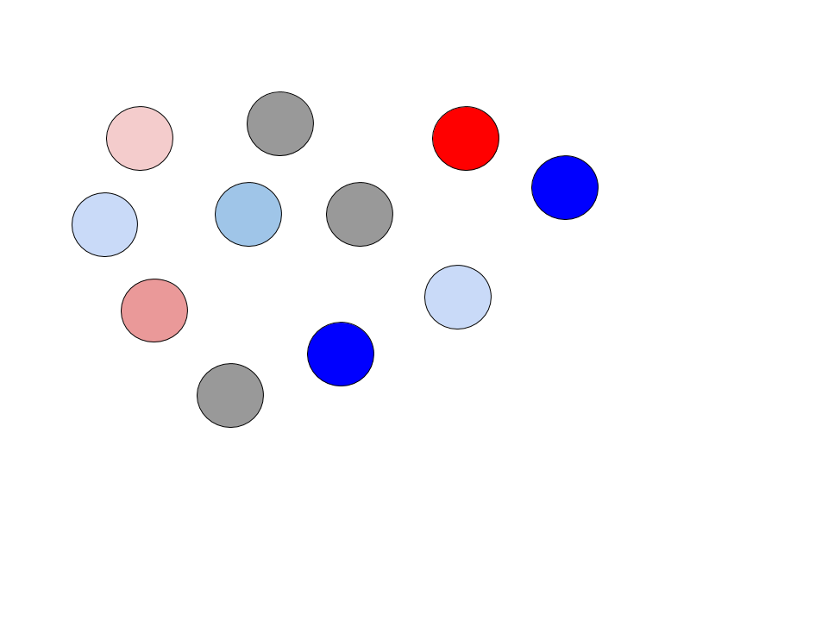
Suppose we only look at the locations of mutated residues...
Strong Clustering of Risk (red) and Protective (blue)
Weak Clustering of Risk (red) and Protective (blue)
No Clear Clustering of Risk or Protective
Takeaway: Identifying risk and protective “clusters” can suggest protein regions for drugs to molecularly bind to or mimic.

Slide 5
Research Goals
We wish to design a maximally powerful statistical test to:
(1) probe whether risk and protective mutations cluster in a given protein
(2) suggest a set of proteins and their corresponding “clustered” domains which have strong associations with diabetes risk/protection.

Slide 6

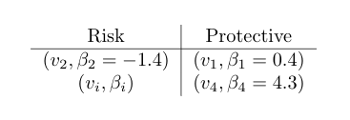
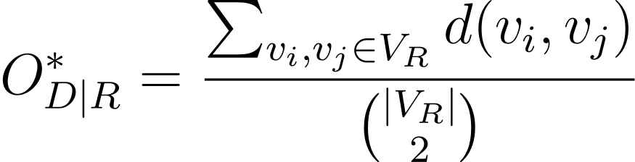
Methods: Understanding the Data
Consider the following representation of our dataset:
Observed (ground truth) average distance of risk mutations
Takeaway: For each protein, we can calculate the average distance between risk, protective mutations as a proxy for clustering.

Slide 7
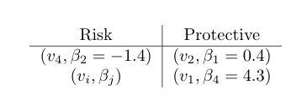
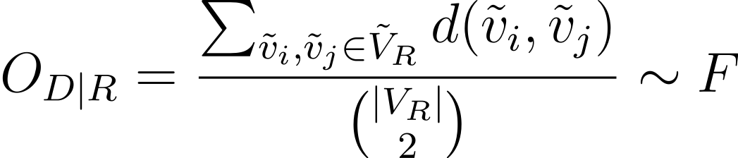
Methods: Permutation Test
Permute the betas (colors) on the residues
Construct a distribution for the risk, protective average distance by permuting values
Takeaway: We can randomly permute the betas on each residue and construct a distribution of the average distance between risk, protective mutations.

Slide 8
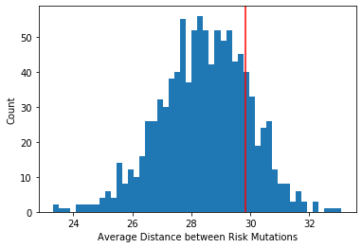

Methods: Permutation Test
Permute the betas (colors) on the residues
Takeaway: We can compute a p-value from the permutation test distribution.

Slide 9
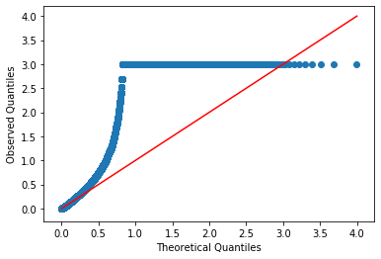
Results: QQ plot
Takeaway: We need a more well-calibrated statistical test.

Slide 10
Discussion of Constraints
We should be careful in how we construct our test. Some considerations:
Want to test for absolute clustering (do risk mutations cluster together and independently, do protective?), but this is hard given our confounders
Solution: Test for relative clustering (i.e. only permute among residues labeled as mutations)
Risk and protective p-values should be correlated, but weakly — in most proteins, mutations exist on very few residues
Certain parts of protein can’t be mutated — artificially inflates p-values
Incorporate information on how certain we are about a mutation’s risk
Under current model, weak betas and strong betas are treated the same
Multiple models of protein
Different models may give different results

Slide 11

Methods: (Modified) Permutation Test
Permute the betas (colors) on ONLY mutated residues
Constrain permutations to only risk and protective residues

Slide 12
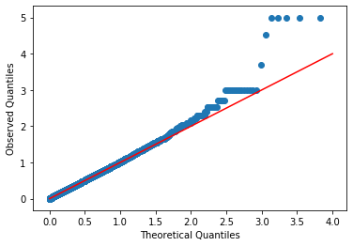
Results: QQ plot
Takeaway: We have a more well-calibrated statistical test!

Slide 13

Methods: (Certainty-Modified) Permutation Test
We want to capture information about how likely a mutation is to be risky
Problem: Weights all betas within risk cluster (< 0) equally

Slide 14


Methods: (Certainty-Modified) Permutation Test
We want to capture information about how likely a mutation is to be risky
Sum is taken over ALL mutations

Slide 15
Future Steps
Some considerations:
Look at top genes and their spatial models
Run on all models of each protein
Certainty-modified permutation test
Euclidean distance is probably not the right metric — some topological model to capture different regions and their biological functions would be better?
Rank-sum test didn’t work, maybe modify?
If you want to see the code/provide technical feedback, see GitHub repo!

