Slide 1
Trimodal Musical Instrument (Using MSP430 LaunchPad+Booster Pack MKII)
Student: Saad Saeed
Instructor: Dr. Ravi Shankar
Final Project for CDA 3331 Spring 2017

Slide 2
Acknowledgements
I want to thank Dr. Shankar and Mr. Weinthal for their encouragement and support for this project and throughout the semester.

Slide 3
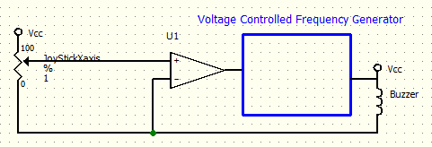
Original Submitted Proposal:
Read the current value of x-axis component of the joystick,
Use A/D converter to change the voltage read to a numerical value
Generate a frequency using PWM within human audible range.
Play the sound using the buzzer.
Dr. Shankar suggested that I should use y-axis of the joystick as well.

Slide 4
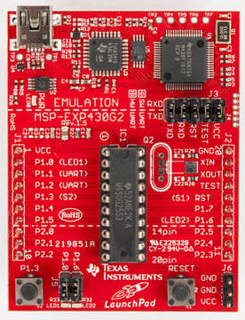
MSP430G2553 Based LaunchPad (Quick Overview)
Has:
Timers
Analog Inputs connected to A/D converter
Digital Ports that can be configured as input or output to connect to peripherals.
Some ports that can be used with the timers to generate Pule-Width-Modulated (PWM) signal.
20-pin Extension Pins to add additional peripheral boards.
Ports are highly configurable

Slide 5
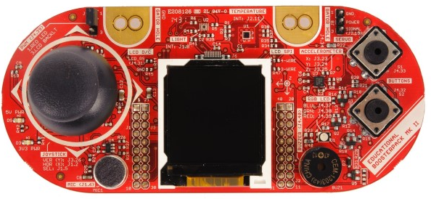
Booster Pack MKII
What we can use:
40 Pin Connectors.
x-y axis joy stick with select
x-y-z axis accelerometer
Buzzer
Two Buttons
Three LEDS
Microphone
Sour Grapes:
LCD – Driver not available for our LaunchPad
Temperature and Light sensors that work with I²C serial bus,

Slide 6
Connecting Pins
As some of the pins on the first 20 pins of the Booster Pack were useless for us, and we needed more pins than were available in the mounted configuration, Dr. Shankar suggested that we connect the wires one at a time.

Slide 7
Updated Specifications of the Trimodal Instrument
Use x and y channels of the joy stick to modify the frequency of the music.
Being able to switch of this feature using a button (used as a toggle switch)
Use the Select switch of the Joy Stick to play a preprogrammed mini song. Play once.
Use the other button to enable x and y channels of the accelerometer to created a motion sensitive musical instrument.

Slide 8
Resources Of the Launch Pad Used
I Needed:
Four Analog input channels to be sampled by ADC:
Two for X and Y inputs from Joystick (A0 and A1)
Two for X and Y inputs from the Accelerometer (A2 and A3)
Pins P1.0 – P1.3 are then unavailable.
Three binary Input ports:
one for Joystick select button (P1.5) and
two for the two buttons (P1.7 and P2.3)
Use of a Timer and Port P1.6 for Timer Output Signal to be connected with the Buzzer

Slide 9

Schematic Diagram
Joy Stick
Sequential Mode: INCH_4
x-axis
A0
ADC10MEM
y-axis
A1
A/D
P1.6
select
MSP430G2553
P1.5
Buzzer
Accelerometer
A2
ADC10SA
x-axis
A3
y-axis
z-axis
Upper
Button 1
P1.7
Timer A
Lower
Button 2
P2.3

Slide 10
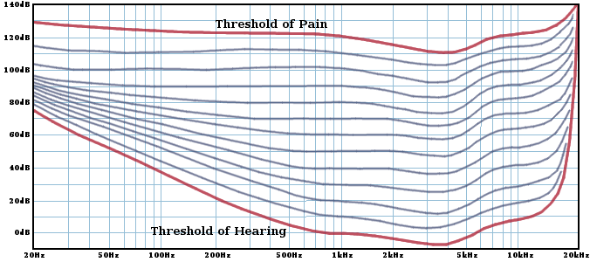
Human Hearing Range
https://i.stack.imgur.com/PuhtK.png
https://upload.wikimedia.org/wikipedia/commons/3/3a/17.4_kHz_sound.ogg

Slide 11
Frequency Generation
Buzzer output is digital, so it can be either low or high.
To generate different tones, we have to bring the voltage up and down on the buzzer port periodically.
If p is the period of the square wave applied to the buzzer, the frequency will be reciprocal of the period, i.e.
Frequency = 1/p cycles/sec or Hz.
I controlled the period using the variable resistance provided by the inputs (x-y of joy stick or x-y of accelerometer). To get one value, I simply added x+y and adjusted the values so that they would fit within the range.

Slide 12
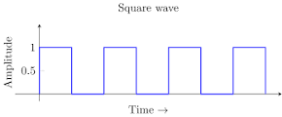
Frequency
Period p
I used the same code for PWM, but instead of changing the duty-cycle, I changed the period of the wave, using the outputs from the A/D converter
The duty cycle was kept at 50%, so the wave applied to the buzzer is a square wave.

Slide 13
Generating Frequency Range
I did normalize the outputs of A/D between 0 and 1.
Linear mapping from this value to the period did not make it very interesting as most of the frequencies were jumbled up on the lower side of the scale due to the reciprocal relationship. Did not have log x or e^x libraries.
I was just studying McLaurin Series in Calculus 2.
Initially I though about the exponential function (e^{(0.7*x)} -1), and its series use for the 4th order approx. It was better but did not provide good results.
I ventured into experimentation by changing the coefficients of the polynomial myself.

Slide 14
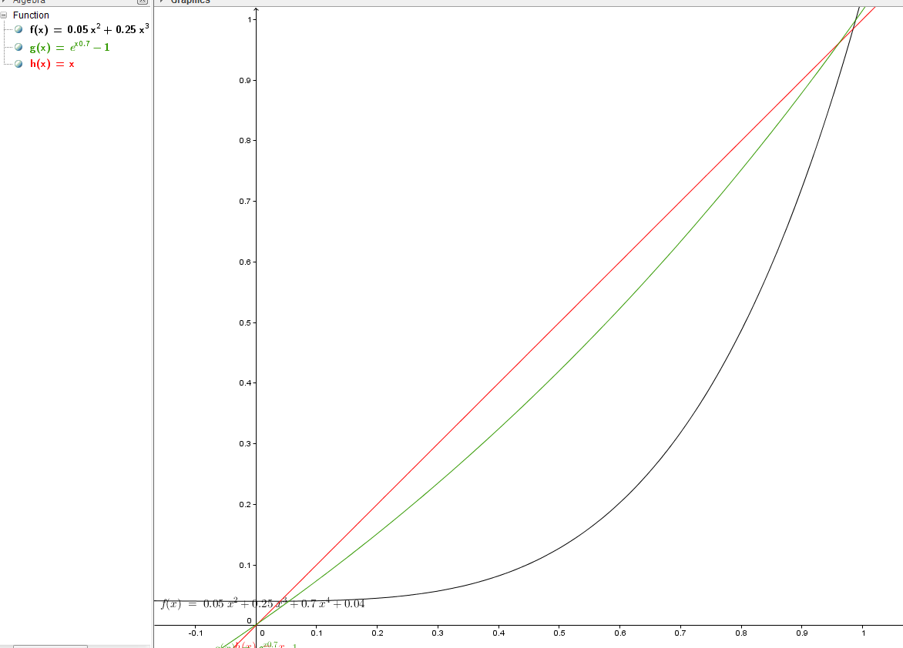
Converting Voltage To Frequency
g(x) = ℯ^(x 0.7) - 1
h(x) = x
f(x) = 0.05x² + 0.25x³ + 0.7x⁴ + 0.04

Slide 15
Actual code
period*(D*D*0.05+D*D*D*0.25+D*D*D*D*0.7+0.004);

Slide 16
A/D Converter: Using Registers
ADC registers we have used during Configuration of ADC:
ADC10CTL0: We have used for configuring Sample and Hold time (ADC10SHT_2), Multiple Sample Conversion (MSC), Powering the ADC (ADC10ON)
ADC10CTL1: To configure sequential mode (CONSEQ_1) and using 4 channels (A0,A1,A2,A3), and to see if ADC is busy.
ADC10AE0: To enable input pins (A0,A1,A2,A3)
ADC10DTC1: Enabling automatic data transfer and ADC10SA Starting address for where to transfer data to.
ADC registers we have used at the time of Conversion
Resetting the Starting address (ADC10SA) before every conversion cycle
ADC10CTL0: Enabling conversion and sending software signal to start conversion.
ADC10CTL1: To see if ADC is busy

Slide 17
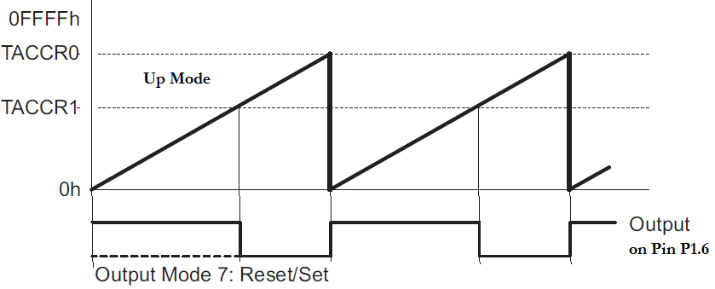
Registers of Timer A (used)
TACCR0: Counter Compare Register. To control the period of the square wave.
TACCR1: Counter Compare Register is used to disable the output. We used it to adjust the duty cycle of the output signal.
TACCTL1: Used to set the Output mode to Set/Reset based on TACCR0 and TACCR1 values.
TACTL: Used to setup the clock speed and setting the Timer to Up modes shown above.

Slide 18
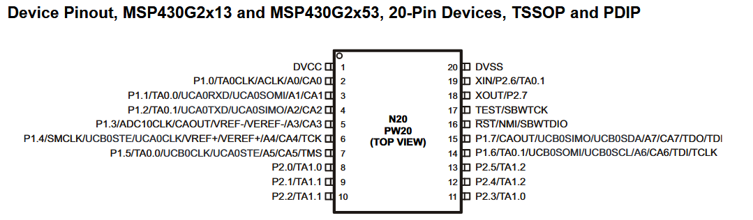
What is the Role of P1.6?
When BIT6 of P1SEL is enabled Timer A’s Output is connected to P1.6 pin.

Slide 19
Difficulties
I have already mentioned the difficulties faced during expression of frequencies.
Earlier in the project, I struggled as shown in following slides.

Slide 20
BoosterPack MKII
Early Disappointments:
Initially I wanted to build a temperature display:
LCD screen was available but no drivers were available for our Launch Pad. Making a new driver in three weeks was not feasible.
No samples for light/temperature sensors were available for our Launch Pad. Implementing I²C protocol from scratch was not feasible within the time frame.
Using MSP432 board could have made this project more interesting.
So I proceeded with making Lemonade (see my proposal).

Slide 21
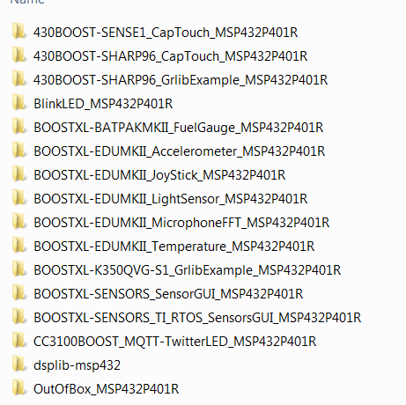
Samples and Drivers that were available
Could not use any.
Mostly relied on sample code from class.
Temperature Sensor sample provided code did not use Booster Pack’s sensor. It used MSP430’s internal sensor.

Slide 22
Conclusion
It was fun to learn and combine many of the ideas we learned during the semester into a single project.
I learned PWM in Lab 2 which I modified to change time period instead of duty cycle.
I learned how to use ADC with a potentiometer in Lab 2, that I used several times here
I learned how to deal with switches in Lab 5 that I used to deal with the buttons.
I learned how to use multiple channels of ADC in Lab 6 that was very helpful in this project.
This was a fun project to work with.

