Slide 1
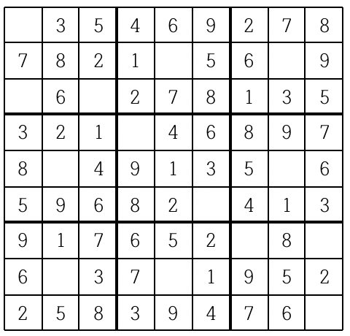

Slide 2
1

Slide 3
1

Slide 4
1

Slide 5
(0, 0)
(1, 4)
(1, 7)
(2, 0)
(2, 2)
(3, 3)
(4, 1)
(4, 7)
(5, 5)
(6, 6)
(6, 8)
(7, 1)
(7, 4)
(8, 8)
1 ~ 9

