Slide 1
Process Management

Slide 2
External View of the OS
wait()
close()
sleep()
File Mgr
Hardware
C
Program
fork()
signal()
Device Mgr
semctl()
Memory Mgr
SetWaitableTimer()
CreateProcess()
Process Mgr
CreateThread()
OS
CloseHandle()
WaitForSingleObject()

Slide 3
Process Management Responsibilities
Define & implement the essential characteristics of a process and thread
  Algorithms to define the behavior
  Data structures to preserve the state of the execution
Define what “things” threads in the process can reference – the address space (most of the “things” are memory locations)
Manage the resources used by the processes/threads
Tools to create/destroy/manipulate processes & threads
Tools to time-multiplex the CPU – Scheduling the (Chapter 7)
Tools to allow threads to synchronization the operation with one another (Chapters 8-9)
Mechanisms to handle deadlock (Chapter 10)

Slide 4
Initializing the Machine
Power up ⇒ fetch-execute cycle begins
Initial (or hardware) process begins to run
Executes ROM diagnostic program
Then bootstrap loads the OS
OS initialization
  Setup & initialize all system data structures (this creates process & resource abstractions)
  Initialize all devices
  Start daemons – including idle process
  Branches to the scheduler

Slide 5
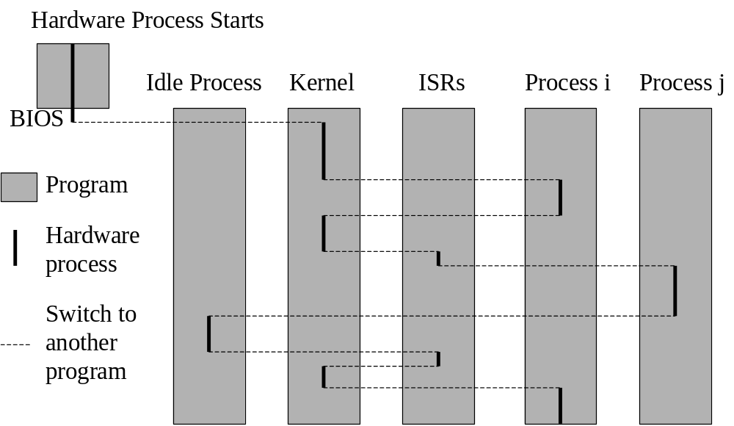

Slide 6
Process Abstraction Layers
Process Mgr
p_{i}, p_{j}, and p_{k} each have their own virtual terminal
P_{i}
Virt Term
P_{j}
Virt Term
P_{k}
Virt Term
Window Mgr interface
P_{i}
Control
Unit
P_{j}
Control
Unit
P_{k}
Control
Unit
p_{i}, p_{j}, and p_{k} each have their own virtual machine
OS interface
OS
Address
Space
P_{i}
Address
Space
Hardware process (OS) coroutines across p_{i}, p_{j}, and p_{k} under OS control
Control
Unit
P_{k}
Address
Space
P_{j}
Address
Space

Slide 7
Process Manager Overview
Process Mgr
Program
Process
Abstract Computing Environment
File
Manager
Deadlock
Process
Description
Protection
Synchronization
Device
Manager
Memory
Manager
Resource
Manager
Scheduler
Resource
Manager
Resource
Manager
Devices
Memory
CPU
Other H/W

Slide 8
Unix Organization
Process
Libraries
Process
Process
System Call Interface
File
Manager
Deadlock
Process
Description
Protection
Synchronization
Device
Manager
Memory
Manager
Resource
Manager
Scheduler
Resource
Manager
Resource
Manager
Monolithic Kernel
Devices
Memory
CPU
Other H/W

Slide 9
NT Organization
Process
Process
T
Process
T
T
Libraries
T
T
T
T
T
T
Subsystem
Subsystem
Subsystem
User
Supervisor
NT Executive
I/O Subsystem
NT Kernel
Hardware Abstraction Layer
Processor(s)
Main Memory
Devices

Slide 10
Process Descriptor
OS creates/manages process abstraction
Descriptor is data structure for each process
  Register values
  Logical state
  Type & location of resources it holds
  List of resources it needs
  Security keys
  etc. (see Table 6.1 and the source code of your favorite OS)

Slide 11
Creating a Process in UNIX
pid = fork();
UNIX kernel
Process Table
…
Process Descriptor

Slide 12
Creating a Process in NT
CreateProcess(…);
Win32 Subsystem
ntCreateProcess(…);
…
ntCreateThread(…);
NT Executive
Handle Table
NT Kernel
…
Process Descriptor

Slide 13
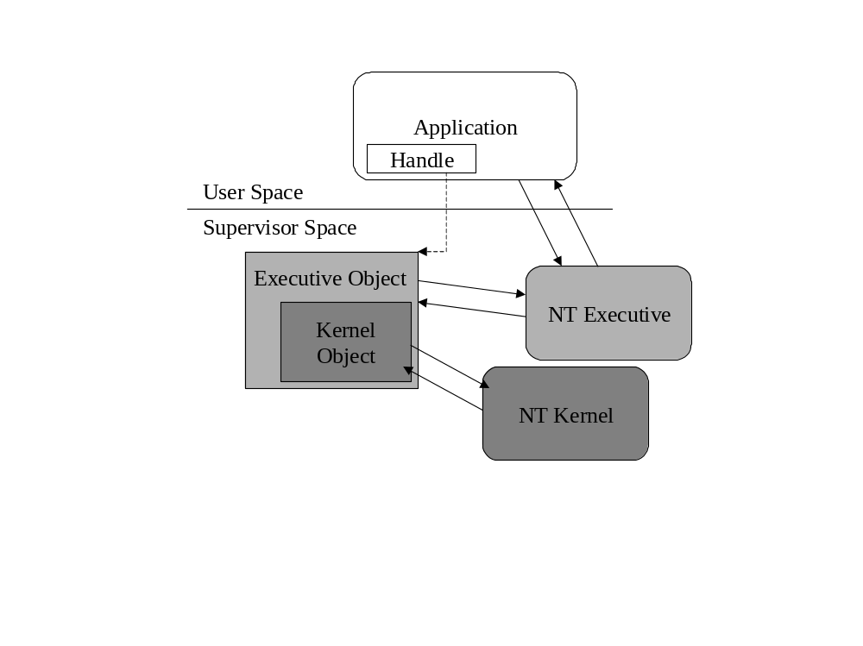
Handles

Slide 14
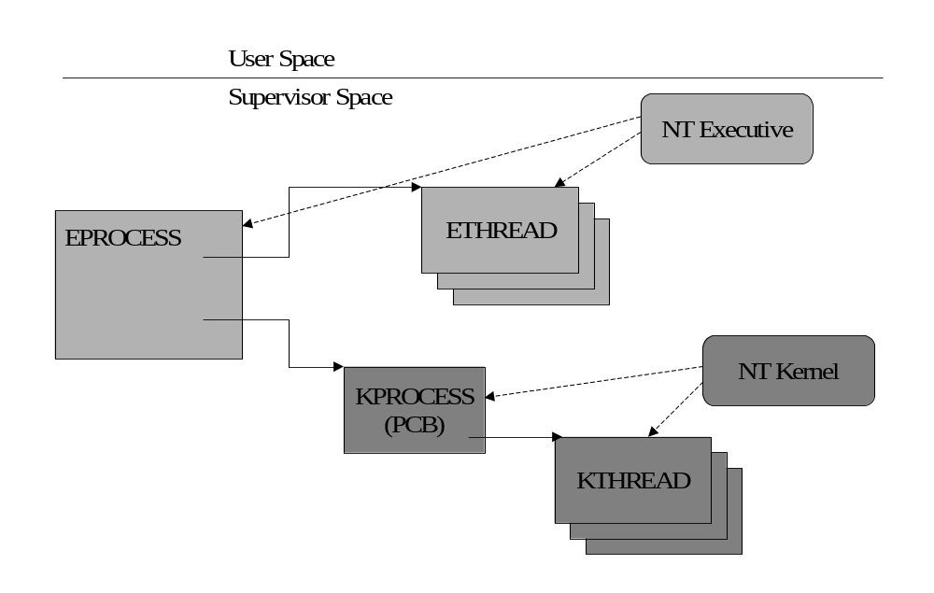
NT Process Descriptor

Slide 15
NT Process Descriptor
Kernel process object including:
  Pointer to the page directory
  Kernel & user time
  Process base priority
  Process state
  List of the Kernel thread descriptors that are using this process

Slide 16
NT Process Descriptor (cont)
Parent identification
Exit status
Creation and termination times.
Memory status
Security information
executable image
Process priority class used by the thread scheduler.
A list of handles used by this process
A pointer to Win32-specific information

Slide 17
Resource Model
Resource: Anything that a process can request, then be blocked because that thing is not available.
R = {R_{j} | 0 ≤ j < m} = resource types
C = {c_{j} ≥ 0 | ∀ R_{j}∈R (0 ≤ j < m)} = units of R_{j} available
Reusable resource: After a unit of the resource has been allocated, it must ultimately be released back to the system. E.g., CPU, primary memory, disk space, … The maximum value for c_{j} is the number of units of that resource
Consumable resource: There is no need to release a resource after it has been acquired. E.g., a message, input data, … Notice that c_{j} is unbounded.

Slide 18
Using the Model
There is a resource manager, Mgr(R_{j}) for every R_{j}
Process p_{i} can request units of R_{j} if it is currently running
p_{i} can only request n_{i} ≤ c_{j} units of reusable R_{j}
p_{i} can request unbounded # of units of consumable R_{j}
Mgr(R_{j}) can allocate units of R_{j} to p_{i}
p_{i} can release units of R_{j} that it holds (reusable) or produces (consumable)
Mgr(R_{j})
request
allocate
release
Process

Slide 19
Resource Manager Design
Mgr(R_{j})
request
release
allocate
release
allocate
release
Process
allocate
Resource Pool

Slide 20
Address Space
Primary
Memory
Process
Address Space
Mailboxes
Files
System services
Other objects

Slide 21
Defining the Address Space
Some parts are built into the environment
  Files
  System services
Some parts are imported at runtime
  Mailboxes
  Network connections
Memory addresses are created at compile (and run) time

Slide 22
The Compile Time Component
Source
Modules
Translator
Relocatable
Modules
Link Editor
Absolute
Program
Primary Memory
Loader
Executable
Program

Slide 23
Processes &Threads
State
Stack
State
Stack
Map
Map
Address Space
Program
Static data
Resources

Slide 24
Process State (Version 1)
Request
Done
Running
Request
Schedule
Allocate
Start
Blocked
Ready

Slide 25
Process State (UNIX)
Request
Wait by
parent
Done
Running
zombie
Request
Schedule
Sleeping
I/O Request
Start
Allocate
Runnable
I/O Complete
Resume
Uninterruptible
Sleep
Traced or Stopped

Slide 26
Process Hierarchies
Parent-child relationship may be significant: parent controls children’s execution
Request
Done
Running
Yield
Suspend
Request
Schedule
Suspend
Start
Ready-Active
Activate
Ready-Suspended
Allocate
Allocate
Suspend
Blocked-Active
Blocked-Suspended
Activate

