Slide 1
CSS for Styling

Slide 2
The good, the bad and the… ugly!
<p>
<font face="Arial">Shashdot.</font>
News for <b>nerds!!</b> You will <i>never</i>, <u>EVER</u> be
<font size="+4" color="red">BORED</font> here!
</p> HTML
Slashdot. News for nerds!! You will never, EVER be BORED here!
output
Tags such as b, i, u, and font are discouraged in strict XHTML
Why is this bad?

Slide 3
Cascading Style Sheets (CSS)
Describes the appearance, layout, and presentation of information on a web page
HTML describes the content of the page
Describes how information is to be displayed, not what is being displayed
Can be embedded in HTML document or placed into separate .css file

Slide 4
Basic CSS rule syntax
selector {
property: value;
property: value;
...
property: value;
} CSS
p {
font-family: sans-serif;
color: red;
} CSS
A CSS file consists of one or more rules
Each rule starts with a selector
A selector specifies an HTML element(s) and then applies style properties to them
a selector of * selects all elements

Slide 5
Attaching a CSS file <link>
<head>
...
<link href="filename" type="text/css" rel="stylesheet" />
...
</head> HTML
<link href="style.css" type="text/css" rel="stylesheet" />
<link href="http://www.google.com/uds/css/gsearch.css"
rel="stylesheet" type="text/css" /> HTML
A page can link to multiple style sheet files
In case of a conflict (two sheets define a style for the same HTML element), the latter sheet's properties will be used
Notes:
a conflict (two sheets define a style for the same HTML element

Slide 6
Embedding style sheets: <style>
<head>
<style type="text/css">
p { font-family: sans-serif; color: red; }
h2 { background-color: yellow; }
</style>
</head>
HTML
CSS code can be embedded within the head of an HTML page
Bad style and should be avoided when possible (why?)

Slide 7
Inline styles: the style attribute
<p style="font-family: sans-serif; color: red;">
This is a paragraph</p>
HTML
This is a paragraph
output
Higher precedence than embedded or linked styles
Used for one-time overrides and styling a particular element
Bad style and should be avoided when possible (why?)

Slide 8
CSS properties for colors
p {
color: red;
background-color: yellow;
}
CSS
This paragraph uses the style above output
property | description
color | color of the element's text
background-color | color that will appear behind the element

Slide 9
Specifying colors
p { color: red; }
h2 { color: rgb(128, 0, 196); }
h4 { color: #FF8800; } CSS
This paragraph uses the first style above
This h2 uses the second style above.
This h4 uses the third style above.
output
color names: aqua, black, blue, fuchsia, gray, green, lime, maroon, navy, olive, purple, red, silver, teal, white (white), yellow
RGB codes: red, green, and blue values from 0 (none) to 255 (full)
hex codes: RGB values in base-16 from 00 (0, none) to FF (255, full)

Slide 10
Grouping styles
p, h1, h2 {
color: green;
}
h2 {
background-color: yellow;
} CSS
This paragraph uses the above style.
output
This h2 uses the above styles.
A style can select multiple elements separated by commas
The individual elements can also have their own styles

Slide 11
CSS comments /*…*/
/* This is a comment.
It can span many lines in the CSS file. */
p {
color: red; background-color: aqua;
} CSS
CSS (like HTML) is usually not commented as rigorously as programming languages such as Java
The // single-line comment style is NOT supported in CSS
The <!-- ... --> HTML comment style is also NOT supported in CSS

Slide 12
CSS properties for fonts
property | description
font-family | which font will be used
font-size | how large the letters will be drawn
font-style | used to enable/disable italic style
font-weight | used to enable/disable bold style
Complete list of font properties (http://www.w3schools.com/css/css_reference.asp#font)

Slide 13
font-family
p {
font-family: Georgia;
}
h2 {
font-family: "Courier New";
} CSS
This paragraph uses the first style above.
This h2 uses the second style above.
output
Enclose multi-word font names in quotes

Slide 14
More about font-family
p {
font-family: Garamond, "Times New Roman", serif;
} CSS
This paragraph uses the above style. output
We can specify multiple fonts from highest to lowest priority
Generic font names:
serif, sans-serif, cursive, fantasy, monospace
If the first font is not found on the user's computer, the next is tried
Placing a generic font name at the end of your font-family value, ensures that every computer will use a valid font

Slide 15
font-size
p {
font-size: 24pt;
} CSS
This paragraph uses the style above. output
units: pixels (px) vs. point (pt) vs. m-size (em)
16px, 16pt, 1.16em
vague font sizes: xx-small, x-small, small, medium, large, x-large, xx-large, smaller, larger
percentage font sizes, e.g.: 90%, 120%

Slide 16
font-size
p {
font-size: 24pt;
} CSS
This paragraph uses the style above. output
pt specifies number of point, where a point is 1/72 of an inch onscreen
px specifies a number of pixels on the screen
em specifies number of m-widths, where 1 em is equal to the font's current size

Slide 17
font-weight, font-style
p {
font-weight: bold;
font-style: italic;
} CSS
This paragraph uses the style above. output
Either of the above can be set to normal to turn them off (e.g. headings)

Slide 18
CSS properties for text
property | description
text-align | alignment of text within its element
text-decoration | decorations such as underlining
line-height, word-spacing, letter-spacing | gaps between the various portions of the text
text-indent | indents the first letter of each paragraph
Complete list of text properties (http://www.w3schools.com/css/css_reference.asp#text)

Slide 19

text-align
blockquote { text-align: justify; }
h2 { text-align: center; } CSS
The Gollum’s Quote
We wants it, we needs it. Must have the precious. They stole it from us. Sneaky little hobbitses. Wicked, tricksy, false! output
text-align can be left, right, center, or justify
Notes:
justify (which widens all full lines
of the element so that they occupy its entire width)

Slide 20
text-decoration
p {
text-decoration: underline;
} CSS
This paragraph uses the style above. output
can also be overline, line-through, blink, or none
effects can be combined:
text-decoration: overline underline;

Slide 21
The list-style-type property
ol { list-style-type: lower-roman; } CSS
Possible values:
i. none : No marker
ii. disc (default), circle, square
iii. Decimal: 1, 2, 3, etc.
iv. decimal-leading-zero: 01, 02, 03, etc.
v. lower-roman: i, ii, iii, iv, v, etc.
vi. upper-roman: I, II, III, IV, V, etc.
vii. lower-alpha: a, b, c, d, e, etc.
viii. upper-alpha: A, B, C, D, E, etc.
x. lower-greek: alpha, beta, gamma, etc.
others: hebrew, armenian, georgian, cjk-ideographic, hiragana…

Slide 22
Body styles
body {
font-size: 16px;
} CSS
Applies a style to the entire body of your page
Saves you from manually applying a style to each element

Slide 23
Cascading Style Sheets
Properties of an element cascade together in this order:
browser's default styles
external style sheet files (in a <link> tag)
internal style sheets (inside a <style> tag in the page's header)
inline style (the style attribute of the HTML element)

Slide 24
Inheriting styles
body { font-family: sans-serif; background-color: yellow; }
p { color: red; background-color: aqua; }
a { text-decoration: underline; }
h2 { font-weight: bold; text-align: center; } CSS
This is a heading
A bulleted list output
A styled paragraph. Previous slides are available on the website.
when multiple styles apply to an element, they are inherited
a more tightly matching rule can override a more general inherited rule
Notes:
not all properties are inherited (notice link's color above)

Slide 25
Styles that conflict
p, h1, h2 { color: blue; font-style: italic; }
h2 { color: red; background-color: yellow; } CSS
This paragraph uses the first style above.
output
This heading uses both styles above.
when two styles set conflicting values for the same property, the latter style takes precedence
Notes:
(later we will learn about more specific styles that can override more general styles)

Slide 26
W3C CSS Validator
<p>
<a href="http://jigsaw.w3.org/css-validator/check/referer">
<img src="http://jigsaw.w3.org/css-validator/images/vcss"
alt="Valid CSS!" /></a>
</p> CSS
output
jigsaw.w3.org/css-validator/
checks your CSS to make sure it meets the official CSS specifications
Notes:
more picky than the web browser, which may render malformed CSS correctly

Slide 27
CSS properties for backgrounds
property | description
background-color | color to fill background
background-image | image to place in background
background-position | placement of bg image within element
background-repeat | whether/how bg image should be repeated
background-attachment | whether bg image scrolls with page
background | shorthand to set all background properties

Slide 28
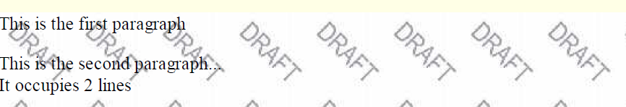
background-image
body {
background-image: url("images/draft.jpg");
}
CSS
background image/color fills the element's content area

Slide 29
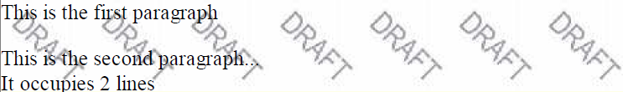
background-repeat
body {
background-image: url("images/draft.jpg");
background-repeat: repeat-x;
}
CSS
can be repeat (default), repeat-x, repeat-y, or no-repeat

Slide 30
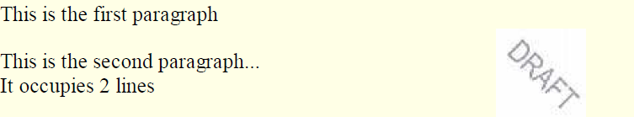
background-position
body {
background-image: url("images/draft.jpg");
background-repeat: no-repeat;
background-position: 370px 20px;
} CSS
value consists of two tokens, each of which can be top, left, right, bottom, center, a percentage, or a length value in px, pt, etc.
value can be negative to shift left/up by a given amount

Slide 31
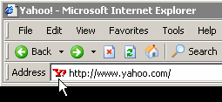
Aside: Favorites icon ("favicon")
<link href="filename" type="MIME type" rel="shortcut icon" /> HTML
<link href="yahoo.gif" type="image/gif" rel="shortcut icon" /> HTML
The link tag, placed in the HTML page's head section, can specify an icon
this icon will be placed in the browser title bar and bookmark/favorite

