Slide 1
GRID IN CSS
.

Slide 2
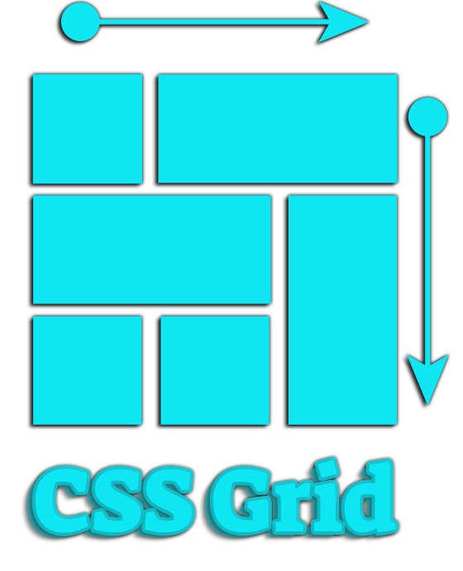
CSS Grid Layout (aka "Grid")

Slide 3
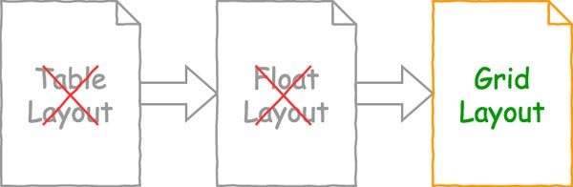
Grid is 2-d layout

Slide 4
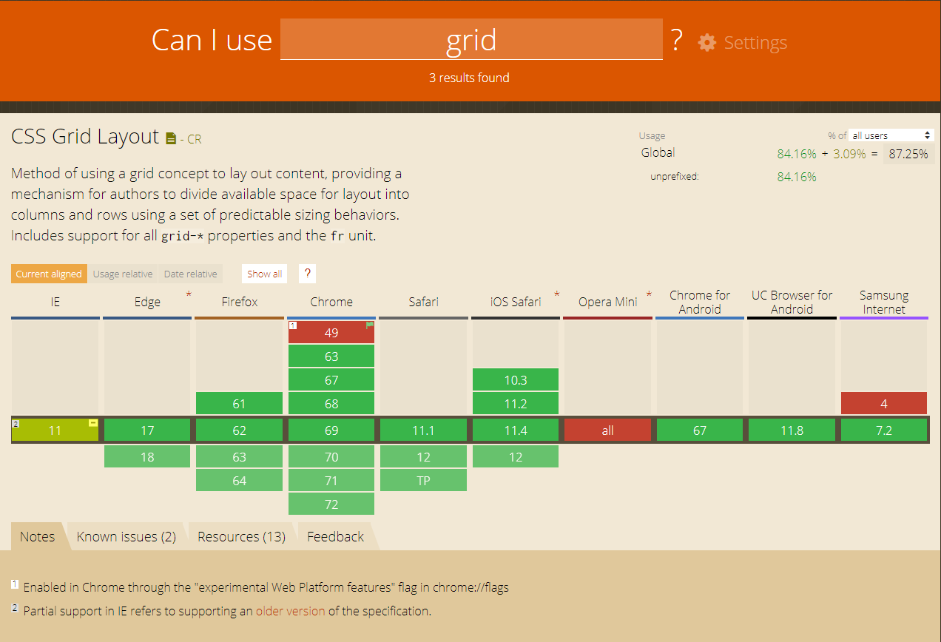
Browser support

Slide 5
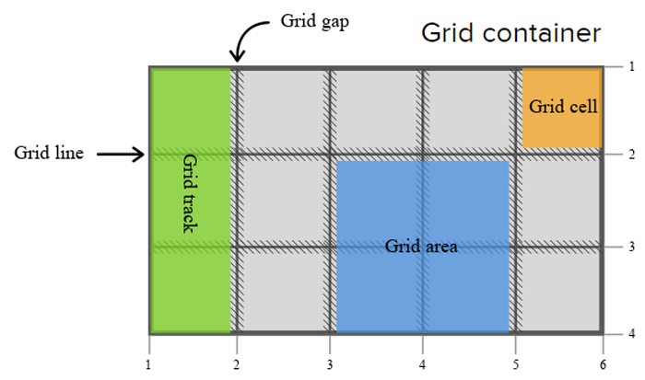
Concepts and Terminology

Slide 6
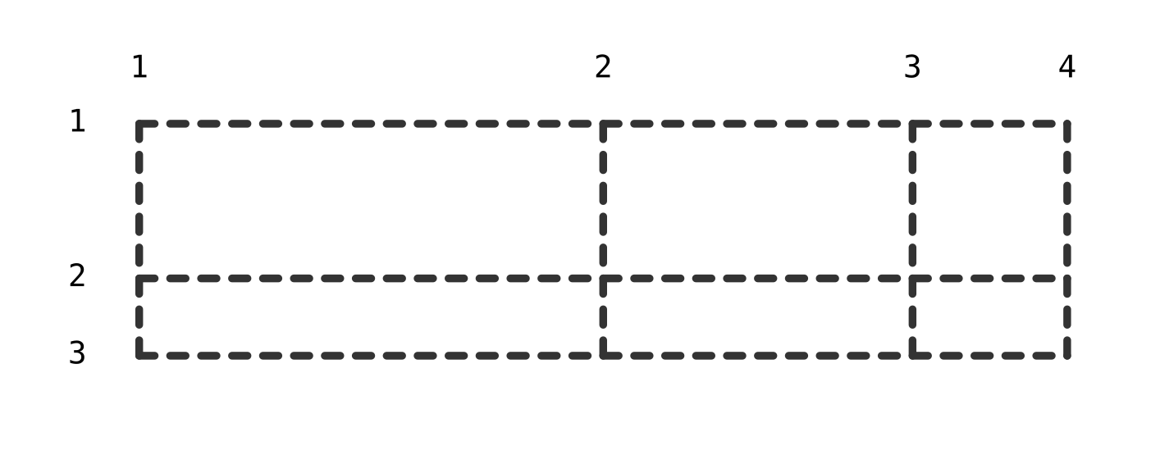
Grid Lines
<div class="grid"></div>
.grid{
display: grid;
grid-template-columns: 300px 200px 100px;
grid-template-rows: 100px 50px;
}

Slide 7
Grid Lines
Properties for the Grid Items:
  Grid-column-start
  Grid-column-end
  Grid-row-start
  Grid-row-end
  Shorthands:
  Grid-column: <grid-column-start> <grid-column-end>
  Grid-row: <grid-row-start> <grid-row-end>
  Grid-area: <row-start> <column-start> <row-end> <column-end>

Slide 8
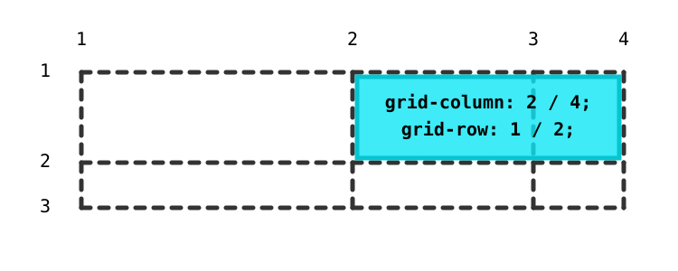
Grid Lines
<div class="grid">
<div class="grid-item">Grid Item</div>
</div>
.grid-item{
grid-column: 2 / 4;
grid-row: 1 / 2;
}
.grid-item{
grid-area: 1 / 2 / 2 / 4;
}

Slide 9
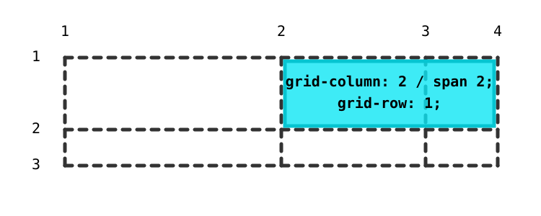
Grid Lines
Cell Coverage …key word <span>

Slide 10
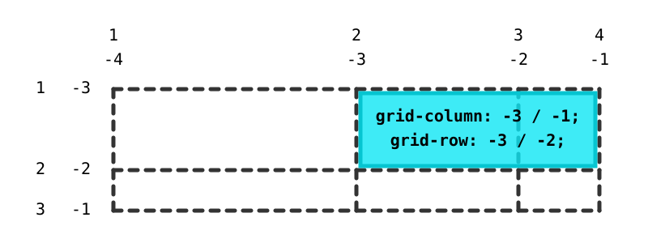
Grid Lines
Negative line numbers

Slide 11
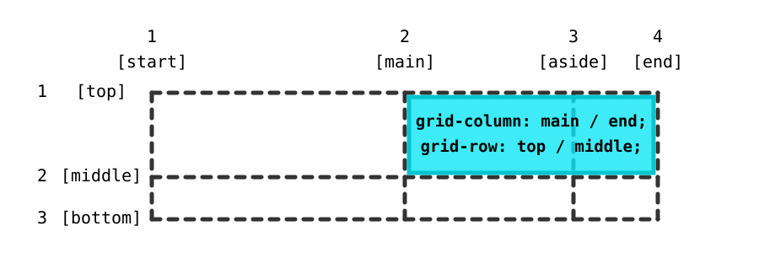
Grid Lines
Naming lines when defining a grid
.grid{
display: grid;
grid-template-columns: [start] 300px [main] 200px [aside] 100px [end];
grid-template-rows: [top] 100px [middle] 50px [bottom];">
}
.grid-item{
grid-column: main / end;
grid-row: top / middle;
}

Slide 12
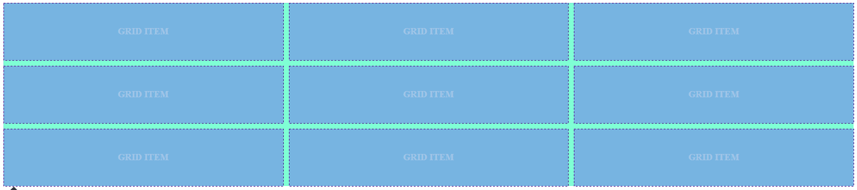
Grid Track
New Fr CSS length (Fraction)
Repeat();
grid-template-columns: 1fr 1fr 1fr;
grid-template-rows: 100px 100px 100px;
grid-template-columns: repeat(3,1fr);

Slide 13
Grid Track
Function minmax();
minmax(min,max);
Static length values
Dynamic length values
The min-content, max-content
grid-template-columns: minmax(100px, 200px) 200px 200px;
grid-template-columns: minmax(50%, 80%) 1fr 1fr;
grid-template-columns: minmax(min-content, max-content) 1fr 1fr;

Slide 14
Grid Track
Function minmax();
Auto keyword
max-content
grid-template-columns: minmax(auto, auto) 1fr 1fr;
min-content
DEMO

Slide 15
Responsive GRID without media queries
Auto-fill
Auto-fit
grid-template-columns: repeat(auto-fill, minmax(150px, 1fr));
grid-template-columns: repeat(auto-fit, minmax(150px, 1fr));
DEMO

Slide 16
Grid Area
Grid-area
Grid-template-areas
.grid-item{
grid-area: <name>;
}
grid-template-areas: "header header header header header"
". . . . ."
"menu . content . sidebar"
". . . . ."
"footer footer footer footer footer";
DEMO

Slide 17
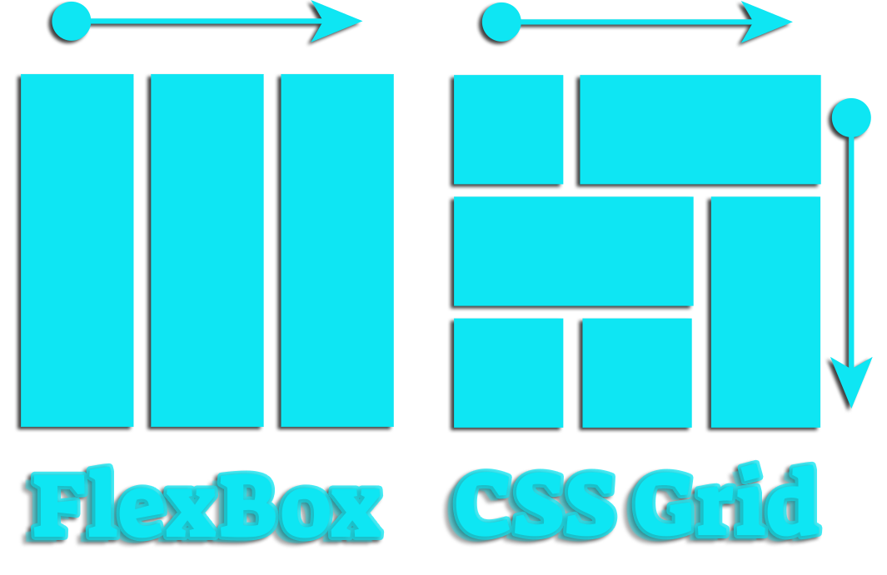
One-dimensional vs Two-dimensional

Slide 18
Summary
Advantages:
Provide a convenient mechanism for placing content on a virtual grid
Clear semantic structure
Сode support
Disadvantages
Subgrid doesn’t work properly
Copyright © 2007-2017 ALTEXSOFT

Slide 19
Thank you for attention
Anyyyy queeeestion

Slide 20

Questions?

